Slide 1
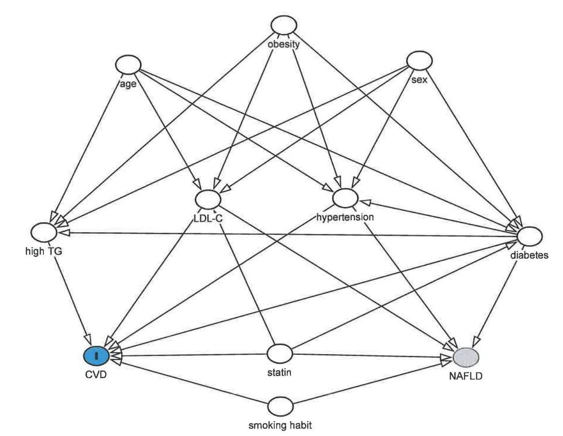
Supplementary Figure 1. Directed acyclic graphs for investigating causal paths for NAFLD and CVD

