Slide 1
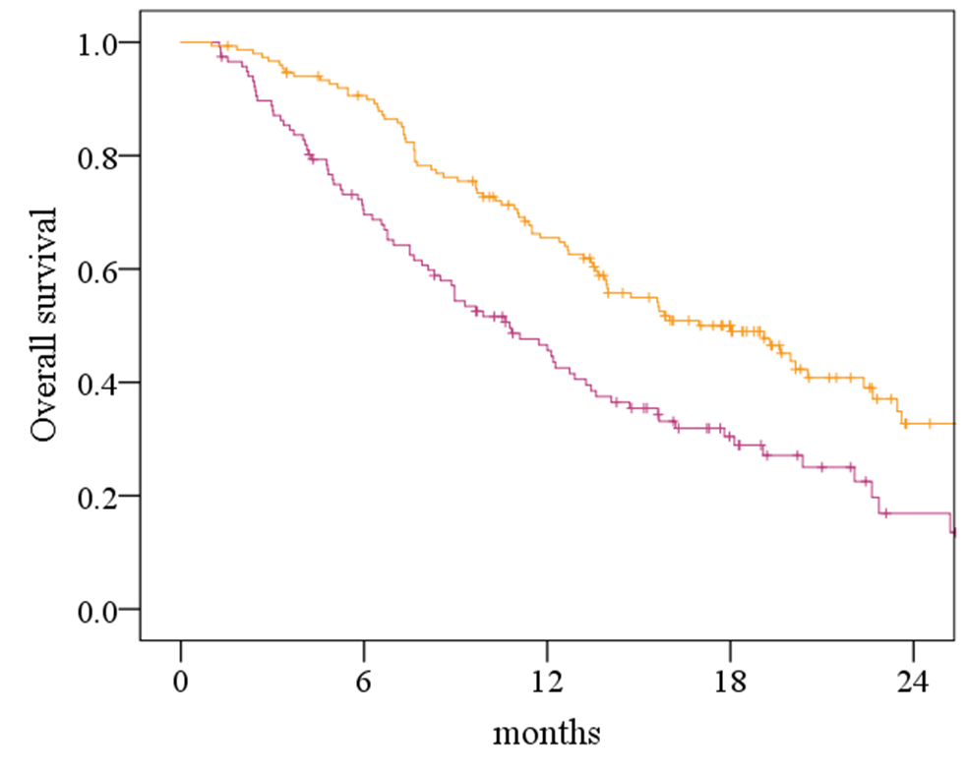
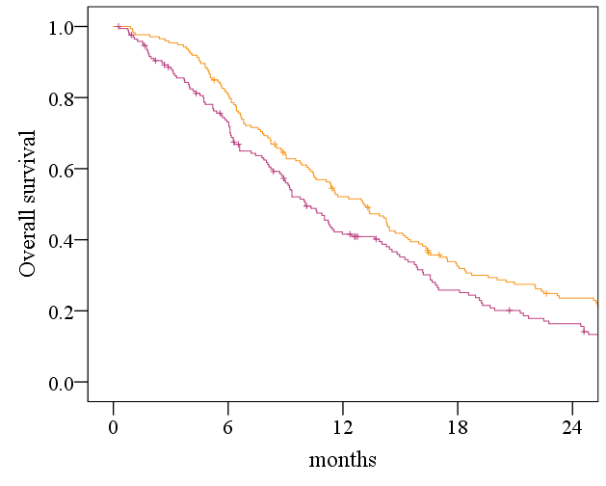
A
B
TOPAZ-1 eligible
TOPAZ-1 eligible
TOPAZ-1 ineligible
TOPAZ-1 ineligible
p < 0.001
p = 0.016
Number at risk
TOPAZ+ | 151 | 132 | 90 | 50 | 12
TOPAZ- | 117 | 79 | 46 | 20 | 5
Number at risk
TOPAZ+ | 173 | 139 | 87 | 51 | 36
TOPAZ- | 169 | 117 | 63 | 36 | 22
Supplementary Figure 1. Overall survival according to TOPAZ-1 eligibility status, stratified by treatment regimen.
Kaplan–Meier curves comparing overall survival between TOPAZ-1–eligible and TOPAZ-1–ineligible patients among those treated with gemcitabine plus cisplatin with durvalumab (GCD) (A) and gemcitabine plus cisplatin (GC) (B). p values were calculated using the log-rank test.
GC, gemcitabine plus cisplatin; GCD, durvalumab plus gemcitabine and cisplatin; TOPAZ-1, a phase 3 trial of durvalumab plus gemcitabine and cisplatin in advanced biliary tract cancer.

Slide 2
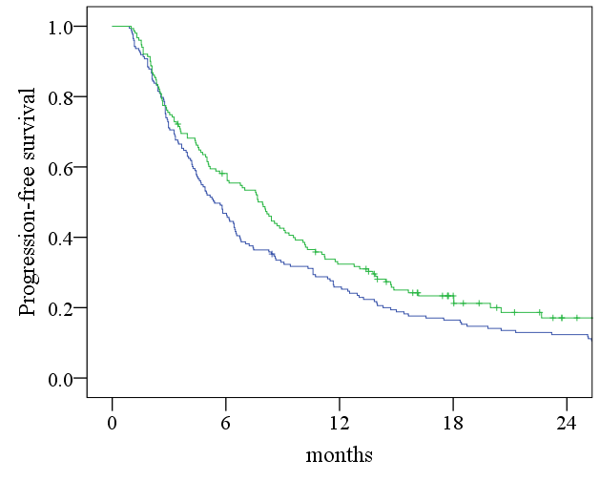
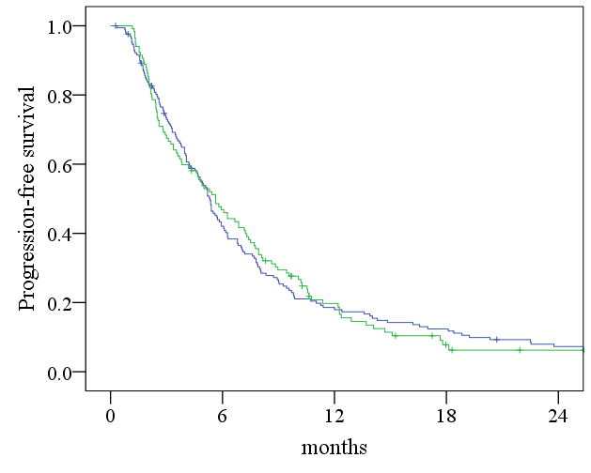
A
B
GCD
GCD
GC
GC
p = 0.069
p = 0.933
Number at risk
GCD | 151 | 86 | 47 | 23 | 8
GC | 173 | 81 | 44 | 28 | 21
Number at risk
GCD | 117 | 54 | 19 | 5 | 2
GC | 169 | 68 | 30 | 20 | 11
Supplementary Figure 2. Progression-free survival according to treatment regimen stratified by TOPAZ-1 eligibility
Kaplan–Meier curves of progression-free survival comparing patients treated with gemcitabine plus cisplatin with durvalumab and gemcitabine plus cisplatin, stratified by TOPAZ-1 eligibility status. Panel A shows patients meeting TOPAZ-1 eligibility criteria, and panel B shows patients not meeting TOPAZ-1 eligibility criteria. p values were calculated using the log-rank test.
GC, gemcitabine plus cisplatin; GCD, durvalumab plus gemcitabine and cisplatin; TOPAZ-1, a phase 3 trial of durvalumab plus gemcitabine and cisplatin in advanced biliary tract cancer.

Slide 3
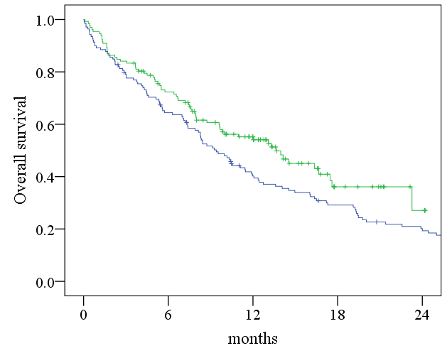
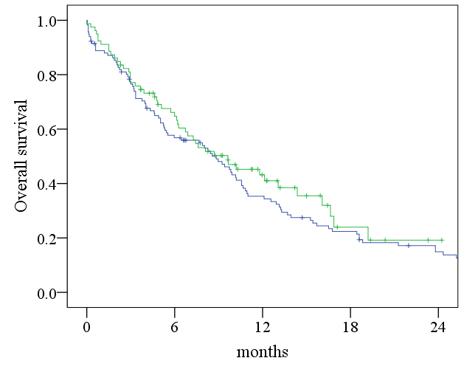
A
B
GCD
GCD
GC
GC
p = 0.047
p = 0.406
Number at risk
GCD | 132 | 90 | 50 | 12 | 3
GC | 139 | 87 | 51 | 36 | 24
Number at risk
GCD | 79 | 46 | 20 | 5 | 1
GC | 117 | 63 | 36 | 22 | 13
Supplementary Figure 3. Six-month landmark analysis of overall survival according to treatment regimen stratified by TOPAZ-1 eligibility status
Kaplan–Meier curves of overall survival from the 6-month landmark comparing patients treated with gemcitabine plus cisplatin with durvalumab (GCD) and gemcitabine plus cisplatin (GC), stratified by TOPAZ-1 eligibility status: (A) TOPAZ-1–eligible and (B) TOPAZ-1–ineligible patients. Only patients alive at 6 months after treatment initiation were included in the analysis. P values were calculated using the log-rank test.
GC, gemcitabine plus cisplatin; GCD, durvalumab plus gemcitabine and cisplatin; TOPAZ-1, a phase 3 trial of durvalumab plus gemcitabine and cisplatin in advanced biliary tract cancer.

