Slide 1
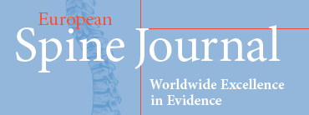

Key points
[List your key words here]
1. OPLL; 2. antedisplacement; 3. cervical myelopathy; 4. multilevel; 5. ACAF

Slide 2
[Place your key figure or table here]

Slide 3
Take Home Messages
[List your Take Home Messages here]
1.Anterior controllable antedisplacement and fusion (ACAF) surgery can achieve anterior direct decompression without cutting the OPLL.
2. Excellent postoperative outcome can be achieved with the use of ACAF for the treatment of multilevel severe OPLL without specific complications.
3. Compared with the anterior decompression with floating method, the antedisplacement of OPLL in ACAF is immediate feedback to and fully controlled by the surgeon.

