Slide 1


Key points
chronic low back pain, degenerative disc disease, radiofrequency ablation, basivertebral nerve, sham controlled, randomized controlled study, IDE trial
1. The basivertebral nerve complex innervates VB endplates
2. Hypothesized that ablating the BVN would aleviate chronic low back pain
3. A randomized, blinded clinical trial showed that RF ablation of the BVN was more effective at improving function and reducing pain than a sham
[Citation]

Slide 2
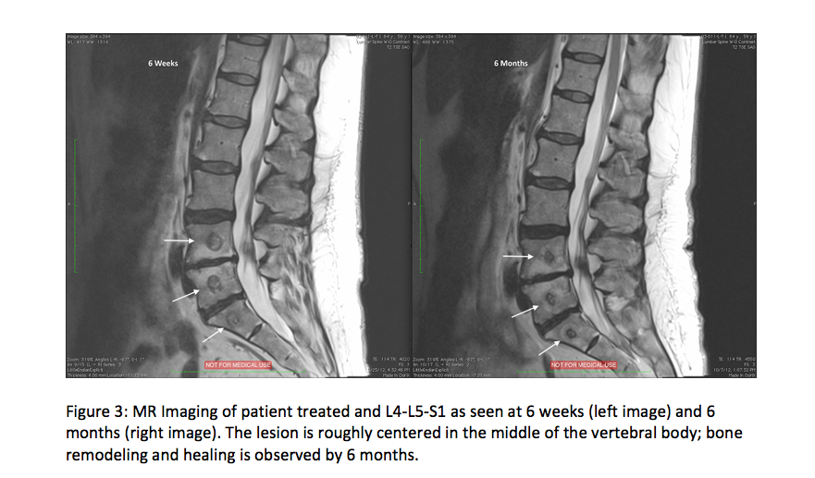

Slide 3
Take Home Messages
1. Mechanical back pain arising from DDD is transmitted through the BVN
2. Patients treated with percutaneous, transpedicular, RF ablation of the BVN reported about one grade decrease in ODI and substantial improvement in VAS
3. The Intracept procedure represents a new, minimally invasive method of providing relief of chronic low back pain

