Slide 1


Key points
A care pathway for the management of spinal disorders should include treatments ranging from primary prevention to rehabilitative services and should describe steps that are considered at each stage of care.
A comprehensive care pathway has the capacity to integrate guidelines for spinal disorders into a single clinical decision tree and can be applicable in clinical settings with limited professional resources.
At present, we are not aware of a care pathway to guide the management of the multiple potential presentations of spine symptoms, concerns, or pathology.
The purpose of this study was to develop and propose an evidence-based care pathway that could apply to any person presenting with a spine-related symptom or concern, especially those who live in low- and middle-income countries or in underserved communities.
The Global Spine Care Initiative: care pathway for people with spine-related concerns
Haldeman S, Johnson CD, Chou R, Nordin M, Côté P, Green BN, Hurwitz, H,et al.
Eur Spine J

Slide 2
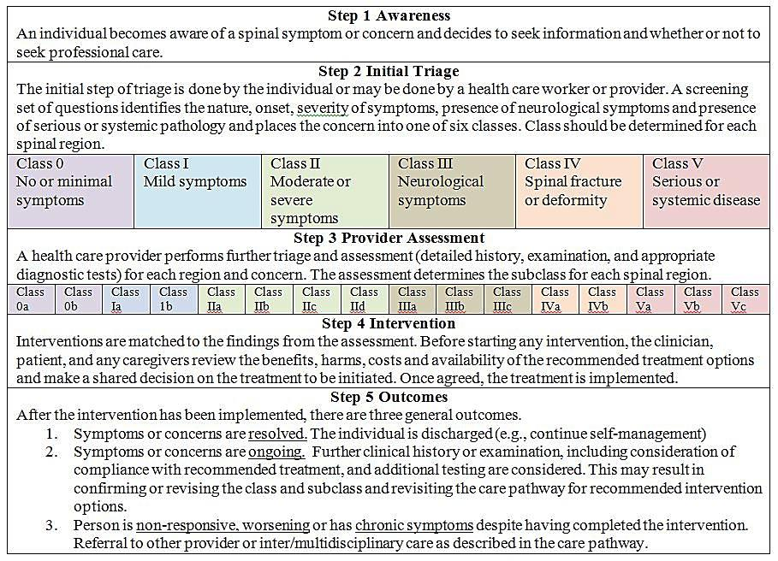
The Global Spine Care Initiative: care pathway for people with spine-related concerns
Haldeman S, Johnson CD, Chou R, Nordin M, Côté P, Green BN, Hurwitz, H,et al.
Eur Spine J

Slide 3
Take Home Messages
As far as we are aware, this is the first international and interprofessional attempt to develop a care pathway for the management of any person presenting with spine-related symptoms or concerns that incorporate the recommendations from multiple evidence-based guidelines.
The five simple decision steps are evidence-based, person-centered, community-based, and consistent with recommendations established by the WHO.
The proposed care pathway may be easily taught to clinicians and stakeholders by using visual educational tools (e.g., chart or flashcards) and may be easily adapted into electronic medical record software.
The acceptability and utility of this care pathway will need to be evaluated in various communities, especially in low- and middle-income countries, with different cultural background and resources.
The Global Spine Care Initiative: care pathway for people with spine-related concerns
Haldeman S, Johnson CD, Chou R, Nordin M, Côté P, Green BN, Hurwitz, H,et al.
Eur Spine J

