Slide 1


Key points
1. Surgical site infection
2. Metastatic Cord Compression
NA Quraishi, MS Ahmed, G Arealis, BM Boszczyk, KL Edwards (2018) Does Surgical
Site Infection Influence Neurological Outcome and Survival in Patients Undergoing
Surgery for Metastatic Spinal Cord Compression? Eur Spine J;

Slide 2
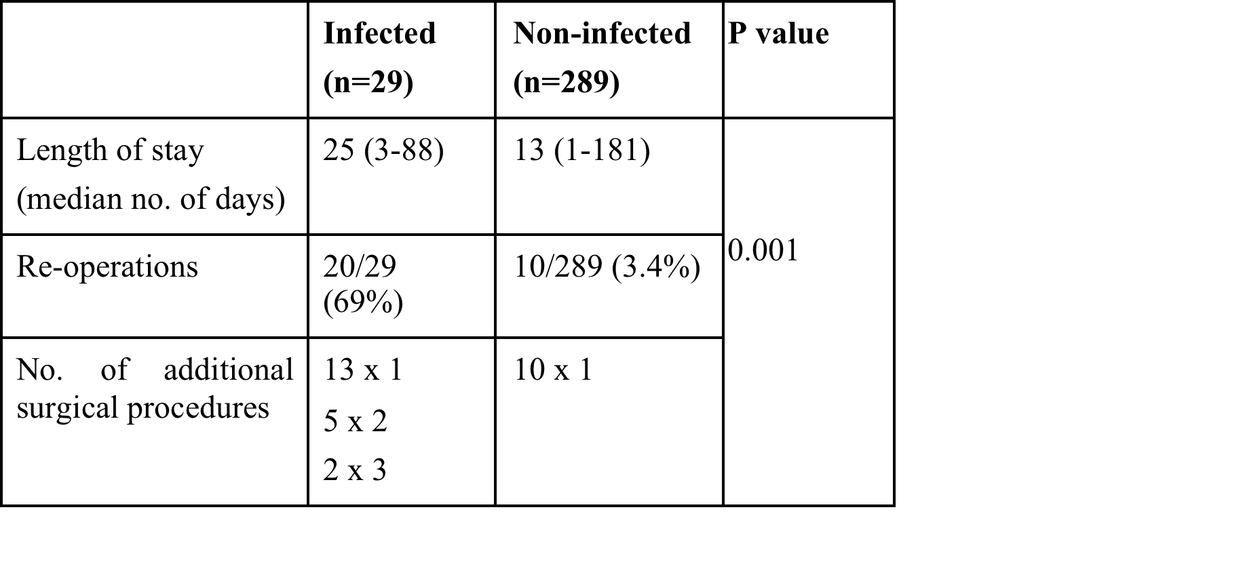
NA Quraishi, MS Ahmed, G Arealis, BM Boszczyk, KL Edwards (2018) Does Surgical
Site Infection Influence Neurological Outcome and Survival in Patients Undergoing
Surgery for Metastatic Spinal Cord Compression? Eur Spine J;

Slide 3
Take Home Messages
The occurrence of surgical site infection increases the morbidity following surgery for MSCC with significantly longer in-patient stay, more procedures and shorter survival.
However, the neurological outcome is not adversely affected by the occurrence of an infection.
NA Quraishi, MS Ahmed, G Arealis, BM Boszczyk, KL Edwards (2018) Does Surgical
Site Infection Influence Neurological Outcome and Survival in Patients Undergoing
Surgery for Metastatic Spinal Cord Compression? Eur Spine J;

