Slide 1


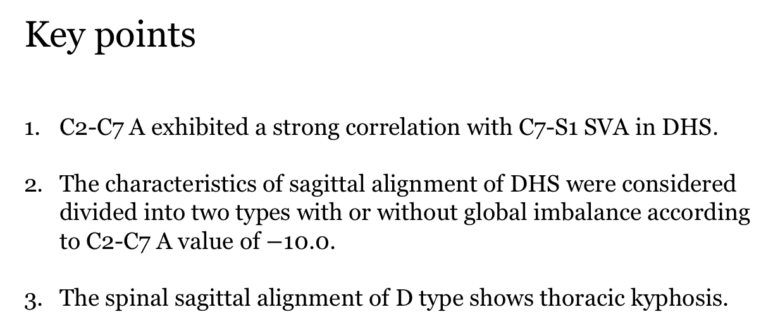
Key points
C2-C7 A exhibited a strong correlation with C7-S1 SVA in DHS.
The characteristics of sagittal alignment of DHS were considered divided into two types with or without global imbalance according to C2-C7 A value of $−$10.0.
The spinal sagittal alignment of D type shows thoracic kyphosis.
Murata K, Endo K, Aihara T, Suzuki H, Matsuoka Y, Nishimura H, Takamatsu T,
Kusakabe T, Maekawa A, Yamamoto K (2019) Relationship between cervical and
global sagittal balance in patients with dropped head syndrome. Eur Spine J;

Slide 2
Murata K, Endo K, Aihara T, Suzuki H, Matsuoka Y, Nishimura H, Takamatsu T,
Kusakabe T, Maekawa A, Yamamoto K (2019) Relationship between cervical and
global sagittal balance in patients with dropped head syndrome. Eur Spine J;

Slide 3
Take Home Messages
C2-C7 A exhibited correlations with global balance.
There should be various type of thoraco-lumbar alignment in DHS.
Global sagittal balance as well as cervical alignment should also be considered in DHS.
Murata K, Endo K, Aihara T, Suzuki H, Matsuoka Y, Nishimura H, Takamatsu T,
Kusakabe T, Maekawa A, Yamamoto K (2019) Relationship between cervical and
global sagittal balance in patients with dropped head syndrome. Eur Spine J;

