Slide 1


Key points
1. Pregnancy-related pelvic girdle pain (PGP)
2. Recovery after delivery
3. Risk factors for persistent PGP
Gausel AM, Malmqvist S, Andersen K, Kjærmann I, Larsen JP, Dalen I, Økland I (2020)
Subjective recovery from pregnancy-related pelvic girdle pain the first six weeks after
delivery: a prospective longitudinal cohort study. Eur Spine J;

Slide 2
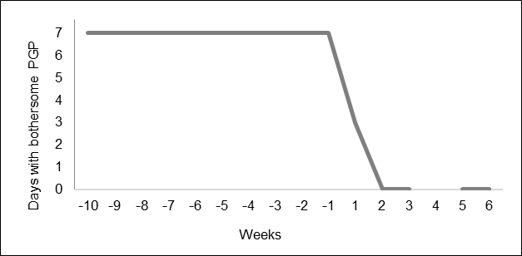
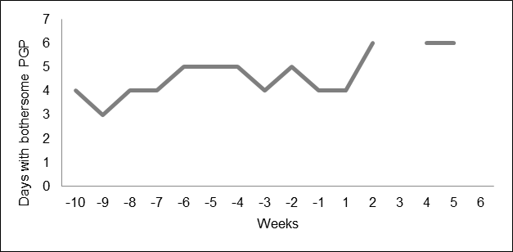
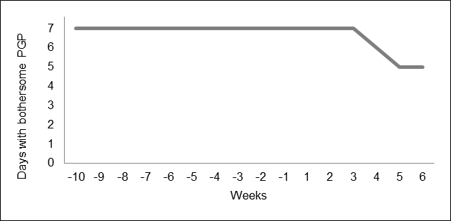
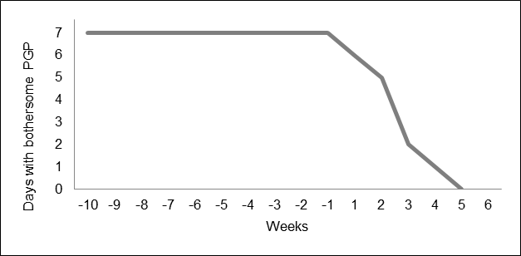
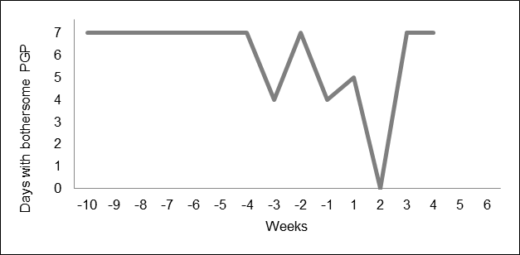
Figure 1: Examples of individual recovery patterns of women with severe or moderate PGP (≥ 3 days with bothersome PGP per week) before delivery
A)
C)
E)
B)
D)
A) Substantial recovery within 2 weeks
B) Substantial recovery within 6 weeks
C) No recovery
D) Transitory recovery
E) Incomplete recovery
Gausel AM, Malmqvist S, Andersen K, Kjærmann I, Larsen JP, Dalen I, Økland I (2020)
Subjective recovery from pregnancy-related pelvic girdle pain the first six weeks after
delivery: a prospective longitudinal cohort study. Eur Spine J;

Slide 3
Take Home Messages
The prognosis following PGP during pregnancy is good, and many women experience a fast recovery already within 2 weeks after delivery.
Multiparity, PGP the year before pregnancy, and a high pain intensity were risk factors for persistent PGP six weeks after delivery.
This study provides new information about the recovery from PGP the first few weeks after delivery. This information is of interest to affected women and to health care providers in pregnancy care.
Gausel AM, Malmqvist S, Andersen K, Kjærmann I, Larsen JP, Dalen I, Økland I (2020)
Subjective recovery from pregnancy-related pelvic girdle pain the first six weeks after
delivery: a prospective longitudinal cohort study. Eur Spine J;

