Slide 1
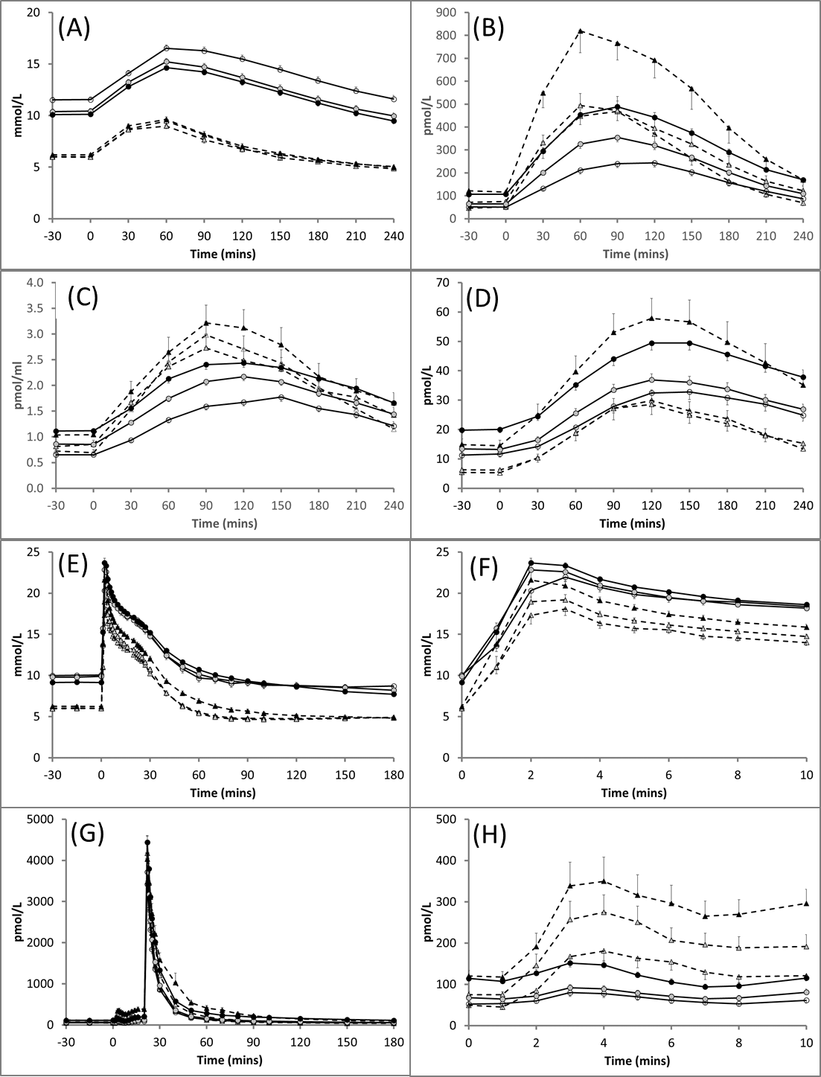
Supplementary Figure 1
^{Adjusted significance Key:}

