Slide 1
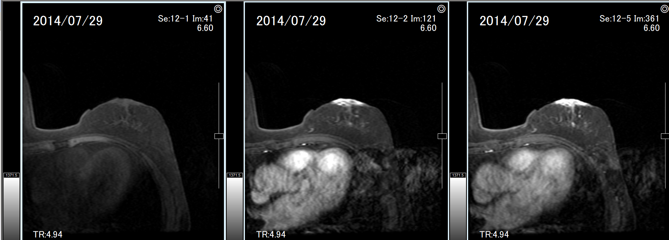
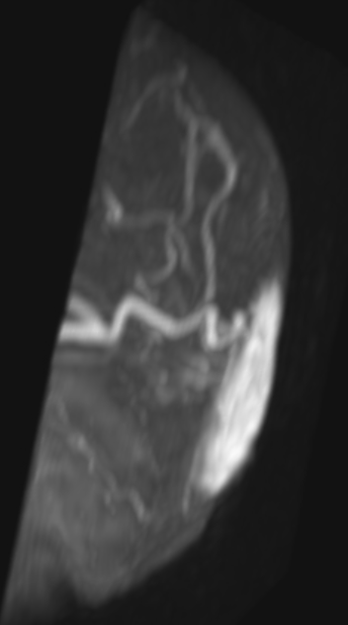
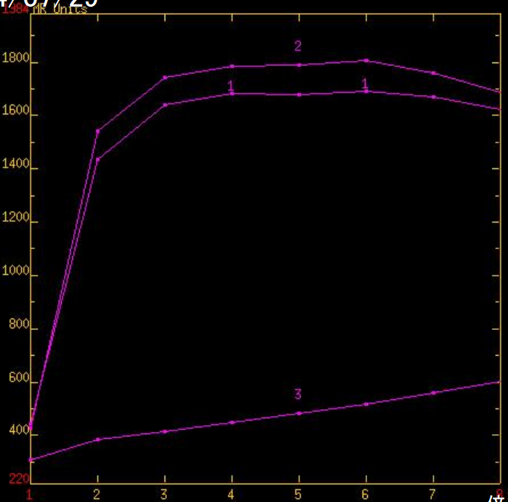
Supplementary Fig.1
Sup Fig.1a
Sup Fig.1b
Sup Fig.1c
Pre-dynamic
MIP (sagittal view)
Dynamic curve
Early phase
Delay phase

