Slide 1
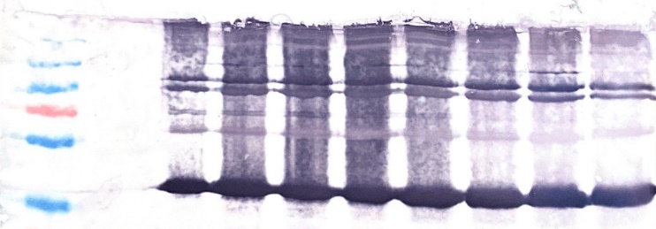
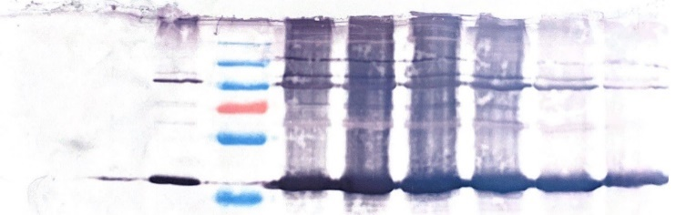
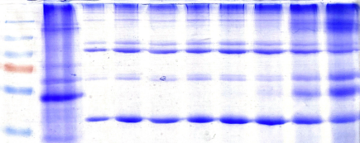
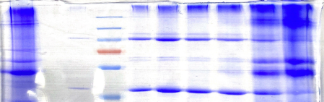
BTV8 VPs
B
Chimaeric VPs
A
40%
% Optiprep™
30%
40%
% Optiprep™
30%
kDa
-ve
5
6
7
8
9
10
11
12
-ve
5
6
kDa
7
8
9
10
11
12
250
130
250
100
130
70
100
55
70
55
35
35
BTV8 VPs
Chimaeric VPs
C
40%
D
40%
% Optiprep™
30%
% Optiprep™
30%
-ve
6
7
10
11
12
-ve
5
7
8
5
8
9
6
9
10
11
12
250
250
130
130
100
100
70
70
55
55
35
35
Fig. S1: Western blot and Coomassie blue-stained SDS-PAGE analysis of purified fractions from plants expressing BTV8 VLP proteins (VPs) (A+C) and purified fractions from plants expressing chimaeric BTV1/8 VLP proteins (B+D). Proteins on western blots were detected with anti-BTV8 VLP sheep serum (1:5000) and anti-goat/sheep alkaline phosphate-conjugated secondary antibody (1:10000). 5-12: 500uL fractions collected from the bottom of the tube where 5 = bottom 40% fraction and 12 = top 30% fraction. Red circles indicate fractions where all four VLP proteins were detected on the Coomassie blue-stained gels. Red arrows indicate VLP proteins where VP2 is 111kDa, VP3 is 103kDa, VP5 is 59kDa and VP7 is 38kDa. -ve: Negative control pEAQ vector. kDa: molecular weight marker (kDa).

