Slide 1
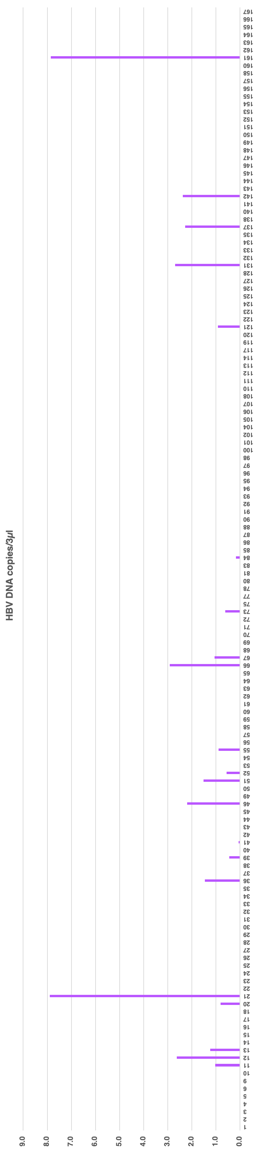
Supplemental figure
a

Slide 2
b
c

Slide 3
d
e

