Slide 1
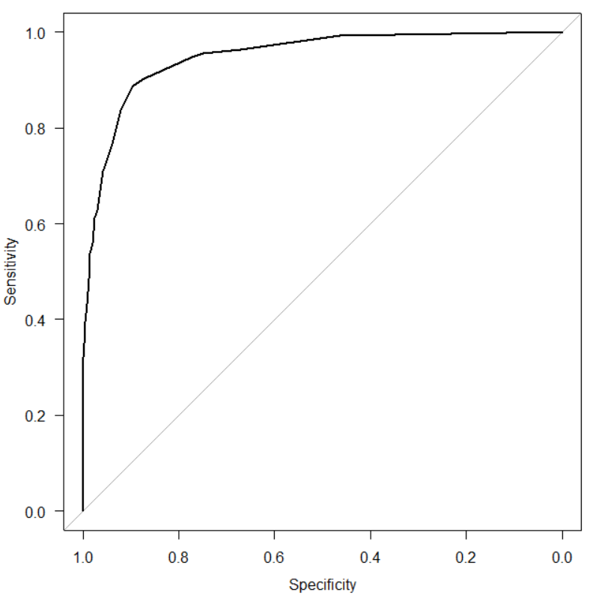

Supplementary Figure 1. AUC for 6 factors significantly associated with Assistance or Long-term care certification.
1.0
0.8
0.6
0.4
0.2
0.0
Sensitivity
Area under the curve: 0.949
0.0 0.2 0.4 0.6 0.8 1.0
Specificity

Slide 2
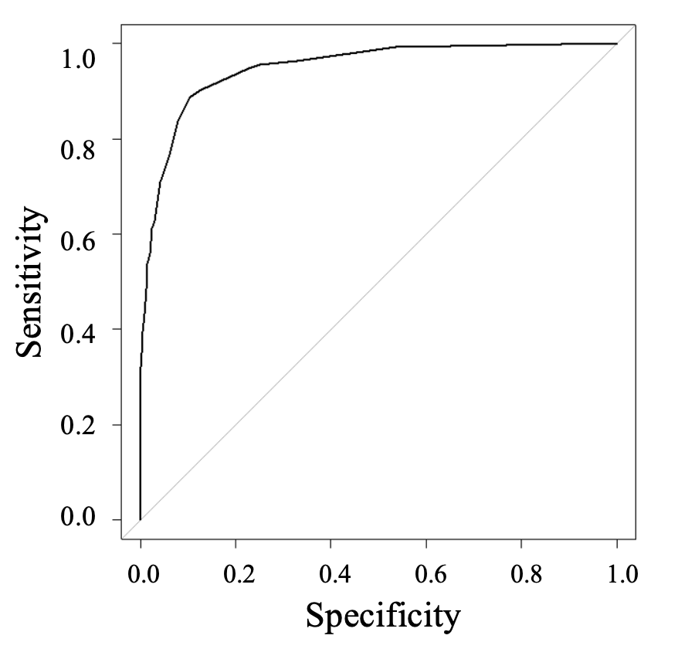
Supplementary Figure 2. Cutoff score for 6 factors significantly associated with Assistance or Long-term care certification.
8.000(0.911, 0.881)

Slide 3
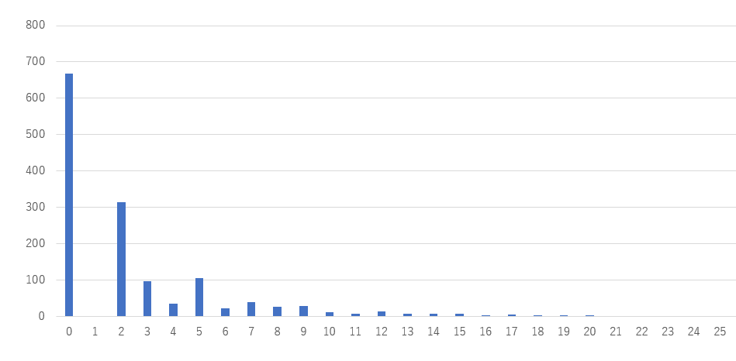
Supplementary Figure 3. Total score distributions of participants in the Independent group. (6 factor version)
(n)
(score)

Slide 4
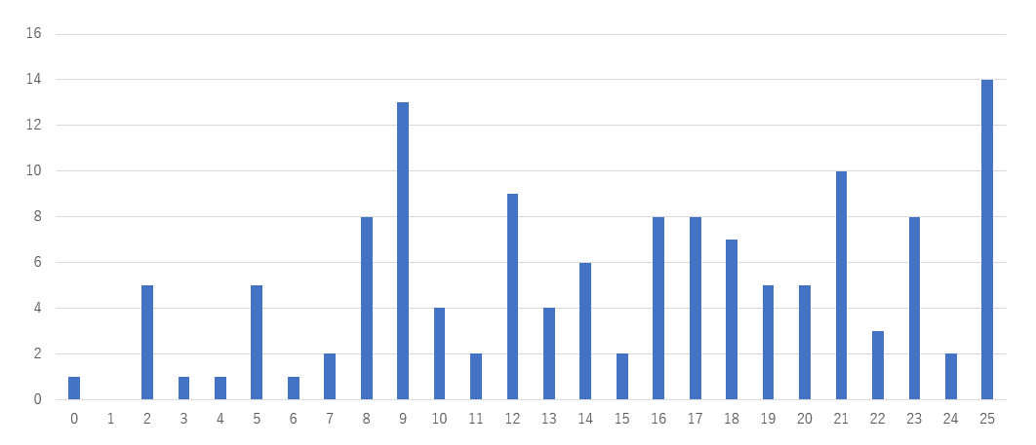
Supplementary Figure 4. Total score distributions of participants in the Dependent group. (6 factor version)
(n)
(score)

