Slide 1
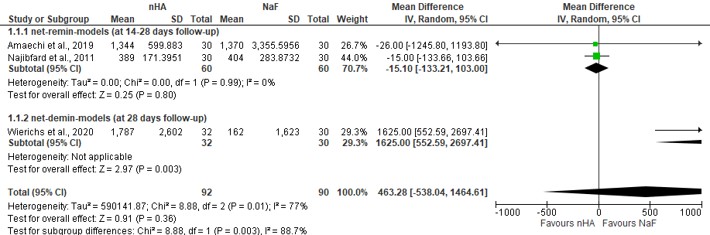
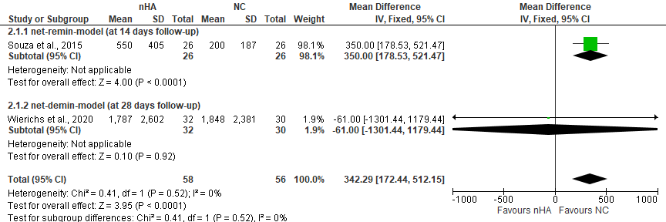
Forest plot of comparison: nHA vs. standard control (NaF), for outcome: mineral loss at 14 - 28 days follow-up in situ period
Forest plot of comparison: nHA vs. negativ control (NC), for outcome: mineral loss at 14 - 28 days follow-up in situ period

