Slide 1
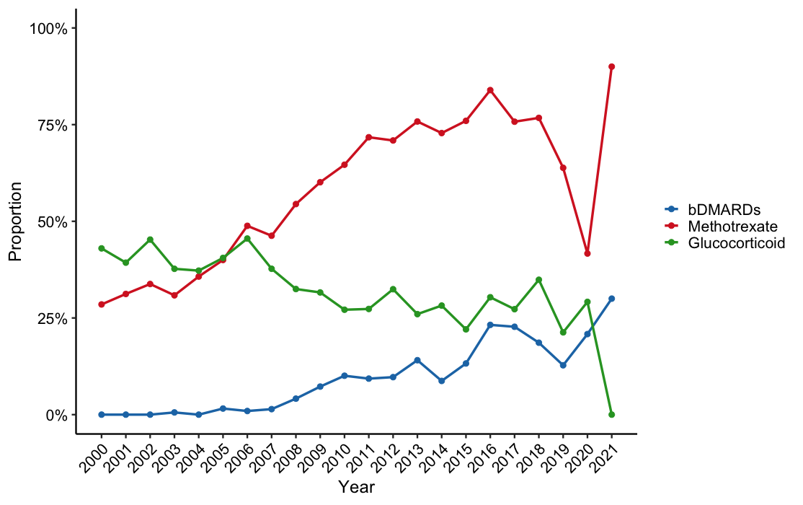
Fig. S1 Time trends in the use of bDMARDs, methotrexate, and glucocorticoid.
Time trends in the proportions of bDMARDs, methotrexate, and glucocorticoid use at enrolment. bDMARDs, biologic disease-modifying anti-rheumatic drugs.

Slide 2
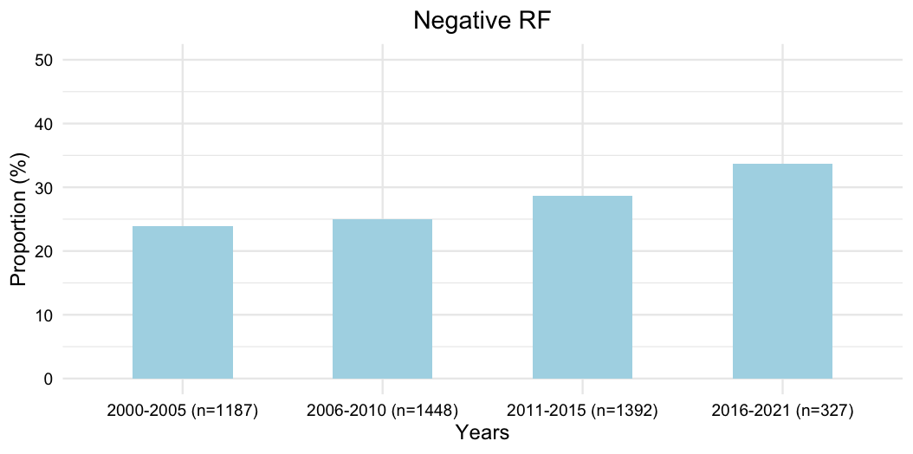
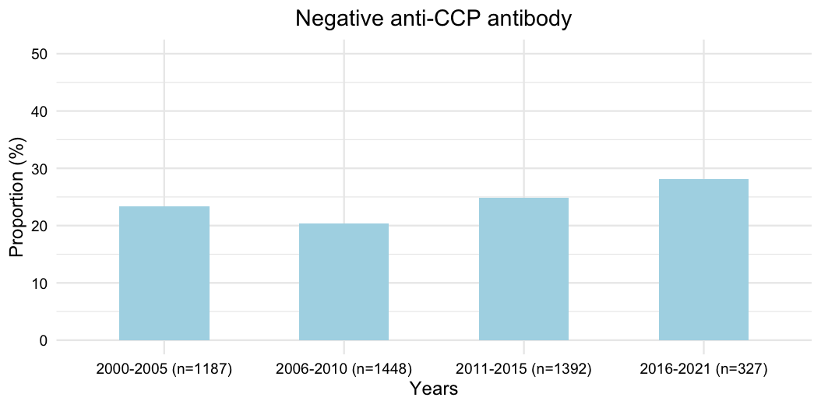
Fig. S2 Chronological change in the proportion of seronegative RA.
(a)
(b)
(a) Proportion of patients who were negative for RF. (b) Proportion of patients who were negative for anti-CCP antibody.

Slide 3
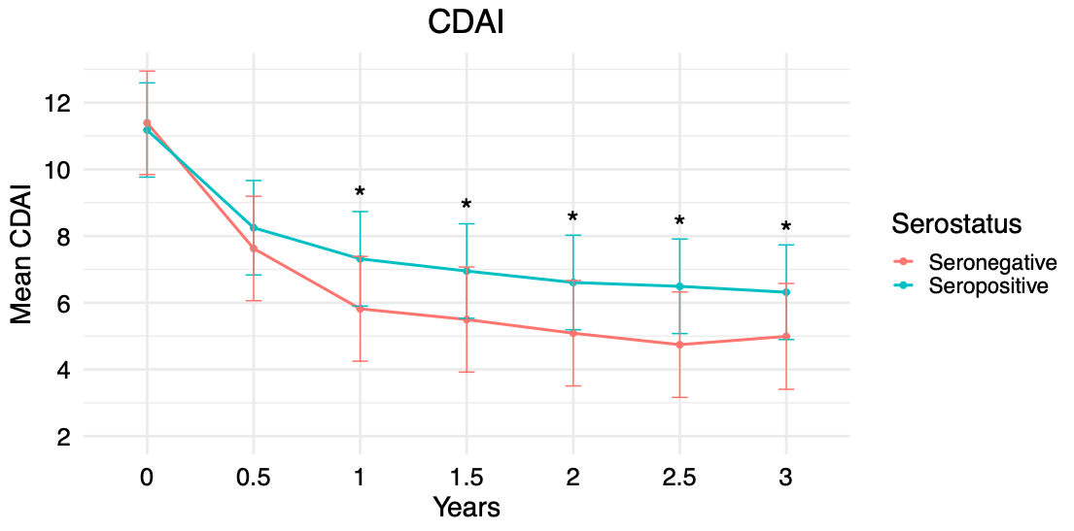
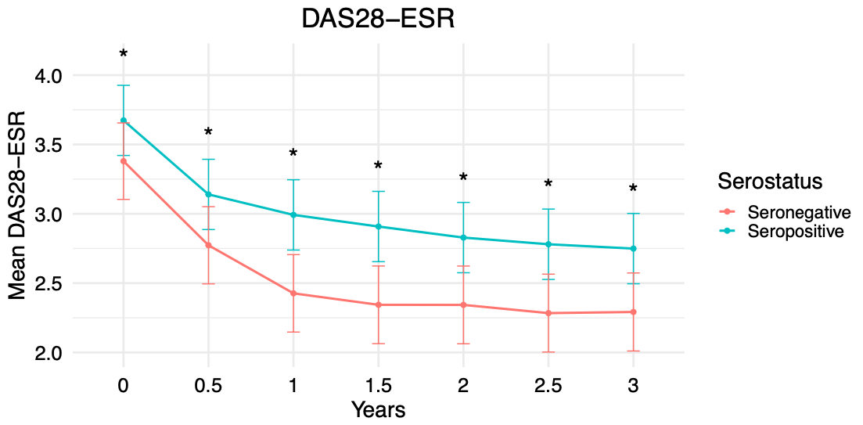
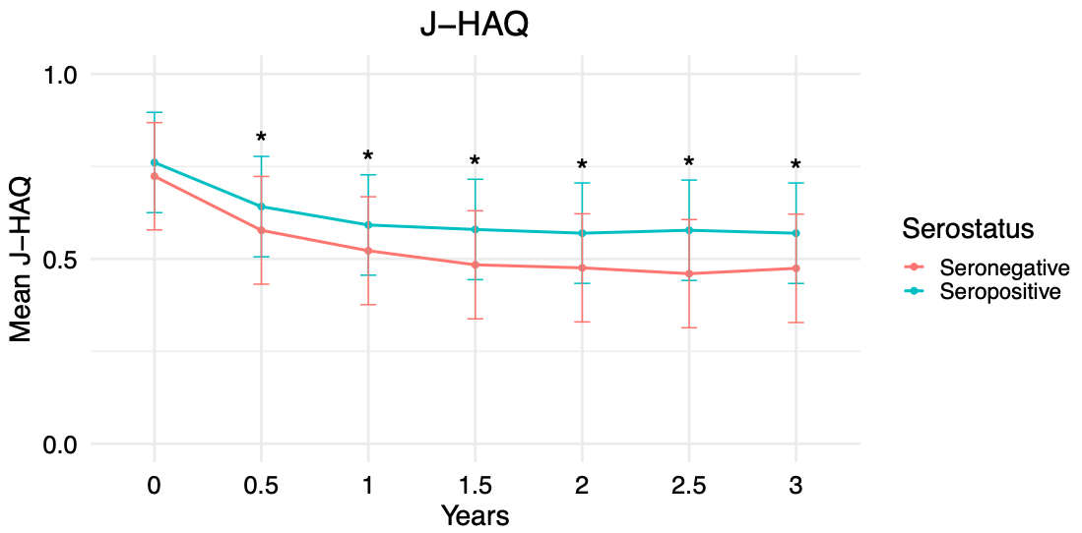
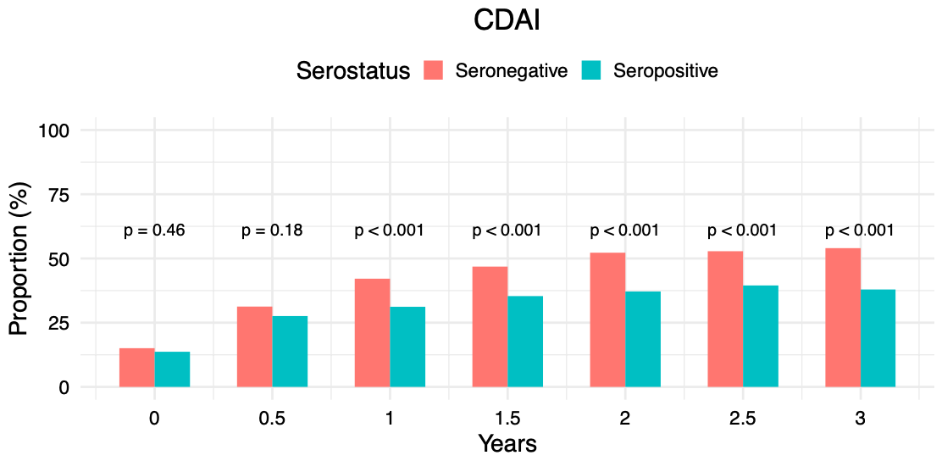
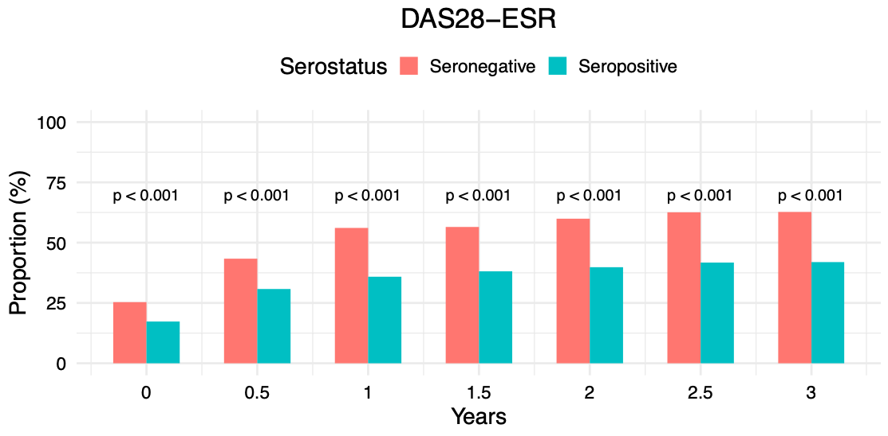
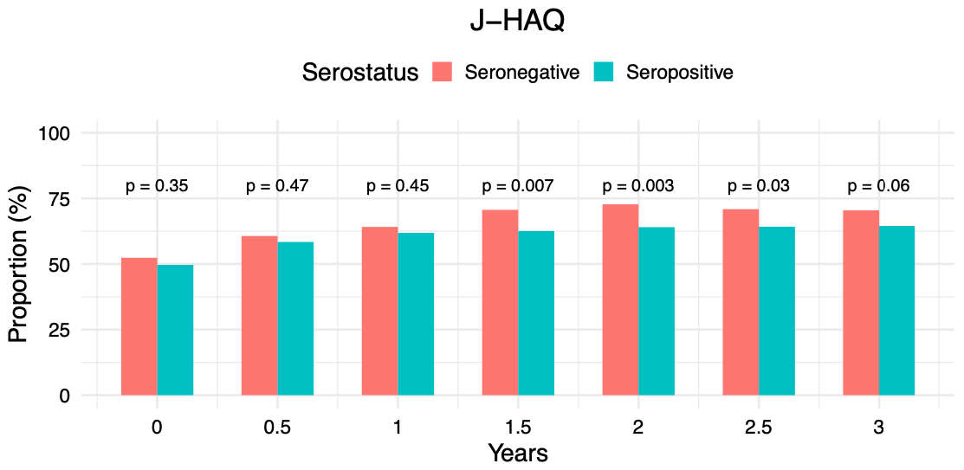
Fig. S3 DAS28-ESR, CDAI, and J-HAQ stratified by seropositive and seronegative RA over 3 years in patients enrolled during 2000–2010.
(a)
(b)
(c)
(d)
Analysed patients, n (missing/ lost to follow-up)
Seronegative | 365 (15) | 323 (57) | 311 (69) | 299 (81) | 291 (89) | 284 (96) | 274 (106)
Seropositive | 2192 (63) | 1983 (272) | 1927 (328) | 1918 (337) | 1898 (357) | 1846 (409) | 1822 (433)
(e)
(f)
Analysed patients, n (missing/ lost to follow-up)
Analysed patients, n (missing/ lost to follow-up)
Seronegative | 367 (13) | 316 (64) | 303 (77) | 292 (88) | 287 (93) | 278 (102) | 271 (109)
Seropositive | 2191 (64) | 1949 (306) | 1887 (368) | 1863 (392) | 1871 (384) | 1816 (439) | 1800 (455)
Seronegative | 380 (0) | 333 (47) | 315 (65) | 303 (77) | 297 (83) | 292 (88) | 274 (106)
Seropositive | 2253 (2) | 2031 (224) | 1950 (305) | 1949 (306) | 1924 (331) | 1864 (391) | 1831 (424)
(a–c) Time trends in (a) DAS28-ESR, (b) CDAI, (c) J-HAQ stratified by seropositive and seronegative RA over 3 years. (d–f) Proportion of patients achieving (d) DAS28 remission (<2.6), (e) CDAI remission (≤2.8) and (f) J-HAQ remission (≤0.5). Error bars represent 95% confidence intervals. ＊p<0.05. CDAI, Clinical Disease Activity Index; DAS28, 28-joint Disease Activity Score using erythrocyte sedimentation rate; J-HAQ, Japanese version of the Health Assessment Questionnaire.

Slide 4
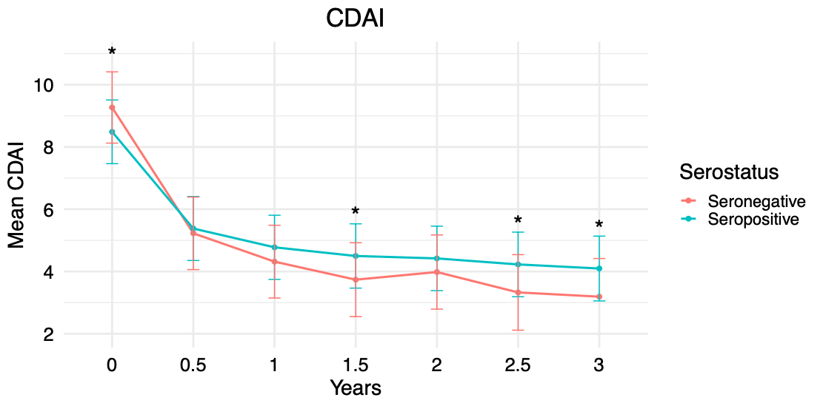
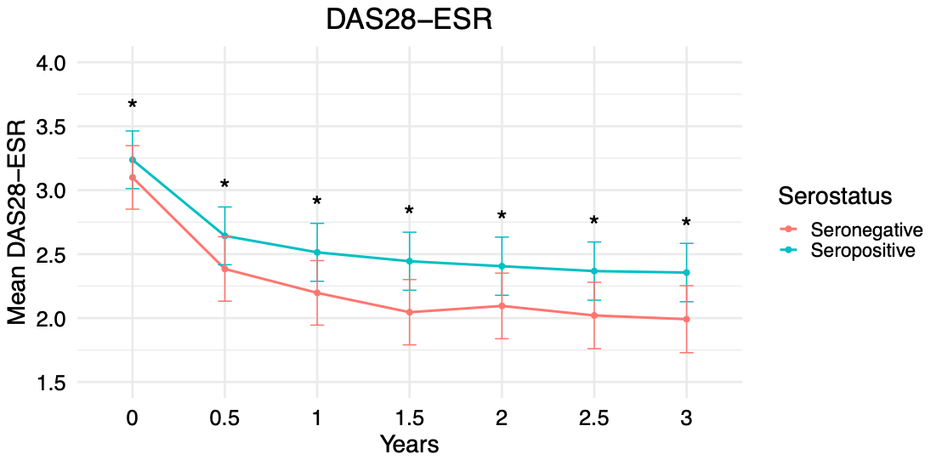
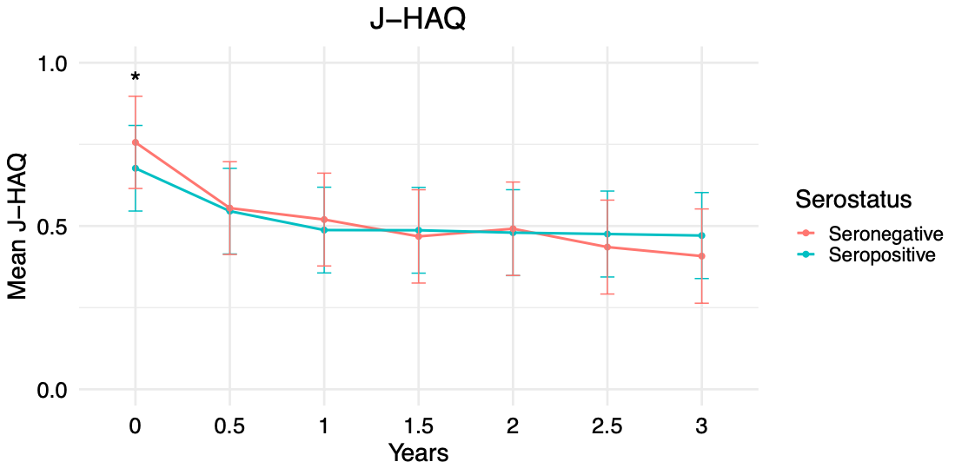
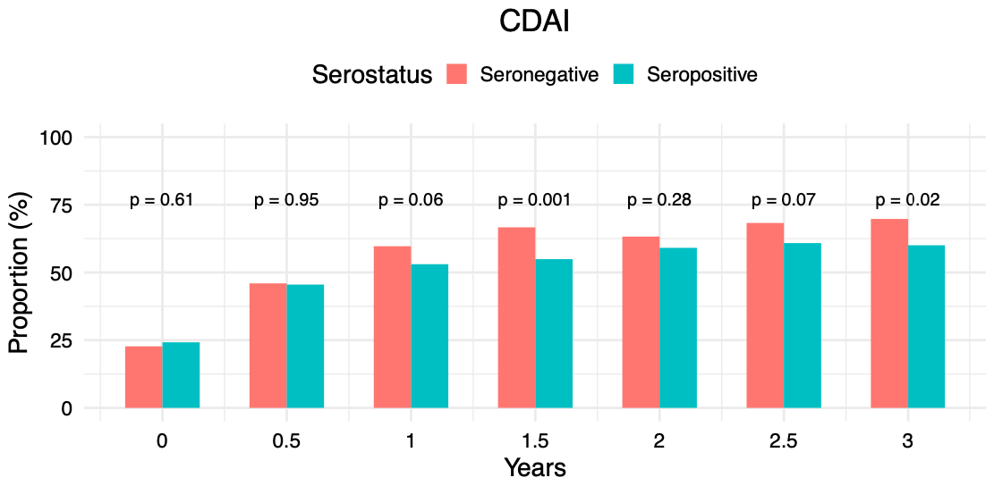
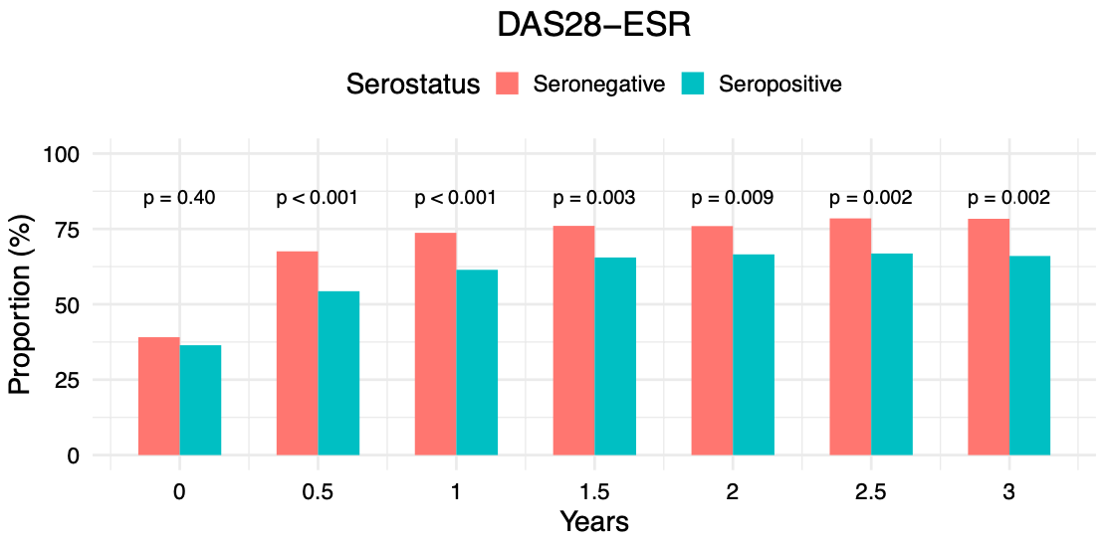
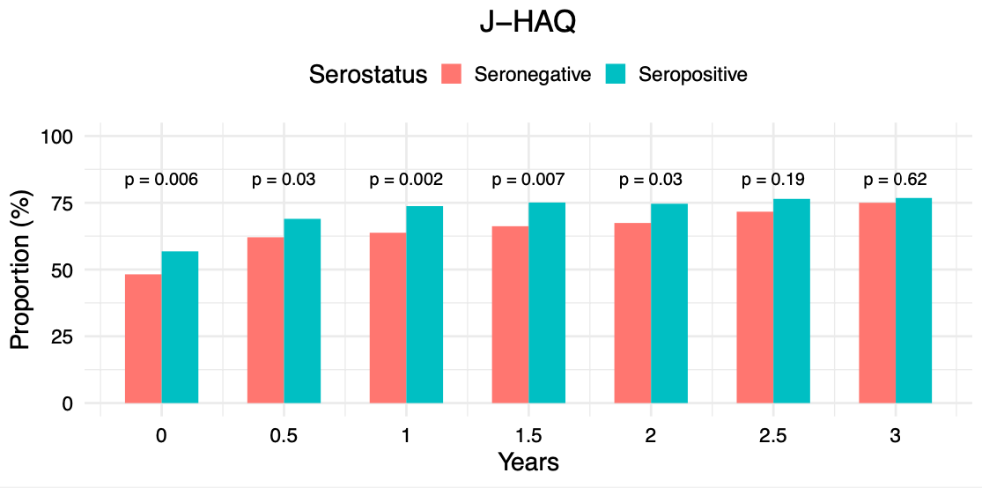
Fig. S4 DAS28-ESR, CDAI, and J-HAQ stratified by seropositive and seronegative RA over 3 years in patients enrolled during 2011–2021.
(a)
(b)
(c)
(d)
Analysed patients, n (missing/ lost to follow-up)
Seronegative | 308 (0) | 261 (47) | 253 (55) | 222 (86) | 215 (93) | 186 (122) | 172 (136)
Seropositive | 1404 (7) | 1208 (203) | 1116 (295) | 1036 (375) | 951 (460) | 894 (517) | 836 (575)
(e)
(f)
Analysed patients, n (missing/ lost to follow-up)
Analysed patients, n (missing/ lost to follow-up)
Seronegative | 307 (1) | 259 (49) | 251 (57) | 221 (87) | 212 (96) | 186 (122) | 171 (137)
Seropositive | 1400 (11) | 1198 (213) | 1110 (301) | 1030 (381) | 945 (466) | 890 (521) | 830 (581)
Seronegative | 307 (1) | 261 (47) | 254 (54) | 222 (86) | 215 (93) | 187 (121) | 172 (136)
Seropositive | 1410 (1) | 1209 (202) | 1120 (291) | 1036 (375) | 954 (457) | 892 (519) | 836 (575)
(a–c) Time trends in (a) DAS28-ESR, (b) CDAI, (c) J-HAQ stratified by seropositive and seronegative RA over 3 years. (d–f) Proportion of patients achieving (d) DAS28 remission (<2.6), (e) CDAI remission (≤2.8) and (f) J-HAQ remission (≤0.5). Error bars represent 95% confidence intervals. ＊p<0.05. CDAI, Clinical Disease Activity Index; DAS28, 28-joint Disease Activity Score using erythrocyte sedimentation rate; J-HAQ, Japanese version of the Health Assessment Questionnaire.

