Slide 1
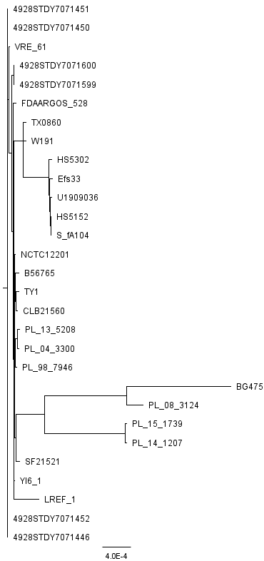
Supplementary Fig. 1A

Slide 2
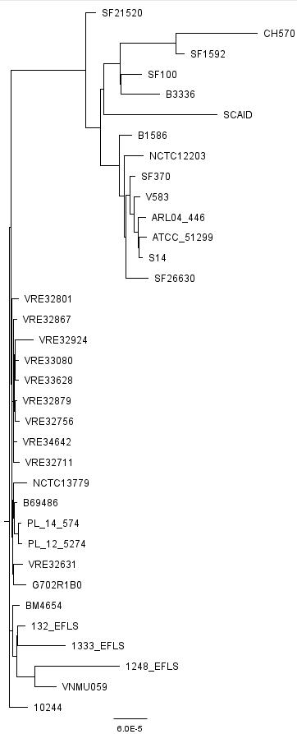
Supplementary Fig. 1B

