Slide 1
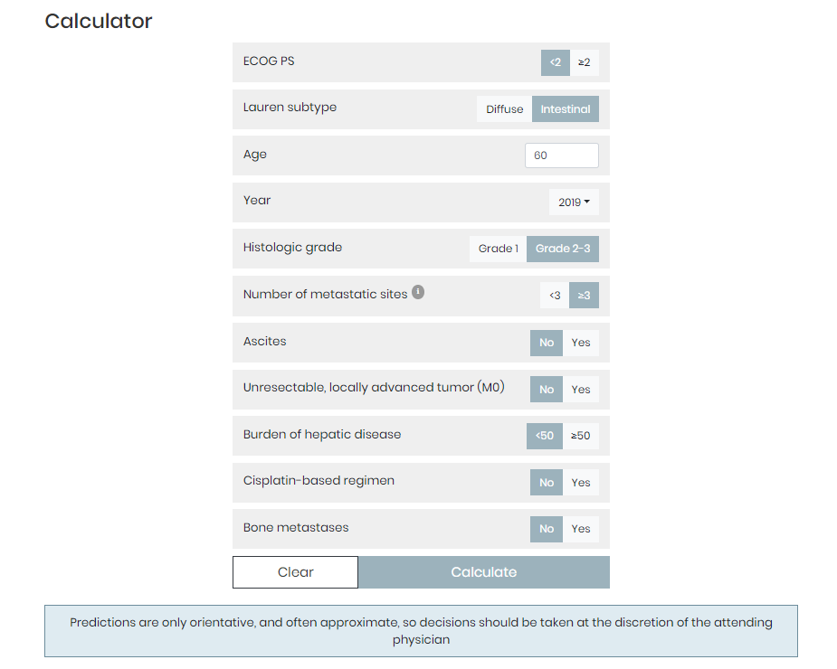
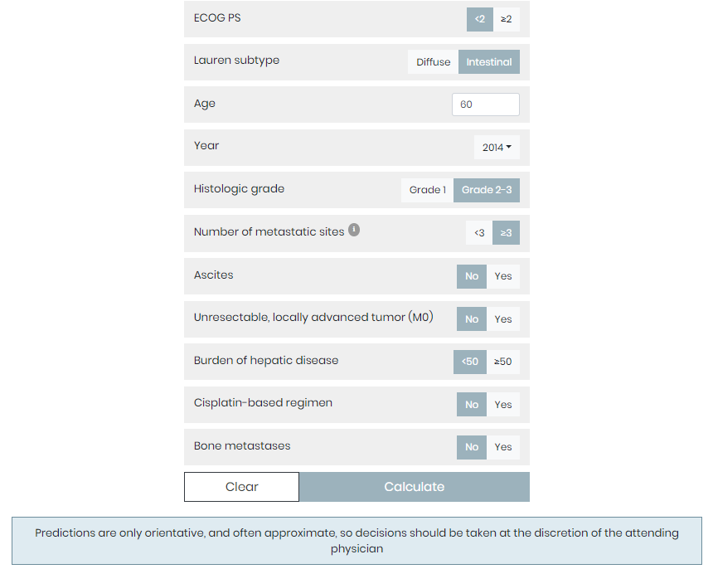
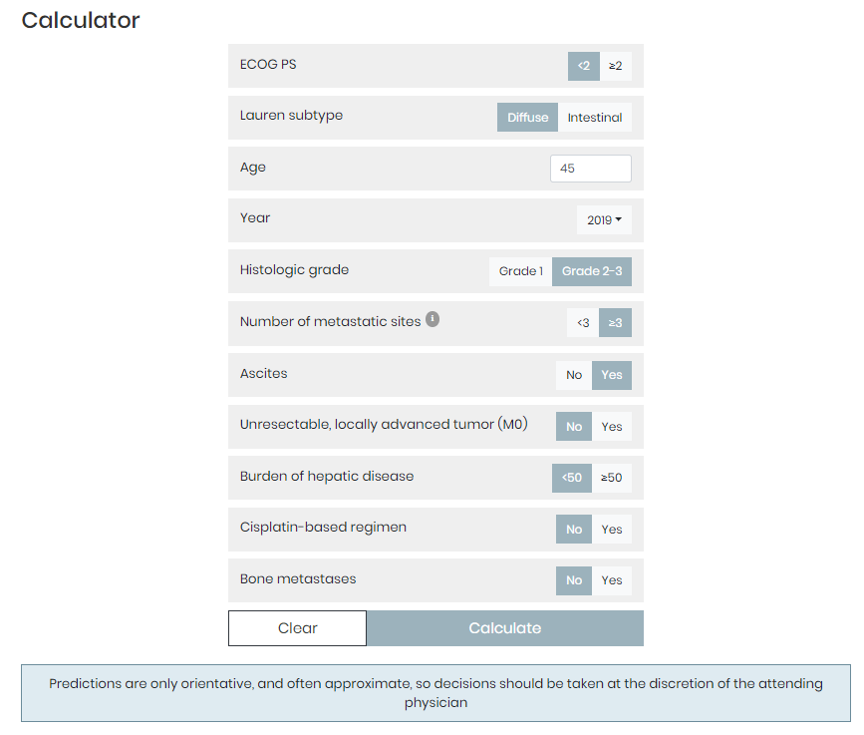
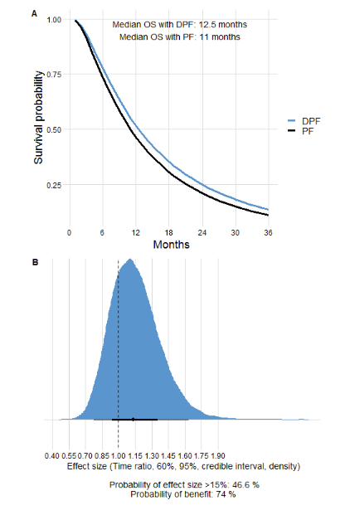
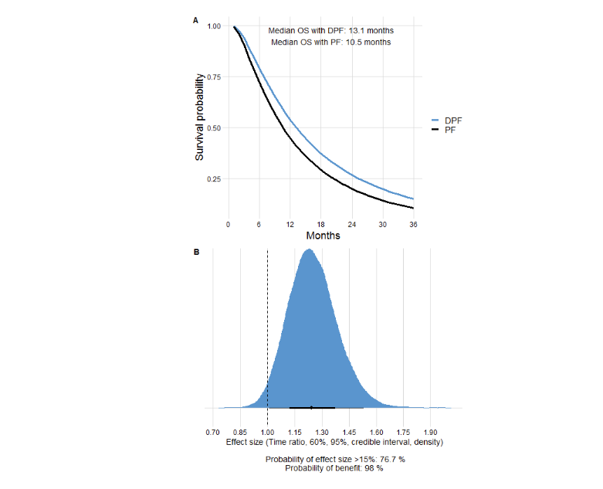
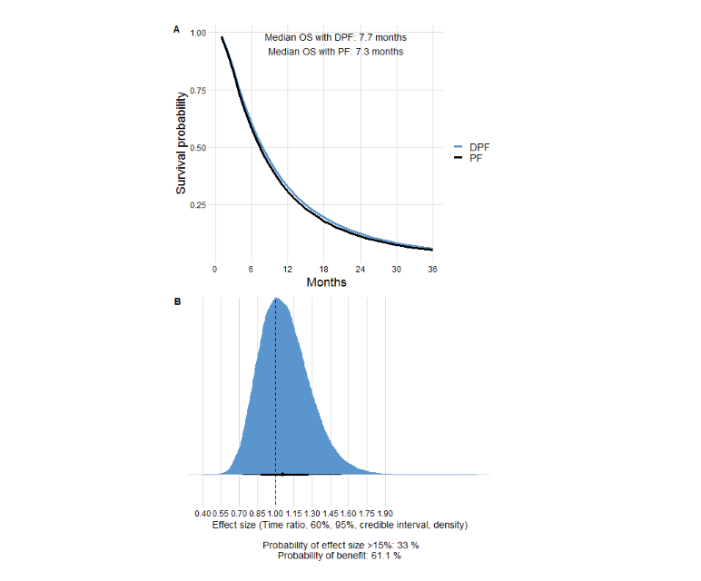
Three examples of the use of the online calculator with different combinations of predictive factors and under Wagner's meta-analysis prior.
A)
B)
C)
In a 60-year-old patient with an intestinal subtype AGC, treatment with DPF is currently beneficial, but the probability of substantial effects is small.
This patient, treated in 2014, would probably have obtained a more substantial benefit with DPF.
In contrast, in a 45-year-old patient with a diffuse subtype cancer and ascites, the results are poor with any regimen.

