Slide 1
Heat susceptibility evaluation among 100 mango (Mangifera indica) genotypes: A comparative study on leaf cell membrane stability at high temperatures using electrolyte leakage
Journal of Plant Research
Hiroshi Matsuda^{1,*}, Sayo Shimizu^{1,2}, Hiroo Takaragawa¹, and Hirokazu Higuchi²
Affiliation:
¹Tropical Agriculture Research Front, Japan International Research Center for Agricultural Sciences, 1091-1 Maezato Kawarabaru, Ishigaki, Okinawa 907-0002, Japan
²Graduate School of Agriculture, Kyoto University, Kitashirakawa, Sakyo, Kyoto 606-8502, Japan
*Corresponding author:
Hiroshi Matsuda
Address: Tropical Agriculture Research Front, Japan International Research Center for Agricultural Sciences, 1091-1 Maezato Kawarabaru, Ishigaki, Okinawa 907-0002, Japan
Tel: +81-980-83-6110
E-mail: matsudah0196@jircas.go.jp
ORCID: 0000-0003-1205-9395

Slide 2
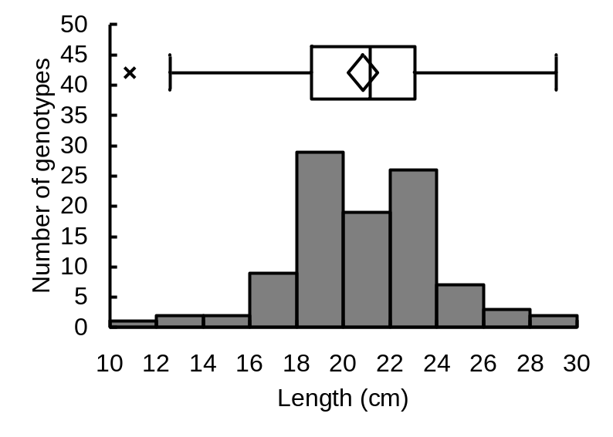
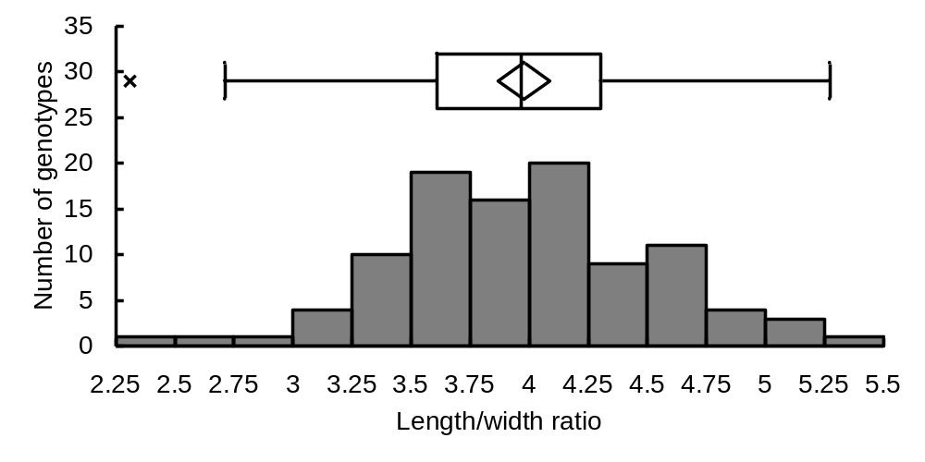
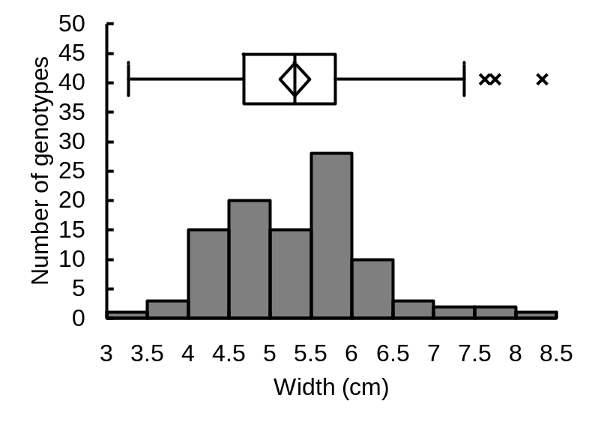
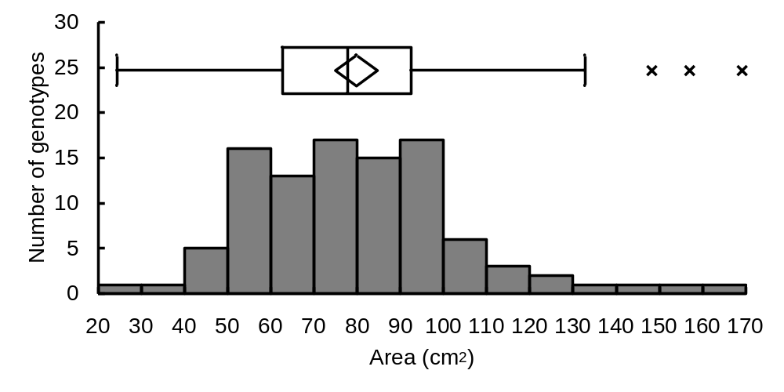
Number of genotypes
50
Number of genotypes
35
45
30
40
35
25
30
20
25
p = 0.062
15
p = 0.734
20
15
10
10
5
5
0
0
10
12
14
16
18
20
22
24
26
28
30
2.5
3.0
3.5
4.0
4.5
5.0
5.5
Length (cm)
Length/width ratio
Number of genotypes
50
Number of genotypes
30
45
25
40
35
20
30
25
p < 0.05
15
p < 0.01
20
10
15
10
5
5
0
0
20
30
40
50
60
70
80
90
100
110
120
130
140
150
160
3.0
4.0
5.0
6.0
7.0
8.0
170
Width (cm)
Area (cm²)
Fig. S1 Histogram and boxplot of leaf phenotypic traits in 100 mango genotypes. The p values in each graph indicate the results of a chi-squared goodness of fit test. The × symbols represent outlier values. Boxes show lower/upper quartiles. Vertical line in the boxes and horizontal bars represent median and lower/upper whiskers, respectively. The diamond represents the mean value at the top and bottom vertices and the 95% confidence interval at the left and right vertices. (continues)
2

Slide 3
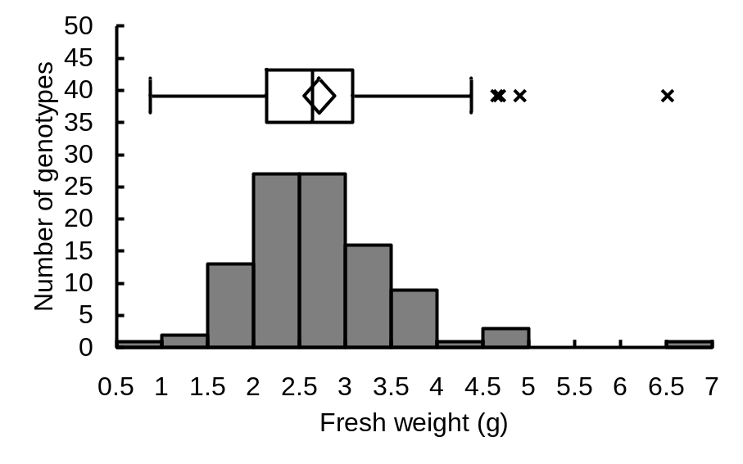
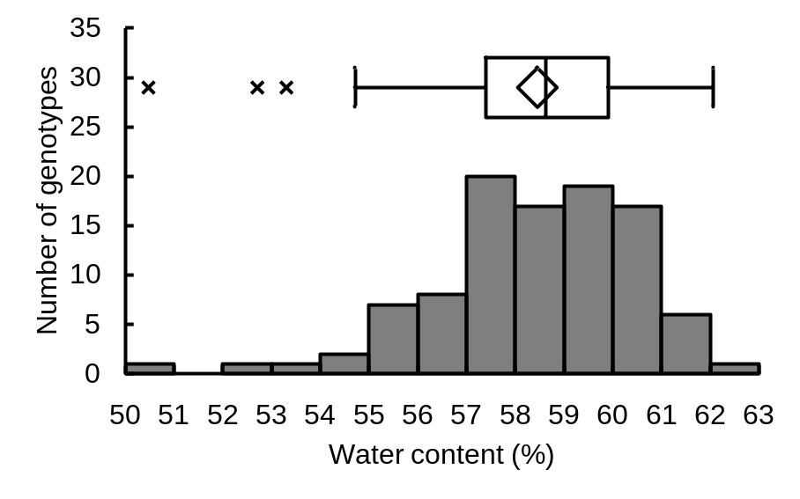
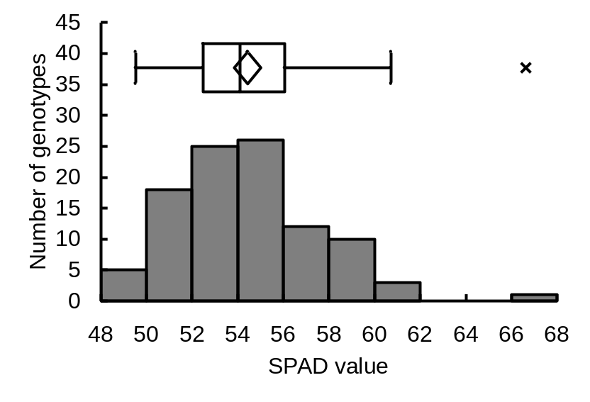
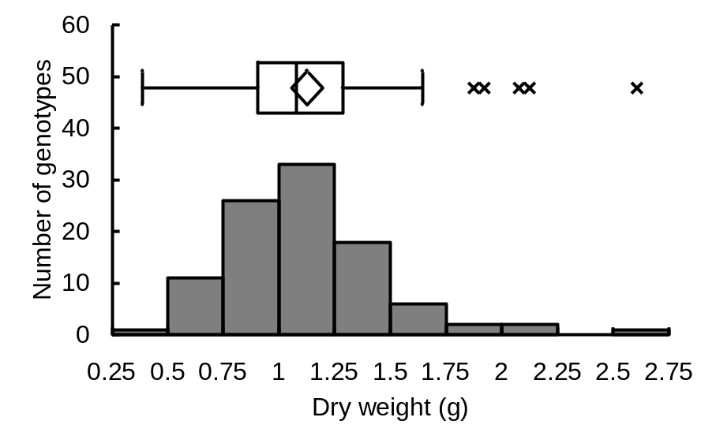
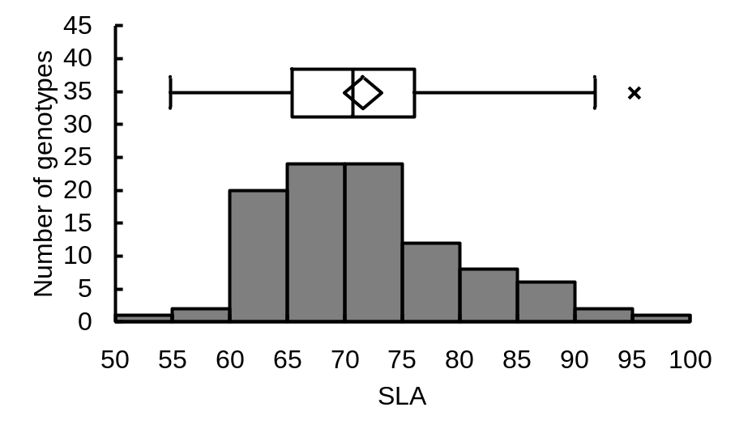
Number of genotypes
50
Number of genotypes
35
Number of genotypes
45
45
30
40
40
35
35
25
30
30
20
25
25
15
20
20
15
15
p < 0.001
10
p < 0.001
p < 0.001
10
10
5
5
5
0
0
0
1.0
2.0
3.0
4.0
5.0
6.0
7.0
50
51
52
53
54
55
56
57
58
59
60
61
62
63
48
50
52
54
56
58
60
62
64
66
68
Fresh weight (g)
Water content (%)
SPAD value
Number of genotypes
60
Number of genotypes
45
50
40
40
35
30
30
25
p < 0.001
20
p < 0.05
20
15
10
10
5
0
0
0.5
1.0
1.5
2.0
2.5
50
55
60
65
70
75
80
85
90
95
100
Dry weight (g)
SLA (leaf area/dry weight)
Fig. S1 (continued) Histogram and boxplot of leaf phenotypic traits in 100 mango genotypes. The p values in each graph indicate the results of a chi-squared goodness of fit test. The × symbols represent outlier values. Boxes show lower/upper quartiles. Vertical line in the boxes and horizontal bars represent median and lower/upper whiskers, respectively. The diamond represents the mean value at the top and bottom vertices and the 95% confidence interval at the left and right vertices.
3

Slide 4
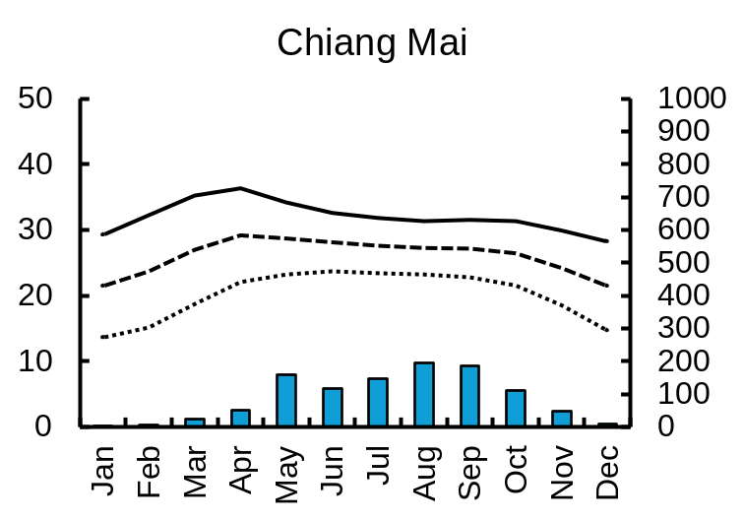
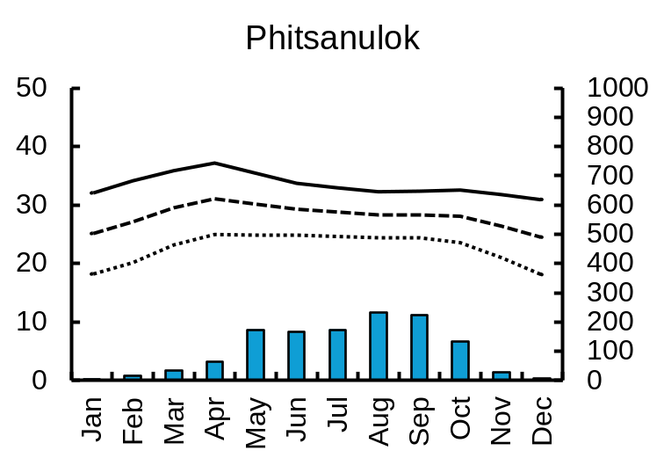
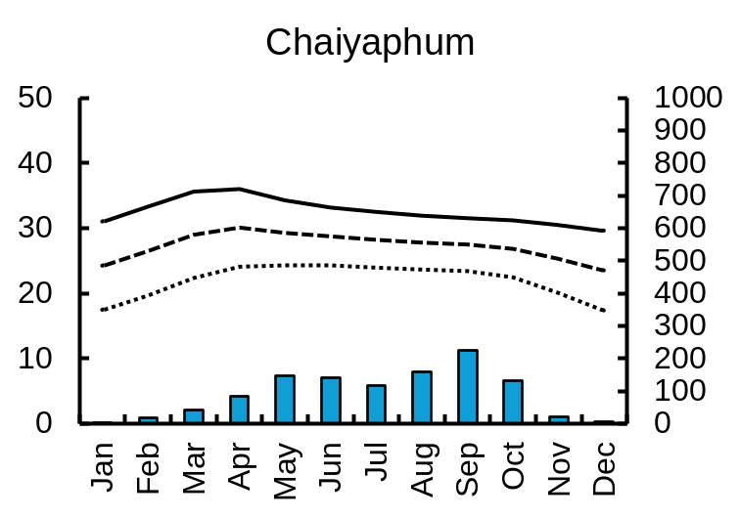
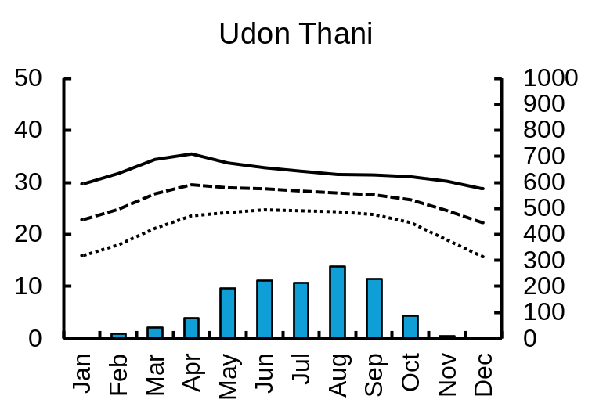
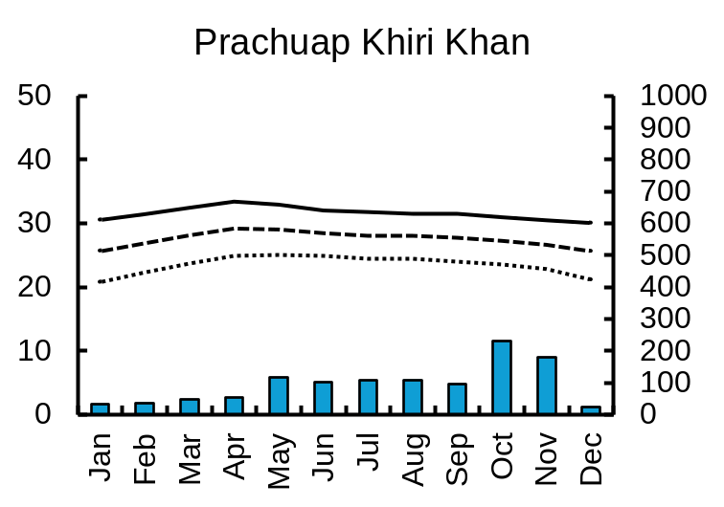
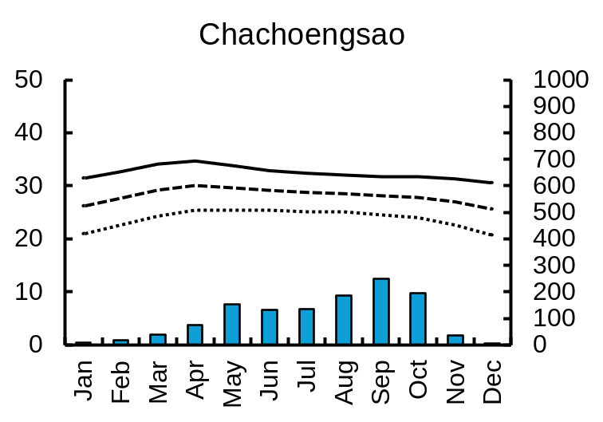
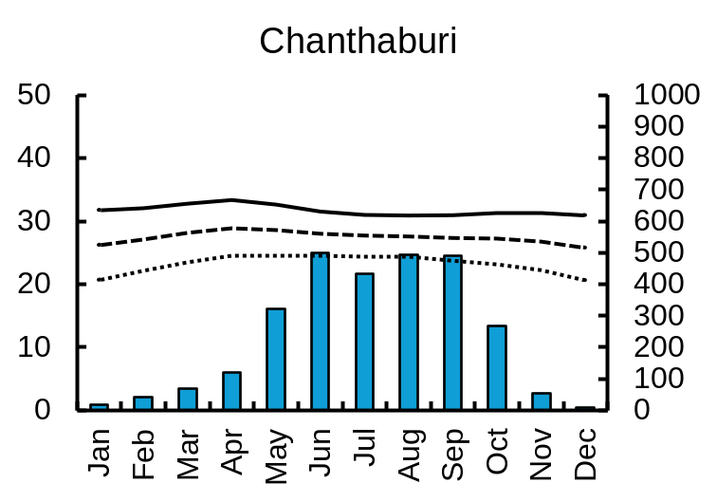
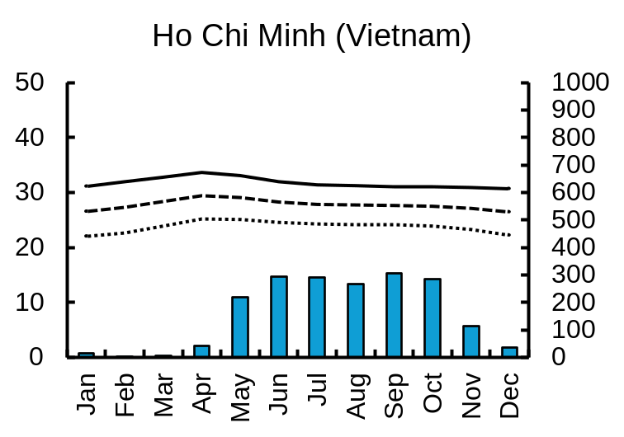
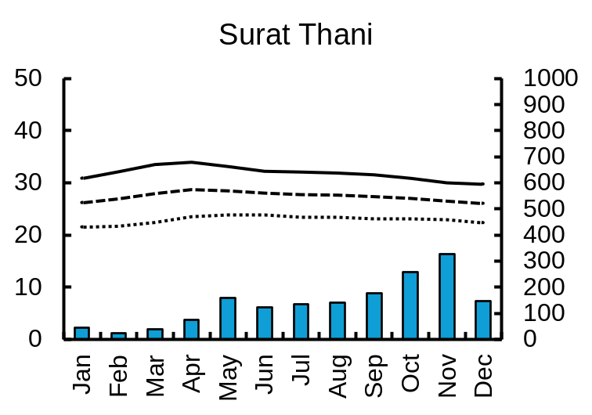
50
1000
Precipitation (mm)
Air temperature (°C)
Chiang Mai (northern Thailand)
Phitsanulok (northern Thailand)
Chaiyaphum
(northeastern Thailand)
Udon Thani (northeastern Thailand)
900
40
800
700
30
600
500
20
26.0 °C
1049.0 mm
28.0 °C
1249.0 mm
27.2 °C
1093.0 mm
400
26.7 °C
1382.0 mm
300
10
200
100
0
0
50
Prachuap Khiri Khan
(central Thailand)
Chachoengsao (central Thailand)
Chanthaburi (eastern Thailand)
Ho Chi Minh (southern Vietnam)
1000
900
40
800
700
30
600
500
20
27.6 °C
1139.0 mm
28.1 °C
1237.0 mm
27.4 °C
2822.0 mm
400
27.8 °C
1878.0 mm
300
10
200
0
100
0
50
Jan
Feb
Mar
Apr
May
Jun
Jul
Aug
Sep
Oct
Nov
Dec
Jan
Feb
Mar
Apr
May
Jun
Jul
Aug
Sep
Oct
Nov
Dec
Jan
Feb
Mar
Apr
May
Jun
Jul
Aug
Sep
Oct
Nov
Dec
Surat Thani (southern Thailand)
1000
40
900
800
30
Maximum
700
600
20
Mean
500
27.4 °C
1650.0 mm
400
10
Minimum
300
200
0
100
Jan
Feb
Mar
Apr
May
Jun
Jul
Aug
Sep
Oct
Nov
Dec
0
Month
Fig. S2 Climographs of the major cities near main cultivation areas of mango in continental areas of Southeast Asia from historical climate data during 1970–2000. Air temperature conditions are shown as monthly means of daily maximum, mean, and minimum values. Precipitations are shown as mean values of monthly sum. Temperature and precipitation values in each graph represent annual mean and total, respectively. Data source: Fick and Hijmans (2017); data are available at online from WorldClim (https://www.worldclim.org/), accessed on December 2, 2024.
4

Slide 5
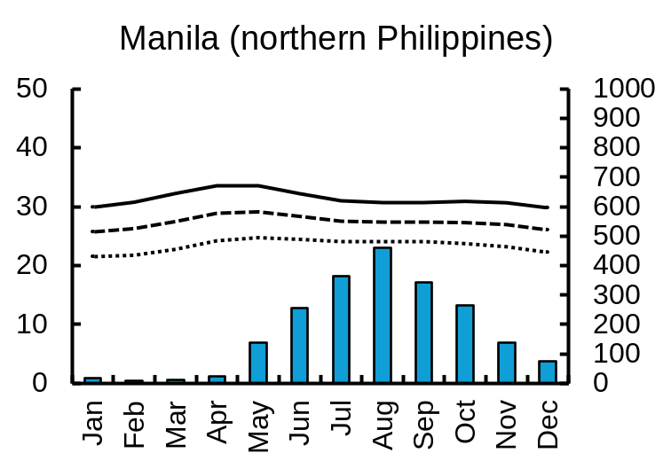
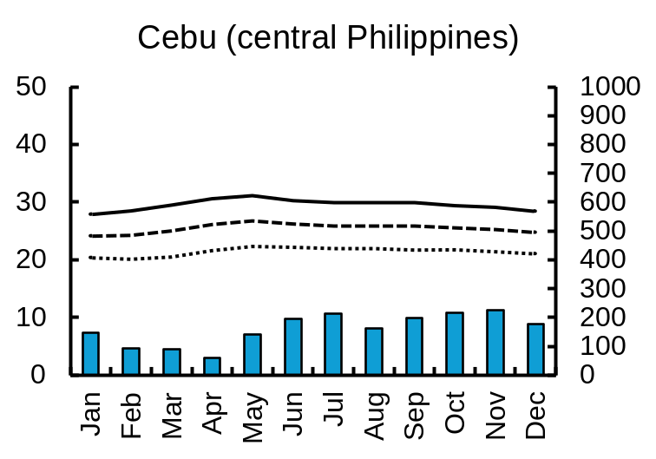
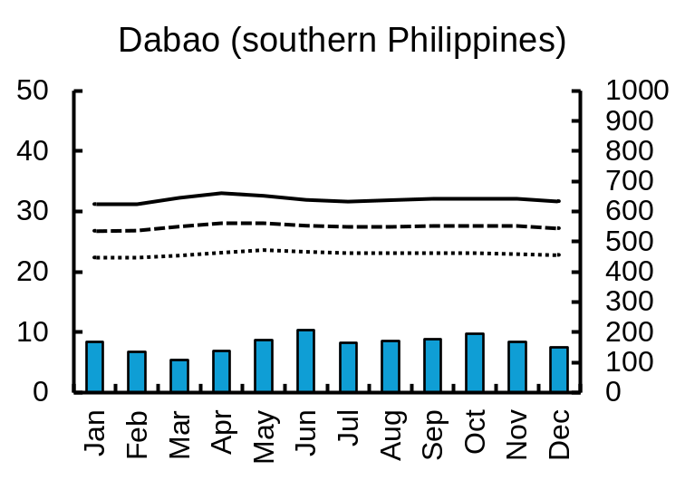
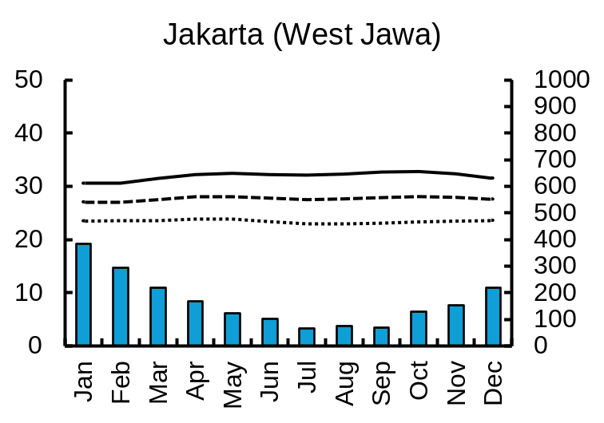
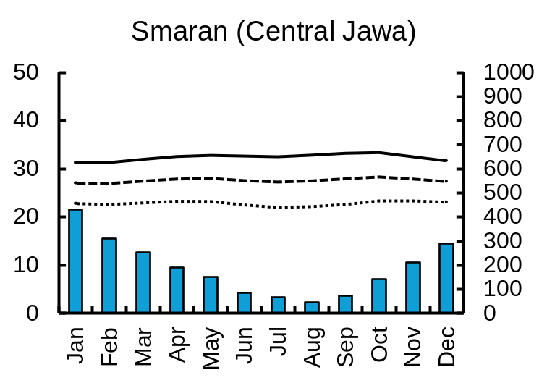
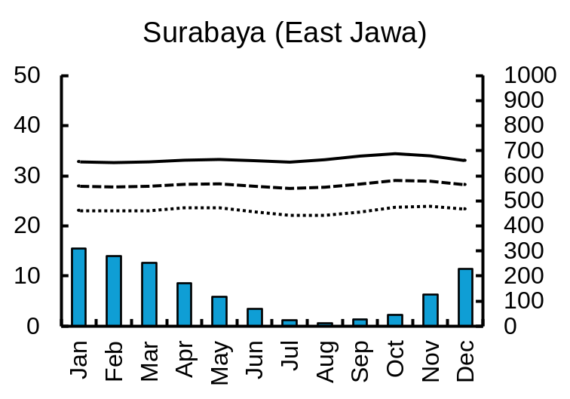
Maximum
Mean
Minimum
Air temperature (°C)
50
1000
Precipitation (mm)
Manila (northern Philippines)
Cebu (central Philippines)
Davao (southern Philippines)
900
40
800
700
30
600
500
20
27.3 °C
2104.0 mm
25.5 °C
1923.0 mm
27.5 °C
1957.0 mm
400
300
10
200
0
100
0
50
Jakarta (West Jawa, Indonesia)
Semarang
(Central Jawa, Indonesia)
1000
Surabaya (East Jawa, Indonesia)
900
40
800
700
30
600
500
20
27.7 °C
1998.0 mm
27.6 °C
2245.0 mm
28.2 °C
1672.0 mm
400
300
10
200
0
100
0
Jan
Feb
Mar
Apr
May
Jun
Jul
Aug
Sep
Oct
Nov
Dec
Jan
Feb
Mar
Apr
May
Jun
Jul
Aug
Sep
Oct
Nov
Dec
Jan
Feb
Mar
Apr
May
Jun
Jul
Aug
Sep
Oct
Nov
Dec
Month
Fig. S3 Climographs of the major cities near main cultivation areas of mango in insular Southeast Asia from historical climate data during 1970–2000. Air temperature conditions are shown as monthly means of daily maximum, mean, and minimum values. Precipitations are shown as mean values of monthly sum. Temperature and precipitation values in each graph represent annual mean and total, respectively. Data source: Fick and Hijmans (2017); data are available at online from WorldClim (https://www.worldclim.org/), accessed on December 2, 2024.
5

Slide 6
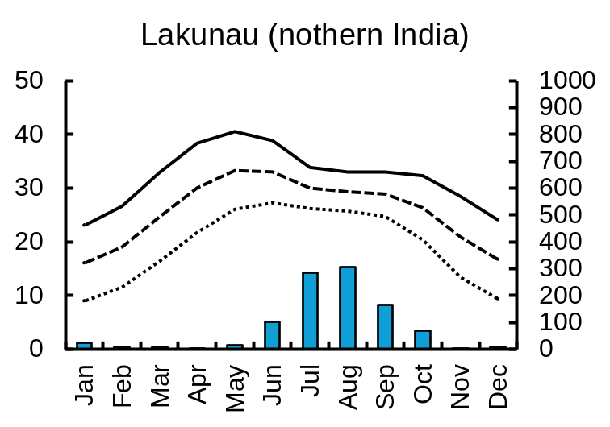
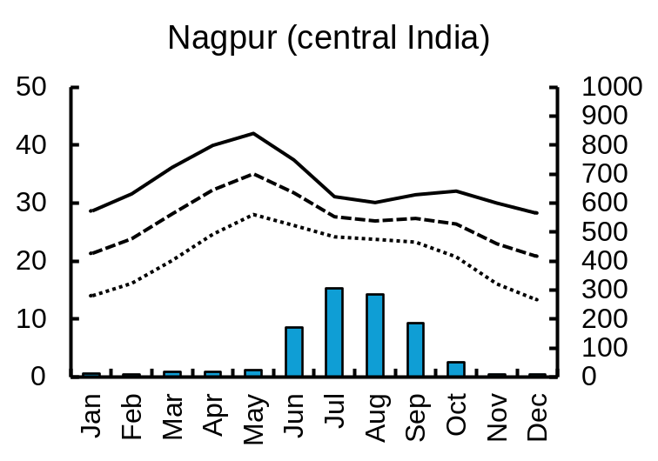
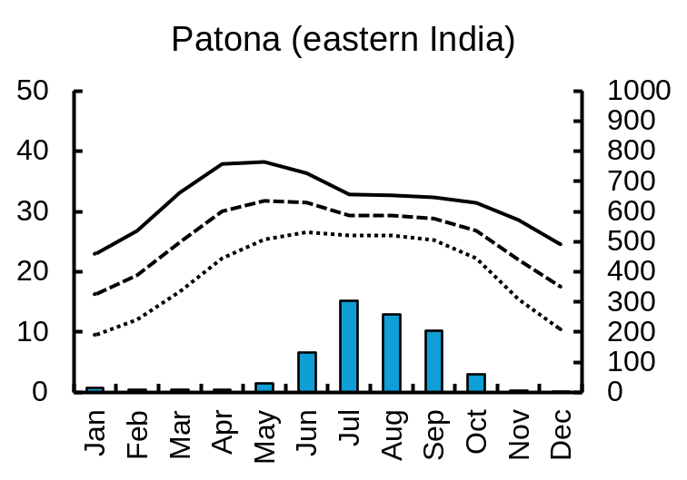
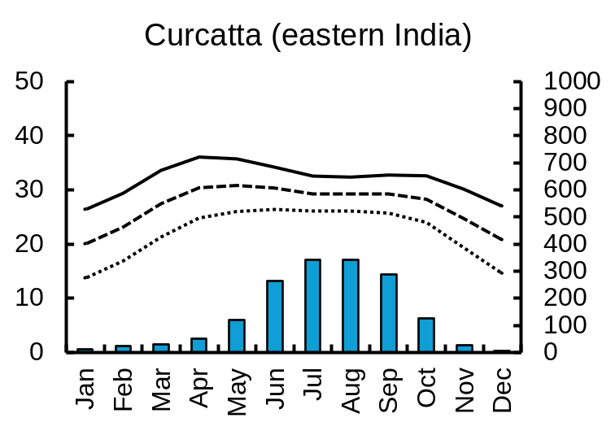
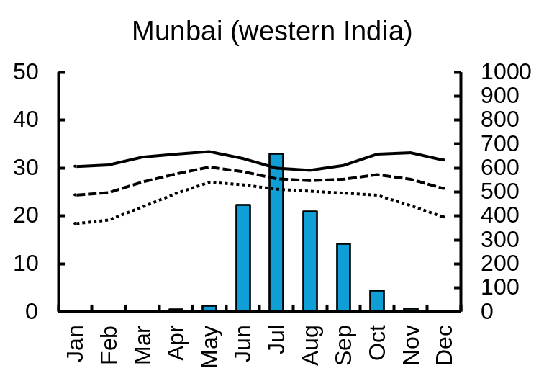
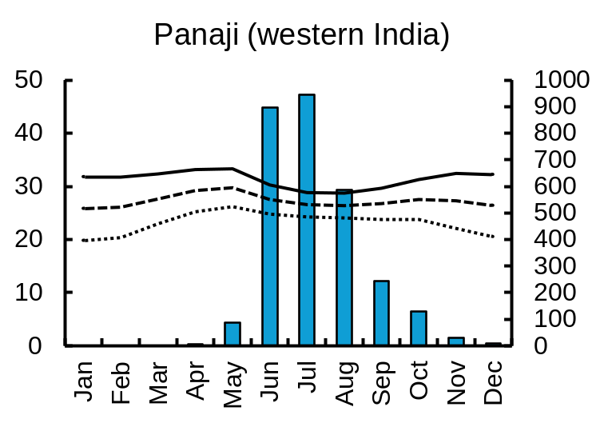
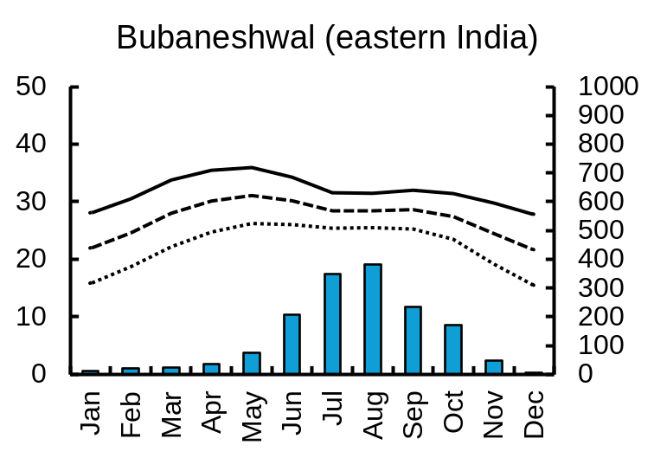
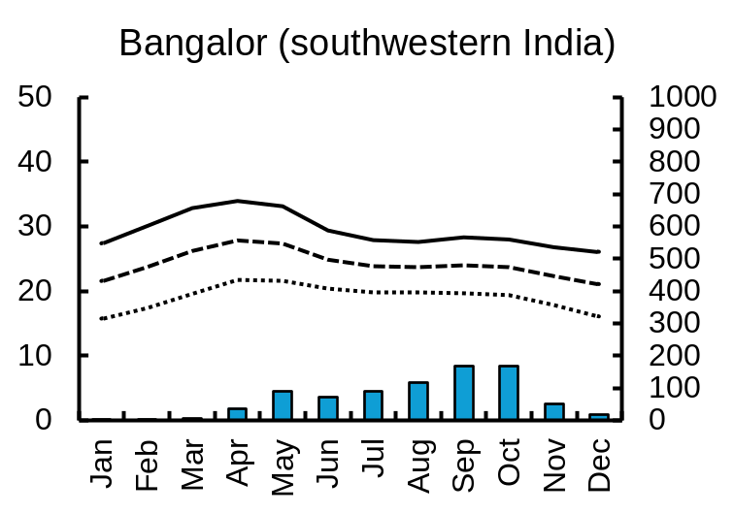
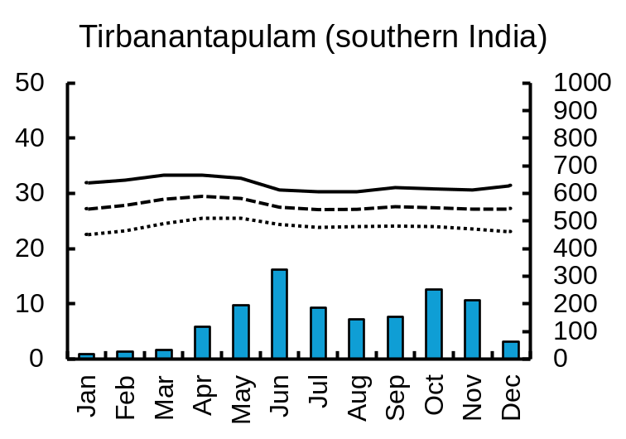
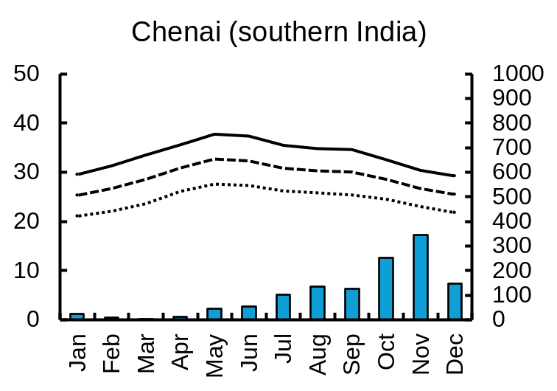
50
1000
Precipitation (mm)
Air temperature (°C)
Lucknow (northern India)
Nagpur (central India)
Patna (eastern India)
Kolkata (eastern India)
900
40
800
700
30
600
500
20
27.0 °C
1629.0 mm
400
25.7 °C
997.0 mm
27.0 °C
1096.0 mm
25.6 °C
1044.0 mm
300
10
200
0
100
0
50
Panaji
(Western India)
Jan
Feb
Mar
Apr
May
Jun
Jul
Aug
Sep
Oct
Nov
1000
Mumbai (western India)
Bhubaneswar (eastern India)
Dec
40
900
800
30
700
600
20
500
27.1 °C
1570.0 mm
400
27.4 °C
1944.0 mm
27.2 °C
2931.0 mm
300
10
Maximum
200
0
100
50
Mean
0
Bangaluru (southern India)
Thiruvananthapuram
(southern India)
Chennai (southern India)
Minimum
1000
40
900
800
30
700
600
20
500
24.2 °C
820.0 mm
27.8 °C
1723.0 mm
29.0 °C
1247.0 mm
400
10
300
200
0
100
Jan
Feb
Mar
Apr
May
Jun
Jul
Aug
Sep
Oct
Nov
Dec
Jan
Feb
Mar
Apr
May
Jun
Jul
Aug
Sep
Oct
Nov
Dec
Jan
Feb
Mar
Apr
May
Jun
Jul
Aug
Sep
Oct
Nov
Dec
0
Month
Fig. S4 Climographs of the major cities near main cultivation areas of mango in India from historical climate data during 1970–2000. Air temperature conditions are shown as monthly means of daily maximum, mean, and minimum values. Precipitations are shown as mean values of monthly sum. Temperature and precipitation values in each graph represent annual mean and total, respectively. Data source: Fick and Hijmans (2017); data are available at online from WorldClim (https://www.worldclim.org/), accessed on December 2, 2024.
6

Slide 7
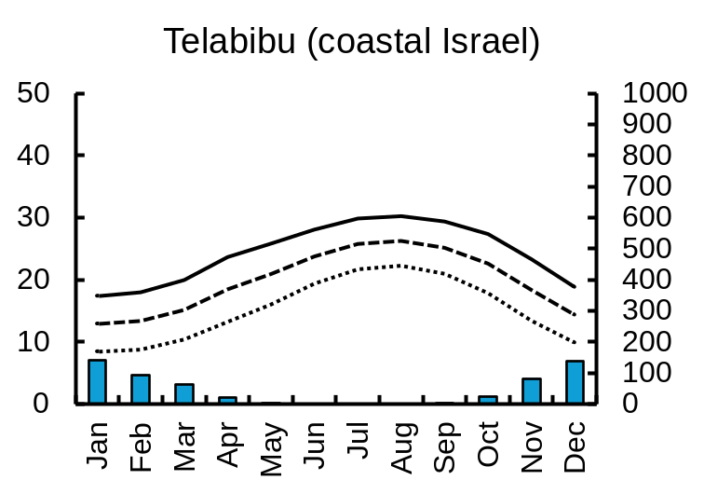
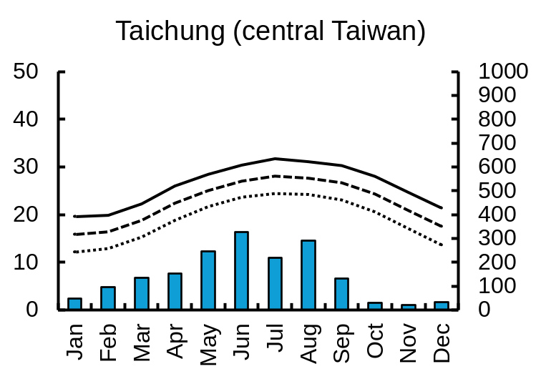
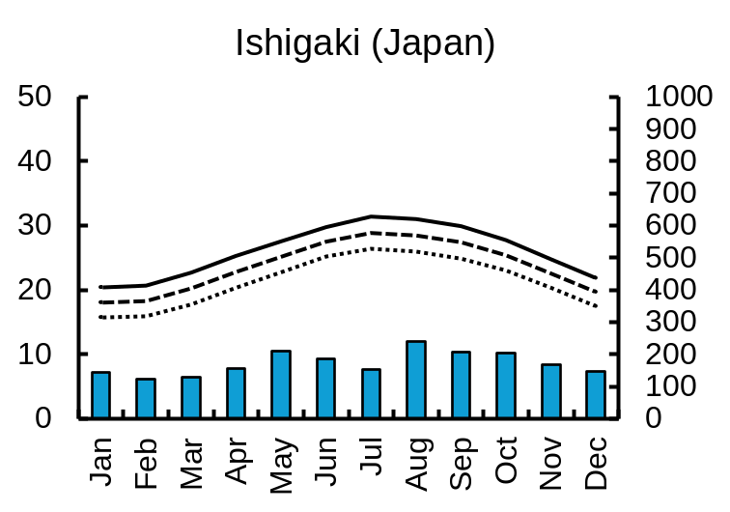
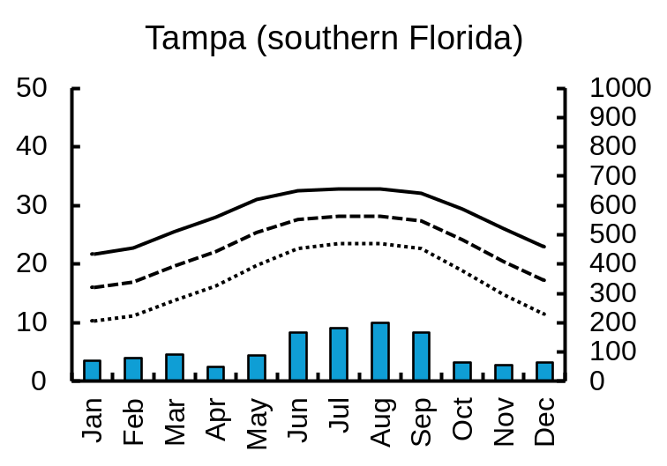
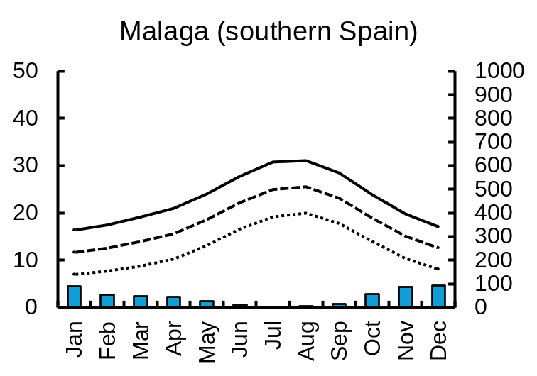
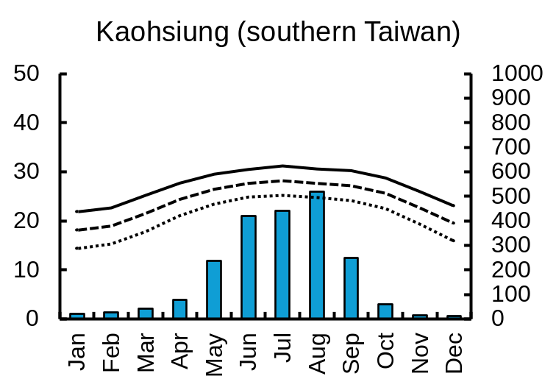
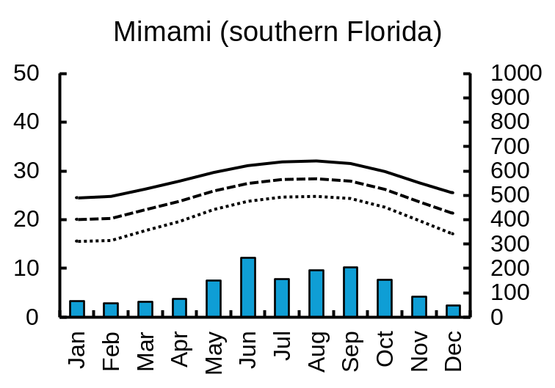
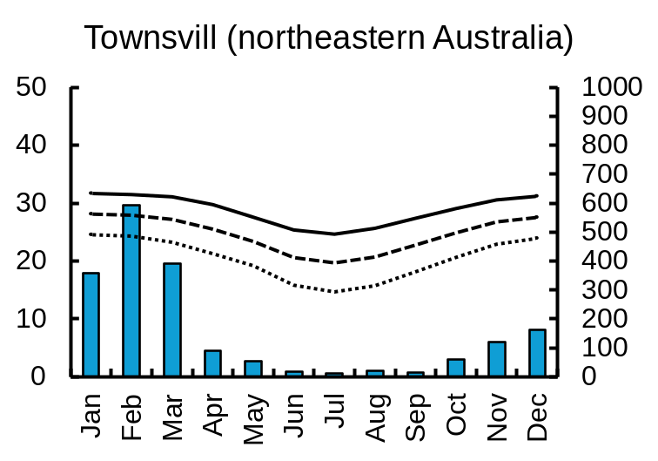
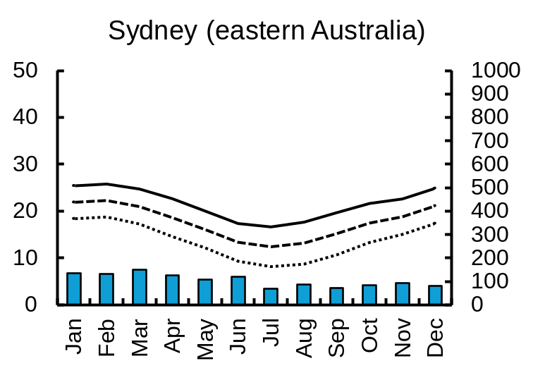
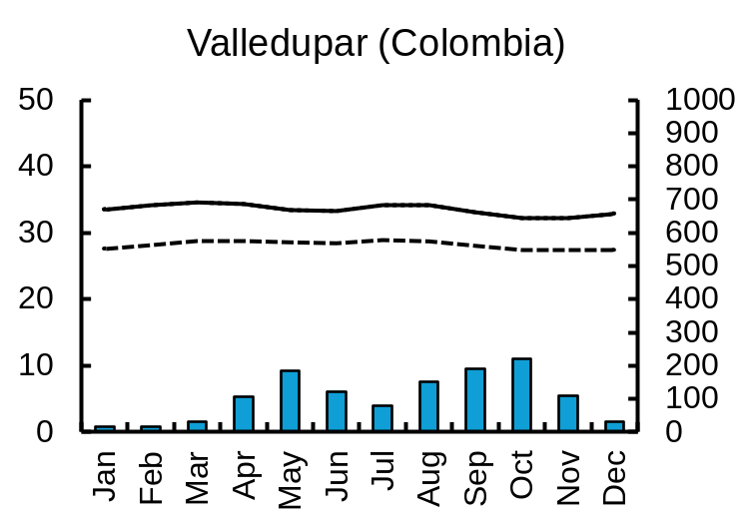
50
1000
Precipitation (mm)
Air temperature (°C)
Tel Aviv (coastal Israel)
Taichung (central Taiwan)
Ishigaki
(subtropical island Japan)
Tampa (central Florida)
900
40
19.8 °C
564.0 mm
22.5 °C
1728.0 mm
22.7 °C
1267.0 mm
800
23.7 °C
2067.0 mm
700
30
600
500
20
400
300
10
200
100
0
0
50
Málaga (southern Spain)
Kaohsiung (southern Taiwan)
Miami (southern Florida)
1000
900
40
17.9 °C
537.0 mm
24.0 °C
2126.0 mm
24.6 °C
1499.0 mm
800
700
30
600
500
20
400
300
10
200
0
100
0
50
Townsville (Queensland)
Sydney (New South Wales)
Valledupar (Colombia)
1000
40
900
Maximum
24.6 °C
1895.0 mm
17.6 °C
1264.0 mm
800
30
700
Mean
600
20
28.2 °C
1251.0 mm
500
Minimum
400
10
300
200
0
100
Jan
Feb
Mar
Apr
May
Jun
Jul
Aug
Sep
Oct
Nov
Dec
Jan
Feb
Mar
Apr
May
Jun
Jul
Aug
Sep
Oct
Nov
Dec
Jan
Feb
Mar
Apr
May
Jun
Jul
Aug
Sep
Oct
Nov
Dec
Jan
Feb
Mar
Apr
May
Jun
Jul
Aug
Sep
Oct
Nov
0
Dec
Month
Fig. S5 Climographs of the major cities near main cultivation areas of mango in Europe, East Asia, America, and Australia from historical climate data during 1970–2000. Air temperature conditions are shown as monthly means of daily maximum, mean, and minimum values. Precipitations are shown as mean values of monthly sum. Temperature and precipitation values in each graph represent annual mean and total, respectively. Data source: Fick and Hijmans (2017); data are available at online from WorldClim (https://www.worldclim.org/), accessed on December 2, 2024.
7

Slide 8
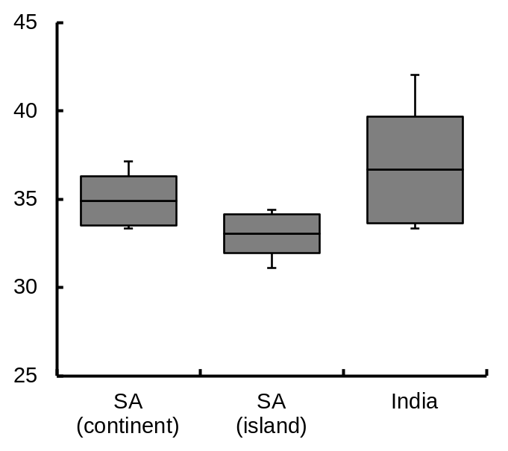
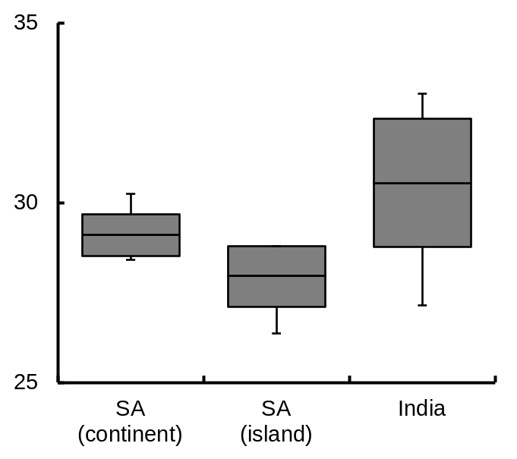
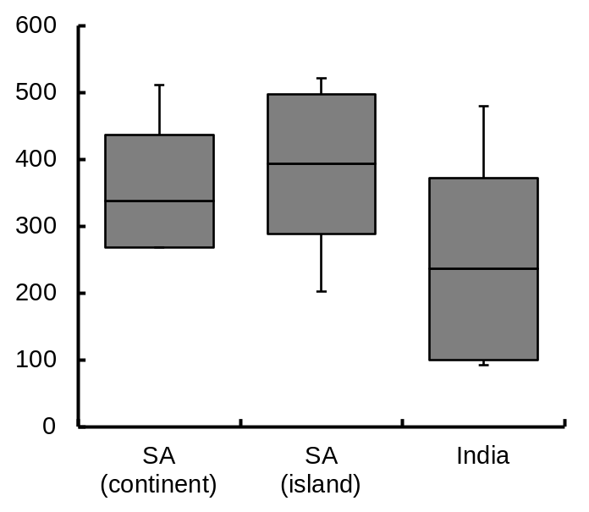
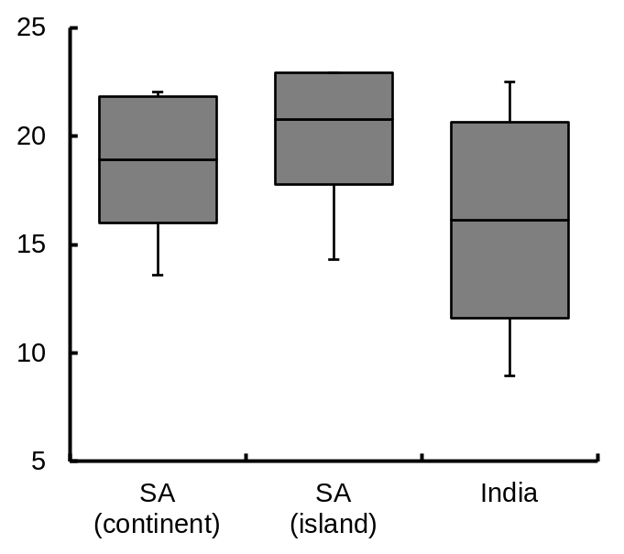
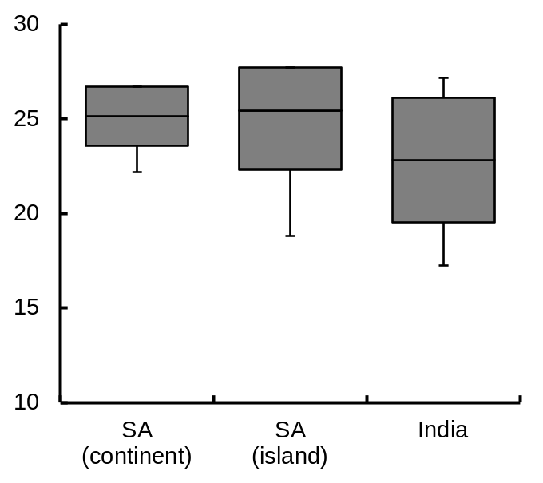
Maximum temperature in the warmest month (°C)
45
Mean temperature in the warmest quarter (°C)
35
Precipitation in the warmest quarter (mm)
600
500
40
400
35
30
300
200
30
100
25
25
0
SA
(continent)
SA
(island)
India
Minimum temperature in the coldest month (°C)
25
Mean temperature in the coldest quarter (°C)
30
20
25
15
20
10
15
5
10
SA
(continent)
SA
(island)
India
SA
(continent)
SA
(island)
India
Fig. S6 Boxplot of some bioclimatic variables in continental and insular Southeast Asia (SA), and India shown in Appendix S4 from historical climate data during 1970–2000. Data source: Fick and Hijmans (2017); data are available at online from WorldClim (https://www.worldclim.org/), accessed on December 2, 2024. Middle horizontal line in each box indicates mean value; top and bottom horizontal lines indicate ± standard deviation, respectively. Vertical bars indicate maximum and minimum values, respectively.
8

