Slide 1

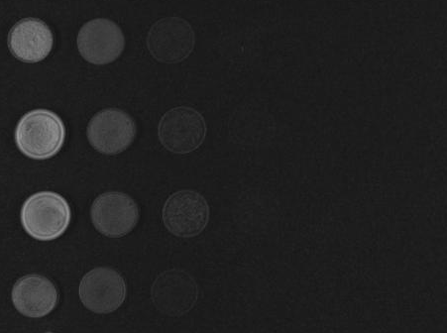
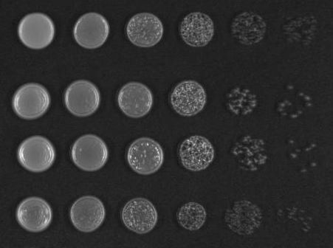


Supplementary Figures
Fig. S1 Evaluation of strain sensitivity to antibiotics. Drop assay of the strains plated on YPD plates and YPD plates supplemented with particular antibiotic.
+200 mg/l G418
+20 mg/l phleomycin
YPD
CLIB382
CBS7960
Ethanol Red
CEN.PK113-7D
+100 mg/l nourseothricin
+200 mg/l hygromycin B

Slide 2
Fig. S2 Flow cytometry analysis of the reporter gene expressing strains and their derivatives. Two parameter 5% probability contour plots demonstrate the population properties of the strains. Cell populations were delineated by the displayed gates to assign CFP (CFP⁺) and RFP (RFP⁺) fluorescent cells. Such populations were then gated for YFP (YFP⁺) fluorescence. For simplicity, outliers are not displayed, but were included in the calculation of the percentage of positive cells. Both CFP⁺YFP⁺ and CFP⁺YFP⁺RFP⁺ cells of CEN.PK, Ethanol Red, CLIB382 and CBS7960 are displayed. Only CFP⁺YFP⁺RFP⁺ populations of CEN.PK and Ethanol Red derivatives grown for 35 generations under non-selective conditions are displayed.

Slide 3
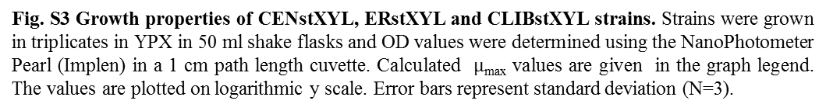
Fig. S3 Growth properties of CENstXYL, ERstXYL and CLIBstXYL strains. Strains were grown in triplicates in YPX in 50 ml shake flasks and OD values were determined using the NanoPhotometer Pearl (Implen) in a 1 cm path length cuvette. Calculated $μ$_{max} values are given in the graph legend. The values are plotted on logarithmic y scale. Error bars represent standard deviation (N=3).
OD_{600nm}
CENstXYL μ_{max}=0.296 h⁻¹
ERstXYL μ_{max}=0.271 h⁻¹
CLIBstXYL μ_{max}=0.283 h⁻¹
time (hrs)

Slide 4
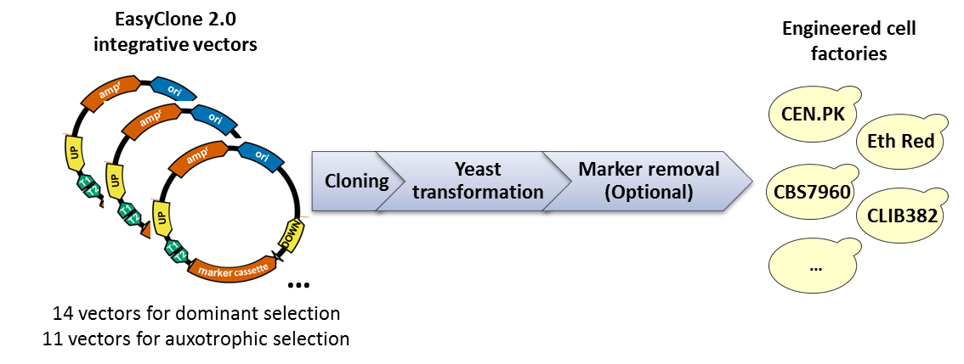
Fig. S4 EasyClone 2.0 at a glance. EasyClone 2.0 is a set of 14 integrative vectors with various dominant selection markers and of 11 integrative vectors with auxotrophic selection markers. The vectors are intended for integrating genes of interest into laboratory and industrial strains of S. cerevisiae. The vectors integrate into previously validated chromosomal locations by double cross-over recombination and result in homogenous stable expression of the integrated genes. Cre-loxP-mediated marker rescue is possible for removing markers positioned on different chromosomes.

