Slide 1
S3
Tutorial about the gravity aspects with emphasis on the combed strike angles
Examples
our figures by surfer © Jan Kostelecký
more examples can be downloaded from
www.asu.cas.cz/~jklokocn

Slide 2
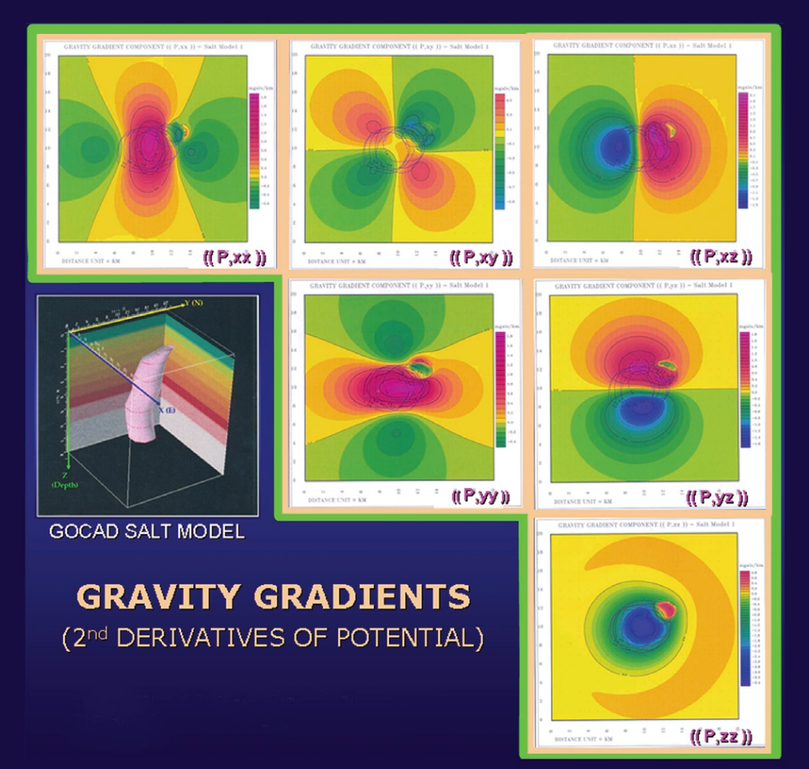
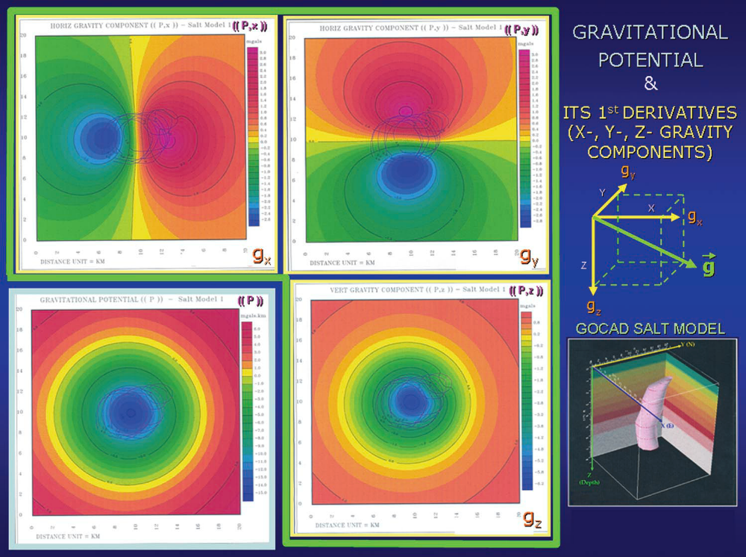
Comparison of
Information
Content:
Gravity anomalies
vs
Gravity gradients
from
the Marussi tensor
A.H.Saad, The Leading Edge, 942-950, Aug. 2006

Slide 3
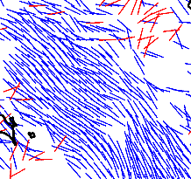
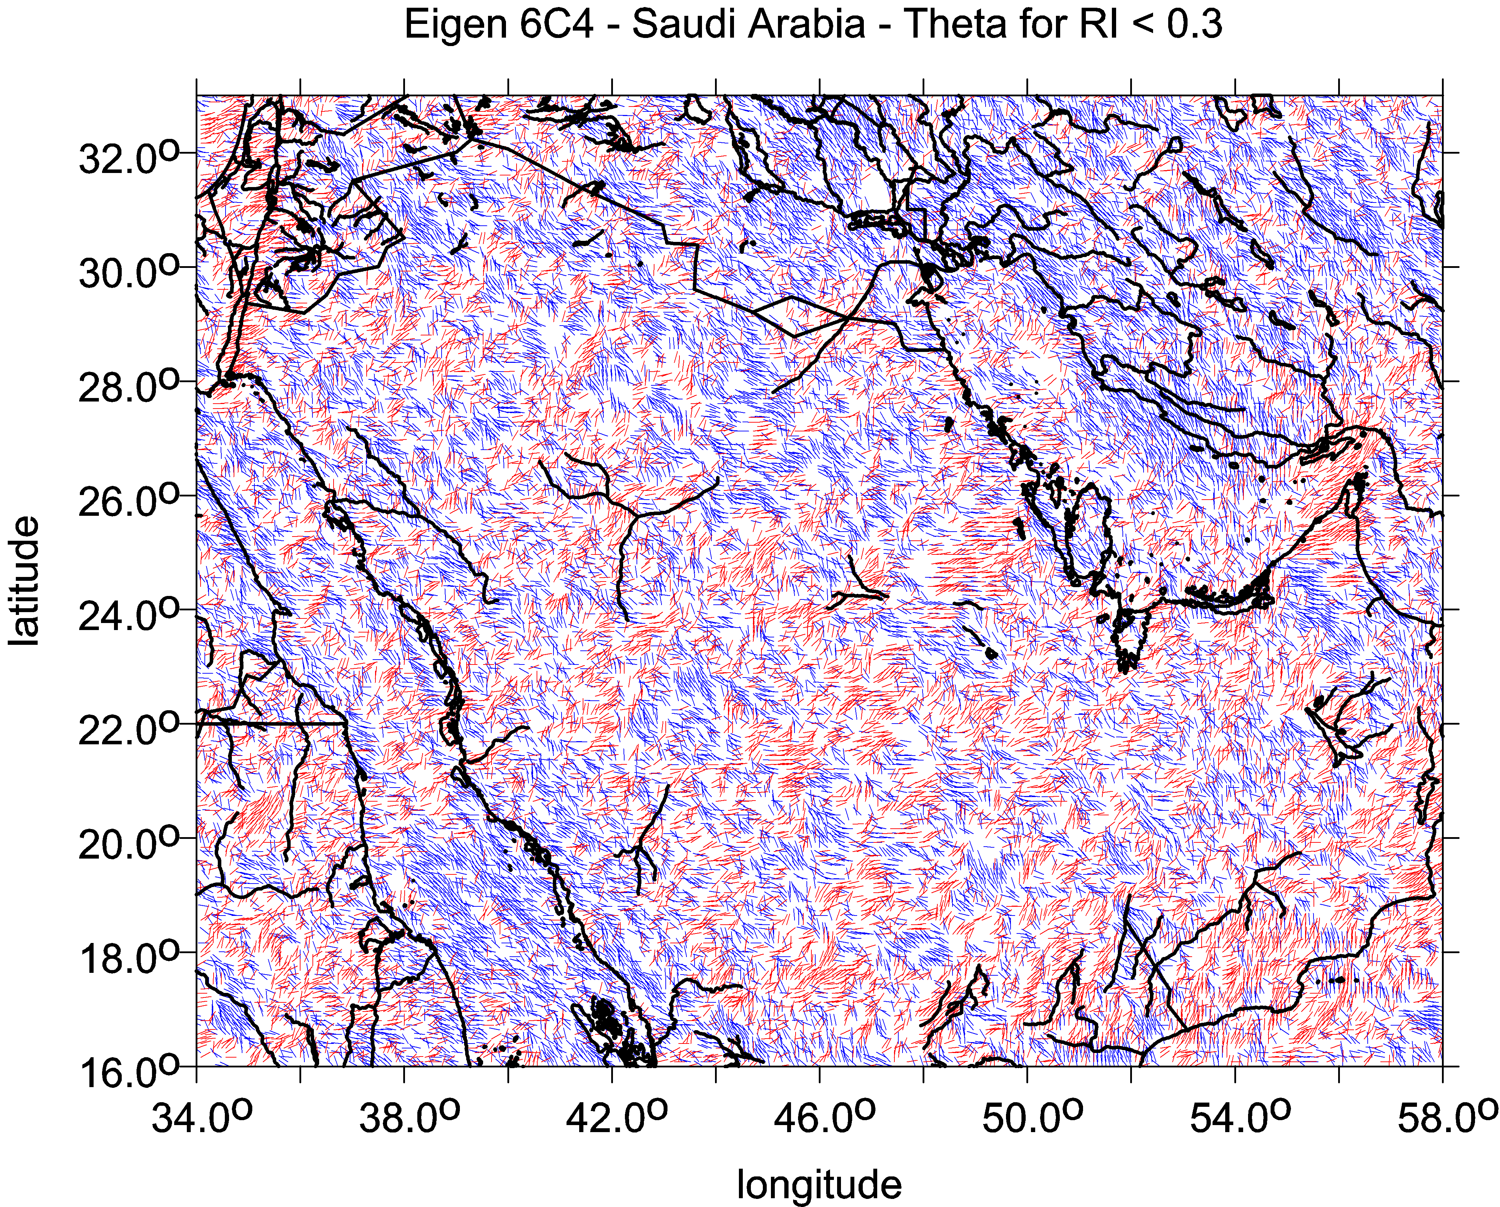
The combed strike angle θ …are the strike angles aligned. Being combed, the strike angle indicates existence of impact craters, or task (target) eposits, TD, but yields no proof of them; the indication is not unambiguous as for oil&gas, it may indicate water, ground water, wadi, deep valley, trench, may be also coal; further information needed (topography, geology, geophysics, …) for specific decision…
The combed θ may provide information about the direction of deformations. They are parallel to the weakness in the strength of the rock, e.g., direction schistosity and or presence of faults or micro-fault zones.
Colors: the red colour means its direction is to the north and blue is to the south of the east
combed strike angles in the studied area, disheveled strike angles in the studied area = one way oriented strike angles = strike angles are in diverse directions
see also S1
comb factor → 1 comb_factor → 0

Slide 4
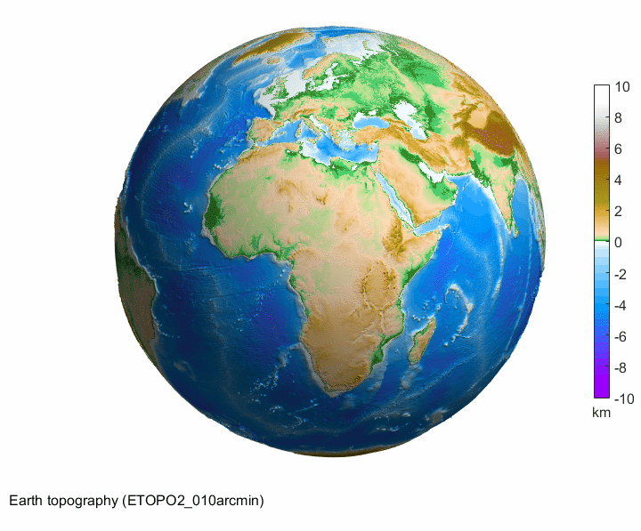
The Earth

Slide 5
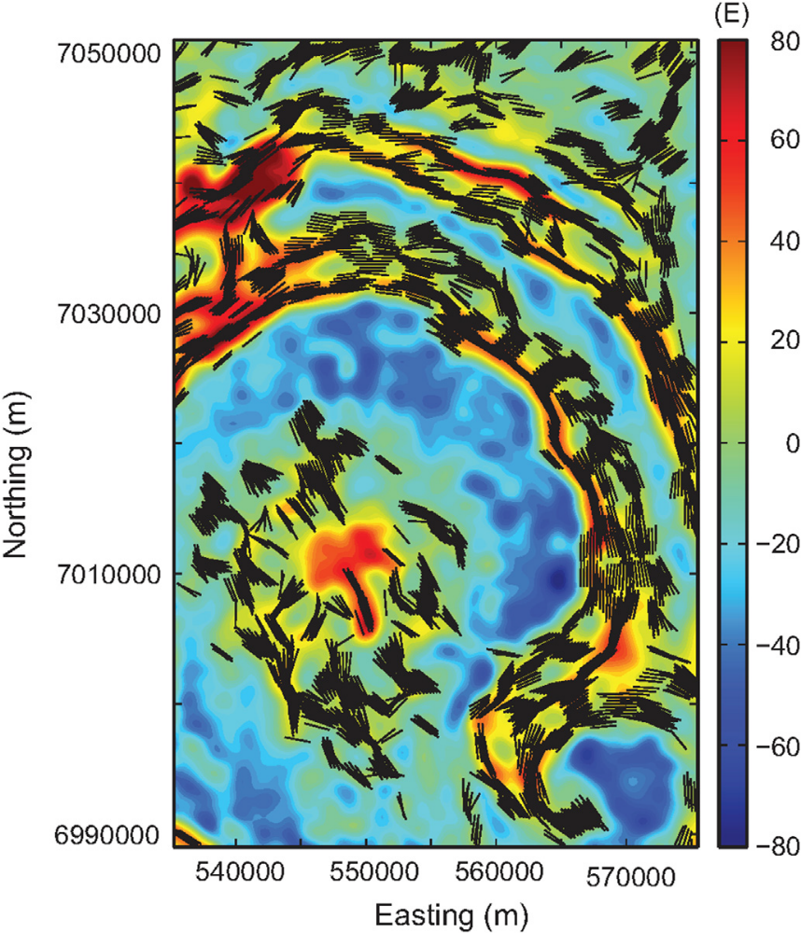
The Earth
impact crater
Vredefort,
South Africa
The strike angles follow rings of the impact structure Vredefort, South Africa. In the central part of the crater they are combed not around the crater but in one prevailing direction.
To draw this, Beiki and Pedersen (2010) used the detailed local airborne gradiometry data, which we have not available and the resolution of our data source (EIGEN 6C4) is not sufficient for this purpose.

Slide 6
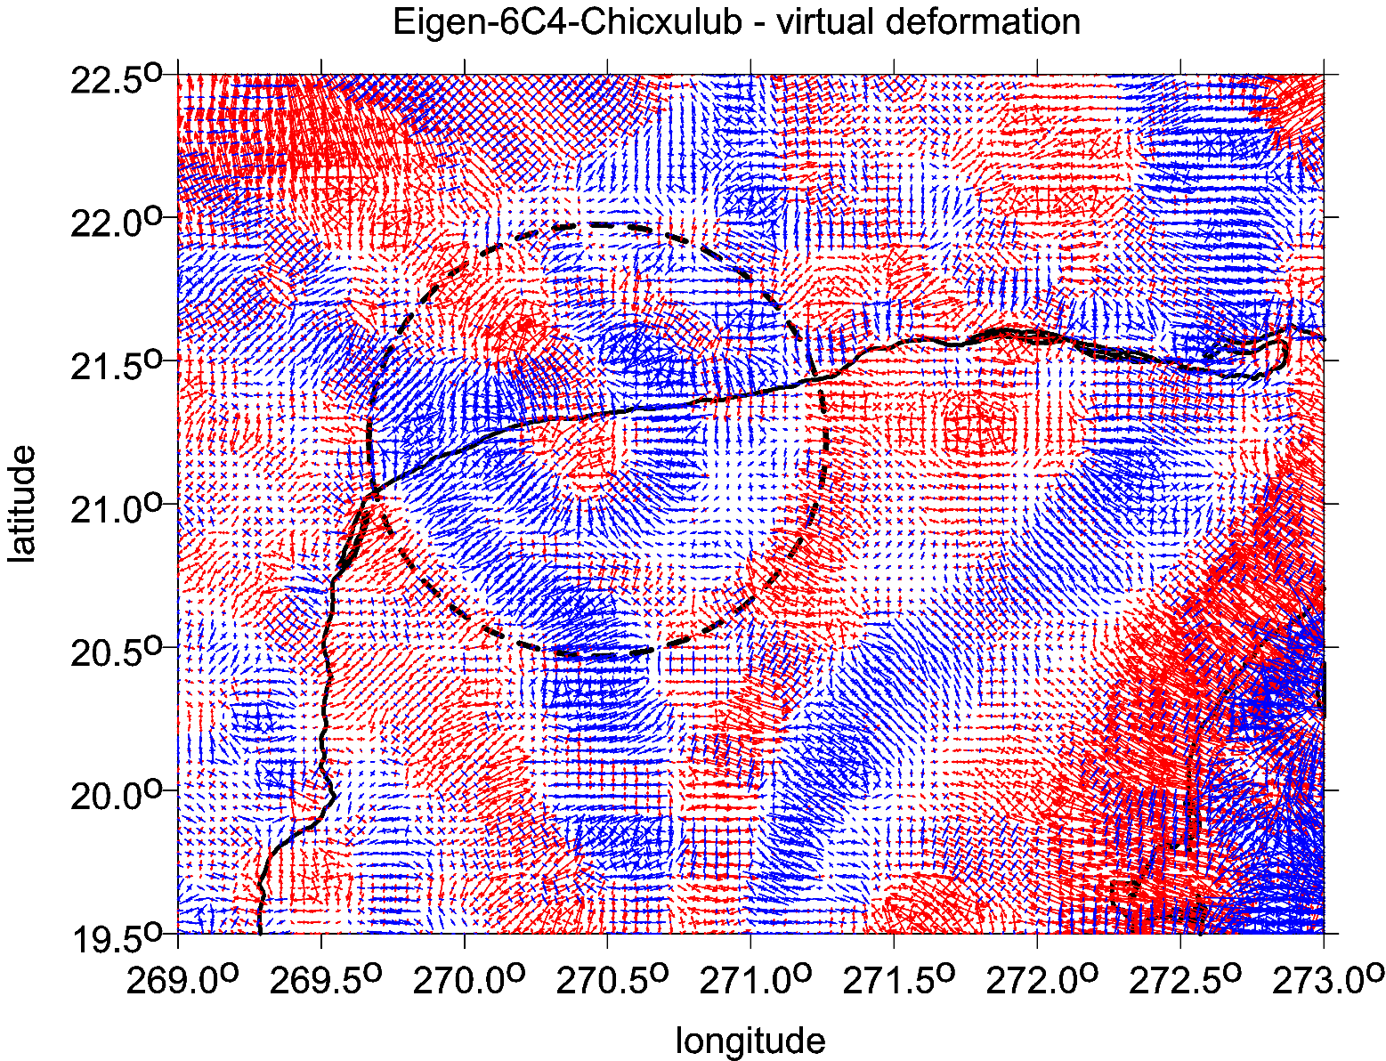
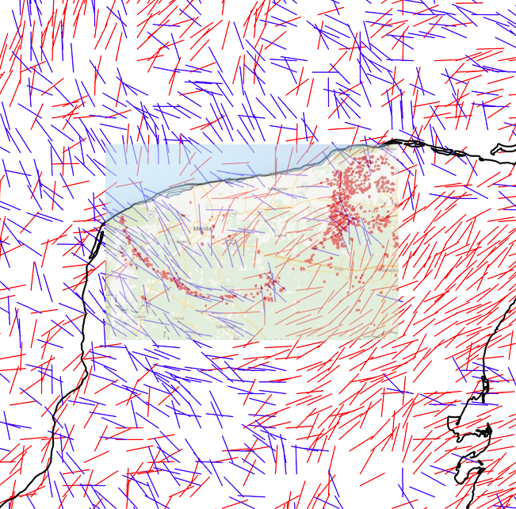
Chicxulub
North Yucatan, Mexico
vd [-]
locations of cenote versus strike angles θ [deg]

Slide 7
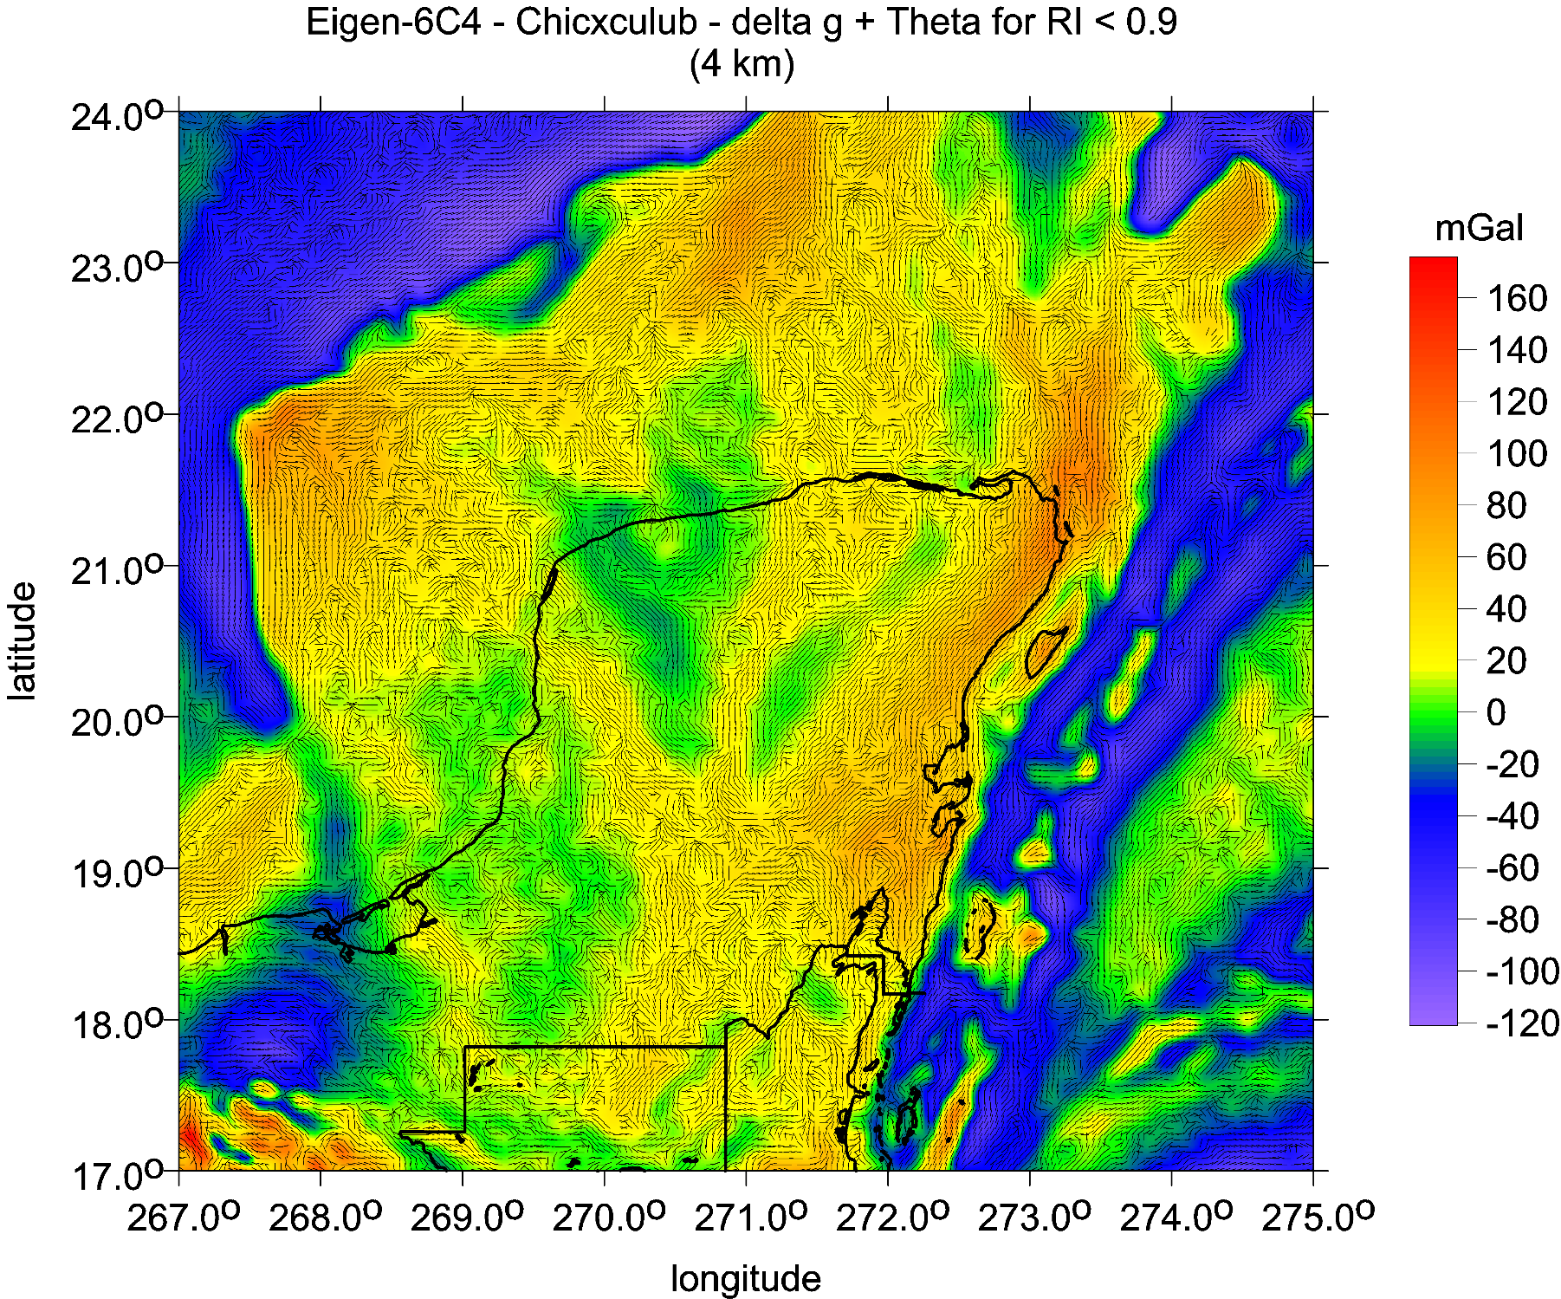
θ [deg] and
∆g

Slide 8
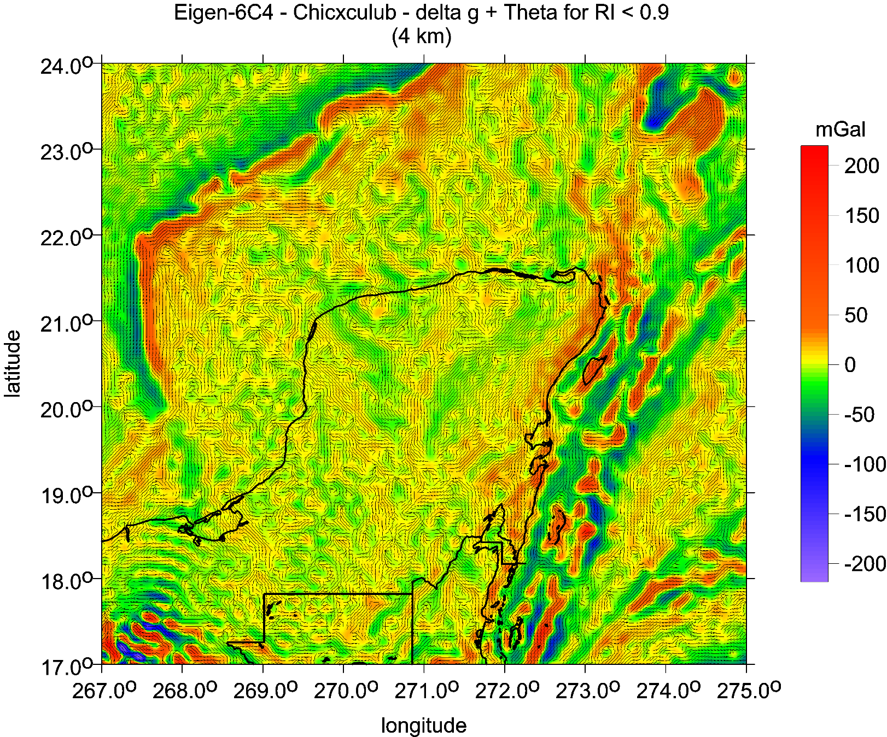
Tzz
E
Strike angles [deg], I<0.9, with Tzz [E])

Slide 9
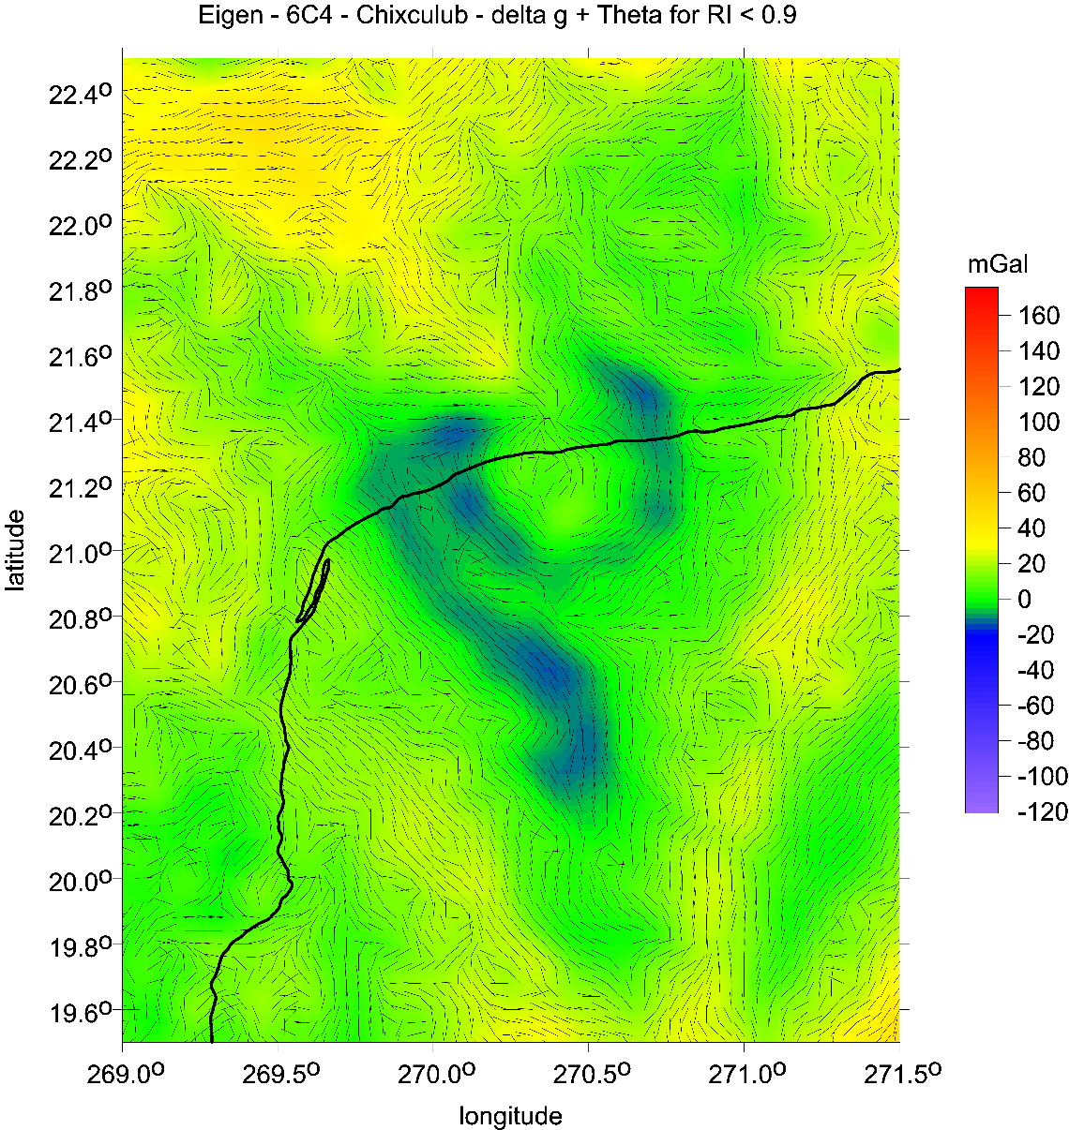
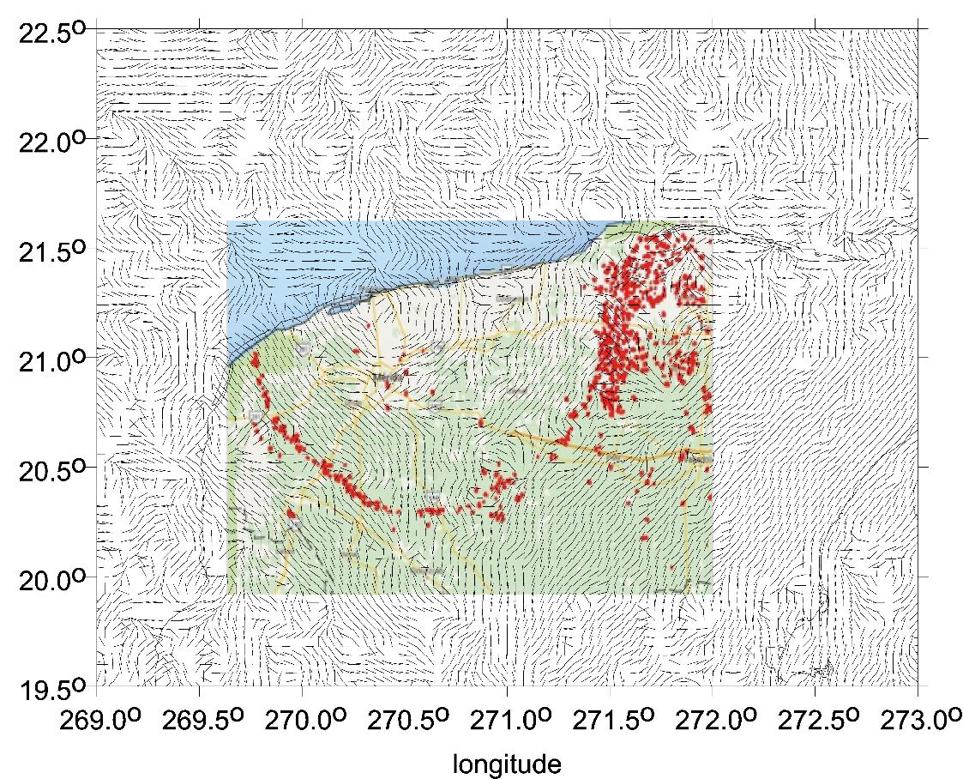
θ [deg]
Δg
θ [deg]
CHICXULUB:
gravity anomalies [mGal] from EIGEN 6C4 and the strike angles;
right, the strikes and red dots for the cenotes

Slide 10
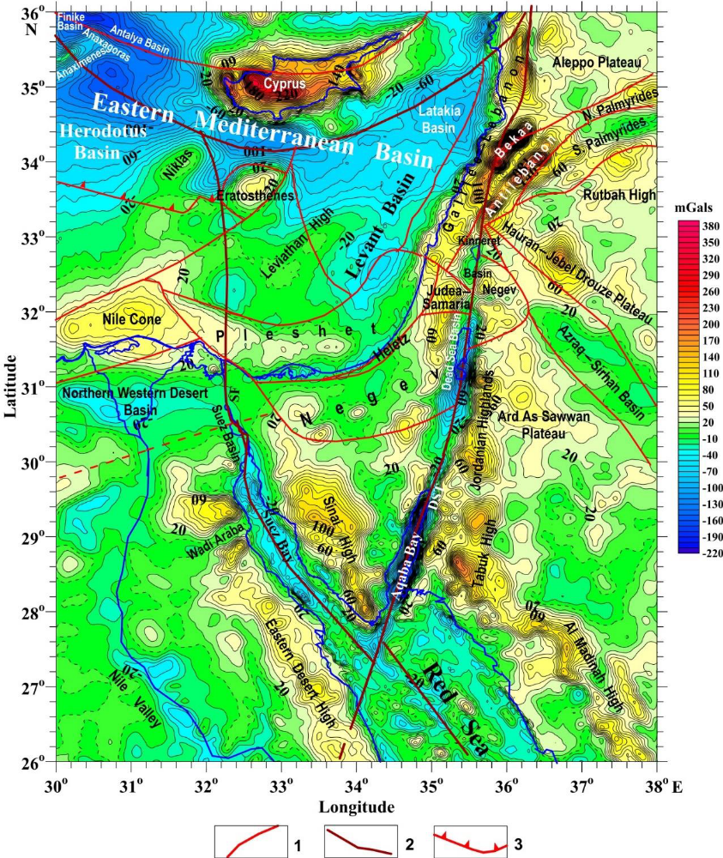
Satellite-derived gravity map of the Eastren Mediterranean area with the main tectonic features
(isoline density is 10 mGals).
(1) Intraplate faults,
(2) interplate faults,
(3) the southern boundary of
the Mediterranean accretionary belt.
Citation: Eppelbaum, L.V.; Katz, Y.I.;
Ben-Avraham, Z. Geodynamic
Aspects of Magnetic Data Analysis
and Tectonic–Paleomagnetic
Mapping in the Easternmost
Mediterranean: A Review.
Appl. Sci. 2023, 13, 10541.
https://doi.org/10.3390/app131810541

Slide 11
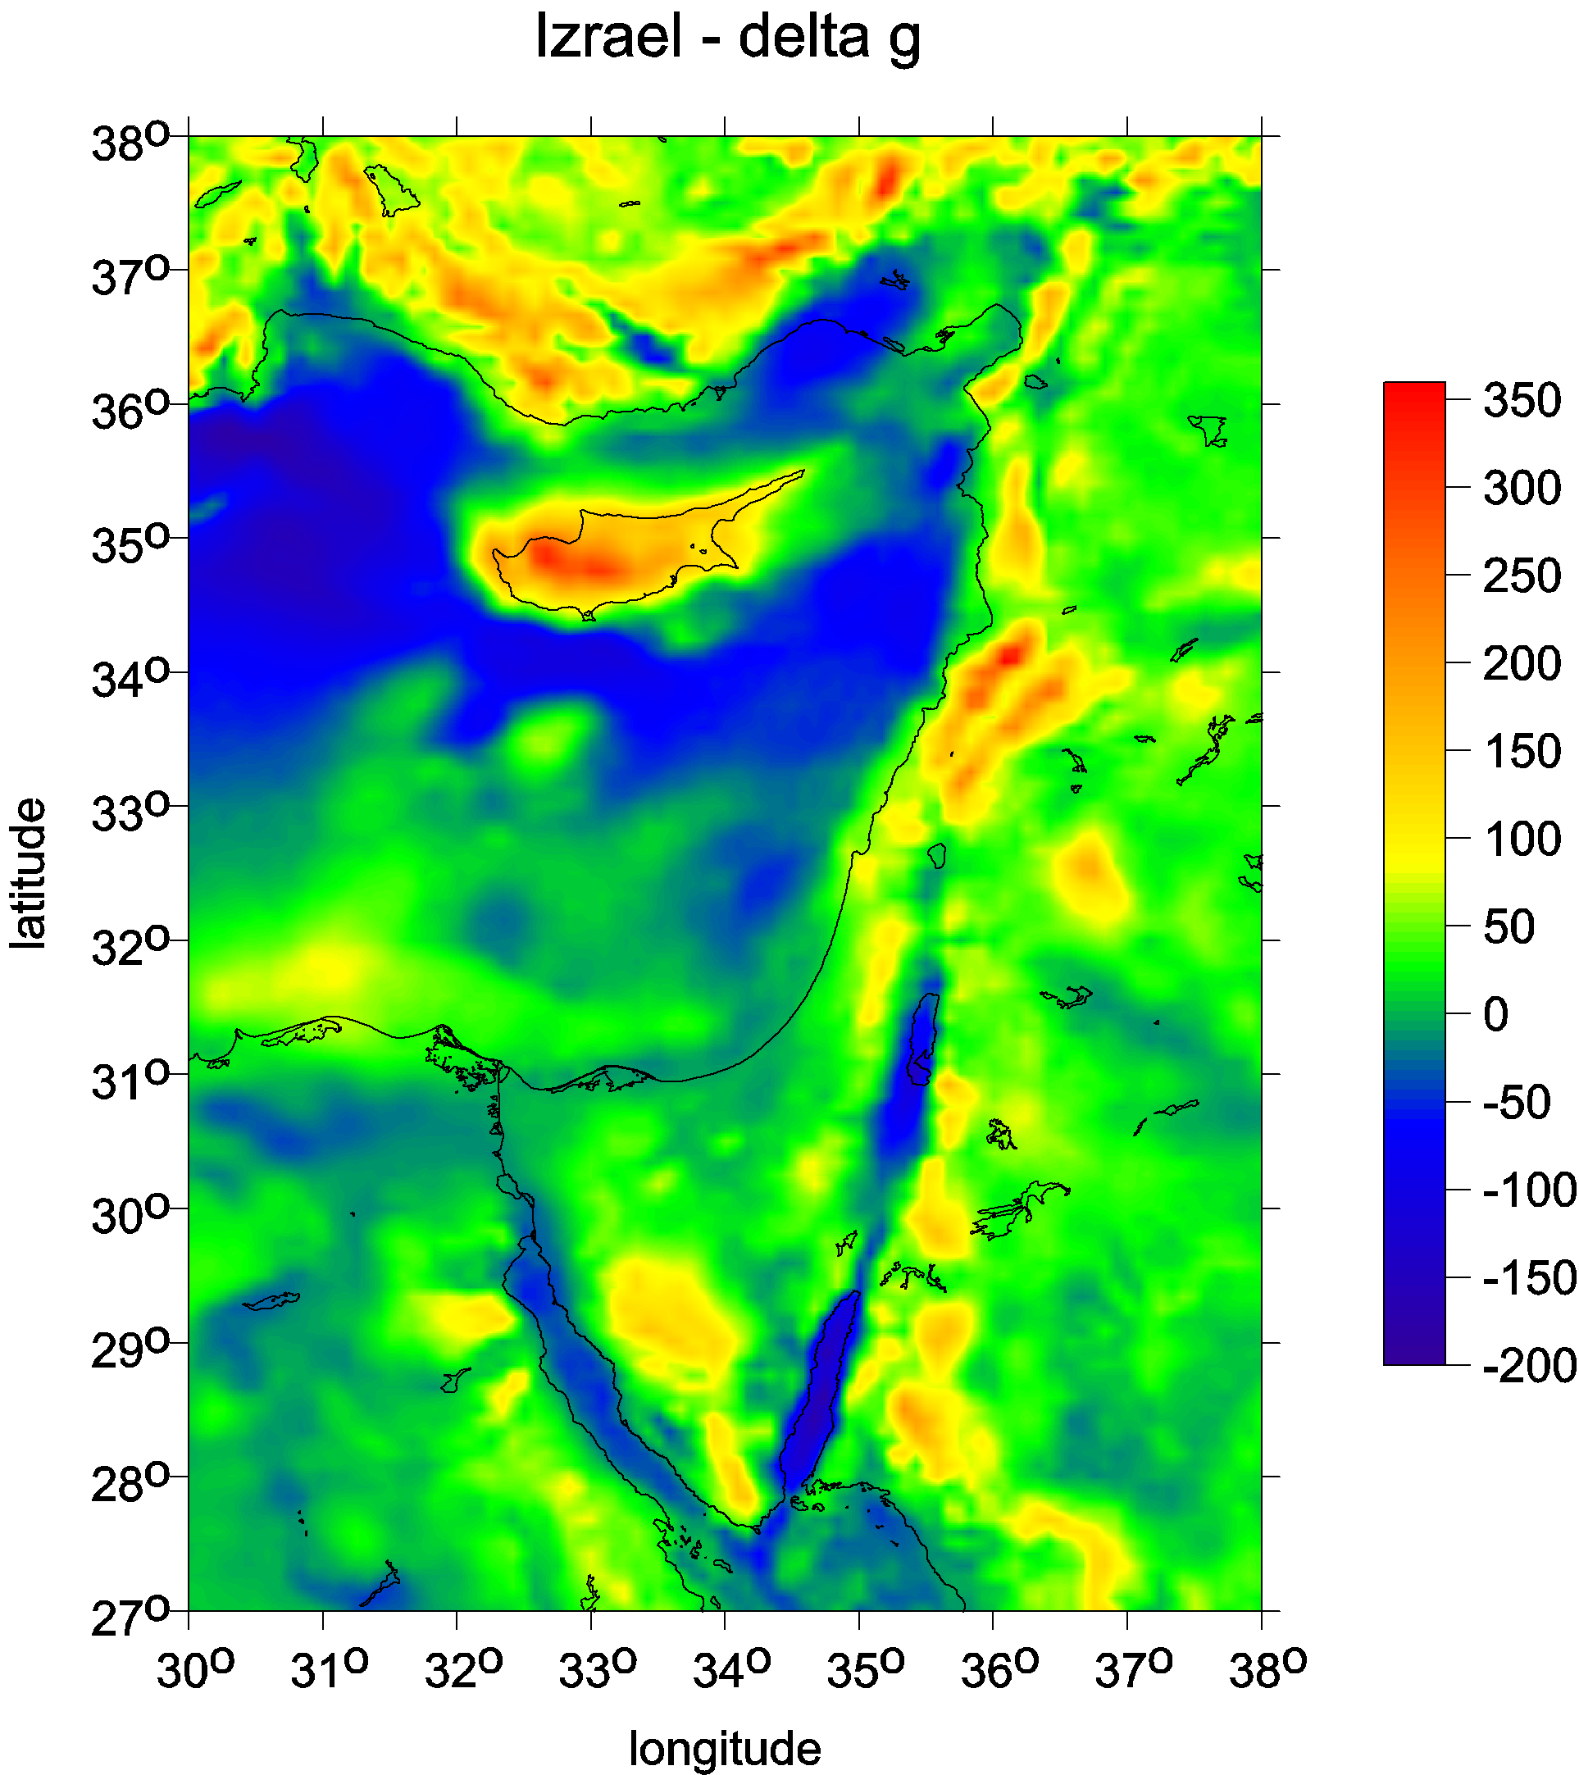
Gravity anomalies ∆g
in miliGals [mGal]

Slide 12
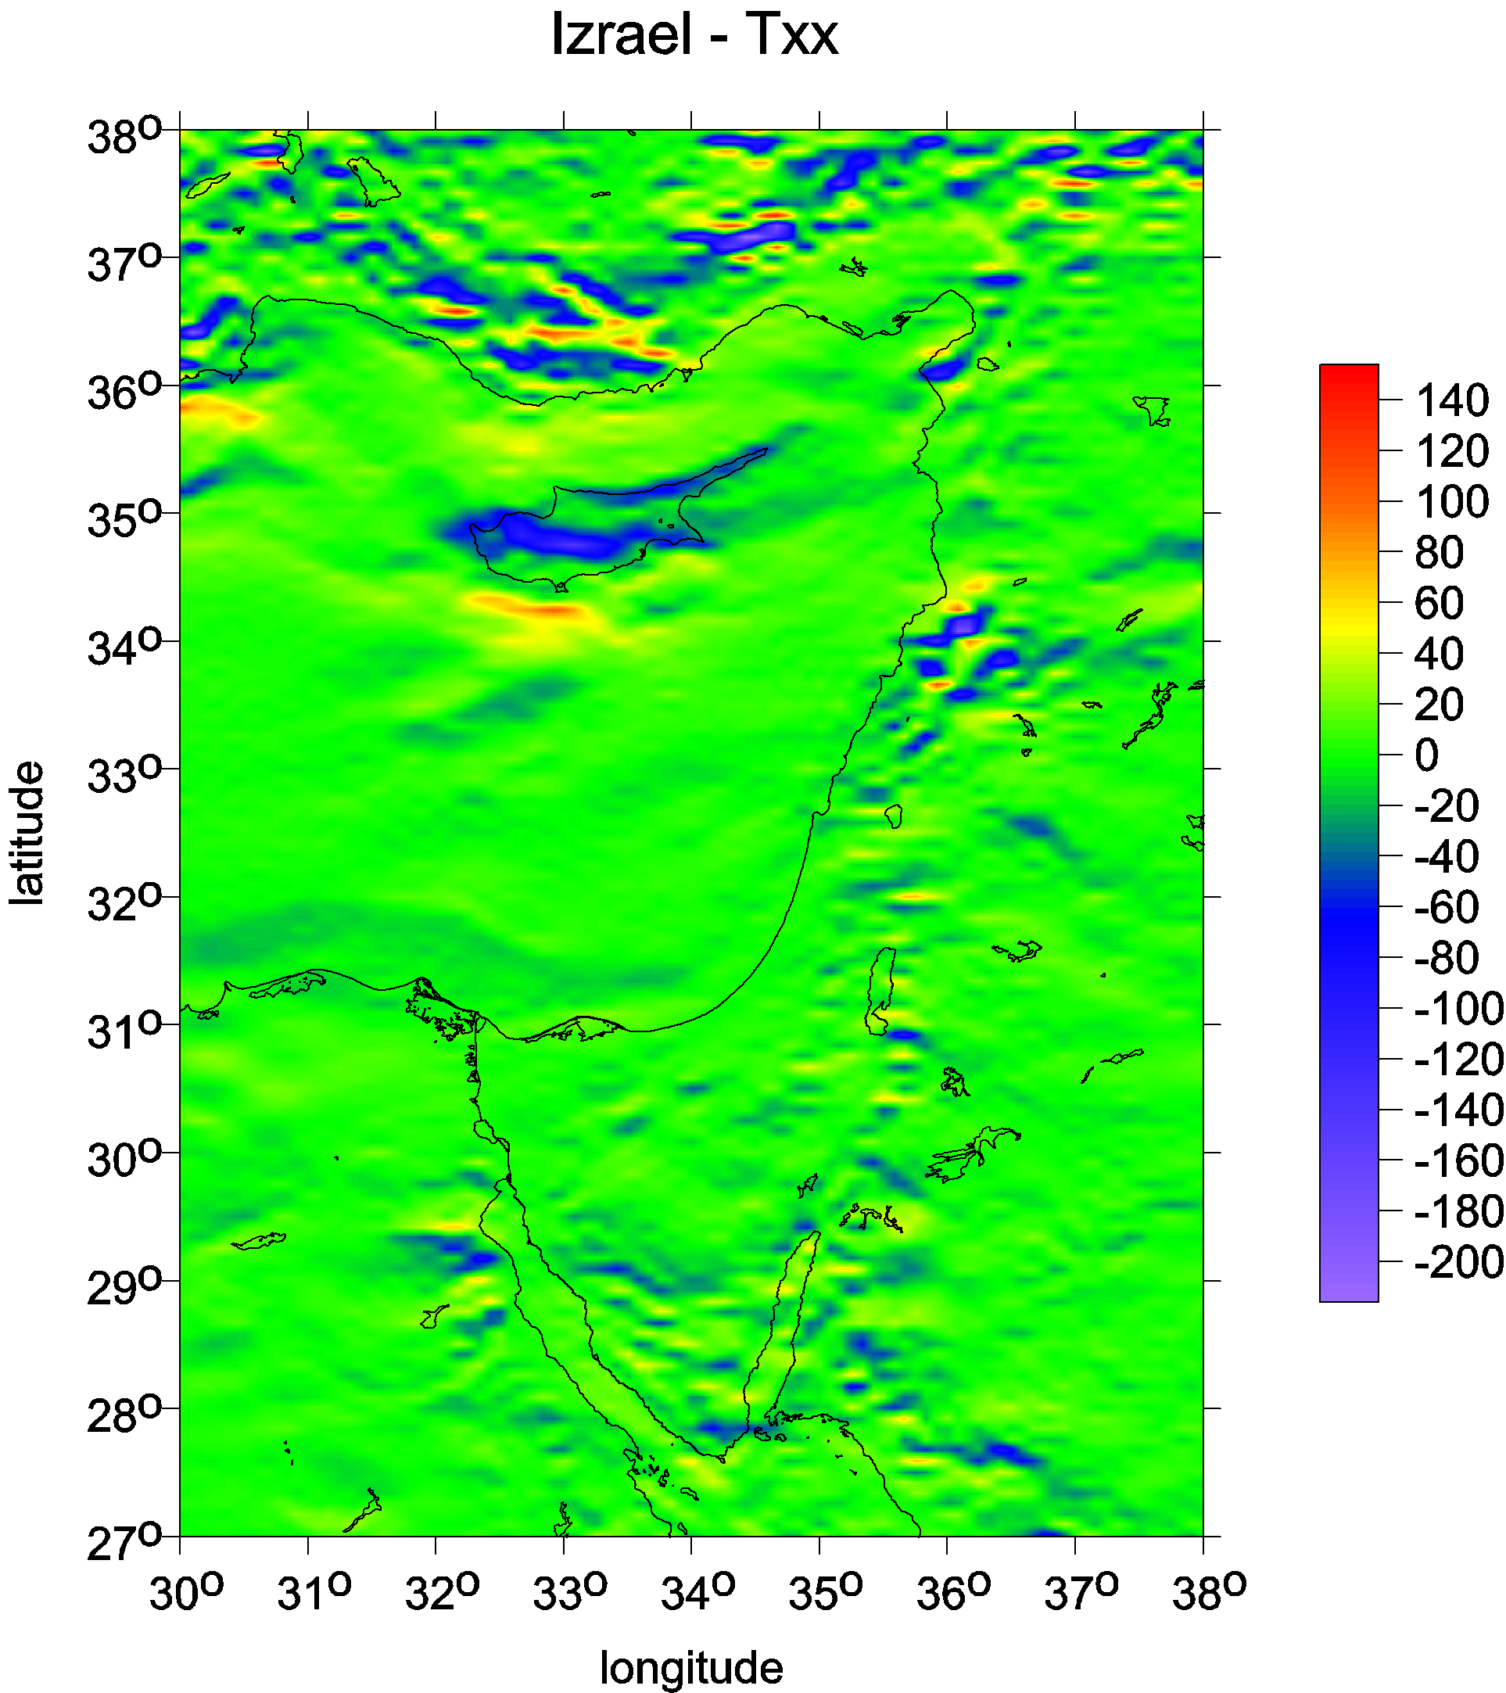
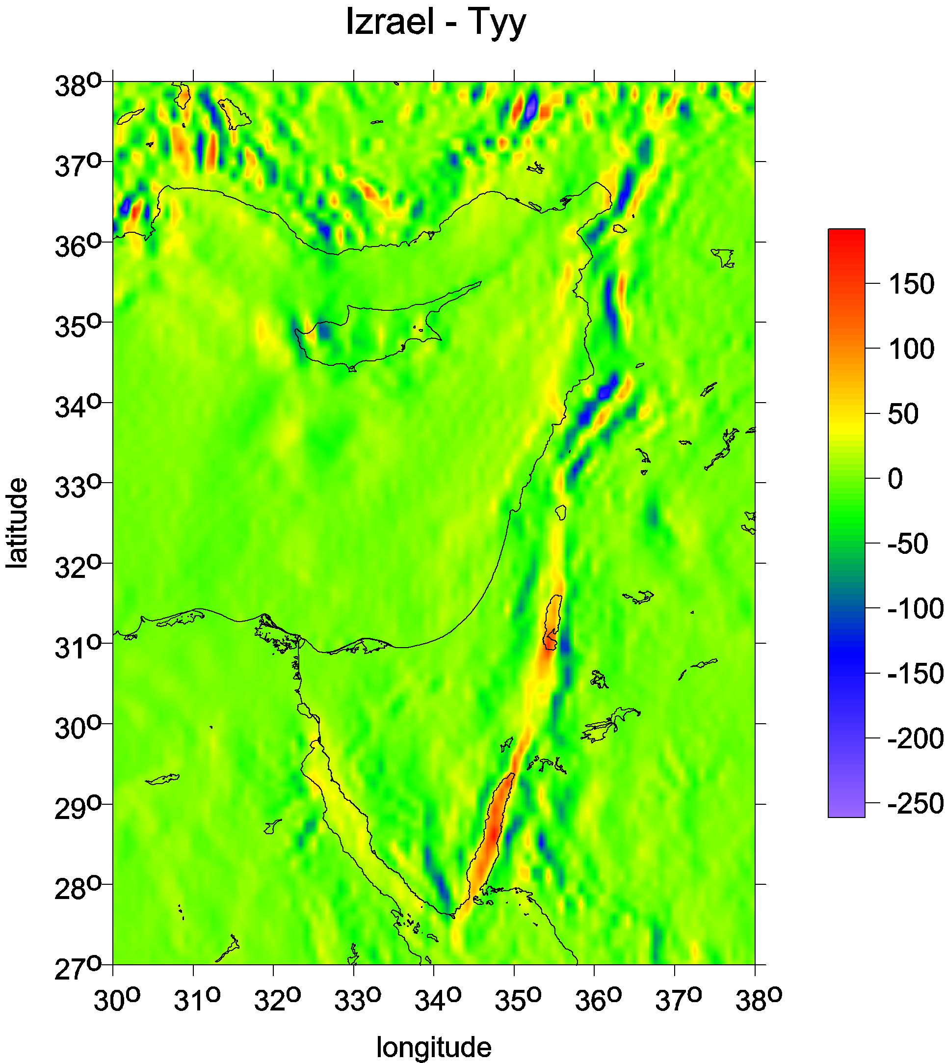
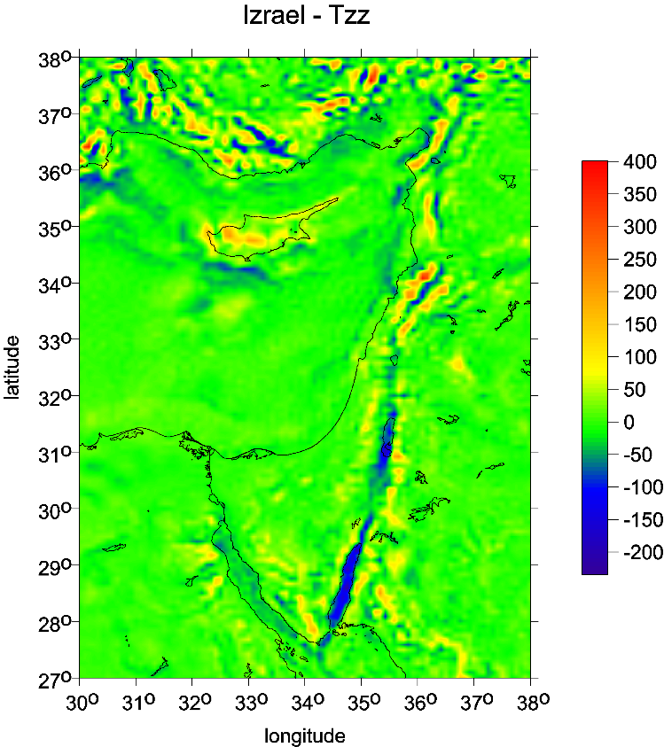
Main diagonal terms
of the Marussi tensor
in Eötvös [E]
T_{xx}
T_{yy}
T_{zz}
North is up

Slide 13
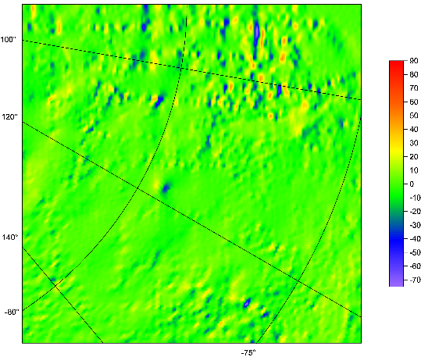
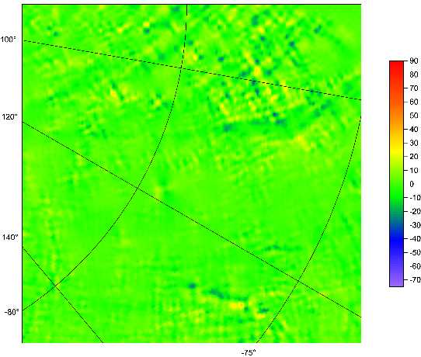
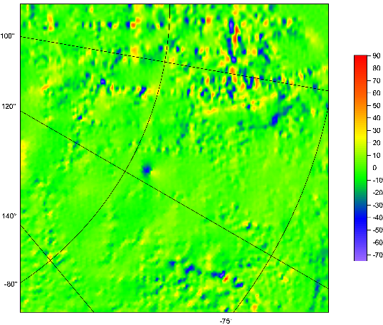
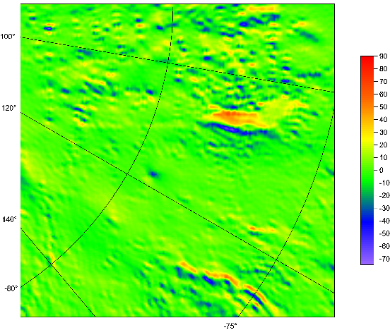
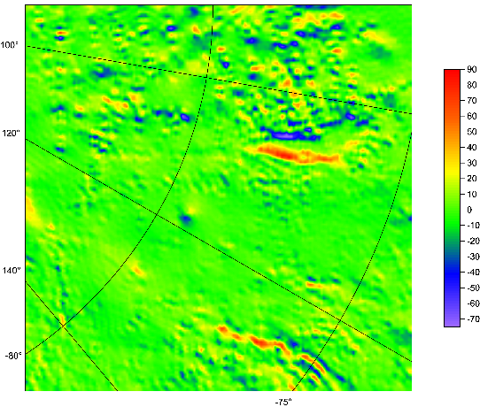
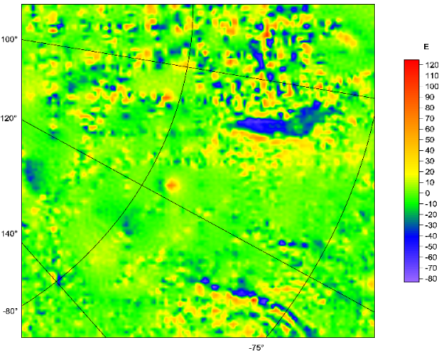
Lake Vostok
East Antarctica
complete Marussi tensor
of the second derivatives
T_{ij} [E]
organized as follows:
T_{xx} T_{xy} T_{xz}
T_{yy} T_{yz}
T_{zz}
North is right
West is up

Slide 14
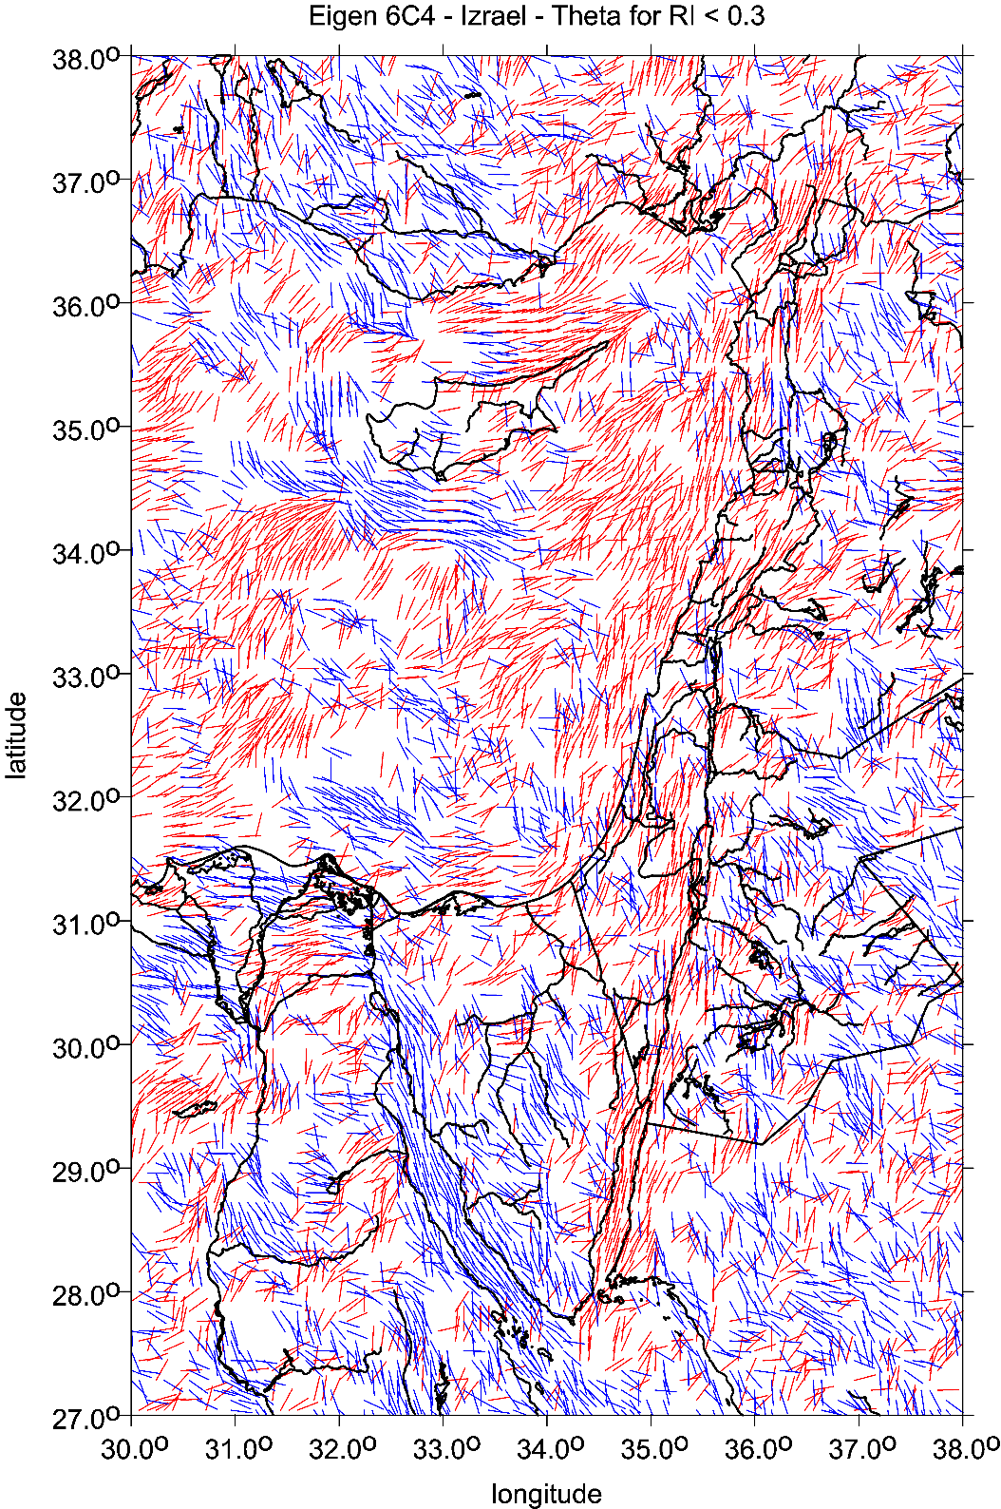
Strike angles
θ [deg]

Slide 15
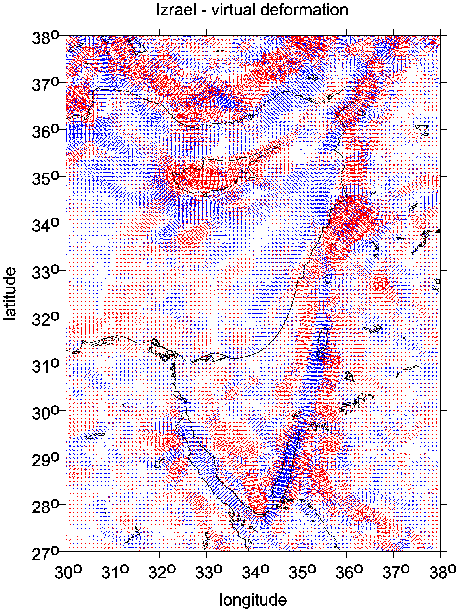
vd [-]
Red … dilatation
Blue compression

Slide 16
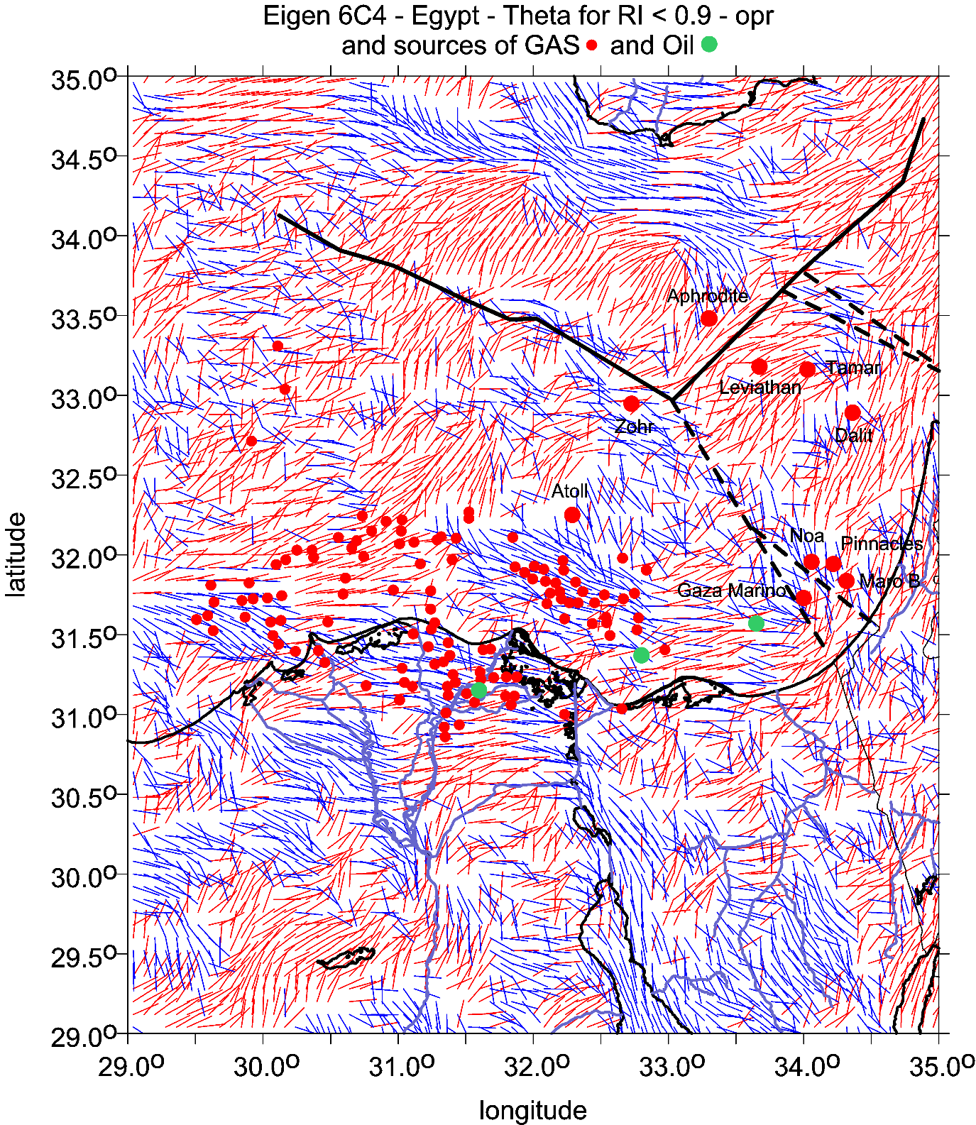
θ [deg]

Slide 17
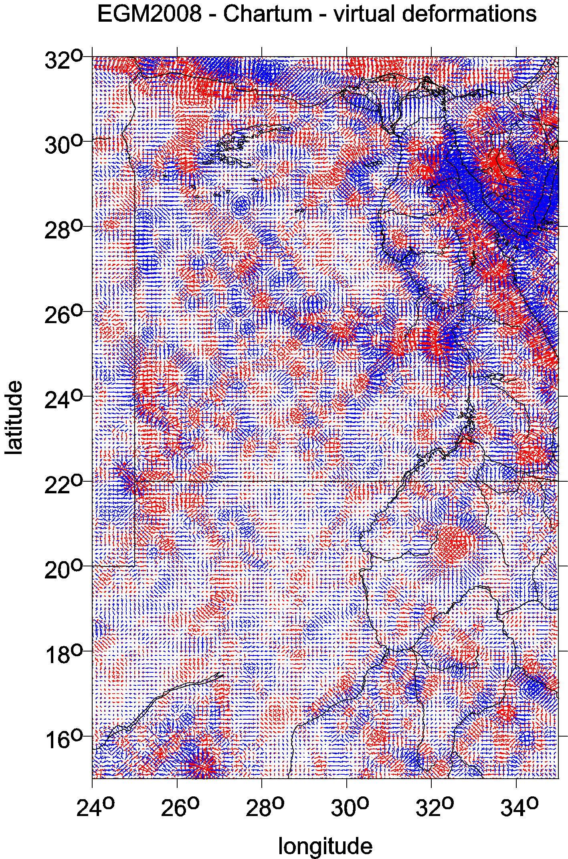
Few
examples
of virtual deformations
[-]
red… dilatation
blue …compression

Slide 18
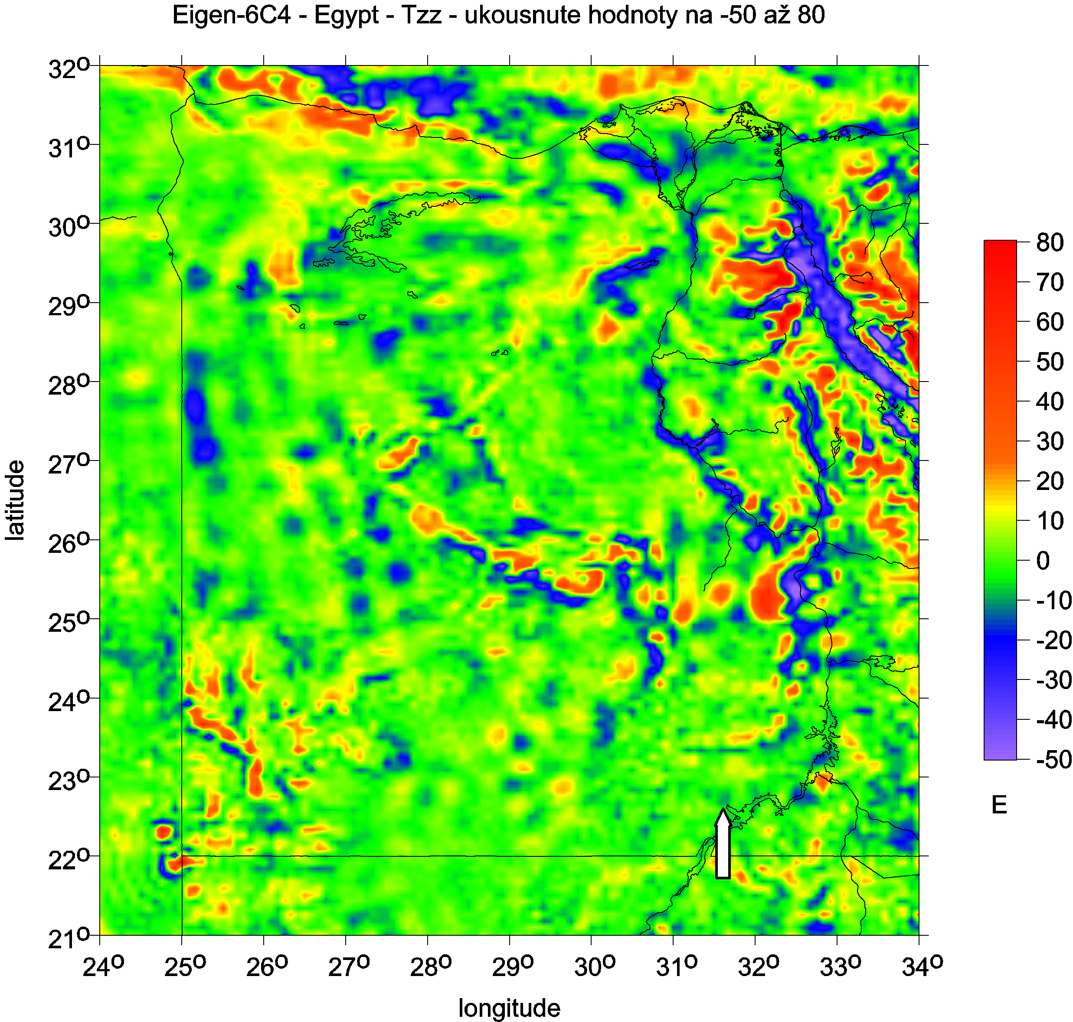
Egypt
Tzz [E]

Slide 19
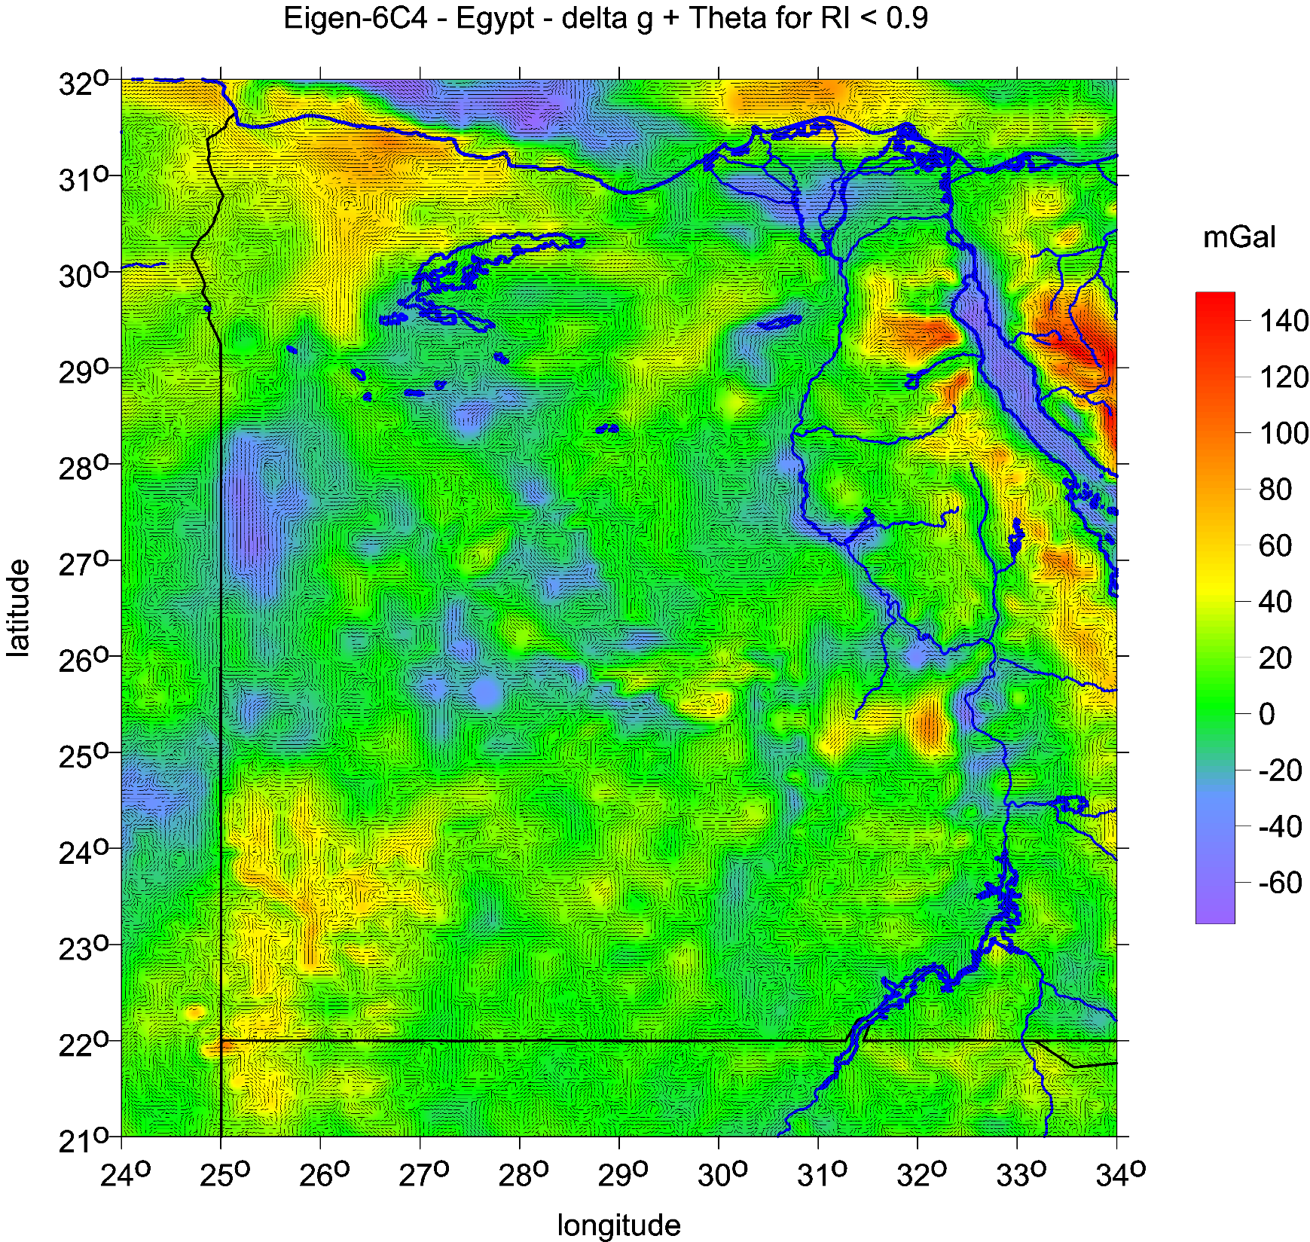
Egypt
θ
and Δg
western
Great Sand Sea
hypothetical
paleolake

Slide 20
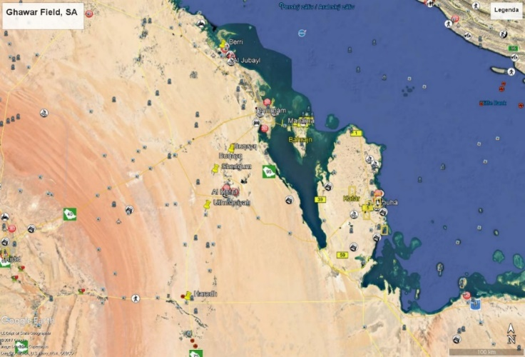
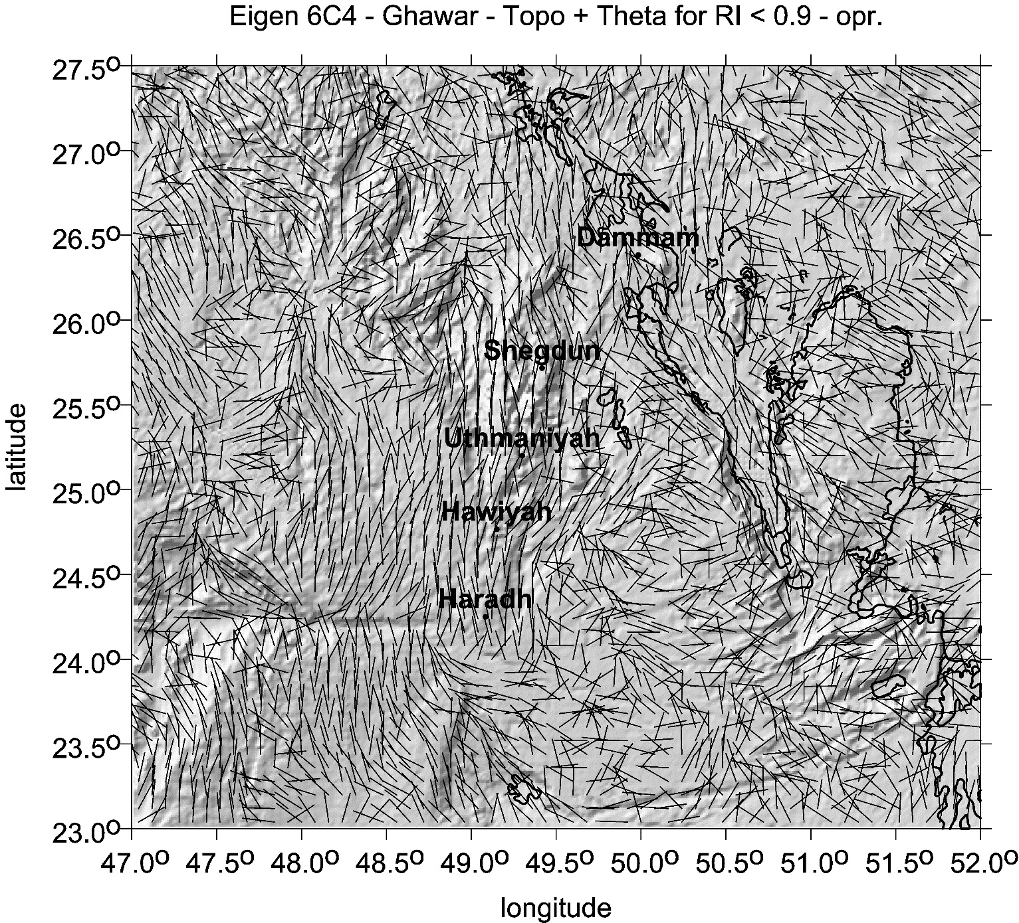
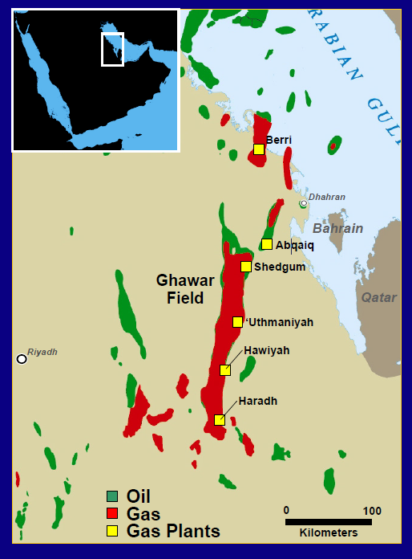
Ghawar
Saudi Arabia
combed strike angles
over oil/gas fields
everywhere EIGEN 6C4 used

Slide 21
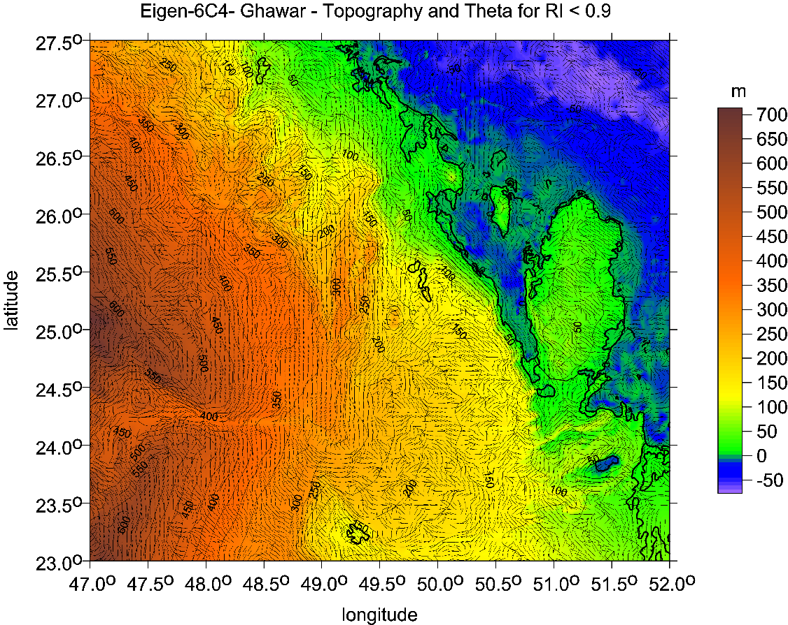
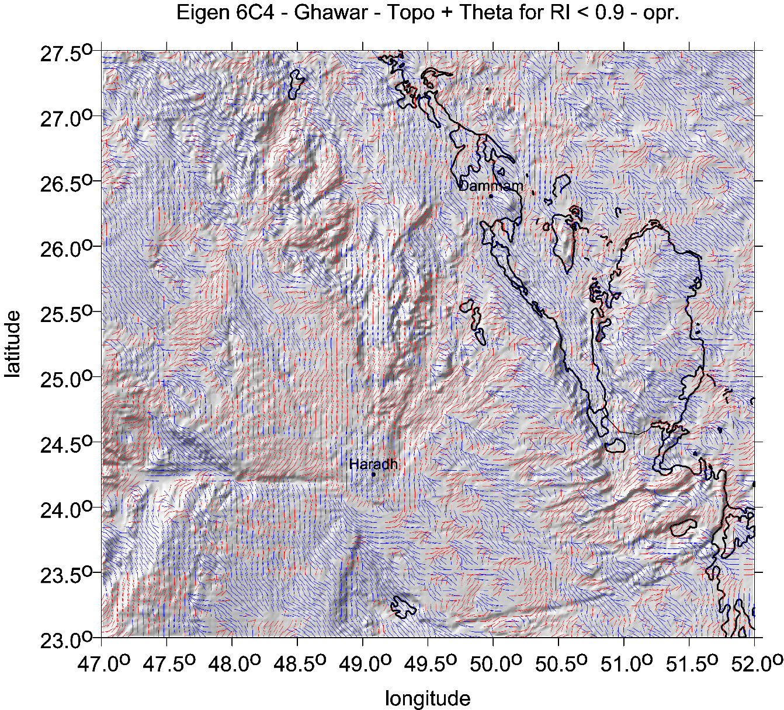
θ [deg]
[m]
blue colour
means direction to north of east
and red color
to east from south.

Slide 22
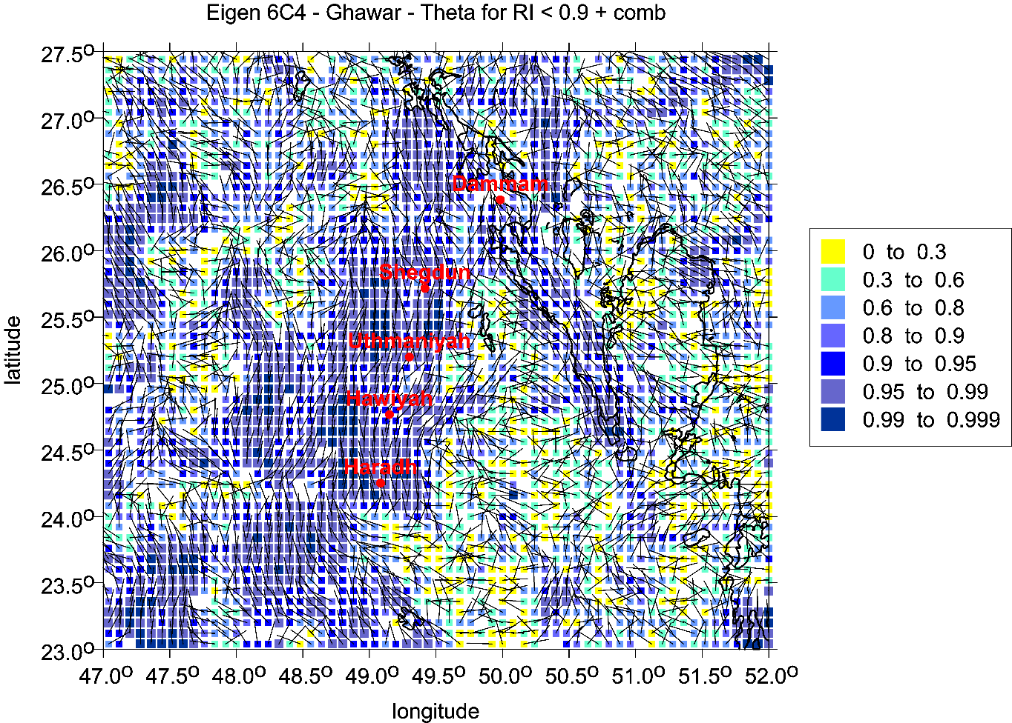
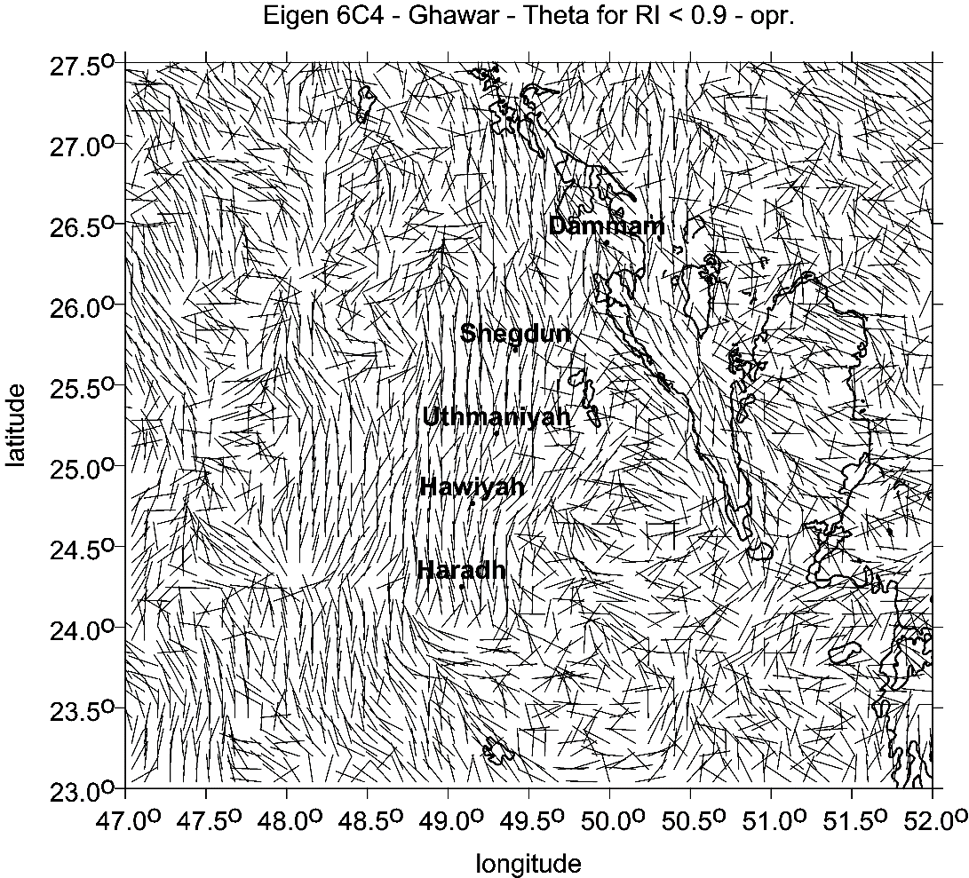
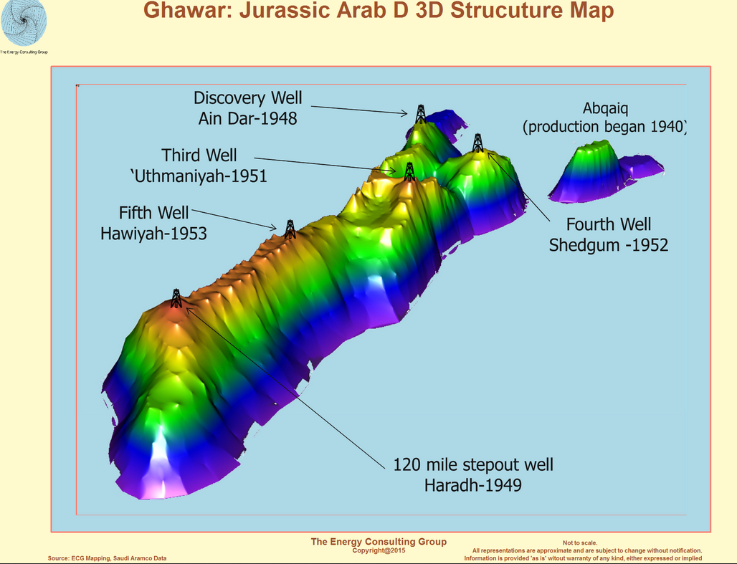
θ [deg]
Strike angles (b&w version)
and
he Comb factors <0,1>
(left bottom) Afifi and Aramco, Ghawar: The Anatomy of the World’s Largest Oil Fields

Slide 23
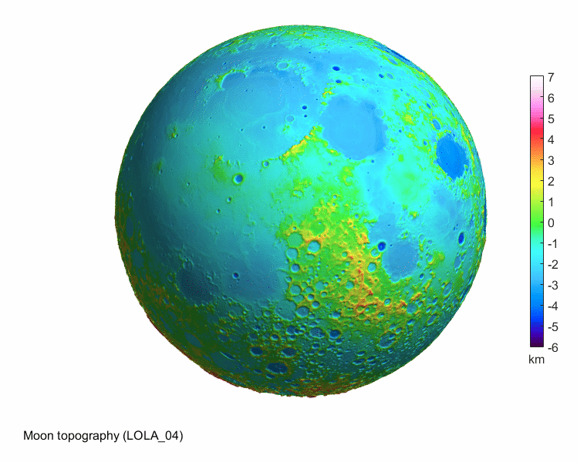
The Moon
The Moon

Slide 24
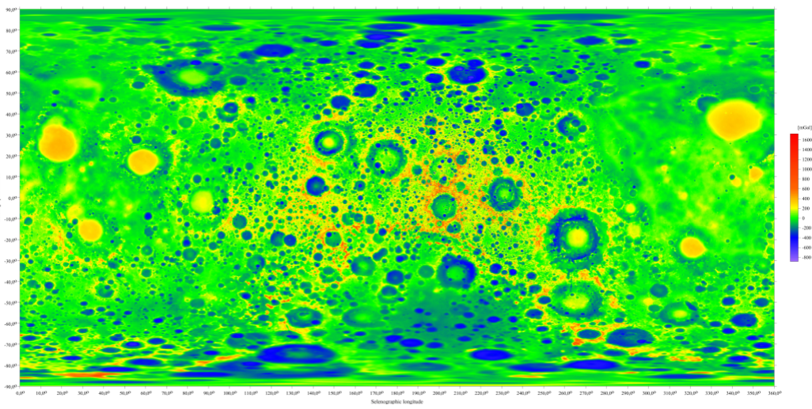
The Moon series
mGal
The gravity anomalies Δg [mGal] for the Moon
with GSFC NASA gravity model GRGM1200A (Lemoine et al 2014), cut at maximum d/o= 600.

Slide 25
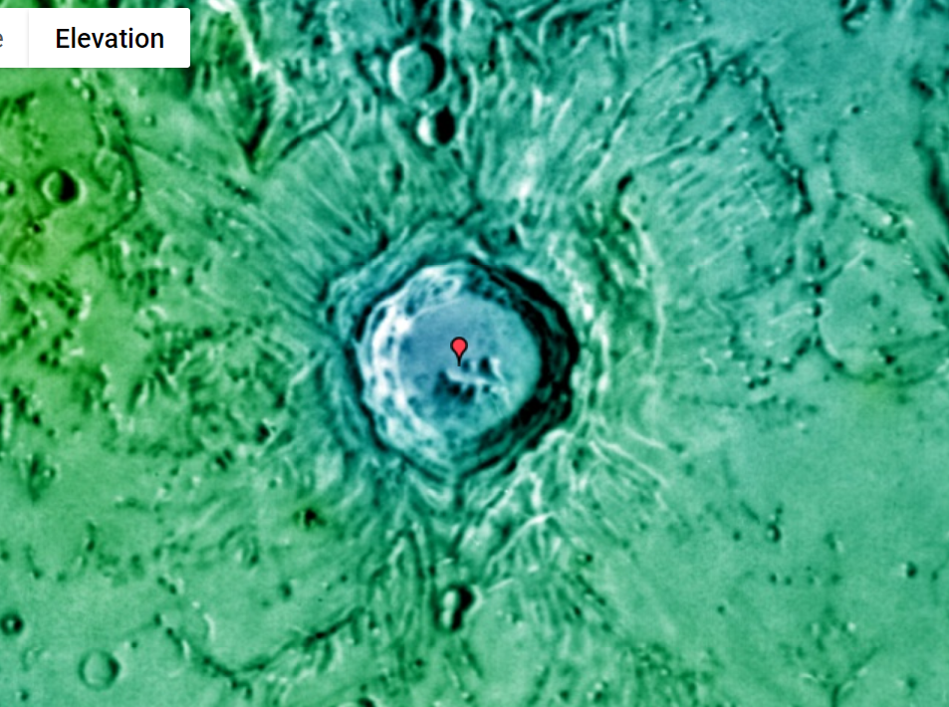
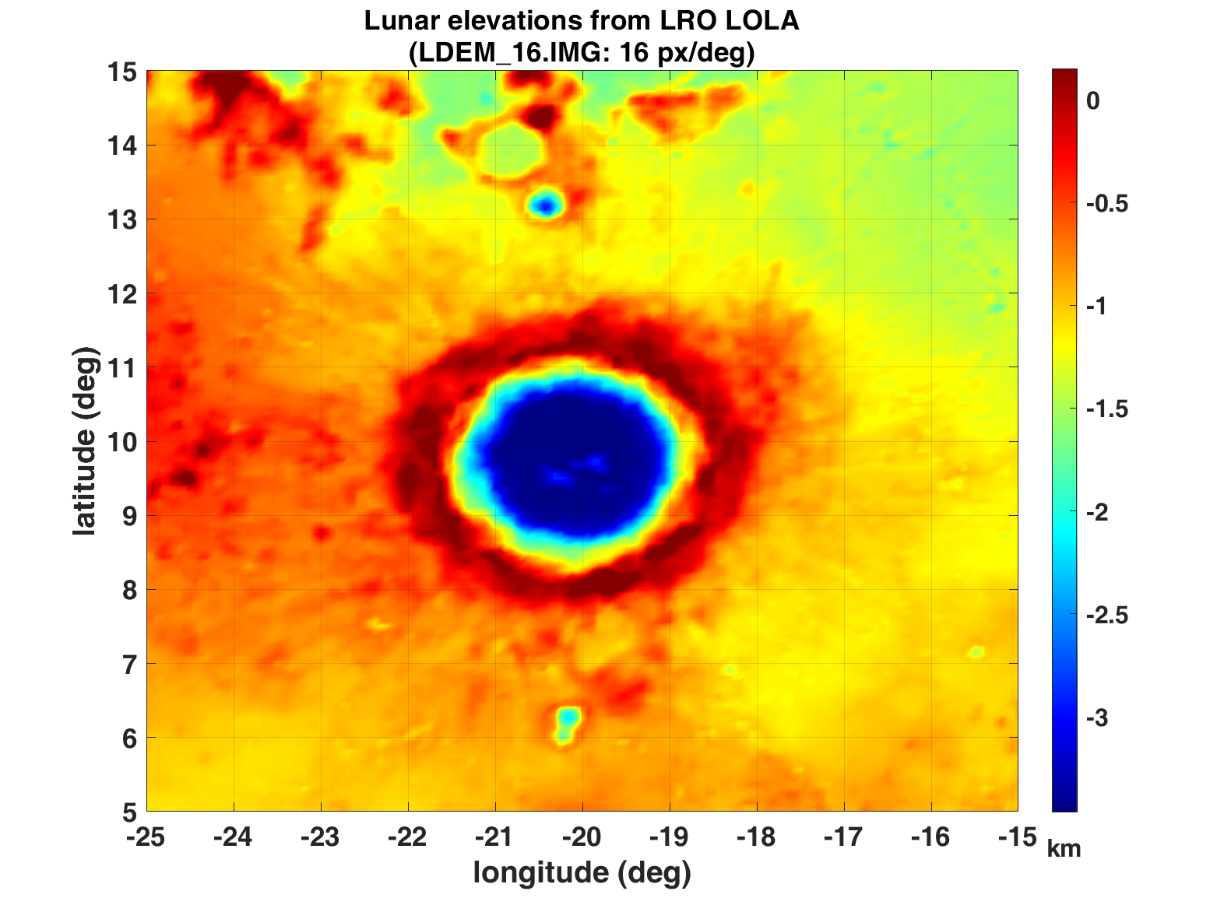
Copernicus topography
All the craters and maria:
Photo Google Moon,
our figures LRO LOLA
Figs. Supp. 8-19
series for Copernicus

Slide 26
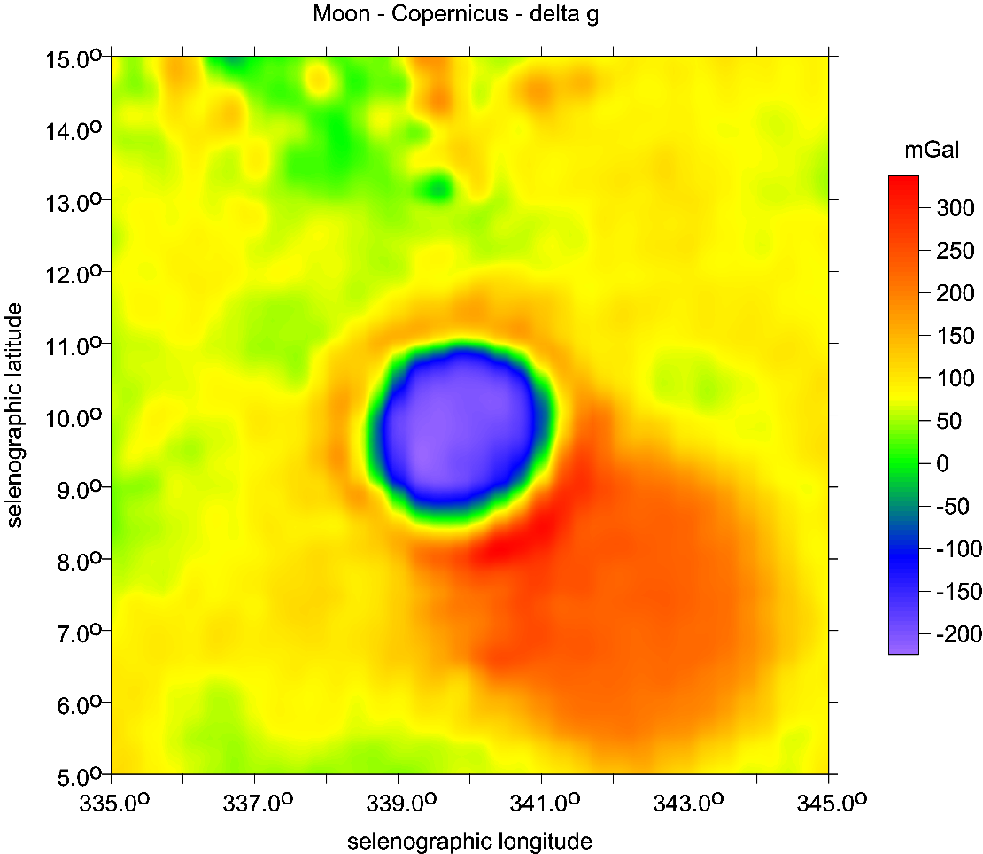
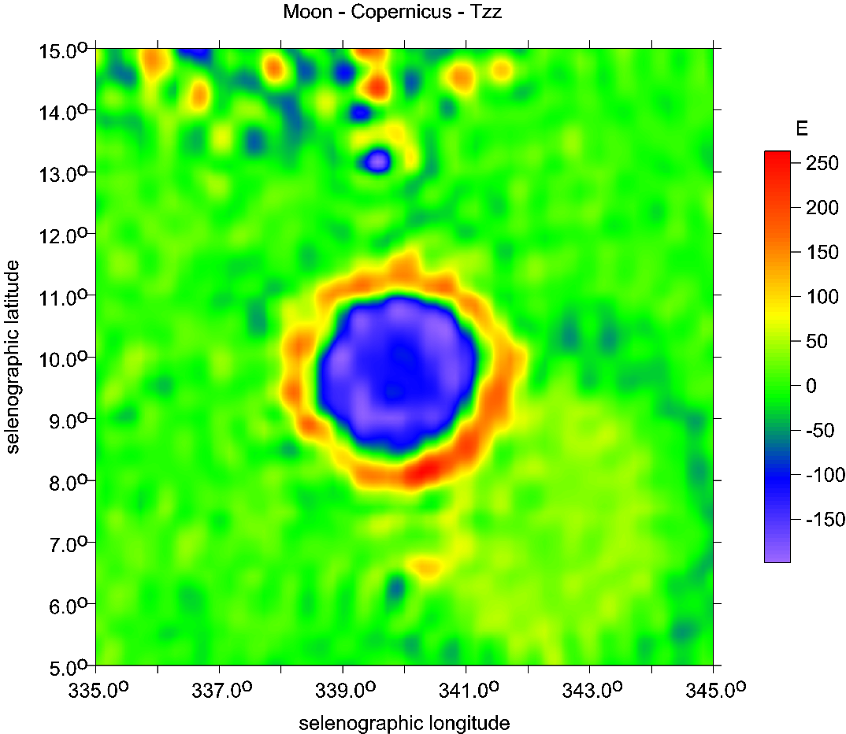
Copernicus main crater
and Copernicus H
older, bigger
in SE direction
∆g [mGal]
Tzz [E]

Slide 27
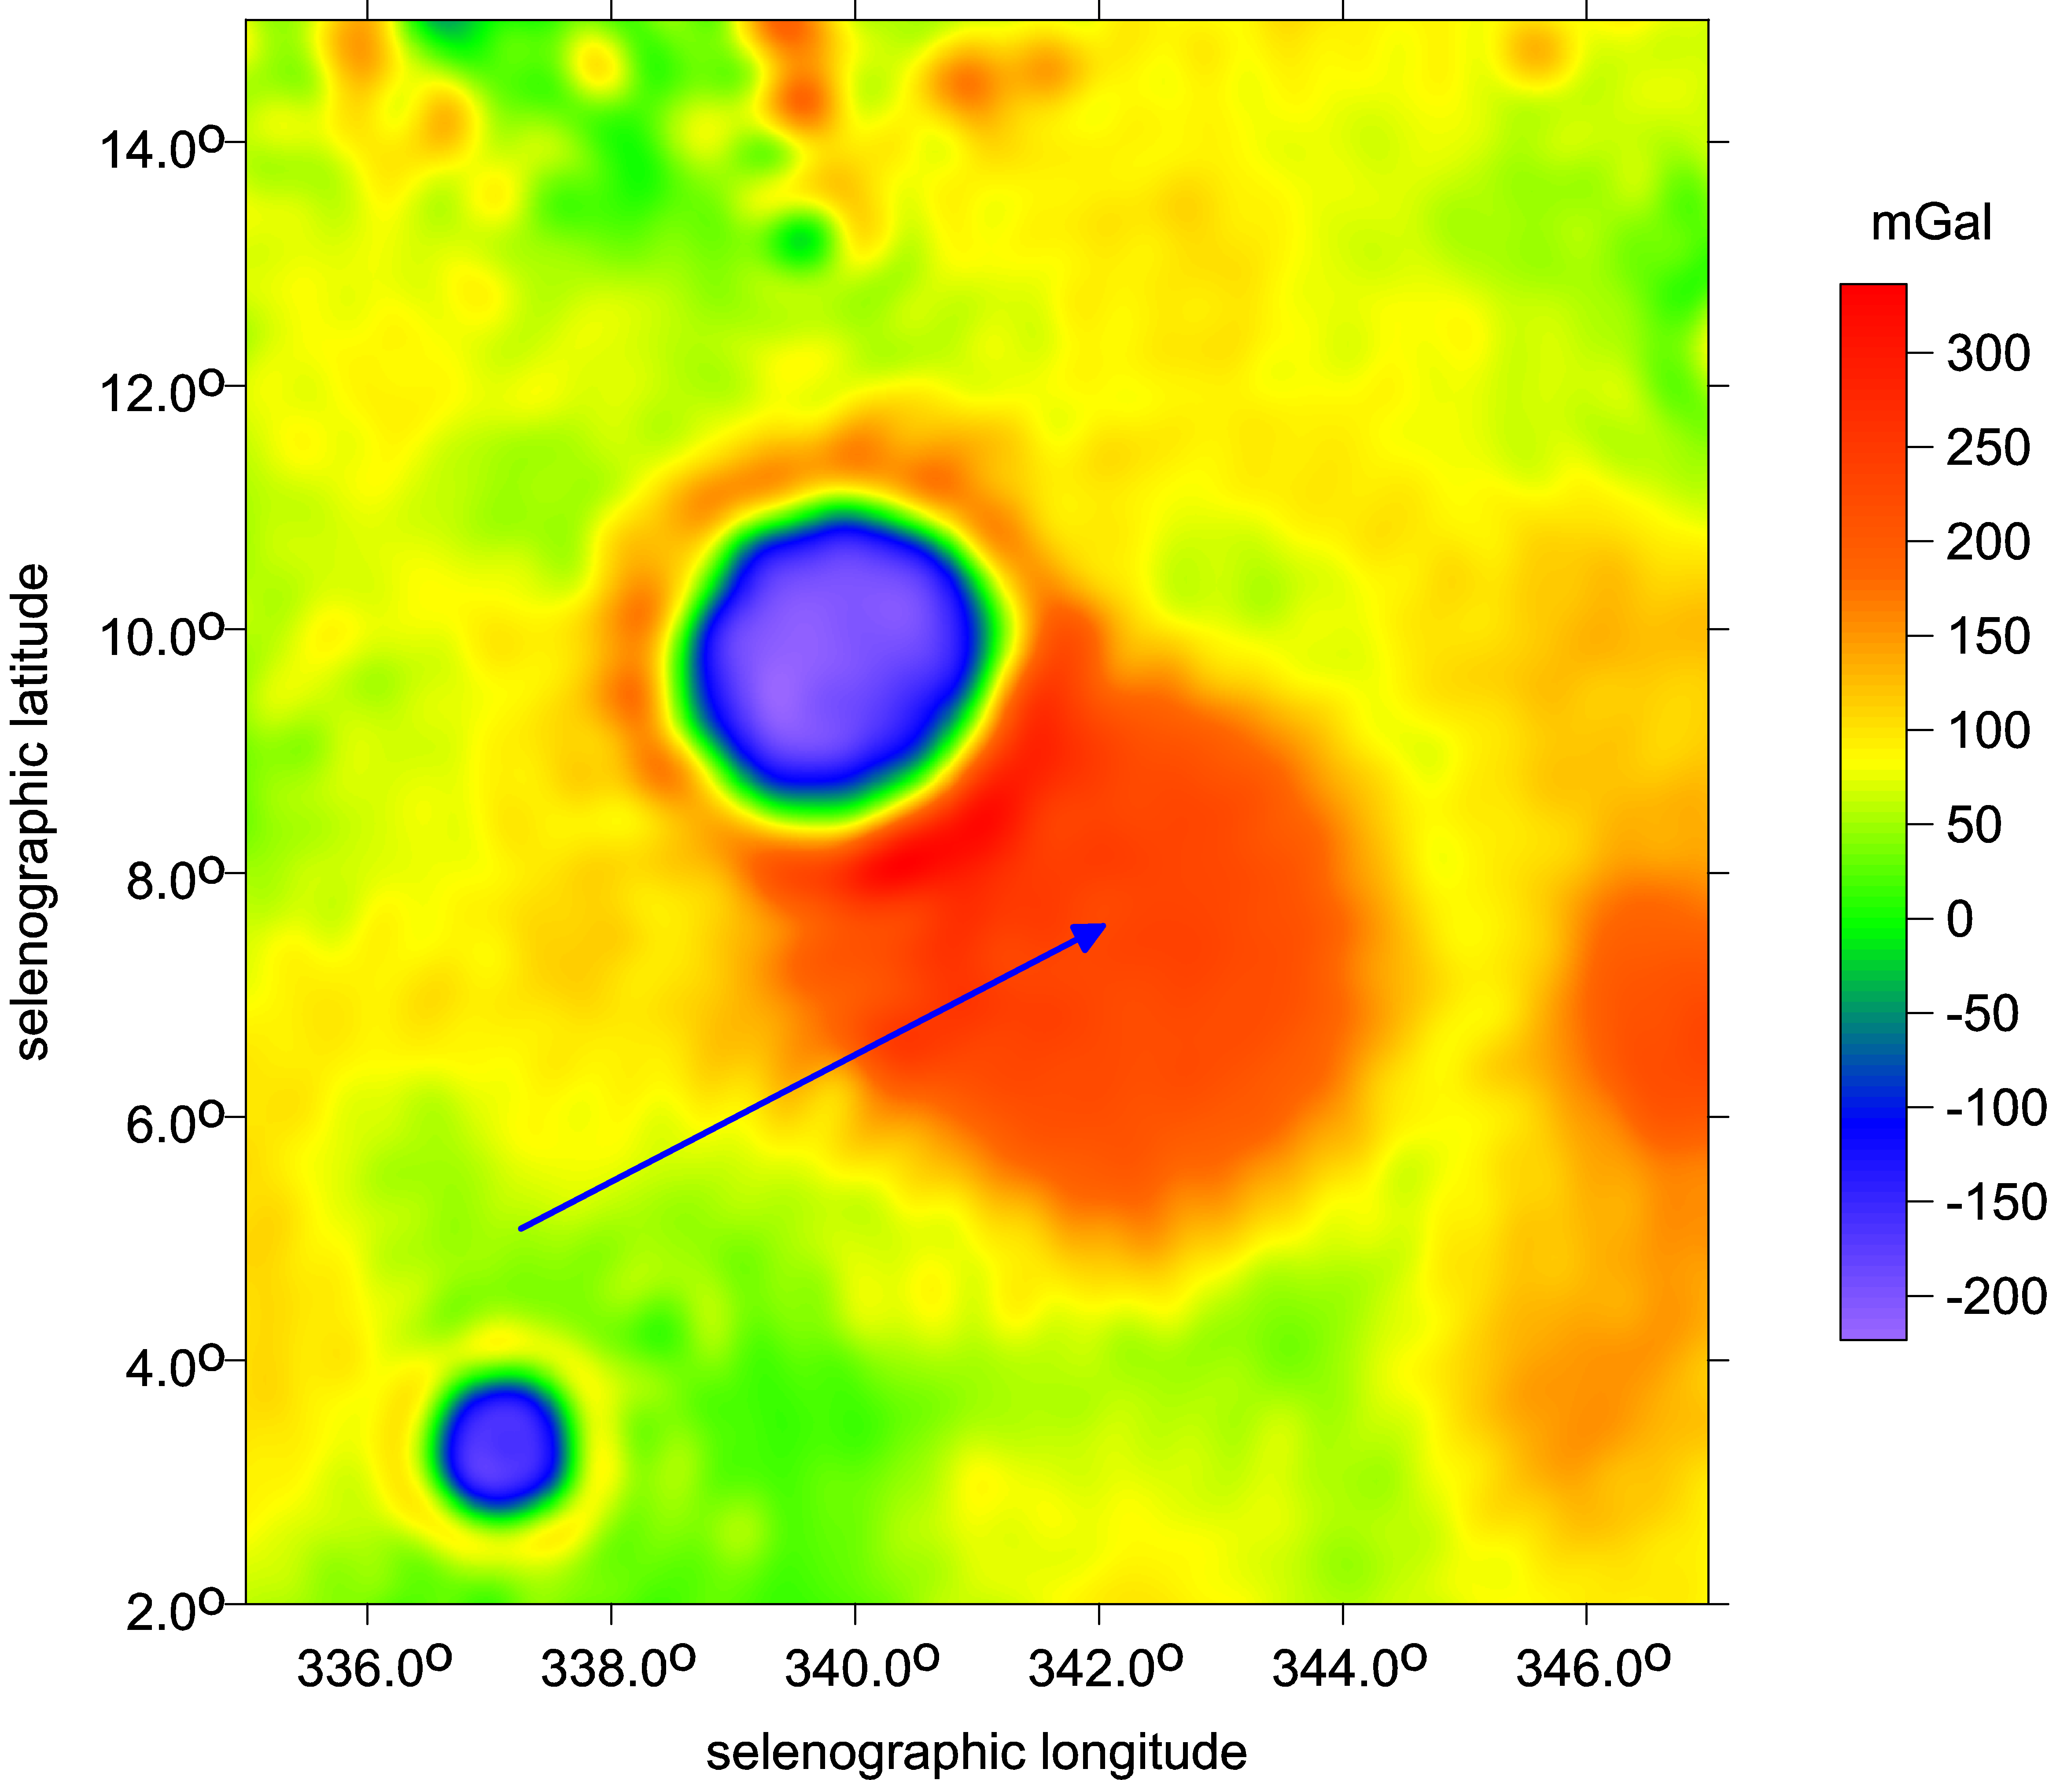
Copernicus and Copernicus H

Slide 28
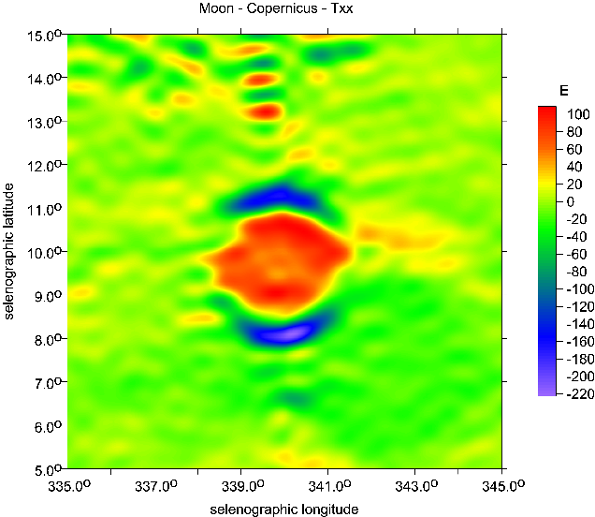
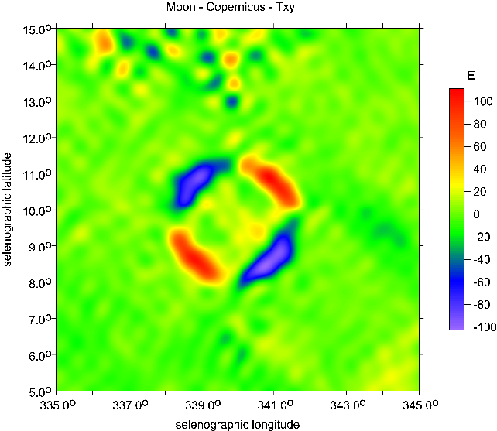
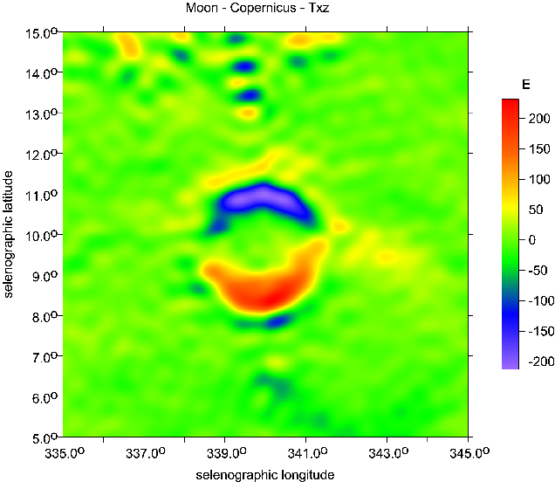
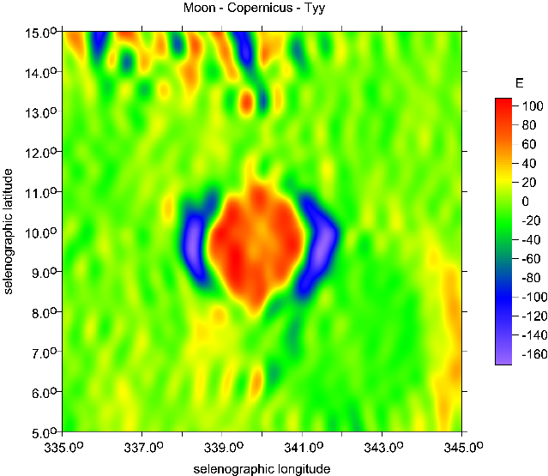
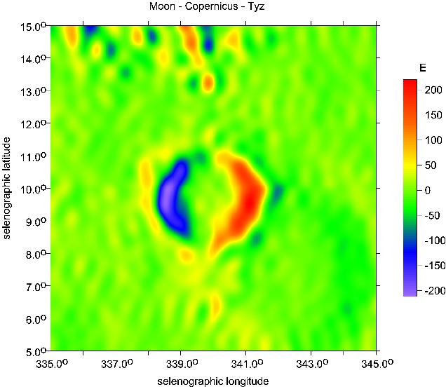

Fig. Supp. 11 Marussi tensor for Copernicus [E]

Slide 29
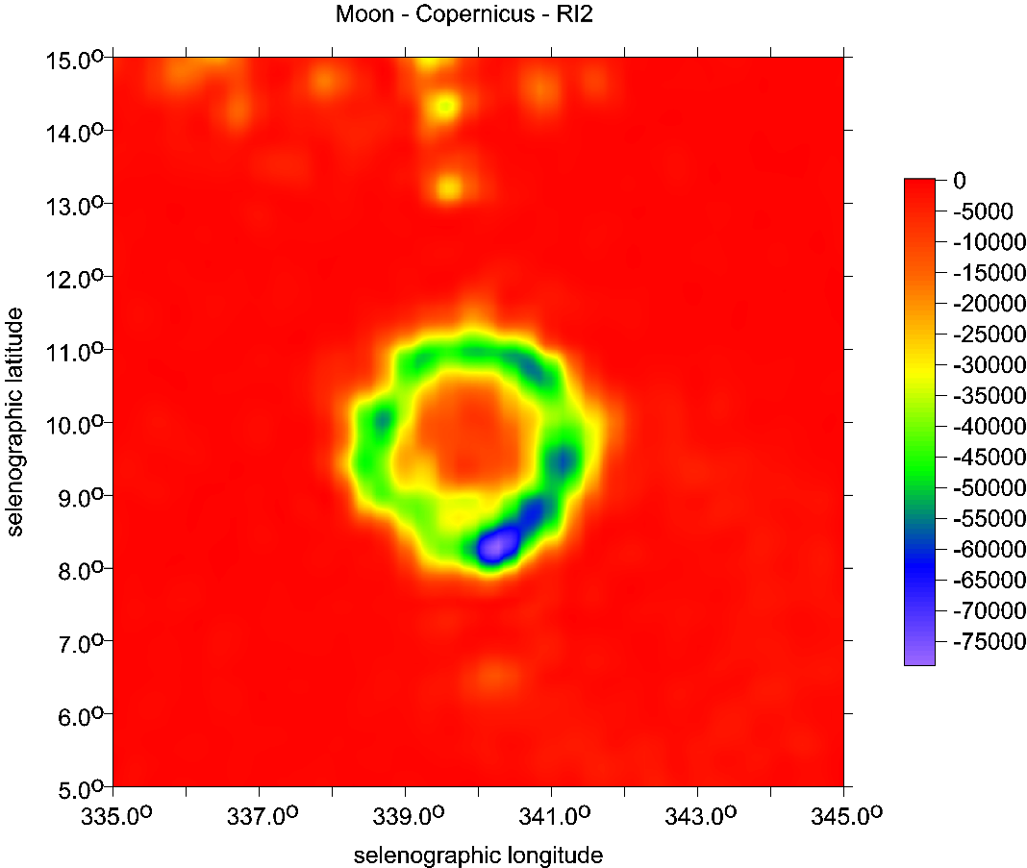

Copernicus
Figs. Supp. 12 a,b
the invariants
[s-4], s[-6]

Slide 30

Copernicus
strike angles
θ [deg]
and topography

Slide 31

vd [-]

Slide 32


Slide 33


Slide 36


Mare Crisium
topography
Figs. Supp. 44-49
series for Mare Crisium

Slide 37


Mare Crisium

Slide 38

Mare Crisium
Θ [deg]

Slide 39

Mare Crisium

Slide 40

The Moon, catena Michelson, strike angles
Catena Michelson near the crater Michelson, the far side of the Moon;
the LOLA topography [m] and the strike angles θ [⁰],
strongly combed along with the long axis of catena.

Slide 41


Slide 42

Mars
MOLA topography
[km]
click and rotate
(only in pptx version, © A. Bezděk)

Slide 43

Utopia Planitia right Olympus volcano, left down Isidis basin
∆g [mGal]
contour lines
MOLA [m]

Slide 44

Utopia Planitia right Olympus volcano, left down Isidis basin
Tzz[E]
contour lines
MOLA [m]

Slide 45

Utopia Planitia right Olympus volcano, left down Isidis basin,
typical signal for θ and vd -
comparison
strike angles [deg]
& contour lines
MOLA [m]

Slide 46

Utopia Planitia right Olympus volcano, left down Isidis basin,
typical signal for θ and vd -
comparison
virt. def.
[-]
& contour lines
MOLA [m]

Slide 47

Utopia Planitia right Olympus volcano, left down Isidis basin,
typical signal for θ and vd
Comb of
strike angles
contour lines
MOLA [m]

Slide 48
the End of S3

