Slide 1
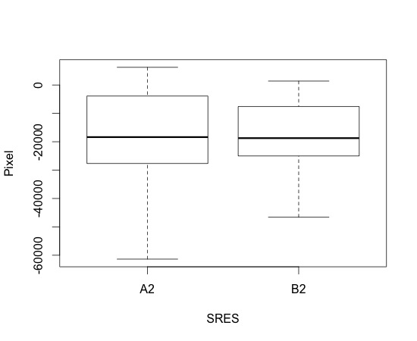
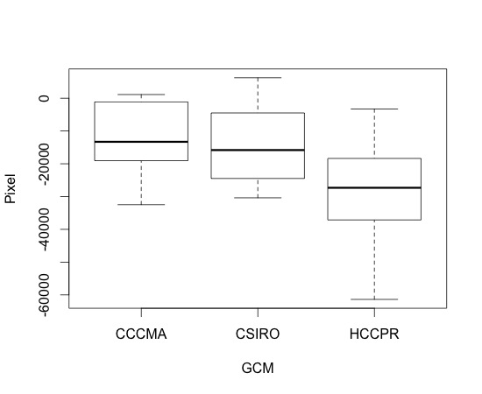
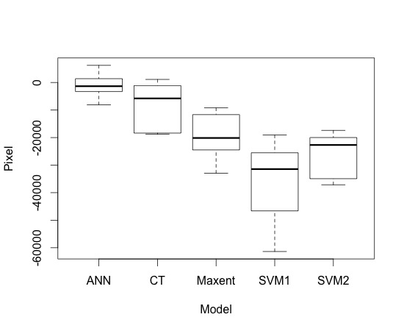
(a)
(b)
(c)
Fig S2. One-way ANOVA using raw data (change in pixel in 2080) to compare differences in individual model forecasts due to differences in (a) CO₂ emission scenarios (SRES), (b) climate models (GCM) and (c) modelling methods. There was no significant difference between projections under different CO₂ emission scenarios [F_{(1,28)}=0,01, p=0,945). The difference between projections based on different GCMs [F_{(2,27)}=3,87, p=0,033) and different modelling methods [F_{(4,25)}=12, p<0,001) were significant, but all individual models were showing the same trend . The analysis was conducted using R software version 2.12.2.
Article title: Global warming may freeze the invasion of big-headed ants.
Authors: Cleo Bertelsmeier, Gloria M. Luque, Franck Courchamp
Affilation: Ecologie, Systématique & Evolution, UMR CNRS 8079, Univ. Paris Sud, Orsay Cedex 91405, France.
Corresponding author: Cleo Bertelsmeier. Email: cleo.bertelsmeier@u-psud.fr

