Slide 1
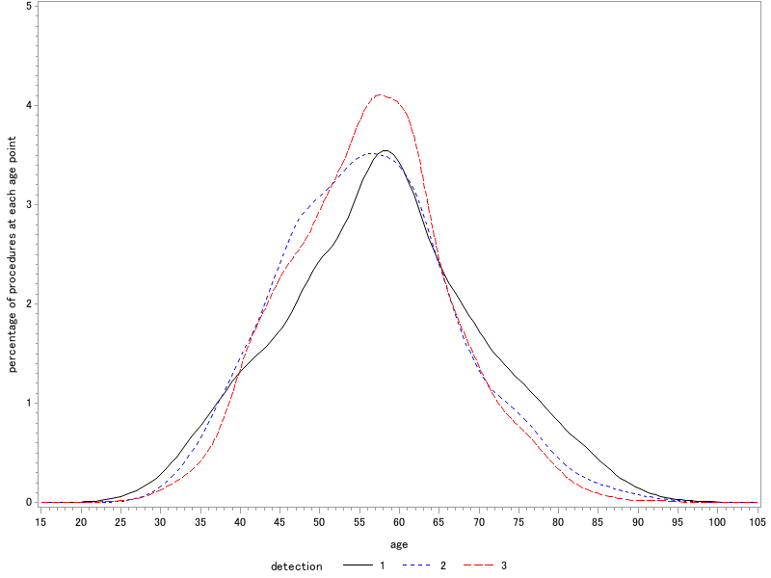
Supplementary Figure 2
: Self detection
: Screening (symptomatic)
: Screening (Asymptomatic)

