Slide 1
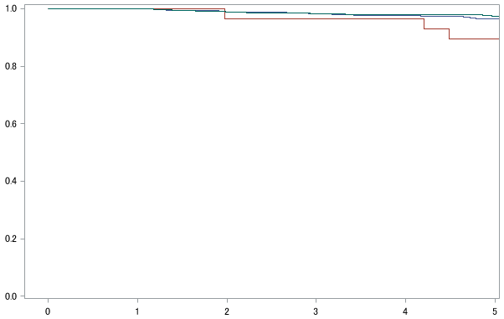
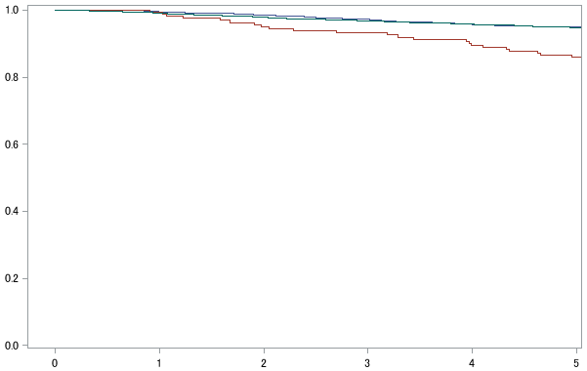
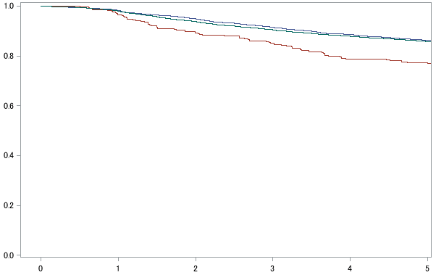
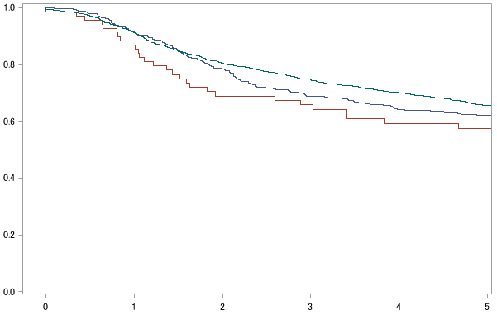
(A) Stage 0 (n=2,357)
(B) Stage I (n=8,892)
Disease-free survival
Disease-free survival
> 50 years old
> 50 years old
35-50 years old
35-50 years old
<35 years old
P=0.053
<35 years old
P<0.001
Time after surgery (years)
Time after surgery (years)
(C) Stage II (n=10,536)
(D) Stage III (n=2,027)
Disease-free survival
Disease-free survival
> 50 years old
> 50 years old
35-50 years old
35-50 years old
<35 years old
<35 years old
P<0.001
P=0.121
Time after surgery (years)
Time after surgery (years)
Notes:
Sup. Figure 1

