Slide 1
Supplementary Fig. S1 Completion of planned treatment for patients in group B1 (a) and group B2 (b).
a
Eribulin
1.4 mg/m²
FEC: 4 patients
AC: 6 patients
Cyclophosphamide
600 mg/m²
3 patients
Surgery
(n = 2)
Discontinued
(n = 1)
1 patient
FEC or AC
1 cycle (n = 1)
Surgery
(n = 1)
9 patients
FEC or AC (n = 9)
1 cycle → discontinued (n = 1)
3 cycles → surgery (n = 2)
4 cycles → surgery (n = 5), discontinued (n = 1)
Surgery
(n = 7)
Discontinued (n = 2)
1 patient
Surgery
(n = 1)
13 patients
Surgery
(n = 12)
FEC or AC (n = 1)
4 cycles
Surgery
(n = 1)

Slide 2
b
Eribulin
1.4 mg/m²
Capecitabine
2000 mg/m²
FEC: 5 patients
AC: 6 patients
1 patient
Discontinued
(n = 1)
2 patients
FEC or AC
2 cycles (n = 1)
4 cycles (n = 1)
Surgery
(n = 2)
9 patients
FEC or AC (n = 9)
1 cycle → surgery (n = 1), discontinued (n = 1)
4 cycles → surgery (n = 7)
Surgery
(n = 8)
Discontinued
(n = 1)
15 patients
Surgery
(n = 15)
AC, doxorubicin–cyclophosphamide regimen; FEC, 5-fluorouracil–epirubicin–cyclophosphamide regimen.

Slide 3
Supplementary Fig. S2 Waterfall plots showing change in tumor size (from the start of the anthracycline-based regimen to completion of neoadjuvant chemotherapy) in patients in group A1 (n = 12) and group A2 (n = 14) for whom data were available.
Group A1
Group A2
40
20
CR
PR
0
PR
SD
SD
NE
-20
Change in tumor size (%)
(from the start of anthracycline-based regimen)
-40
-60
-80
-100
Data from patients with tumor size 0 mm (–100%) before the start of FEC or AC (group A1 n = 9; group A2 n = 6) and data unavailable at the start of anthracycline-based regimen (n = 1 each in groups A1 and A2) or at completion of neoadjuvant chemotherapy (n = 1 each in groups A1 and A2) are not included. In group A2, 1 patient was classified as not evaluable (NE) because, although the target lesion disappeared, the target lesion lymph node was located outside the imaging area and could not be measured.
CR, complete response; NE, not evaluable; PR, partial response; PD, progressive disease; SD, stable disease.

Slide 4
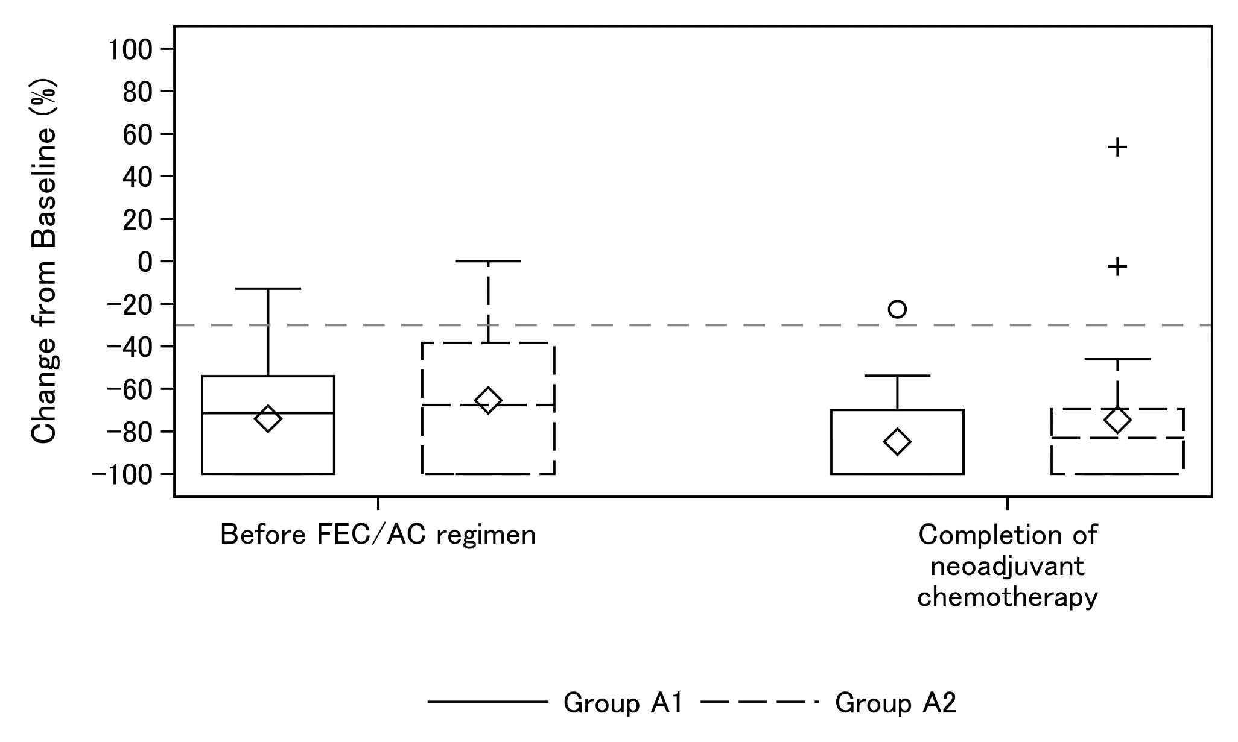
Supplementary Fig. S3 Mean change in tumor size from baseline at the start of FEC or AC and at completion of neoadjuvant chemotherapy in group A1 (n = 23) and group A2 (n = 22).
♢ ： Mean
+/〇: Outlier
Change from baseline (%)

