Slide 1
Fig. S1 Alteration of H3K4me3 makers on the proximal ESR1 promoter in MEN1-KD MCF7 cells.
72h
ChIP: H3K4me3
96h
ChIP: H3K4me3

Slide 2
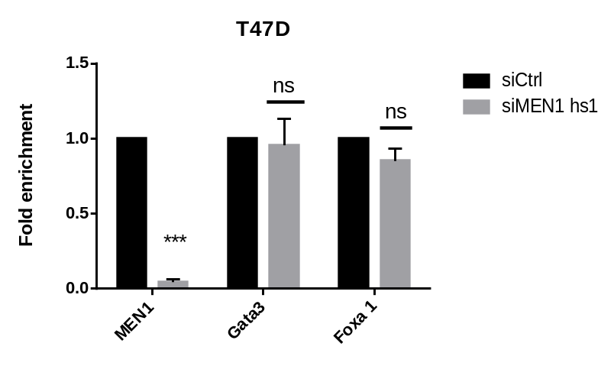
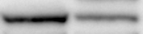
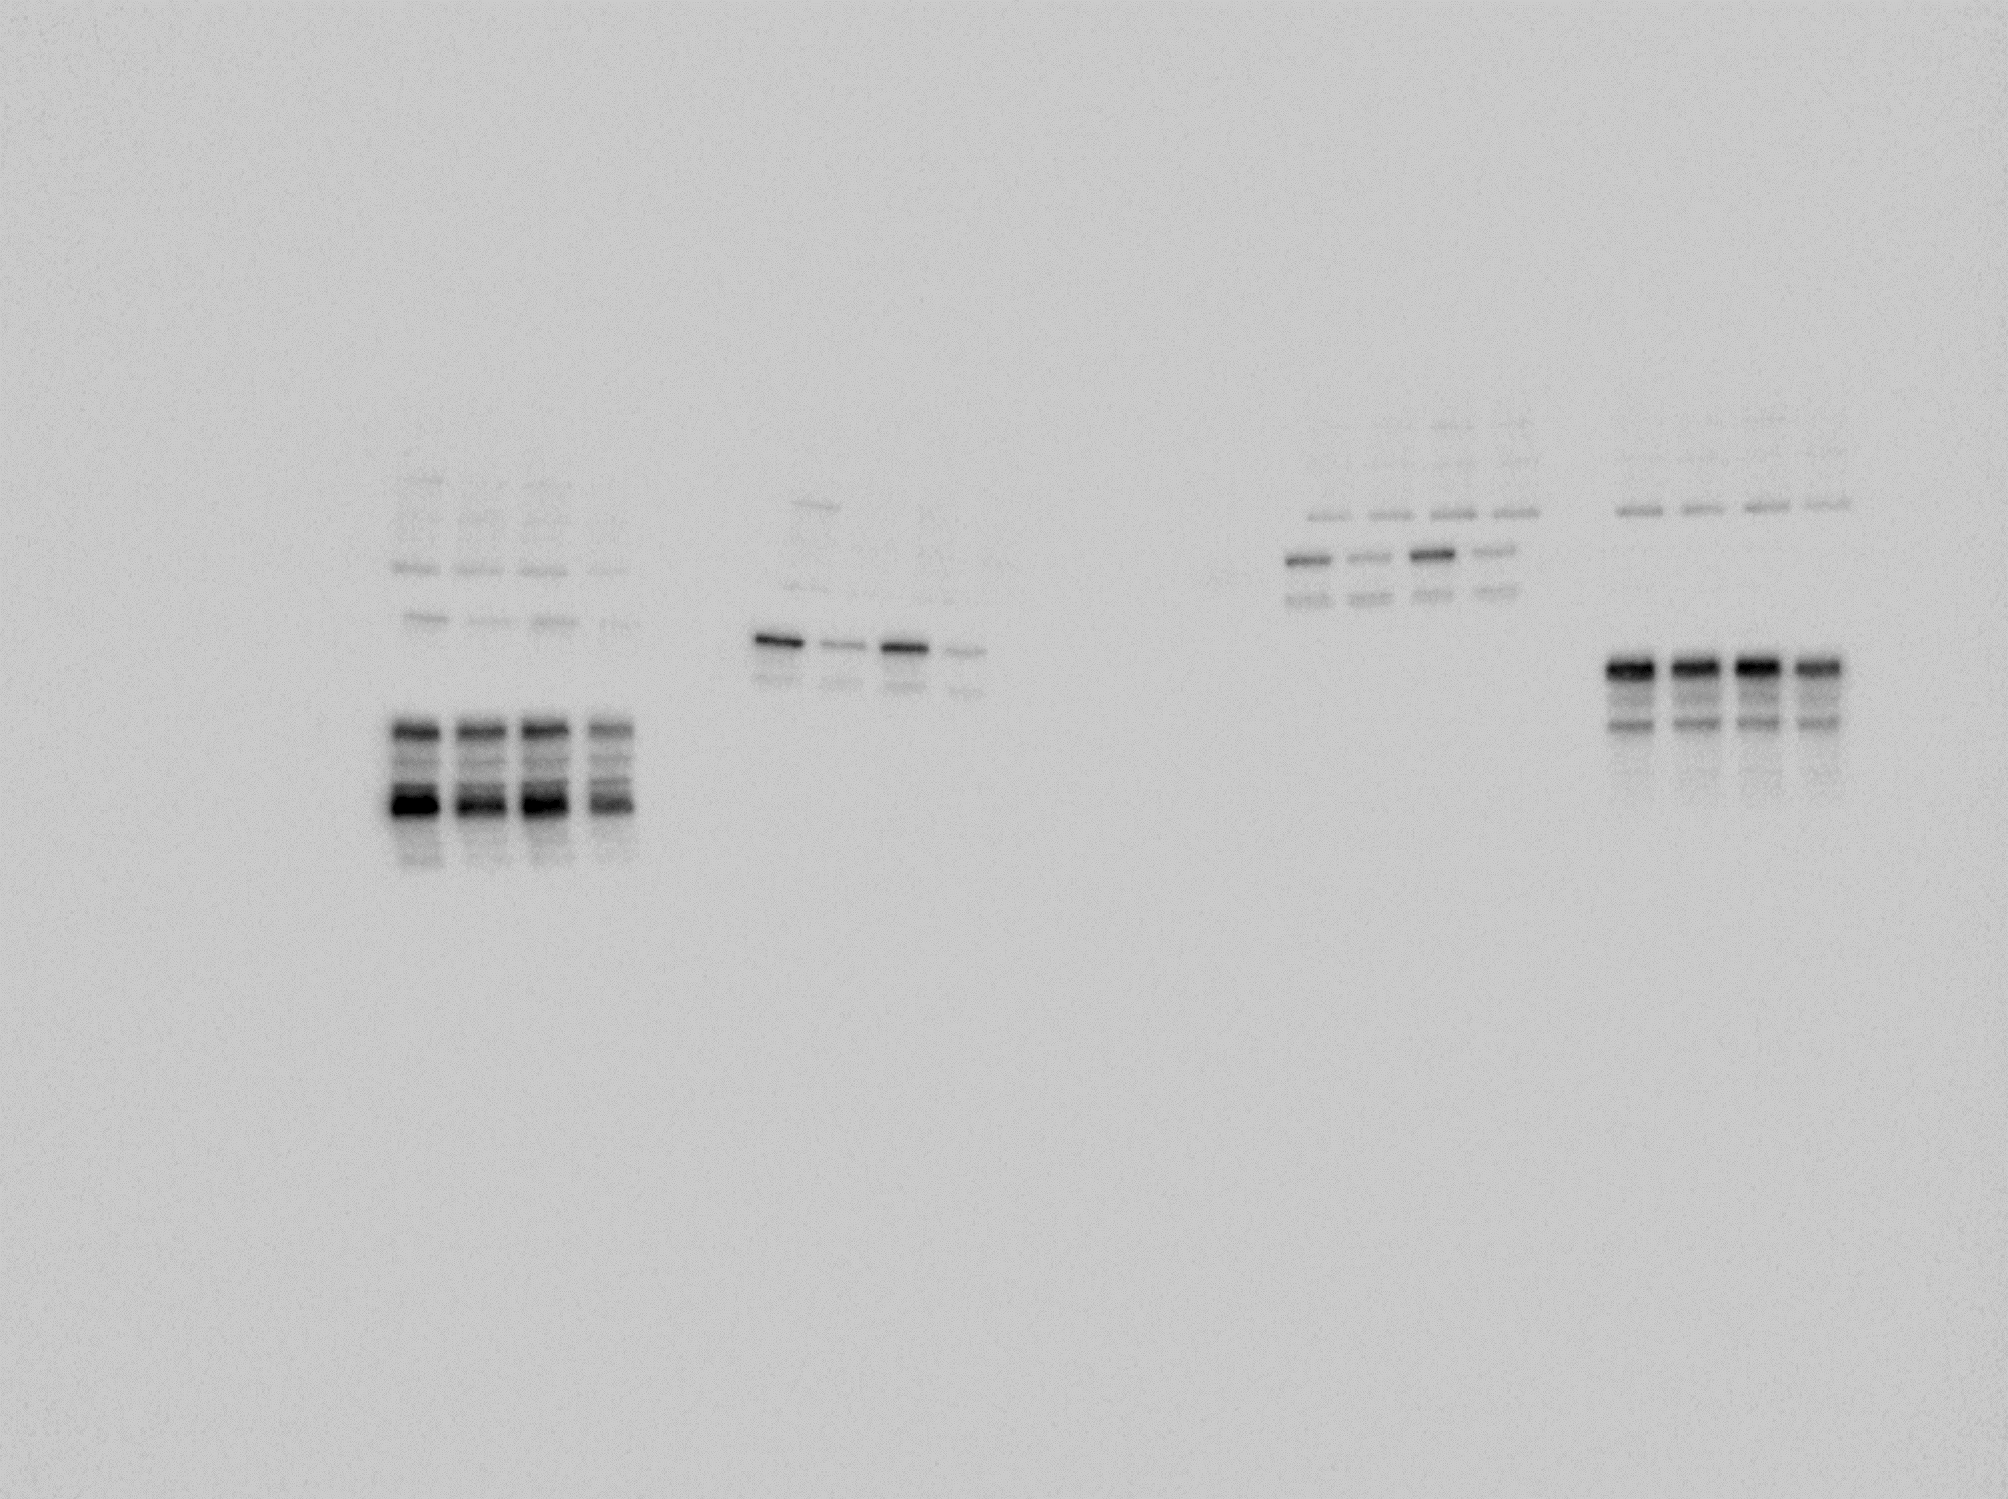
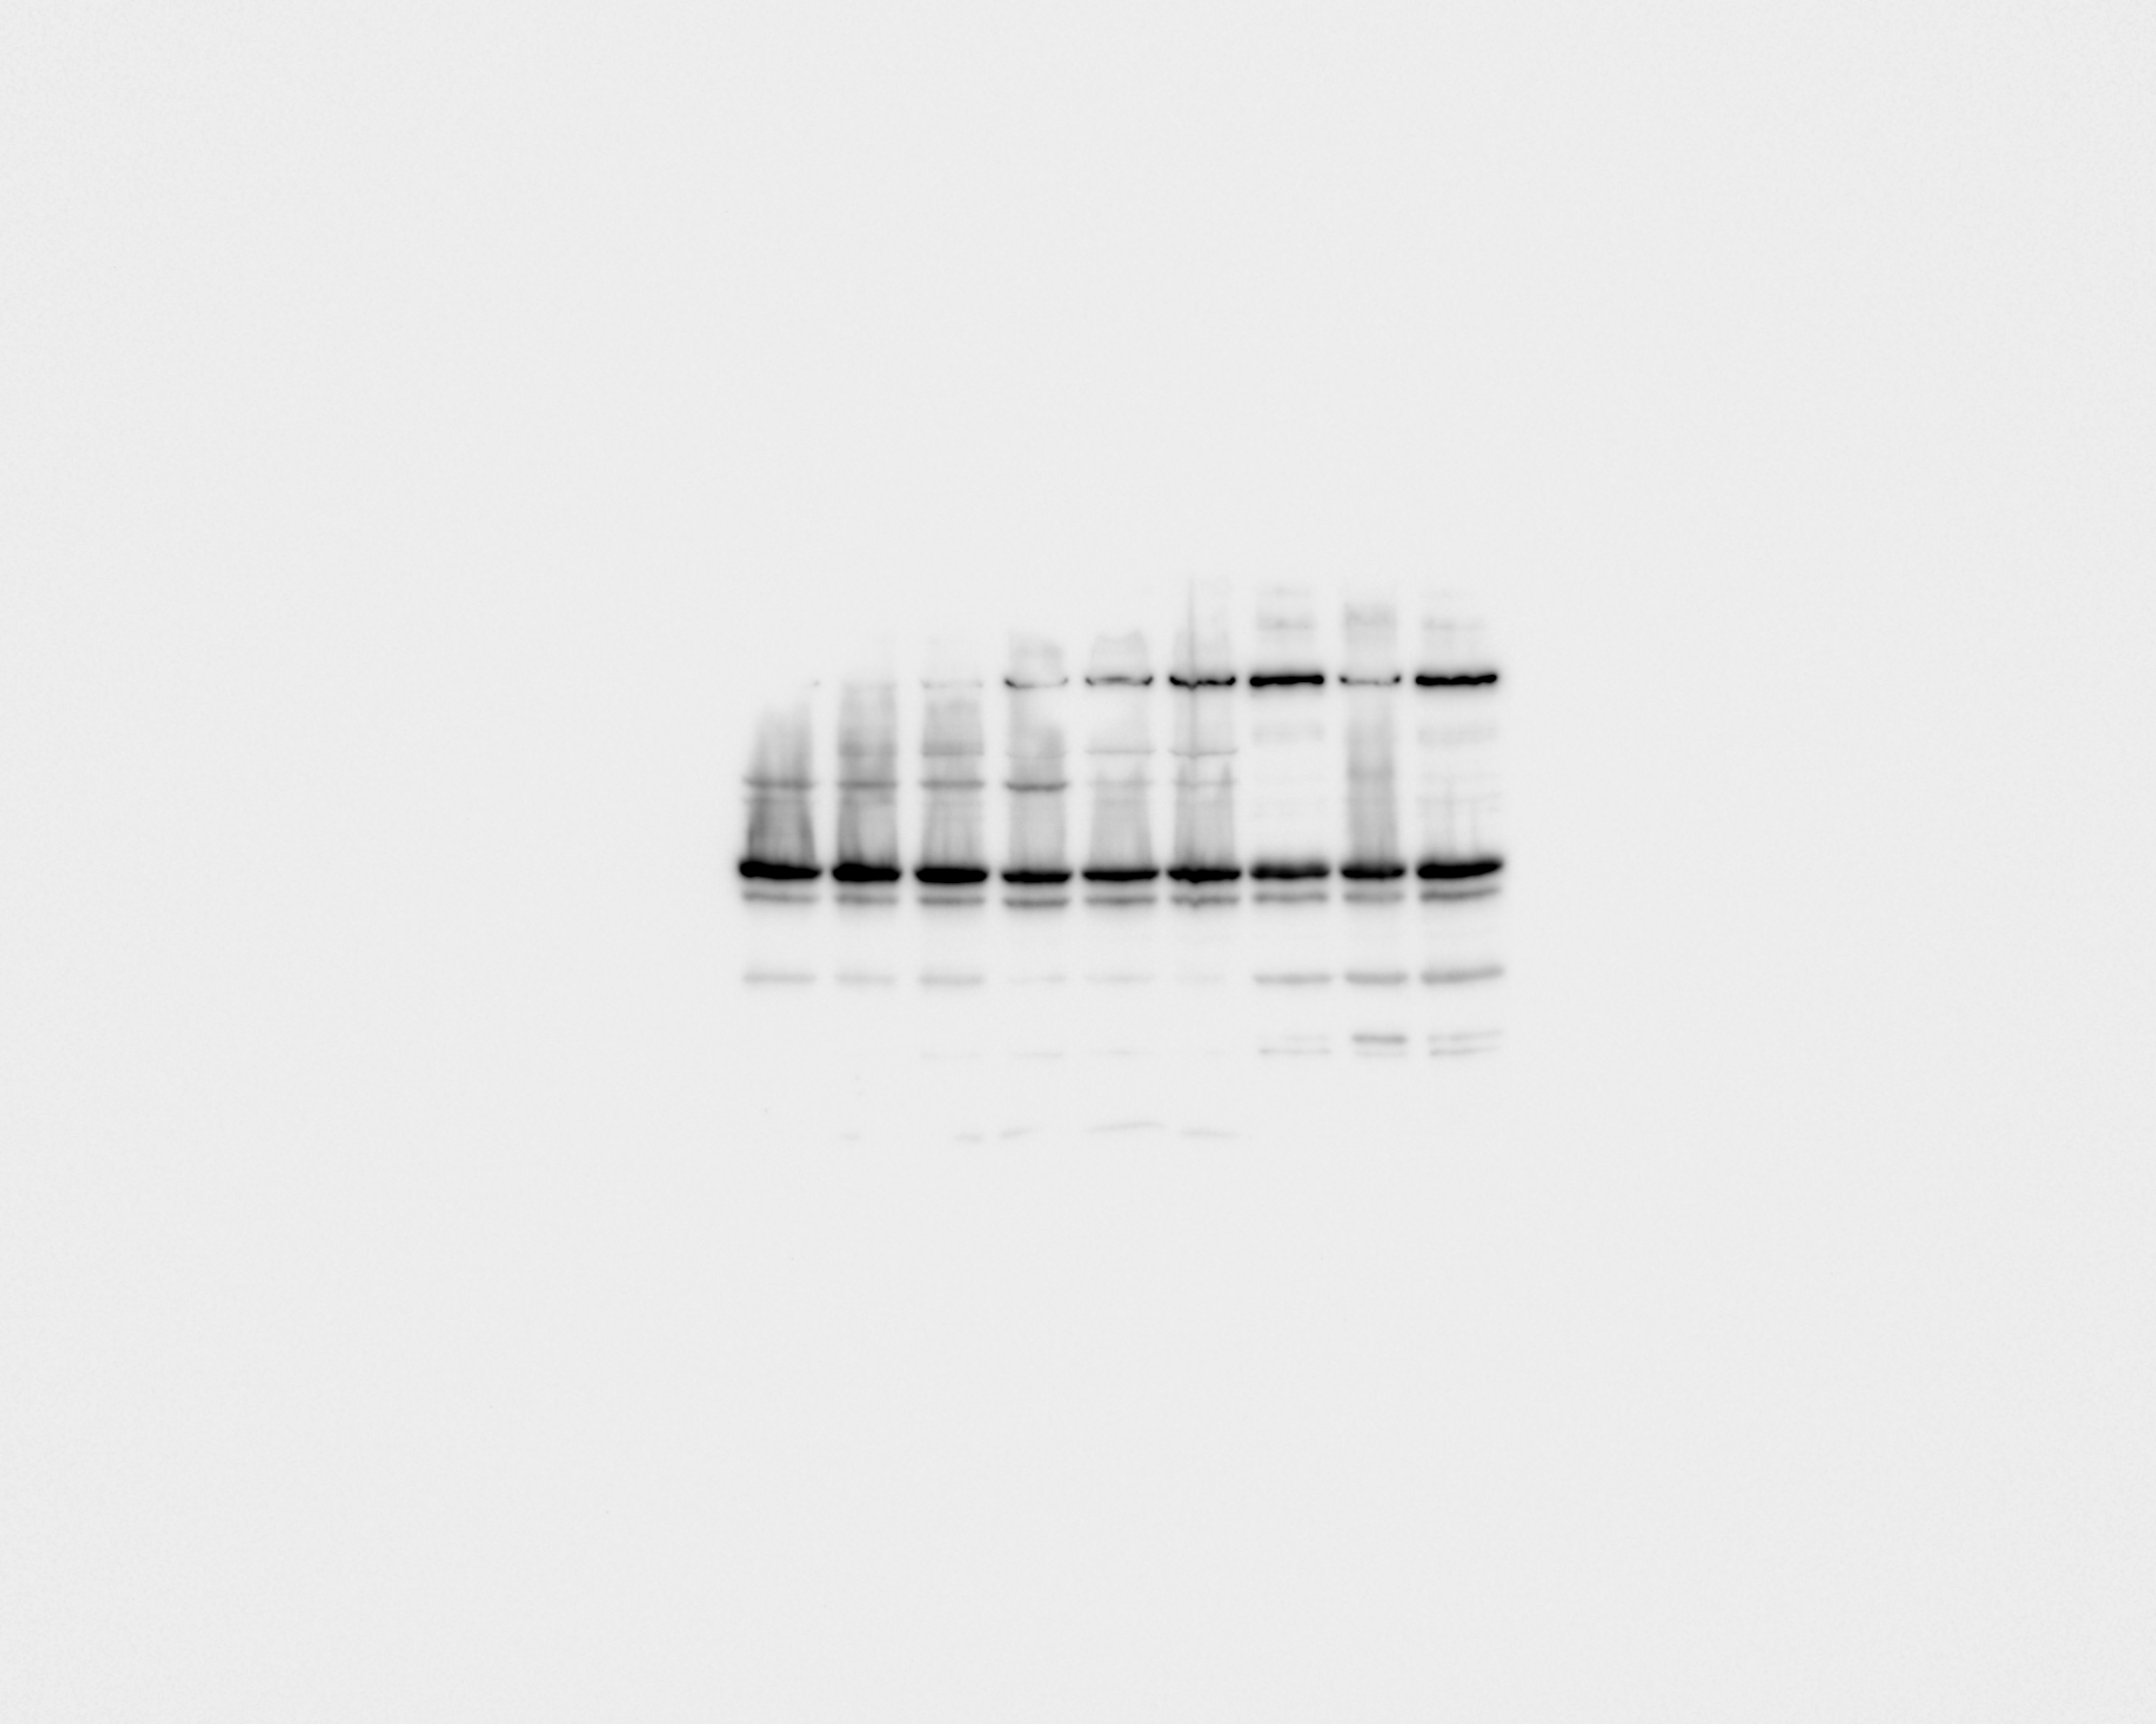
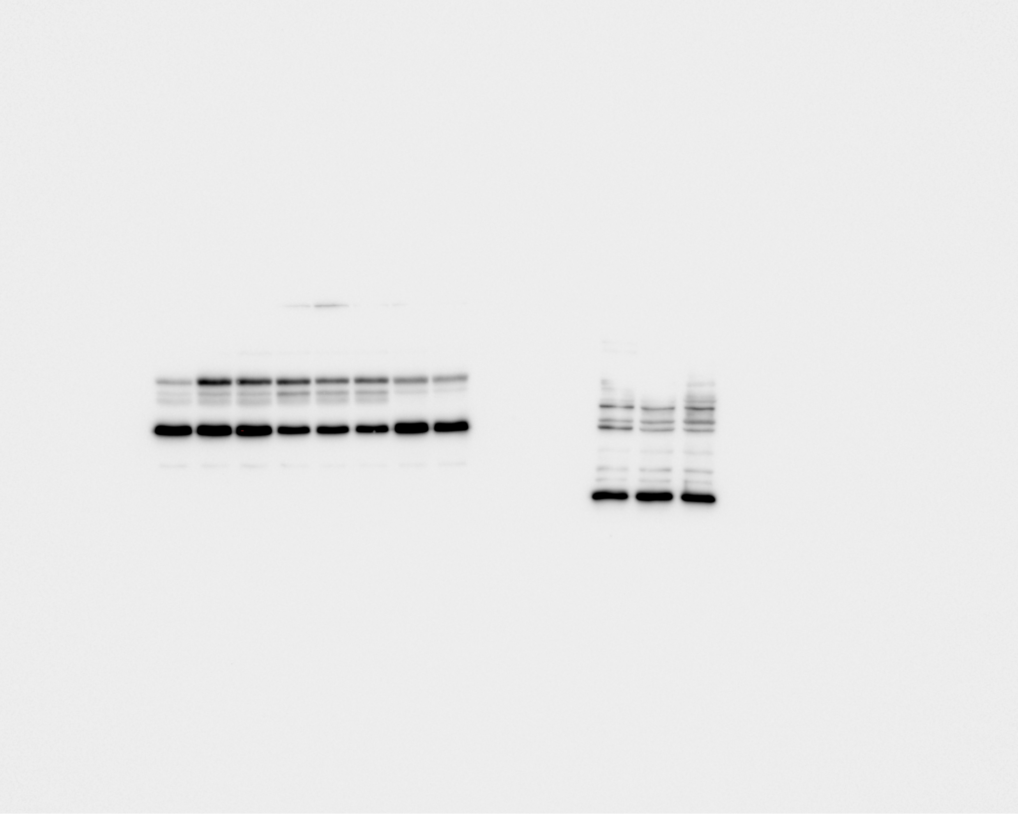
Fig. S2 Menin and the expression of GATA3 and FOXA1 in T47D cells.
T47D
siCtrl
siMEN1 hs1
menin
GATA3
FOXA1
GAPDH

