Slide 1
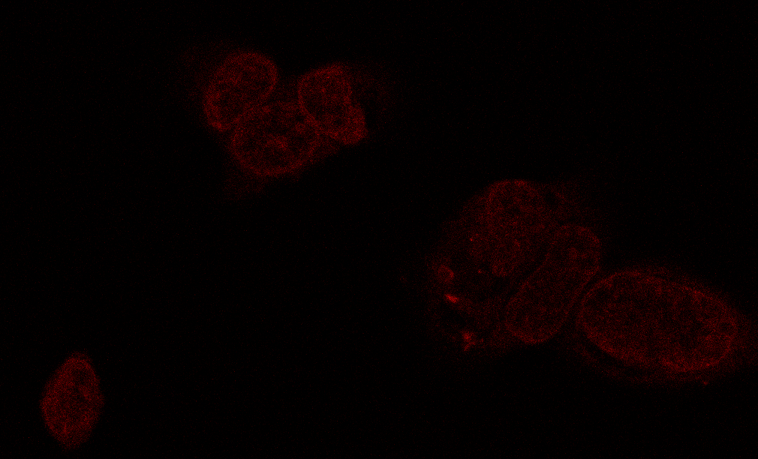
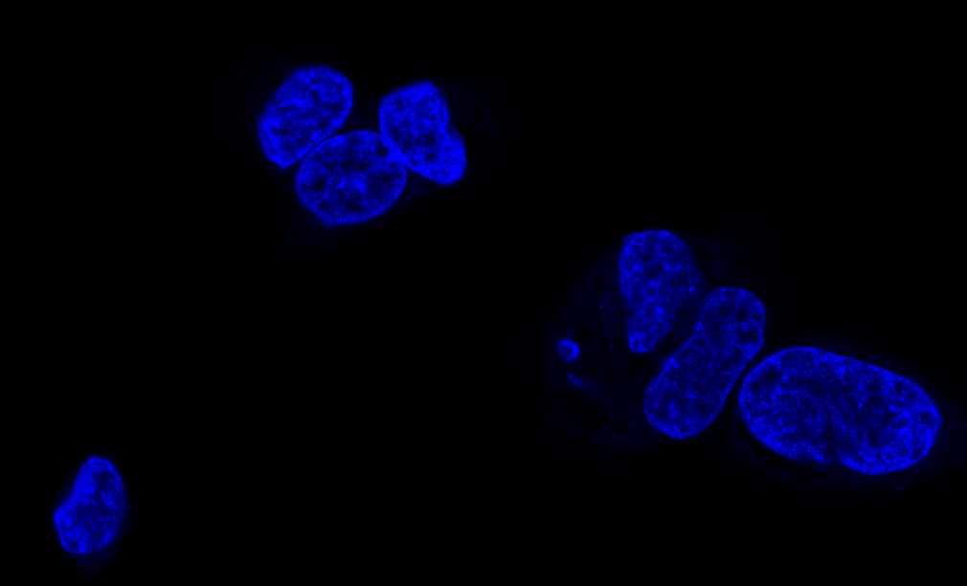
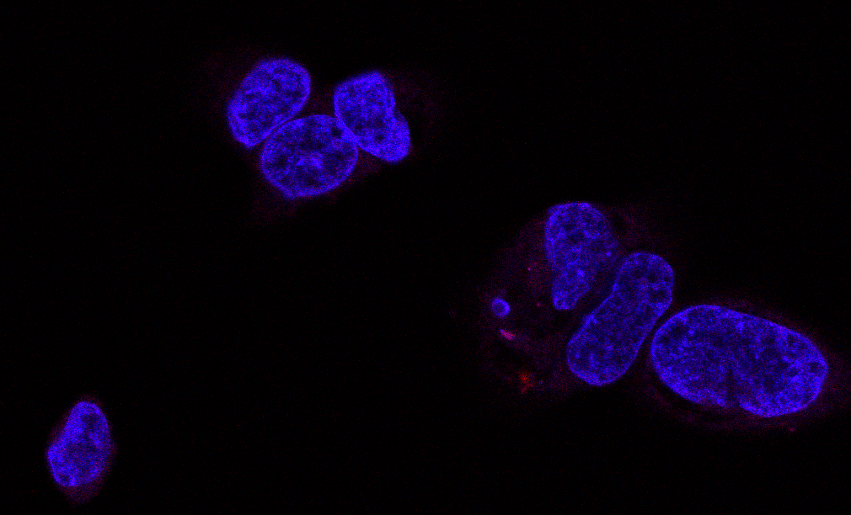
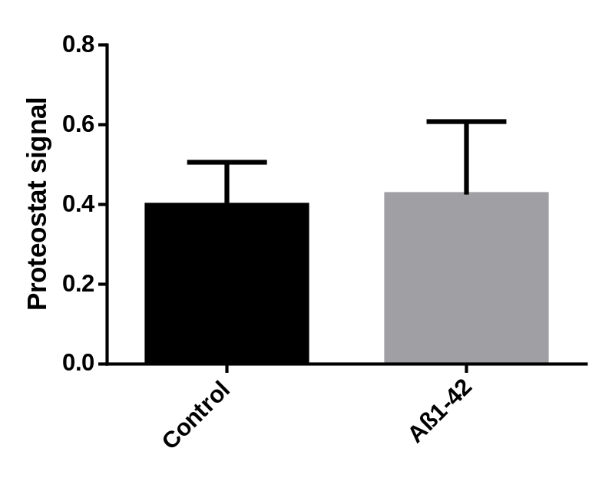
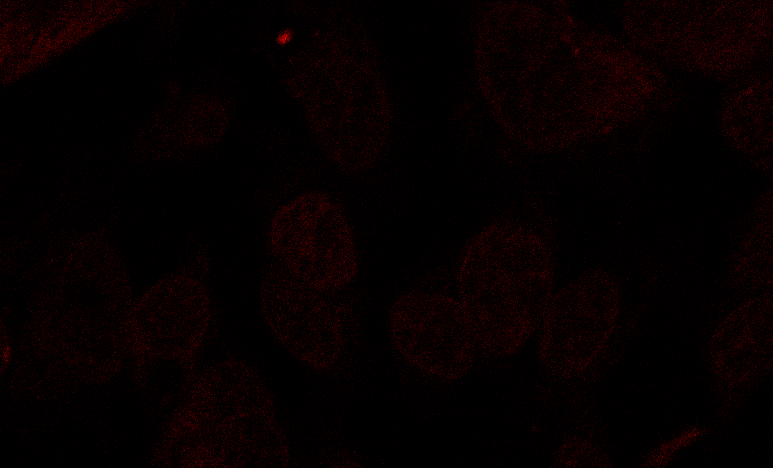
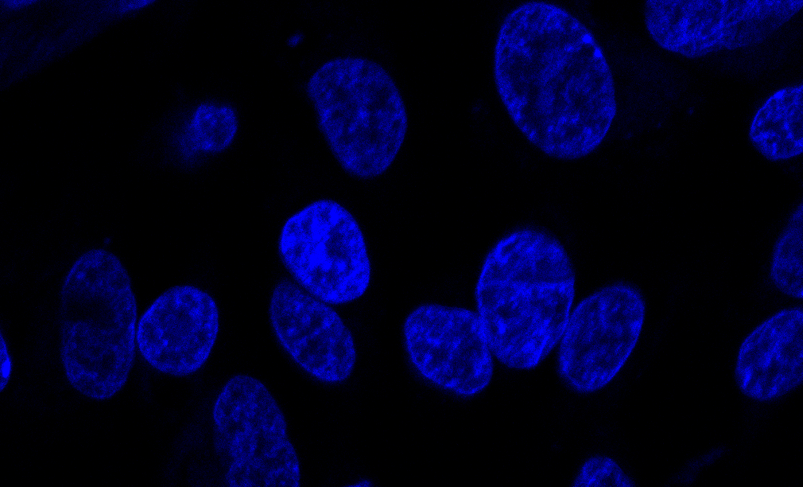
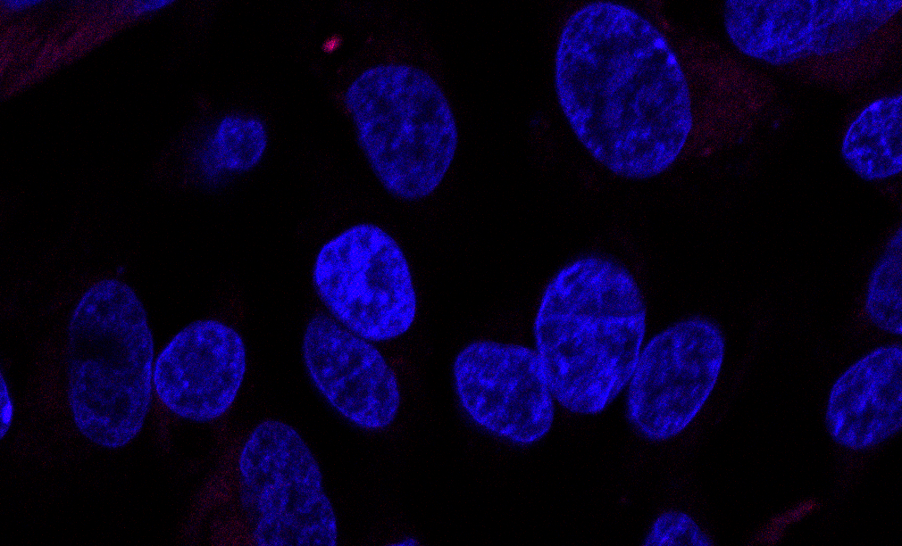
(a)
(b)
Proteostat
DAPI
Merge
Control
Aβ1-42
20 µm
Supplementary Fig. 1
Acute treatment with Aβ peptide does not promote aggresome accumulation in SH-SY5Y cells.
Cells treated with Aβ-42 for 5 minutes were fixed and stained with proteostat dye (red) and DAPI (blue) and imaged using a confocal microscope (Zeiss LSM 880) (a, quantified in b).

Slide 2
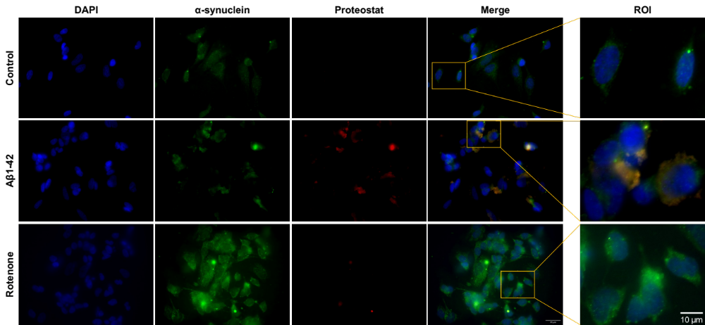
25 µm
10 µm
Supplementary Fig. 2
α-synuclein aggregation is promoted by Aβ peptide in SH-SY5Y cells.
Cells treated with Aβ-42 and RT were fixed and stained with α-synuclein (green), proteostat dye (red), and DAPI (blue). Images were acquired using Zeiss fluorescence microscope.
Notes:
Supplementary Fig.1

Slide 3
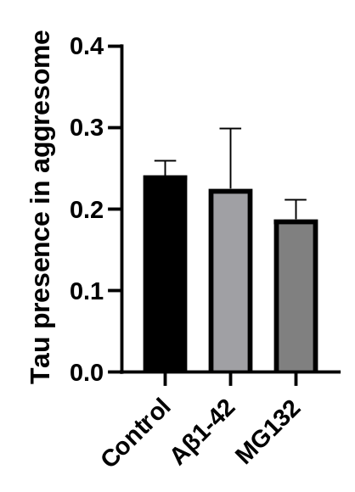
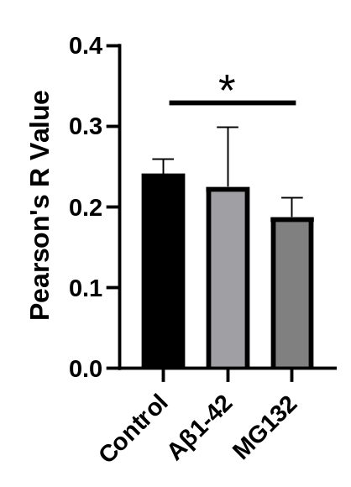
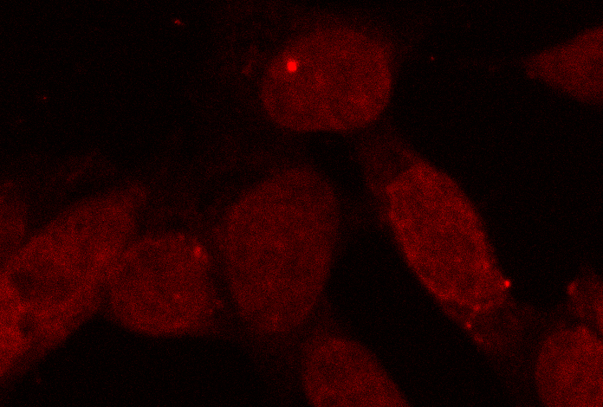
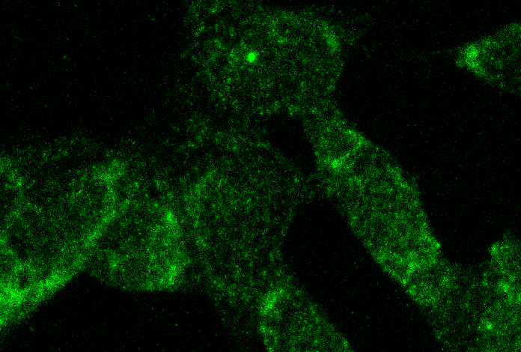
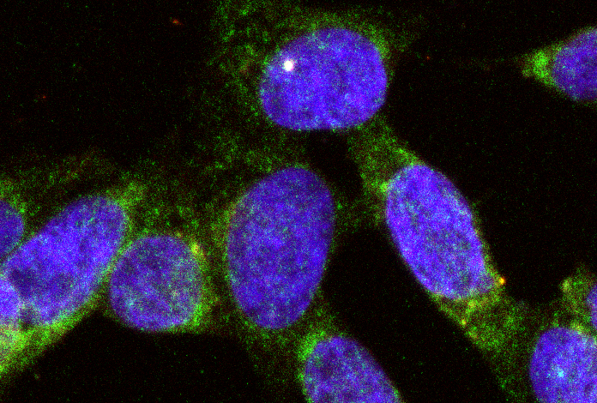


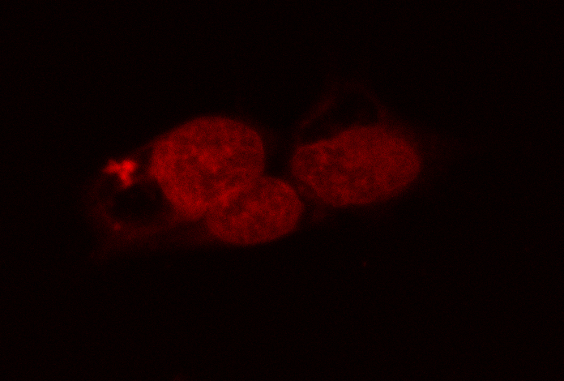
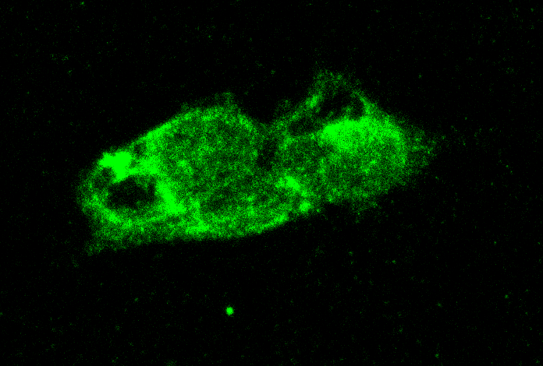
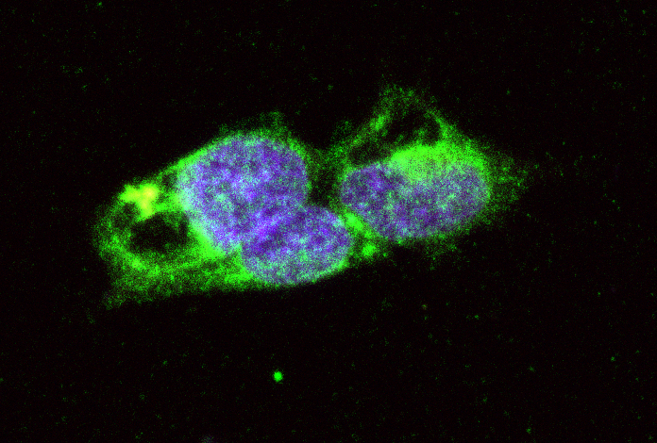


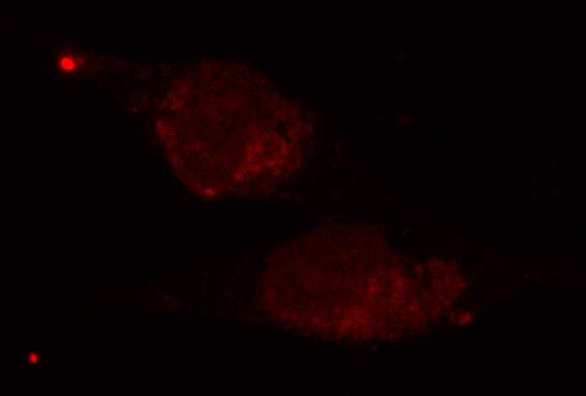
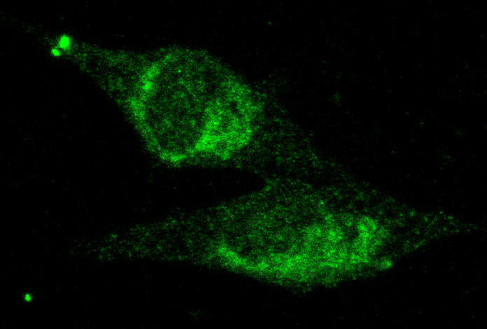
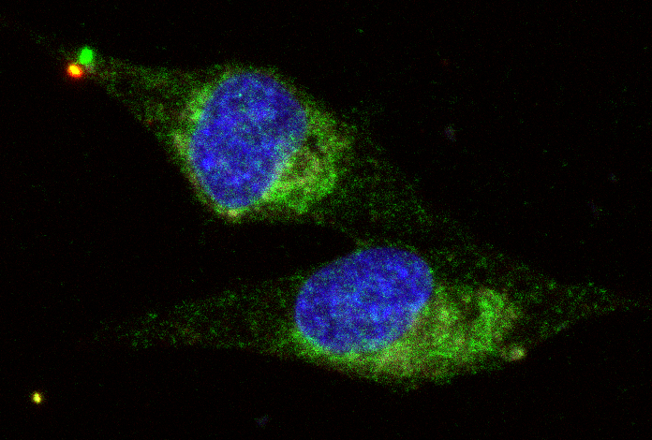
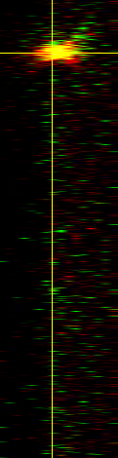
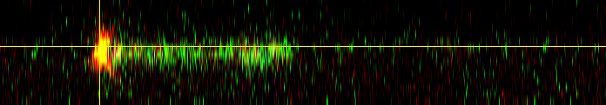
(a)
(b)
(c)
Proteostat
Tau
Merge
Control
Aβ1-42
MG132
20 µm
Supplementary Fig. 3: Increased Tau phosphorylation appears to not result in aggresomal aggregation. SH-SY5Y cells treated with aggregated Aβ1-42 and MG-132 were investigated for Tau protein accumulation in aggresomes. Aggresome was detected by staining cells with proteostat (red), and Tau was detected by immunostaining (green), and nuclei were stained with dapi (blue). Micrographs were obtained by confocal microscopy (Zeiss LSM 880, 63x objective) (a). Investigation for tau signal in aggresomes revealed no evident alterations (b), but treatment with protesome inhibitor MG132 appears to result in decreased co-localization between Tau and aggresomes, expressed by Pearson’s R value (c). Results expressed as mean ± SEM of 3 independent experiences. *P<0.05, significantly different from control.

Slide 4
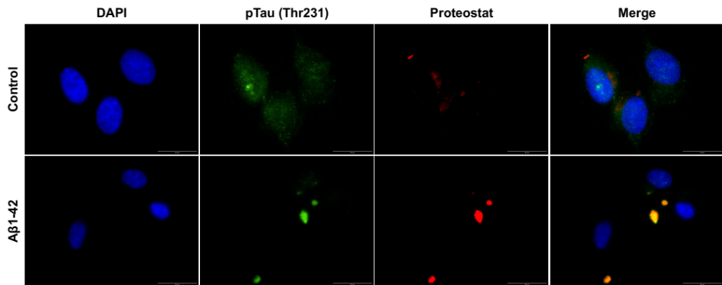
10 µm
Supplementary Fig. 4
pTau (Thr231) aggregation is promoted by Aβ peptide in SH-SY5Y cells.
Cells treated with Aβ-42 were fixed and stained with pTau (Thr231) (green), proteostat dye (red), and DAPI (blue). Images were acquired using Olympus IX81 fluorescence microscope.
Notes:
Supplementary Fig.2

Slide 5
Western Blots

Slide 6
Figure 1
Olig
CTRL
Aβ1-42
RT
MG-132
HSP-70
CTRL
Aβ1-42
RT
Olig
MG-132
Ponceau

Slide 7
Figure 2
CTRL
Aβ1-42
RT
Olig
MG-132
α-synuclein
CTRL
Aβ1-42
RT
Olig
MG-132
Ponceau

Slide 8
Figure 3
CTRL
Aβ1-42
RT
Olig
MG-132
Tau
CTRL
Aβ1-42
RT
Olig
MG-132
pTau (Thr231)

Slide 9
Figure 3
CTRL
Aβ1-42
RT
Olig
MG-132
Ponceau

Slide 10
Figure 4
CTRL
Aβ1-42
RT
Olig
MG-132
22C11- esAPP
CTRL
Aβ1-42
RT
Olig
MG-132
22C11 - isAPP

Slide 11
Figure 4
CTRL
Aβ1-42
RT
Olig
MG-132
Ponceau

Slide 12
Figure 5
CTRL
Aβ1-42
22C11- esAPP
CTRL
Aβ1-42
22C11 - isAPP (110kDa)

Slide 13
Figure 5
CTRL
Aβ1-42
Ponceau

