Slide 1
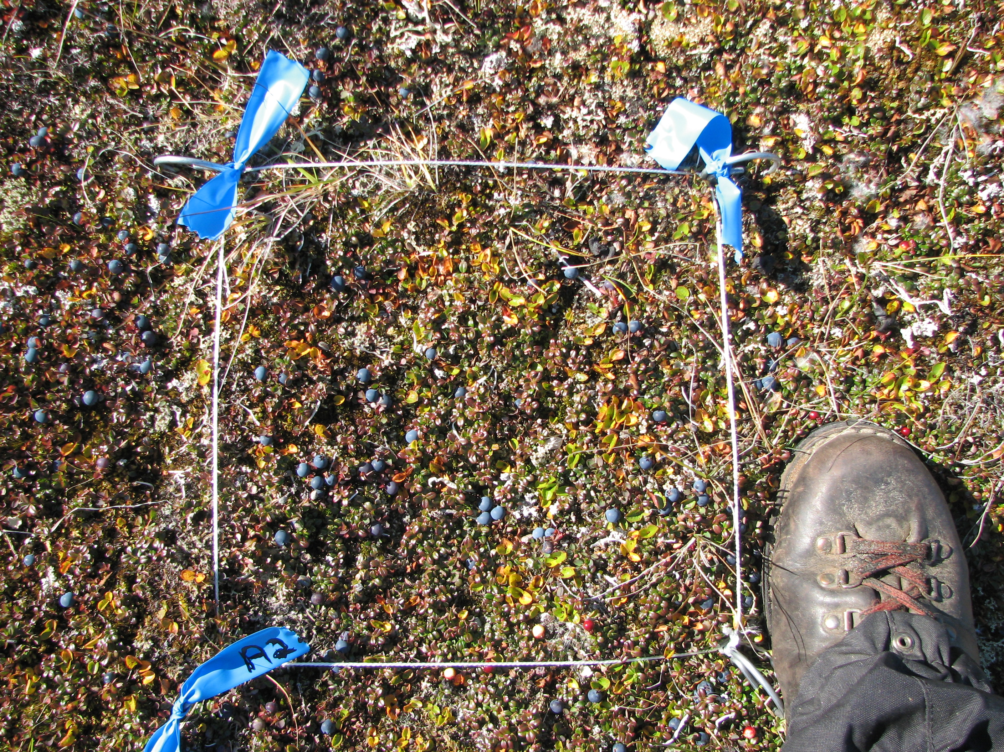
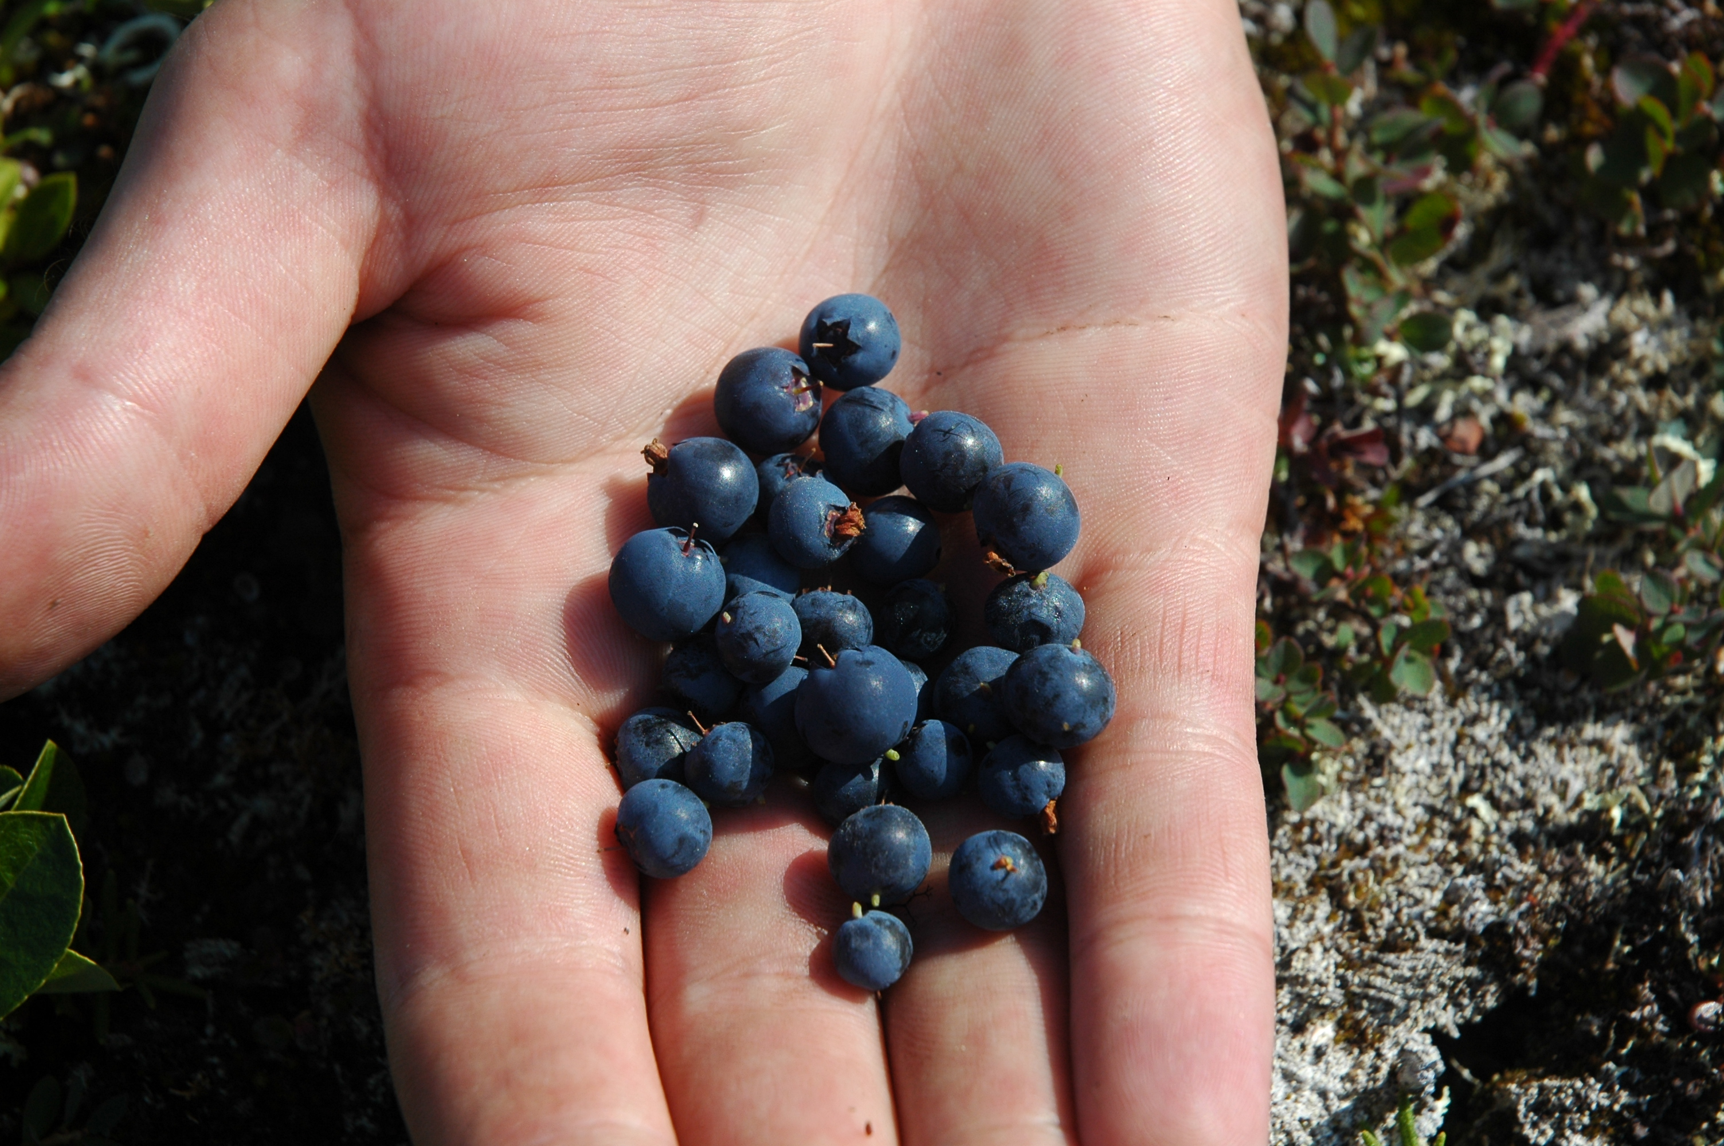
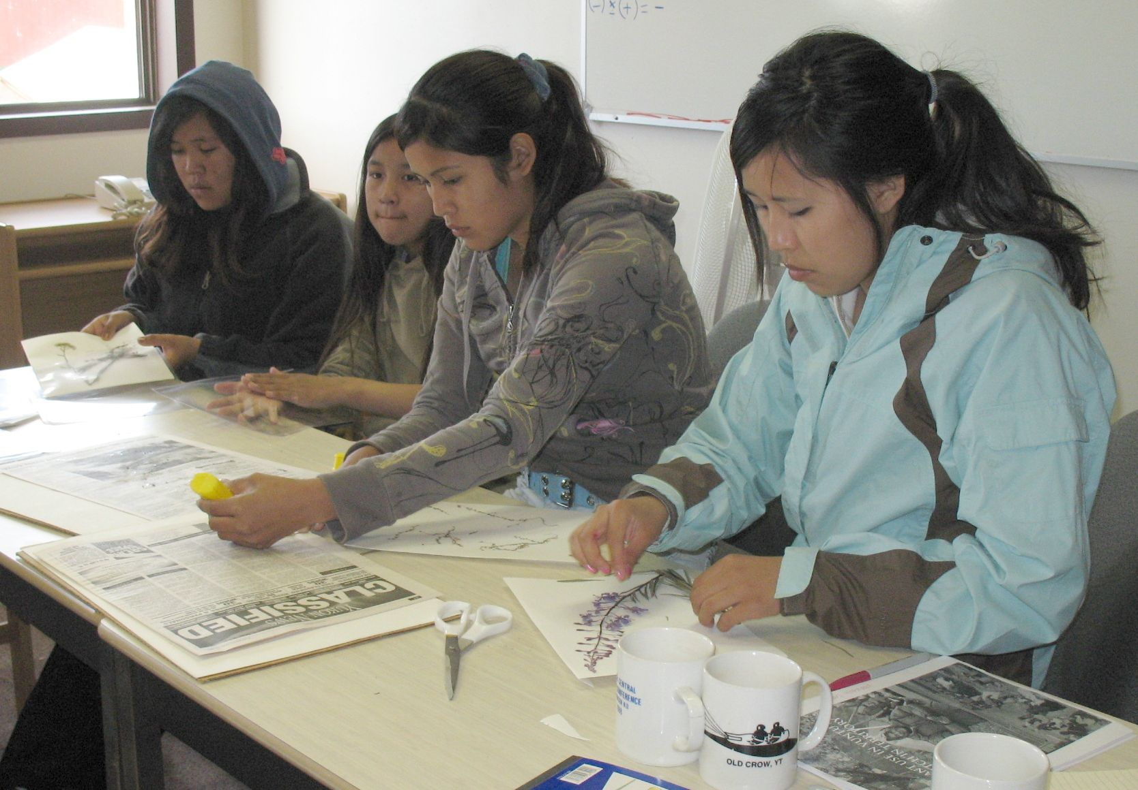
A)
B)
C)
Notes:
Figure 4. Photos showing a) berry sampling plot and b) harvested blue berries (Vaccinium uliginosum) in the berry production project involving high schools in Arctic communities. c) Students mounting plant specimens at a plant workshop held in Old Crow, Yukon. In the foreground of the photo are Chelsea Charlie and Liannah Charlie-Tizya (Photo by Jill Johnstone).

