Slide 1
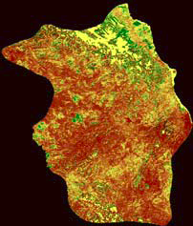
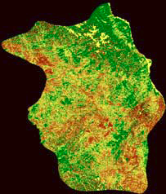

1986
2005
AK
AK
Yukon
Yukon
Notes:
Figure 6. Percent changes of aboveground biomass (NDVI) in mid-summer relative to its baseline value in 2000 for the Porcupine caribou habitat during 1986 and 2005, derived from 1-km resolution AVHRR data.

