Slide 1
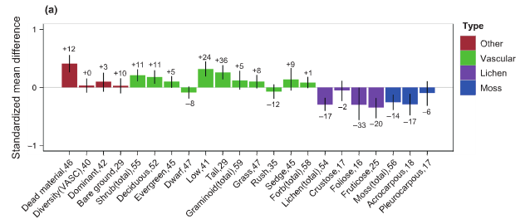
Notes:
Supplementary Materials Fig. 5 Average effects of experimental warming on plant community attributes and abundance of plant functional groups in tundra ecosystems based on analysis of 61 warming experiments. Bars show the weighted mean effect size (standardized mean difference) based on intercept-only weighted linear mixed models of all studies and sampling years. Error bars show 95% credible intervals. Median per cent change recorded over all studies and years is inset above or below the corresponding bar. The x-axis labels show response variable and number of studies included in the analysis. From Elmendorf et al. (2012a).

