Slide 1
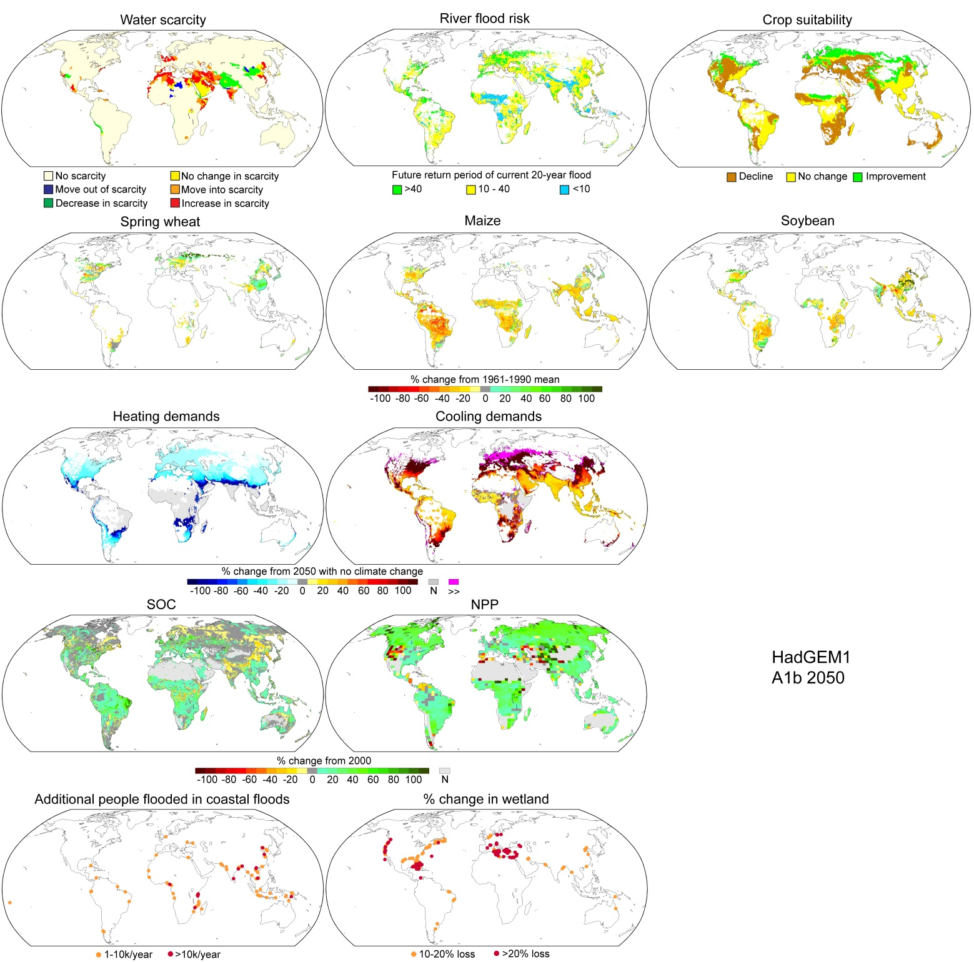
Supplementary Figure 2: Distribution of impacts under HadGEM1

Slide 2
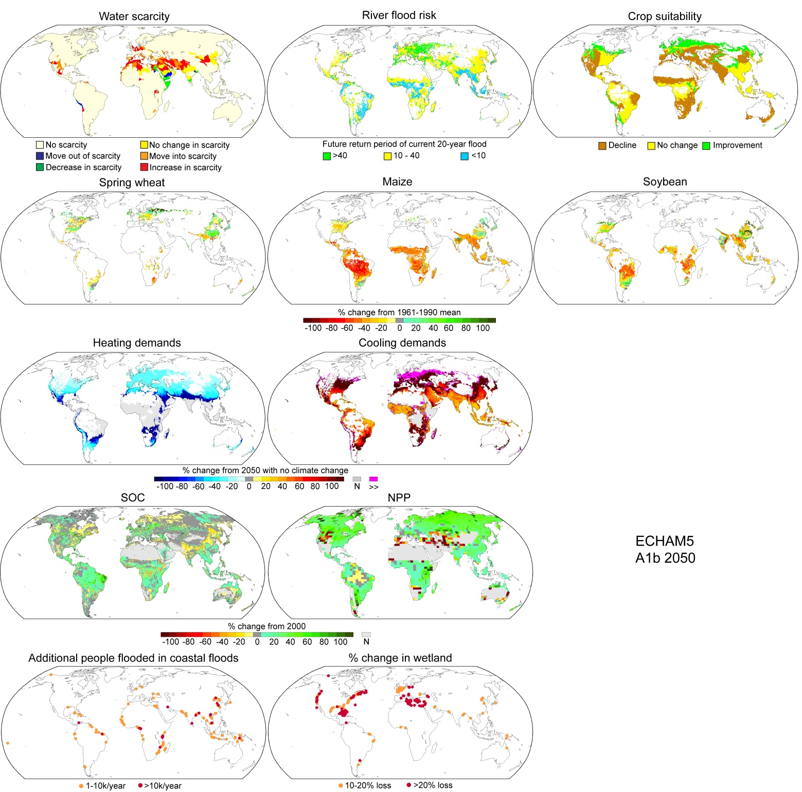
Supplementary Figure 3: Distribution of impacts under ECHAM5

Slide 3

Supplementary Figure 4: Distribution of impacts under CGCM3.1 (T47)

Slide 4
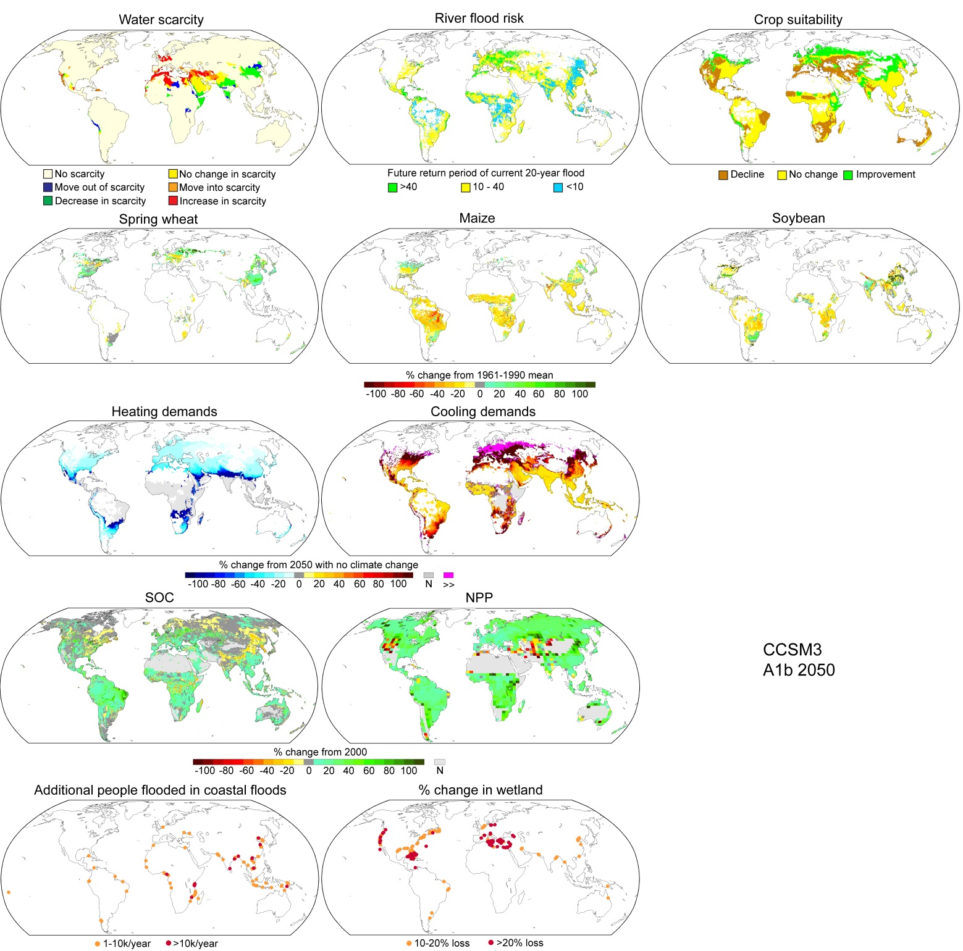
Supplementary Figure 5: Distribution of impacts under CCSM3

Slide 5
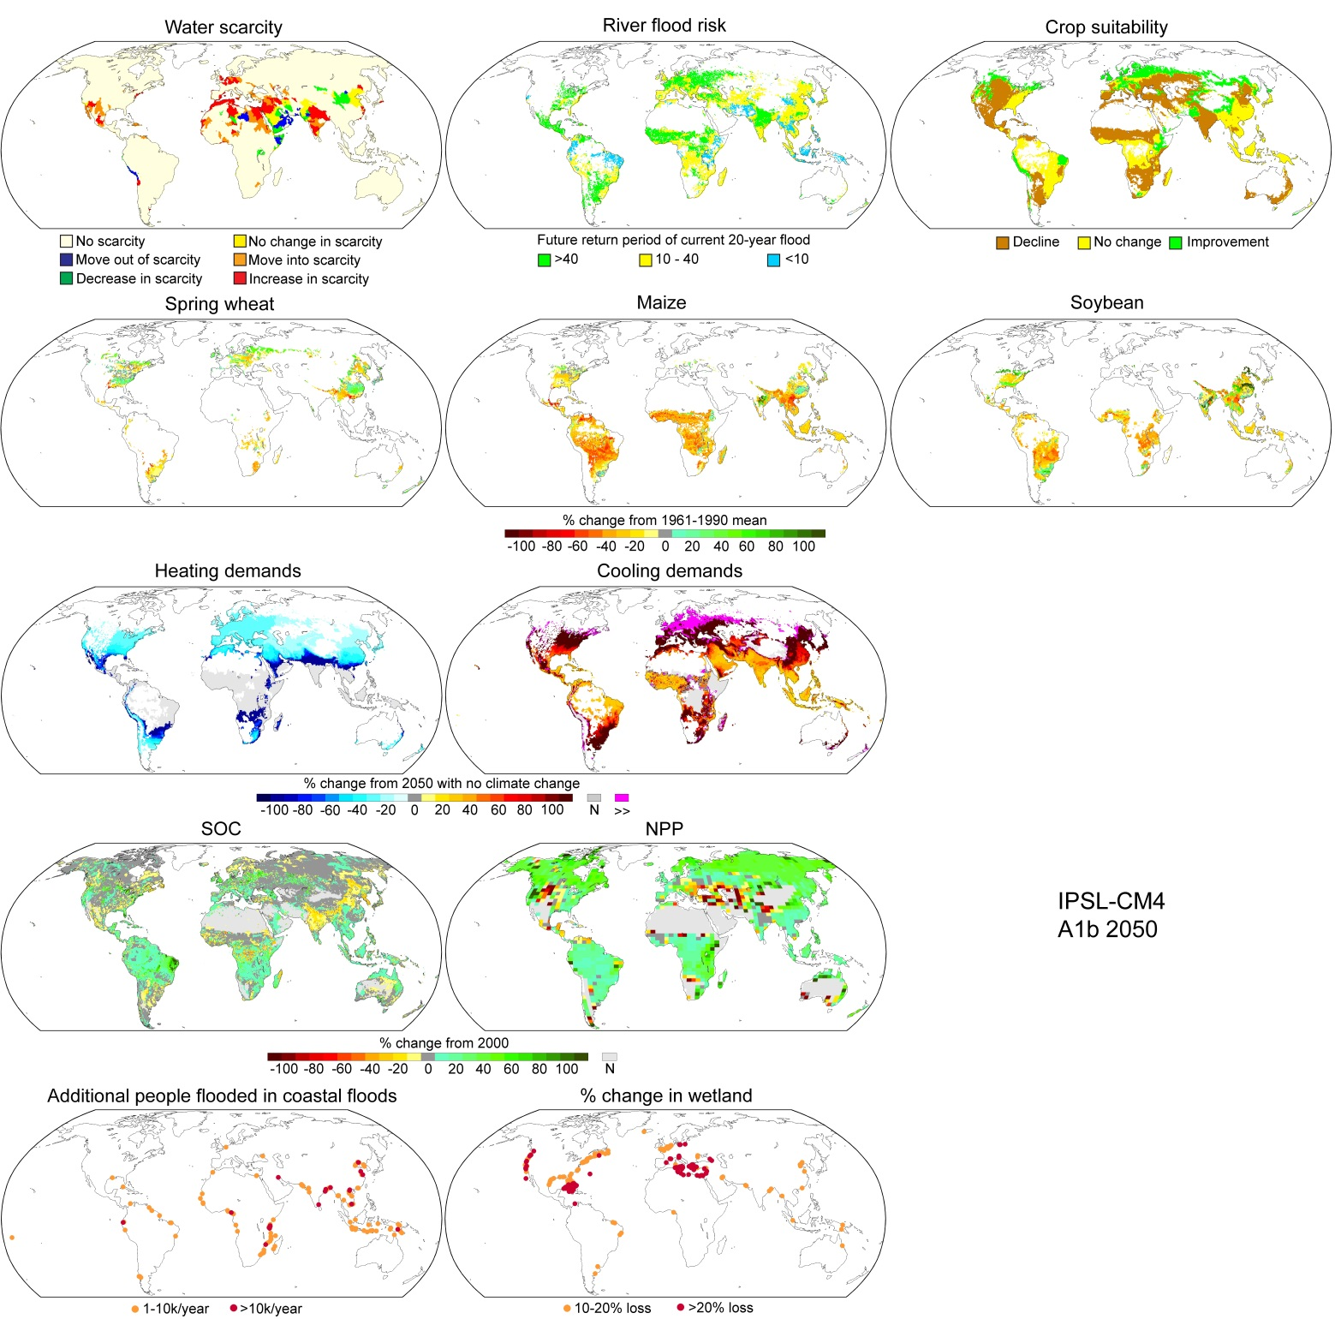
Supplementary Figure 6: Distribution of impacts under IPSL-CM4

Slide 6
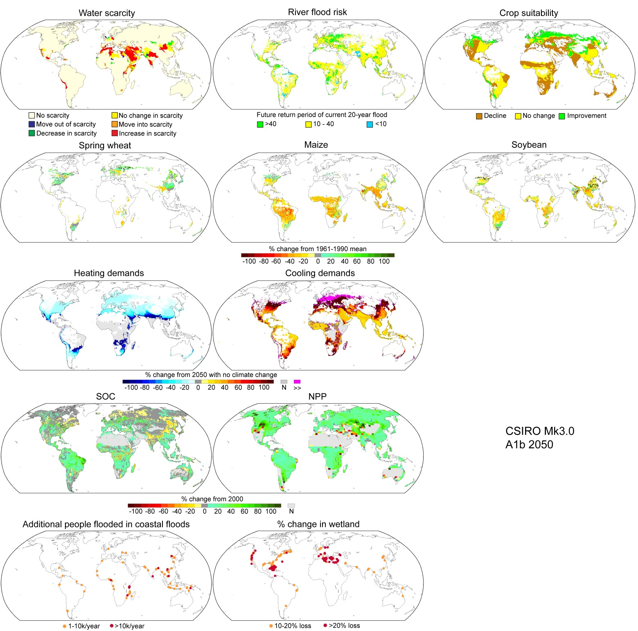
Supplementary Figure 7: Distribution of impacts under CSIRO MK3.0

