Slide 1
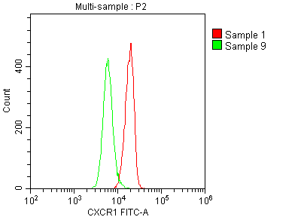
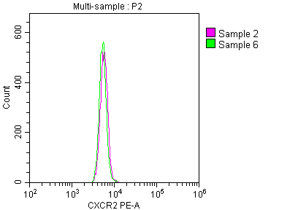
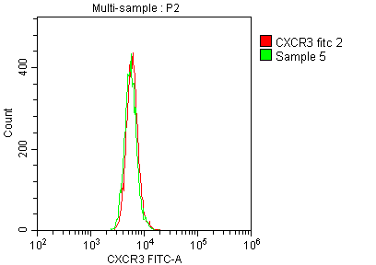
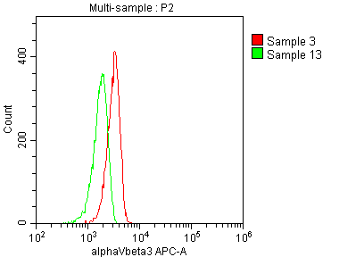
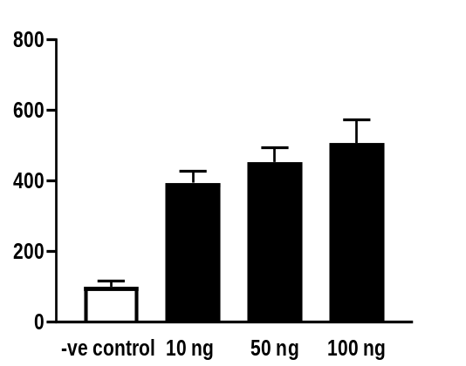
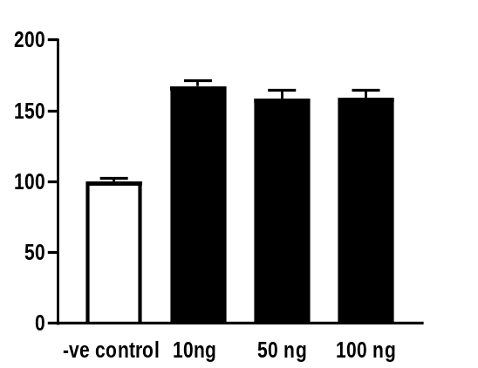
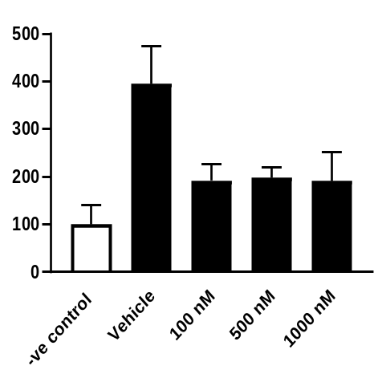
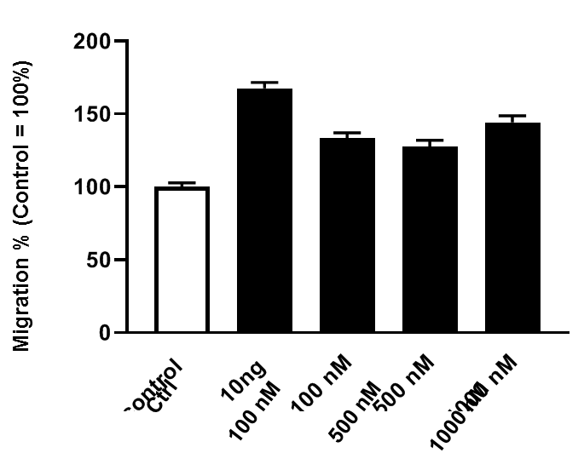
Supplementary Fig 1
A
Control
Control
Control
CXCR2
Control
CXCR1
CXCR3
αvβ3
Count
Expression
B
C
D
E
#
CXCL8 (10 ng/ml)
#
CXCL8 (10 ng/ml)
#
#
*
*
*
#
Proliferation (% of Control)
#
Migration (% of Control)
Proliferation (% of Control)
*
*
*
Migration (% of Control)
#
#
Ctrl
10
50
100
Ctrl
10
50
100
Ctrl
100
500
1000
Ctrl
Vehicle
100
500
1000
Vehicle
CXCL8 (ng/ml)
CXCL8 (ng/ml)
Reparixin (nM)
Reparixin (nM)
Supplementary Fig 1: A) Chemokine receptor expression on human colon cancer cells HT-29. B-E) CXCL8 induce HT-29 colon cancer cell proliferation and migration. In vitro cell migration and proliferation in response to 24h stimulation of CXCL8 (10-100 ng/ml). Proliferation was determined fluorometrically after adding calcein AM to cells as described in Materials and Methods. Migration was quantified by counting cells in High Power Fields in 5 different fields. Data represents mean ± SEM and n = 4. # P < 0,05 vs Ctrl and * P < 0.05 vs Vehicle.

Slide 2
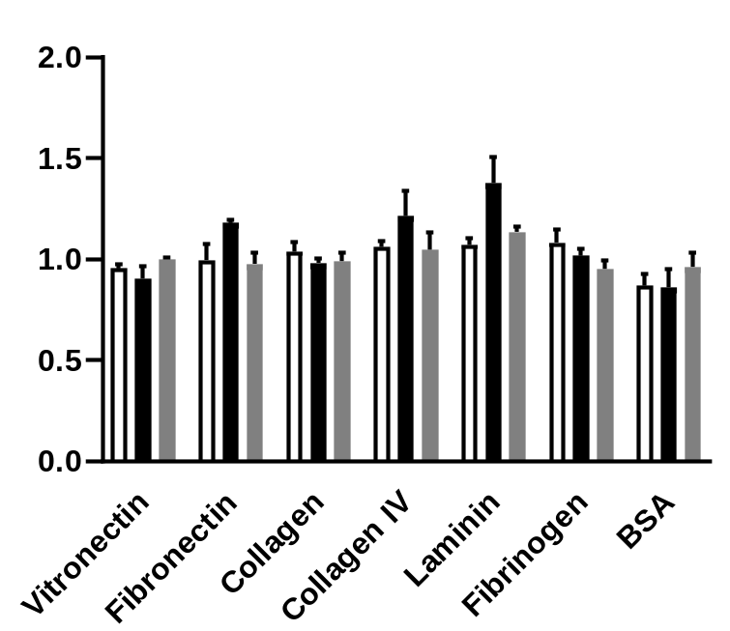
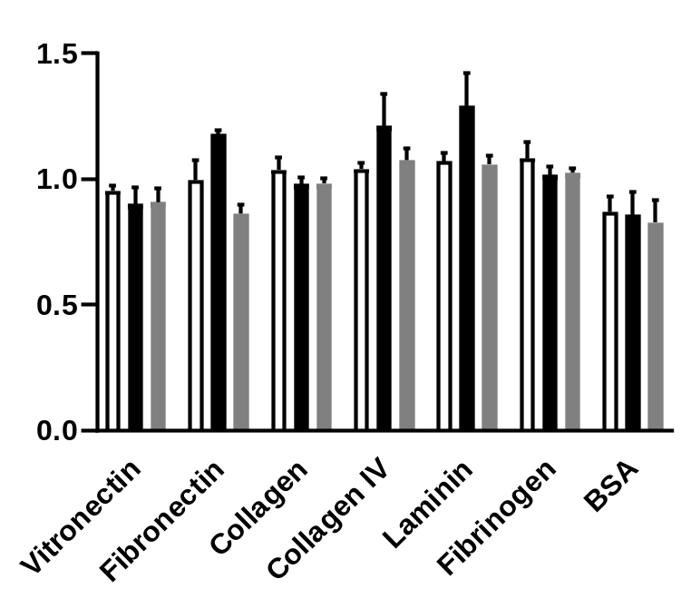
Supplementary Fig 2
A
Untreated
B
Untreated
CXCL8 + Vehicle
CXCL8 + Vehicle
CXCL8 + Reparixin
#
CXCL8 + Anti-αVβ3
#
#
*
#
*
*
*
Adhesion (Fold Change)
Adhesion (Fold Change)
BSA
Collagen l
Fibrinogen
BSA
Laminin l
Vitronectin
Laminin l
Vitronectin
Fibronectin
Collagen l
Fibrinogen
Fibronectin
Collagen lV
Collagen lV
Supplementary Figure 2: A) HT-29 cells were stimulated with CXCL8 (10 ng/ml) and allowed to adhere to different ECM proteins. Cells were pre-incubated with Reparixin (100 nM). B) HT-29 cells were stimulated with CXCL8 and allowed to adhere to different ECM proteins. Cells were pre-incubated with anti αvb3 (10 ng/ml). Data represents mean ± SEM and n = 4. # P < 0.05 vs Ctrl and * P < 0.05 vs Vehicle.

