Slide 1
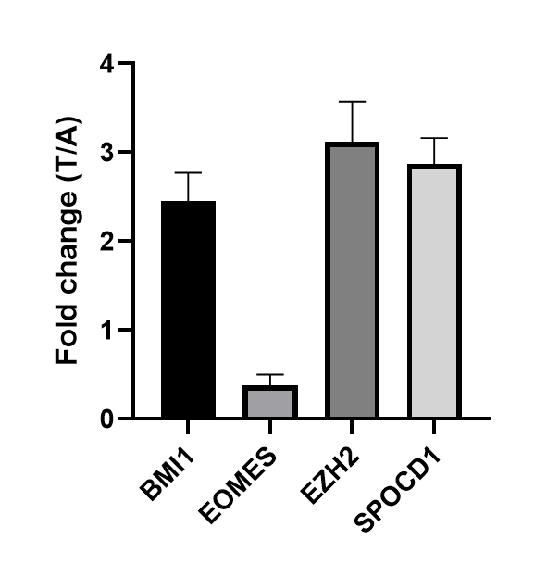
Figure S1
Figure S1. Relative expression of BMI1, EOMES, EZH2, and SPOCD1 in HCC tumor tissues compared to adjacent normal tissues.

