Slide 1
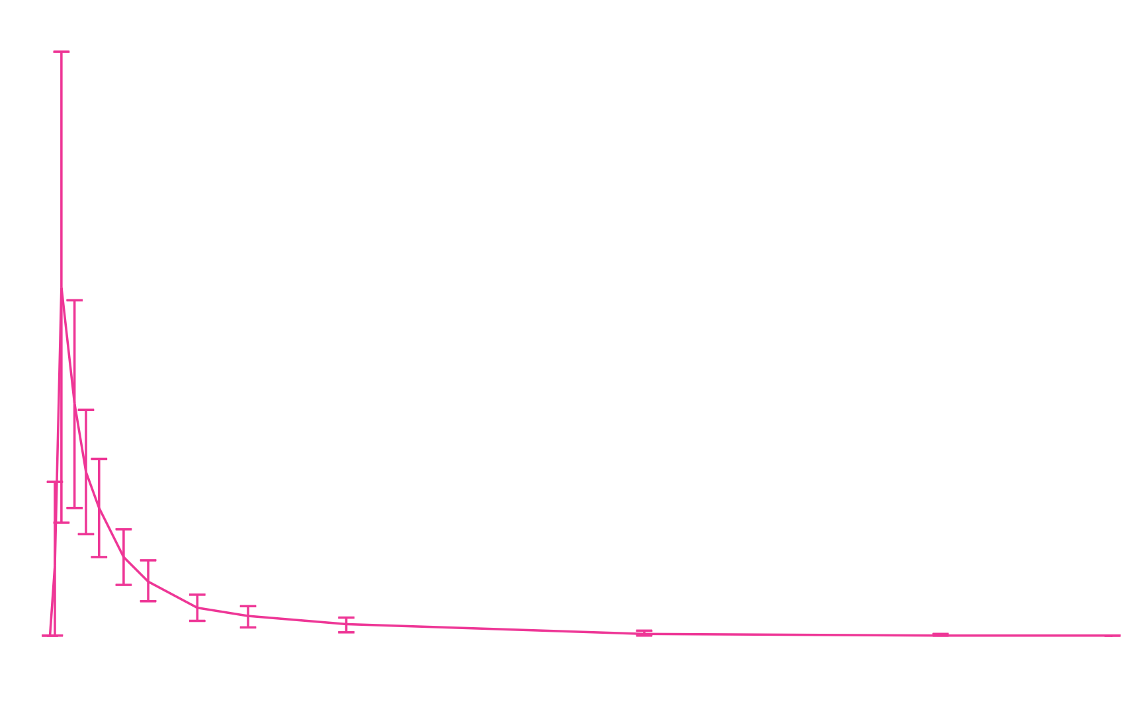
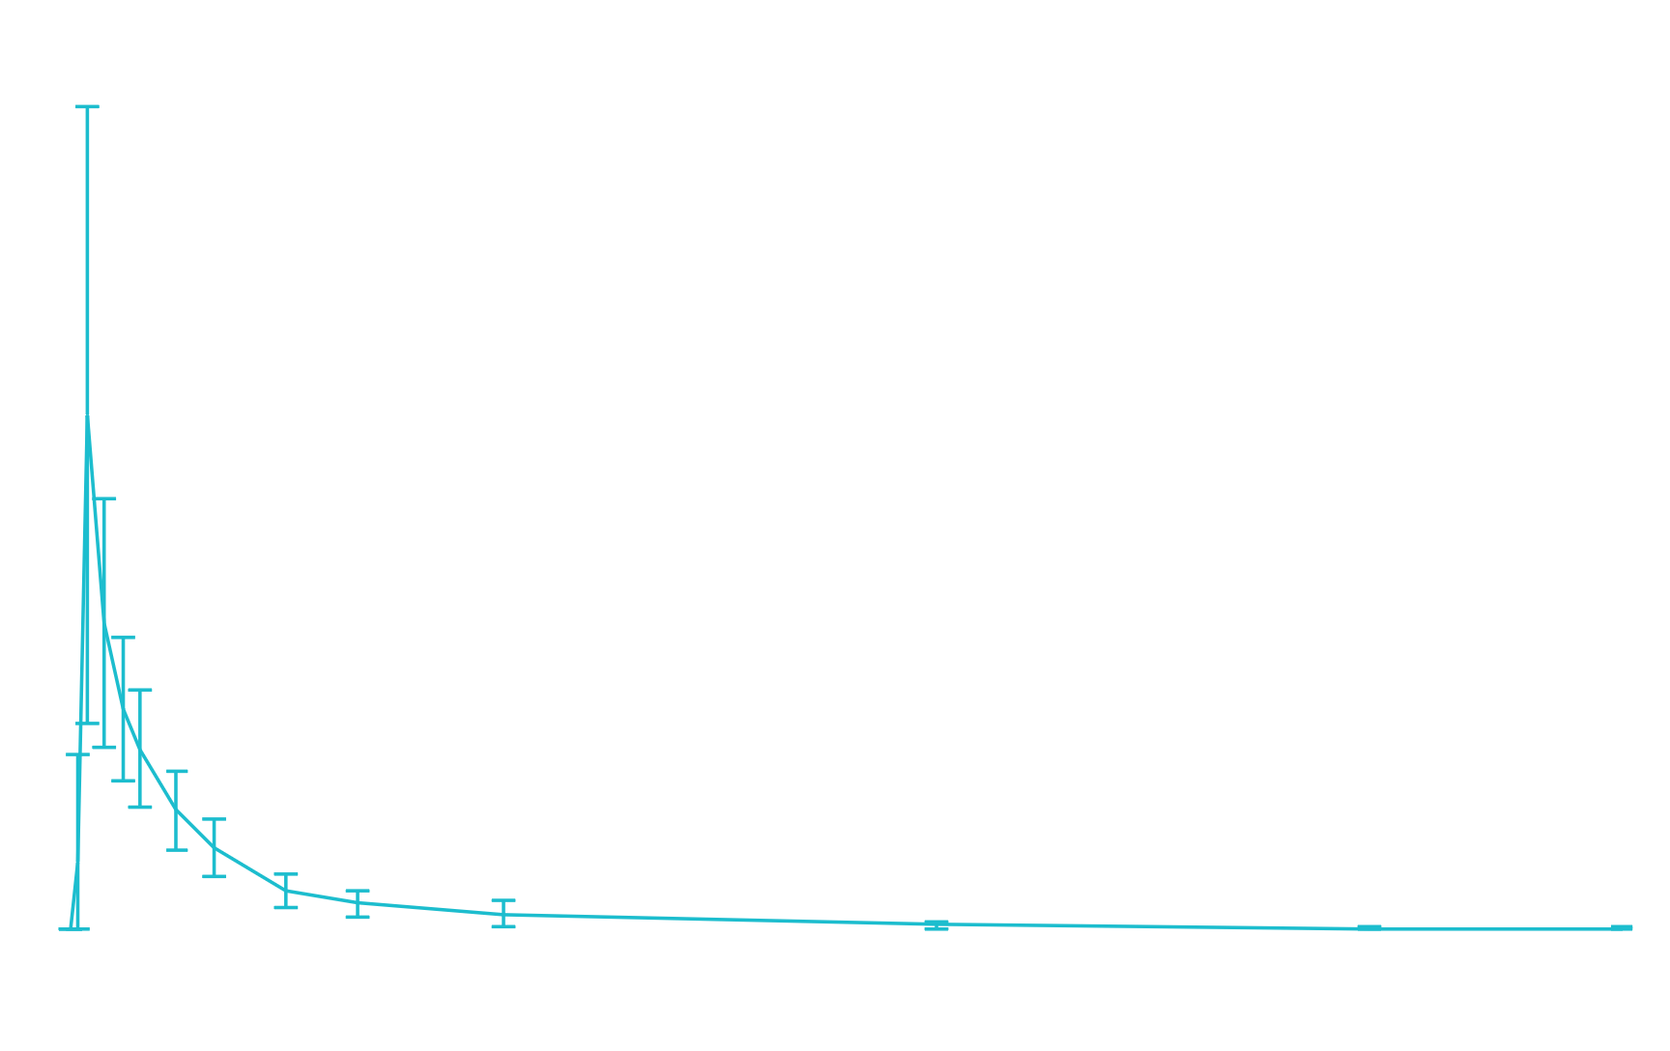
90000
80000
70000
60000
50000
Midazolam concentration (pg/mL)
40000
30000
20000
10000
0
0
6
12
18
24
30
36
42
Scheduled time (hours)
Treatment:
Midazolam
Tepotinib + midazolam

