Slide 1
Online resources:
Pulmonary function and atherosclerosis in the general population: Causal associations and clinical implications. European Journal of Epidemiology
Authors
Gunnar Engström (MD, PhD)ª, Erik Lampa (PhD)^{b}, Koen Dekkers (MSc)^{c}, Yi-Ting Lin (MD, PhD)^{b, d, e}, Kristin Ahlm (PhD)^{f}, Håkan Ahlström (MD, PhD)^{g, h, i}, Joakim Alfredsson (MD, PhD)^{j}, Göran Bergström (MD, PhD)^{k, l}, Anders Blomberg (MD, PhD)^{f}, John Brandberg (MD, PhD)^{m, n}, Kenneth Caidahl (MD, PhD)^{o, p}, Kerstin Cederlund (MD, PhD)^{q}, Olov Duvernoy (MD, PhD)^{g}, Jan E. Engvall (MD, PhD)^{r, s}, Maria J Eriksson (MD, PhD)^{o, t}, Tove Fall (PhD)^{c}, Bruna Gigante (MD, PhD)^{u, v}, Anders Gummesson (MD, PhD)^{k, w}, Emil Hagström (MD, PhD)^{x, y}, Viktor Hamrefors (MD, PhD)^{a, z}, Jan Hedner (MD, PhD)^{aa, ab}, Magnus Janzon (MD, PhD)^{ac}, Tomas Jernberg (MD, PhD)^{ad}, Linda Johnson (PhD)ª, Lars Lind (MD, PhD)^{ae}, Eva Lindberg (MD, PhD)^{af}, Maria Mannila (MD, PhD)^{ag}, Ulf Nilsson (MD, PhD)^{f}, Anders Persson (MD, PhD)^{r, ah, ai}, Hans Lennart Persson (MD, PhD)^{aj}, Margaretha Persson (MPH, PhD)^{a, ak}, Anna Ramnemark (MD, PhD)^{al}, Annika Rosengren (MD, PhD)^{k, am}, Caroline Schmidt (MD, PhD)^{k}, Linn Skoglund Larsson (MD)^{an}, C. Magnus Sköld (MD, PhD)^{ao, ap}, Eva Swahn (MD, PhD)^{ac}, Stefan Söderberg (MD, PhD)^{f}, Kjell Torén (MD, PhD)^{aq, ar}, Anders Waldenström (MD, PhD)^{f}, Per Wollmer (MD, PhD)^{as}, Suneela Zaigham (MBSS, PhD)^{a, b}, Carl Johan Östgren (MD, PhD)^{r, at}, Johan Sundström (MD, PhD)^{b, au}
ªDepartment of Clinical Sciences in Malmö, Lund University, Lund, Sweden; ^{b}Department of Medical Sciences, Uppsala University, Uppsala, Sweden; ^{c}Department of Medical Sciences, Molecular Epidemiology and Science for Life Laboratory, Uppsala University, Uppsala, Sweden; ^{d}Department of Neurobiology, Care Sciences and Society, Karolinska Institute, Huddinge, Sweden; ^{e}Department of Family Medicine, Kaohsiung Medical University, Kaohsiung City, Taiwan; ^{f}Department of Public Health and Clinical Medicine, Section of Medicine, Umeå University, Umeå, Sweden; ^{g}Department of Surgical Sciences, Section of Radiology, Uppsala University, Uppsala, Sweden; ^{h}BFC, Uppsala University Hospital, Uppsala, Sweden
^{i}Antaros Medical AB, Mölndal, Sweden; ^{j}Department of Cardiology, and Department of Health, Medicine and Caring Sciences, Unit of Cardiovascular Sciences, Linköping University Linköping, Sweden; ^{k}Department of Molecular and Clinical Medicine, Institute of Medicine, Sahlgrenska Academy, University of Gothenburg, Gothenburg, Sweden;
^{l}Clinical Physiology, Sahlgrenska University Hospital, Gothenburg, Sweden; ^{m}Region Västra Götaland, Sahlgrenska University Hospital, Department of Radiology, Gothenburg, Sweden;
^{n}Department of Radiology, Institute of Clinical Sciences, Sahlgrenska Academy, University of Gothenburg, Gothenburg, Sweden; ºDepartment of Clinical Physiology, Karolinska University Hospital, Stockholm, Sweden; ^{p}Department of Clinical Physiology, Sahlgrenska University Hospital, and Sahlgrenska Academy, Gothenburg, Sweden; ^{q}Department of Clinical Science, Intervention and Technology, Karolinska Institutet, Stockholm, Sweden; ^{r}CMIV, Centre of Medical Image Science and Visualization, Linköping University, Linköping, Sweden; ^{s}Department of Clinical Physiology, and Department of Health, Medicine and Caring Sciences, Linköping University, Linköping, Sweden; ^{t}Department of Molecular Medicine and Surgery, Karolinska Institutet, Stockholm; ^{u}Division of Cardiovascular Medicine Unit, Department of Medicine Solna, Karolinska Institute, Stockholm, Sweden; ^{v}Department of Clinical Science, Danderyd University Hospital, Stockholm, Sweden; ^{w}Department of Clinical Genetics and Genomics, Region Västra Götaland, Sahlgrenska University Hospital, Gothenburg, Sweden; ^{x}Department of Medical Sciences, Cardiology, Uppsala University, Uppsala, Sweden; ^{y}Uppsala Clinical Research Center, Uppsala University, Uppsala, Sweden; ^{z}Department of Cardiology, Skåne University Hospital, Malmö, Sweden; ^{aa}Pulmonary Department, Sleep Disorders Center, Sahlgrenska University Hospital, Gothenburg, Sweden; ^{ab}Center of Sleep and Wake Disorders, Sahlgrenska Academy, Gothenburg University, Göteborg, Sweden; ^{ac}Department of Cardiology, and Department of Health, Medicine and Caring Sciences, Unit of Cardiovascular Sciences, Linköping University, Linköping, Sweden; ^{ad}Department of Clinical Sciences, Danderyd University Hospital, Karolinska Institutet, Stockholm, Sweden; ^{ae}Department of Medical Sciences, Clinical Epidemiology, Uppsala University, Uppsala, Sweden; ^{af}Department of Medical Sciences, Respiratory, Allergy and Sleep Research, Uppsala University, Sweden; ^{ag}Heart and Vascular Theme, Department of Cardiology, and Clinical Genetics, Karolinska University Hospital, Stockholm, Sweden; ^{ah}Department of Radiology, and Department of Health, Medicine and Caring Sciences, Linköping University, Linköping, Sweden; ^{ai}Department of Clinical Sciences, Huddinge University Hospital, Karolinska Institute, Stockholm, Sweden
^{aj}Respiratory Medicine, Department of Medical and Health Sciences (IMH), Linköping University, Linköping, Sweden; ^{ak}Department of Internal Medicine, Skåne University Hospital, Malmö, Sweden; ^{al}Department of Community Medicine and Rehabilitation, Geriatric Medicine, Umeå university, Umeå, Sweden; ^{am}Department of Medicine Geriatrics and Emergency Medicine, Sahlgrenska University Hospital Östra Hospital, Gothenburg, Sweden; ^{an}Department of Public Health and Clinical Medicine, Umeå University, Umeå, Sweden; ^{ao}Department of Respiratory Medicine and Allergy, Karolinska University Hospital Solna, Stockholm, Sweden; ^{ap}Respiratory Medicine Unit, Department of Medicine Solna and Center for Molecular Medicine, Karolinska Institutet, Stockholm, Sweden; ^{aq}Section of Occupational and Environmental Medicine, School of Public Health and Community Medicine, Institute of Medicine, Sahlgrenska Academy, University of Gothenburg, Gothenburg, Sweden; ^{ar}Department of Occupational and Environmental Medicine, Sahlgrenska University Hospital, Gothenburg, Sweden; ^{as}Department of Translational Medicine, Lund University, Malmö; ^{at}Department of Health, Medicine and Caring Sciences, Linköping University, Linköping, Sweden
^{au}The George Institute for Global Health, University of New South Wales, Sydney, Australia
Corresponding author: Gunnar Engström, Department of Clinical science in Malmö, Lund university, Sweden. Email: Gunnar.Engstrom@med.lu.se.

Slide 2
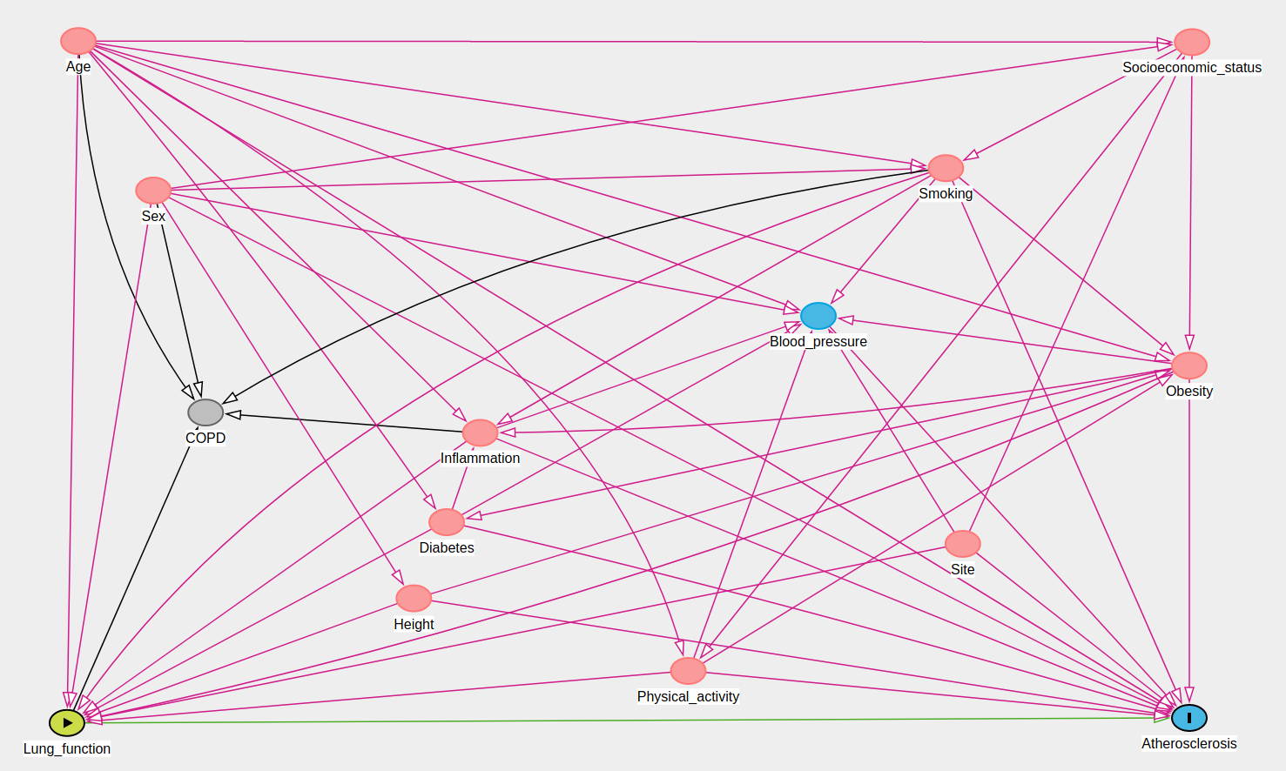
Supplement figure 1

Slide 3
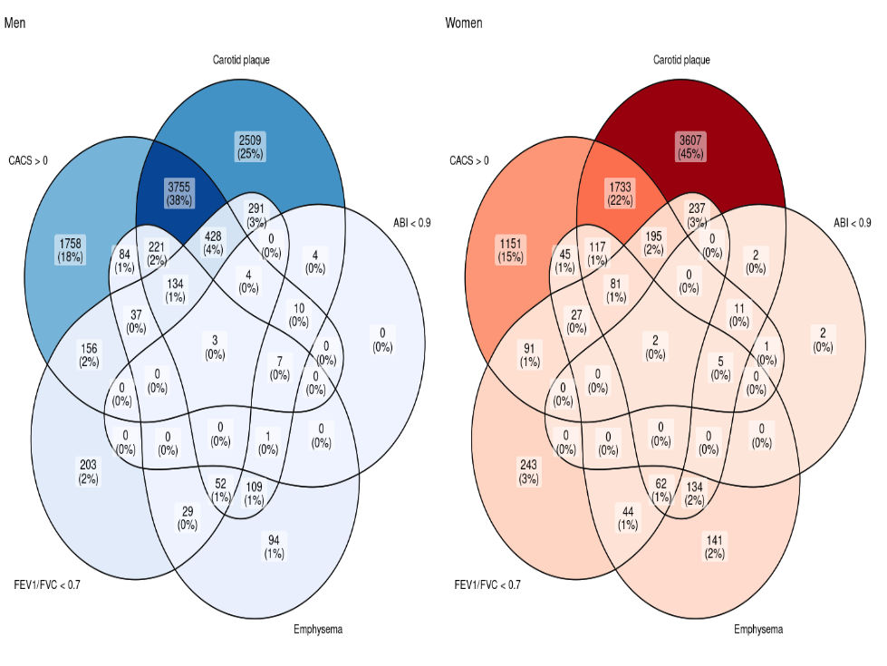
Supplement figure 2

Slide 4
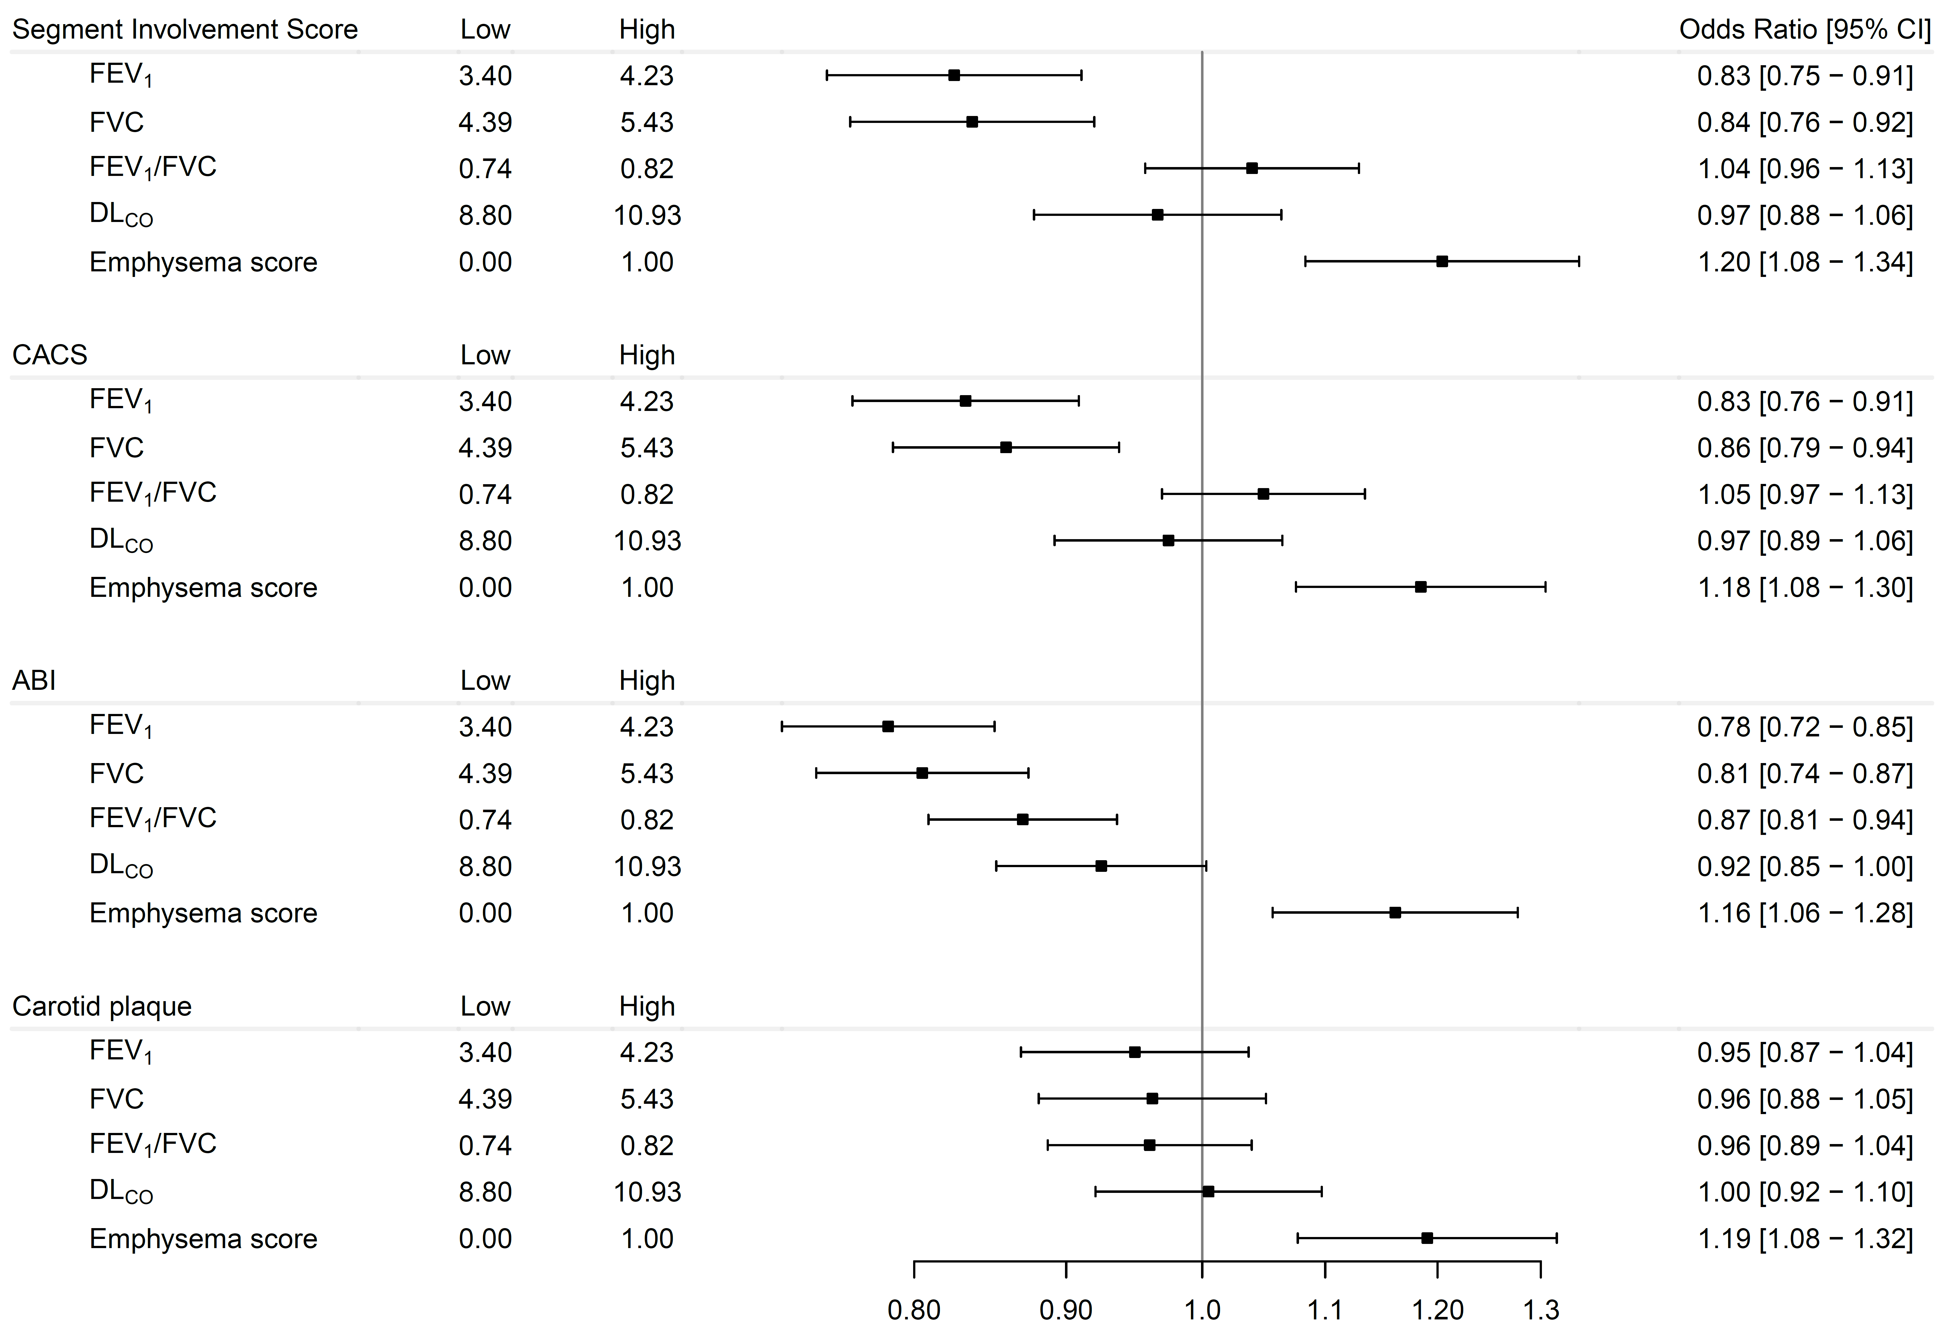
Supplement figure 3a, men

Slide 5
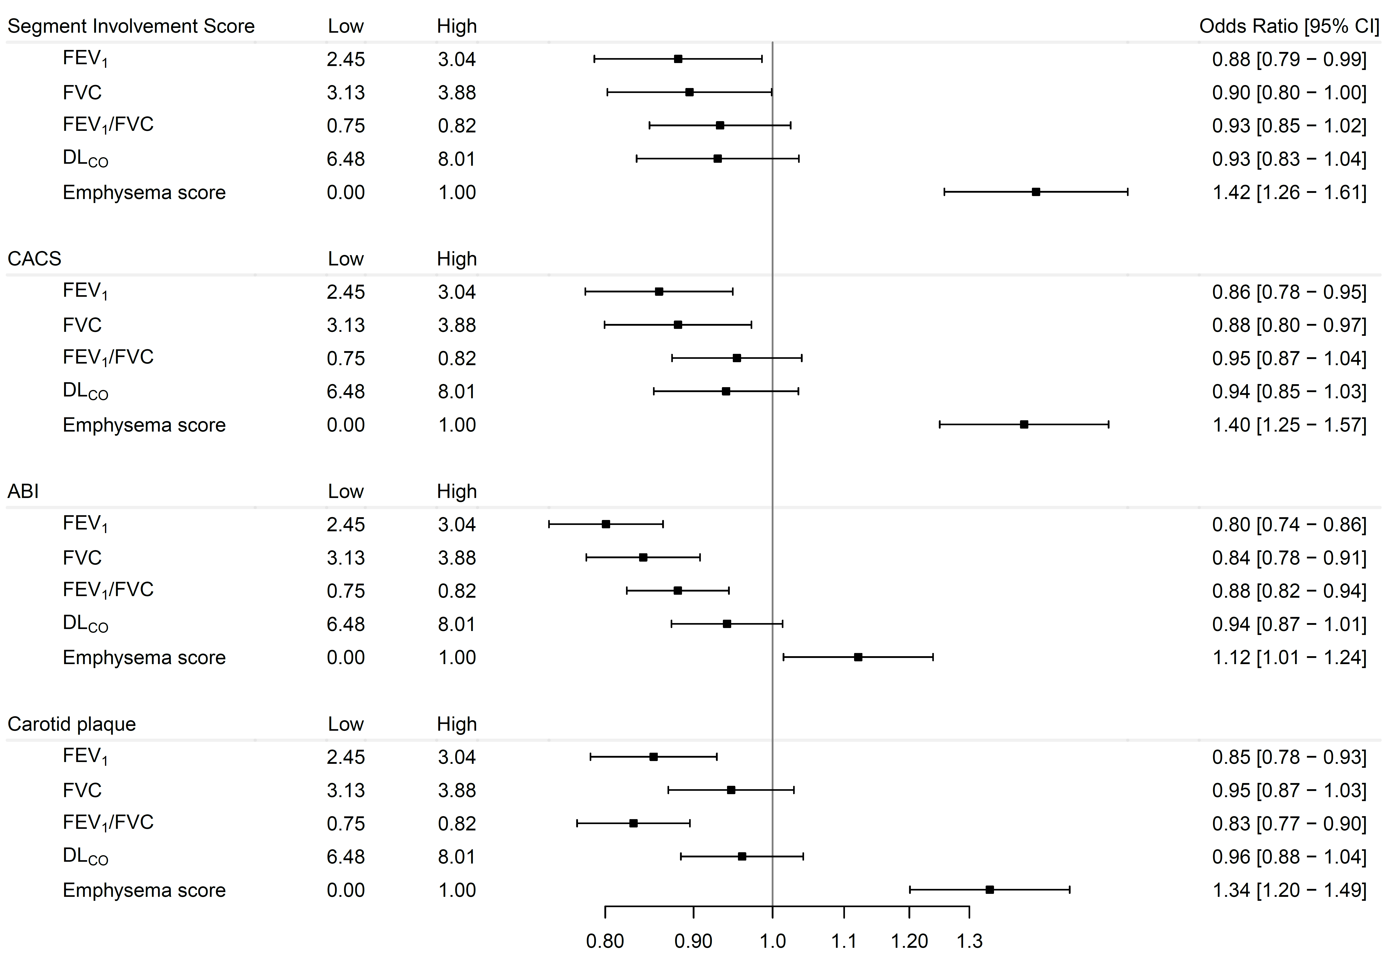
Supplement figure 3b, women

Slide 6
Supplement figure 4
never smokers
FEV₁ (L)
FVC (L)
FEV₁/FVC (%)
D_{LCO} (mmol*min⁻¹*kPa⁻¹)
Emphysema
SIS>2 (A)
CACS>0 (B)
ABI<0.9 (C)
Carotid plaque
yes (D)

