Slide 1
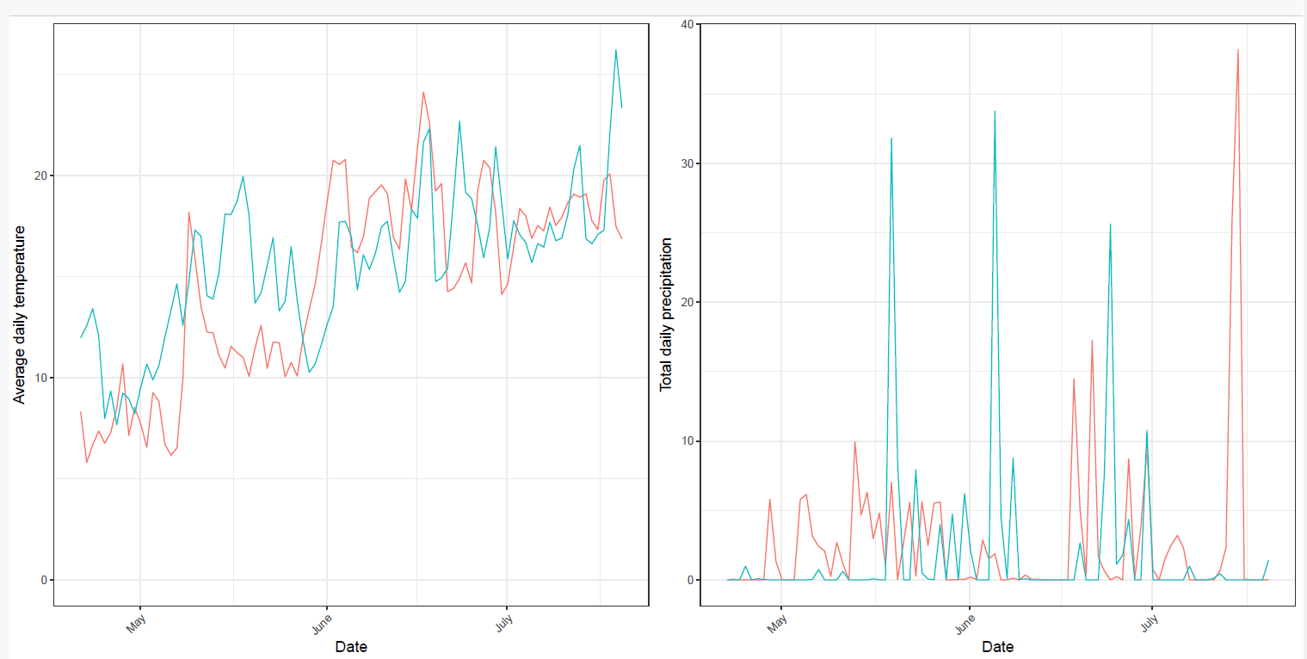
Figure S3. Average daily temperature (left) and average daily precipitation (right) at weather station ‘Veenkampen’, at ca. 3 km from an experimental field in which the relation was determined between inoculum dose of P. brasiliense and infection incidence. Data were collected in the period between half April and the third week of July, the period between planting and sampling. Lines in red: data 2021; lines in blue: data 2022.

