Slide 1
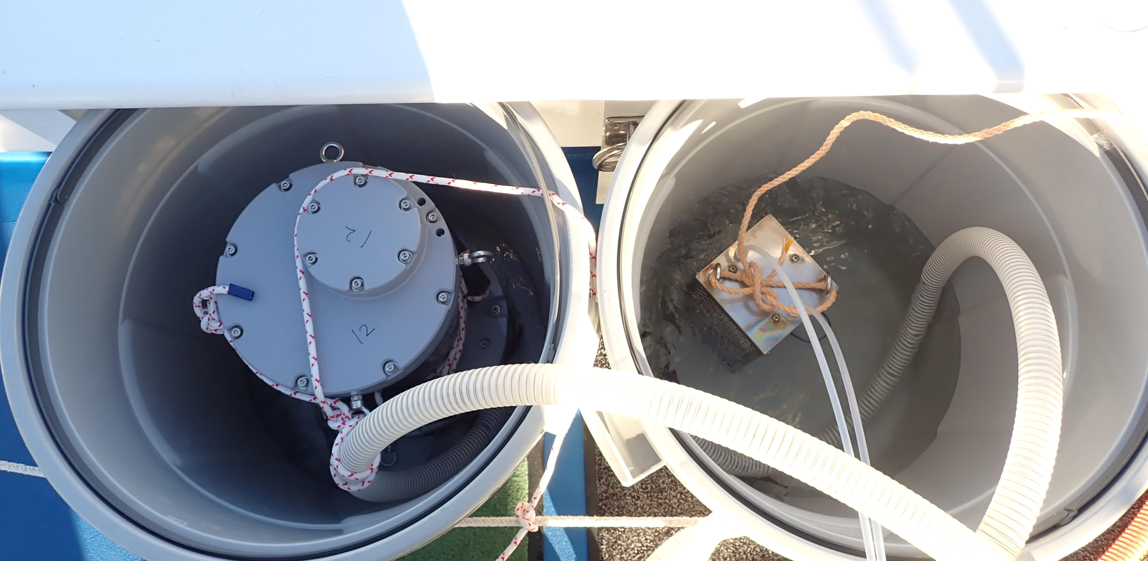
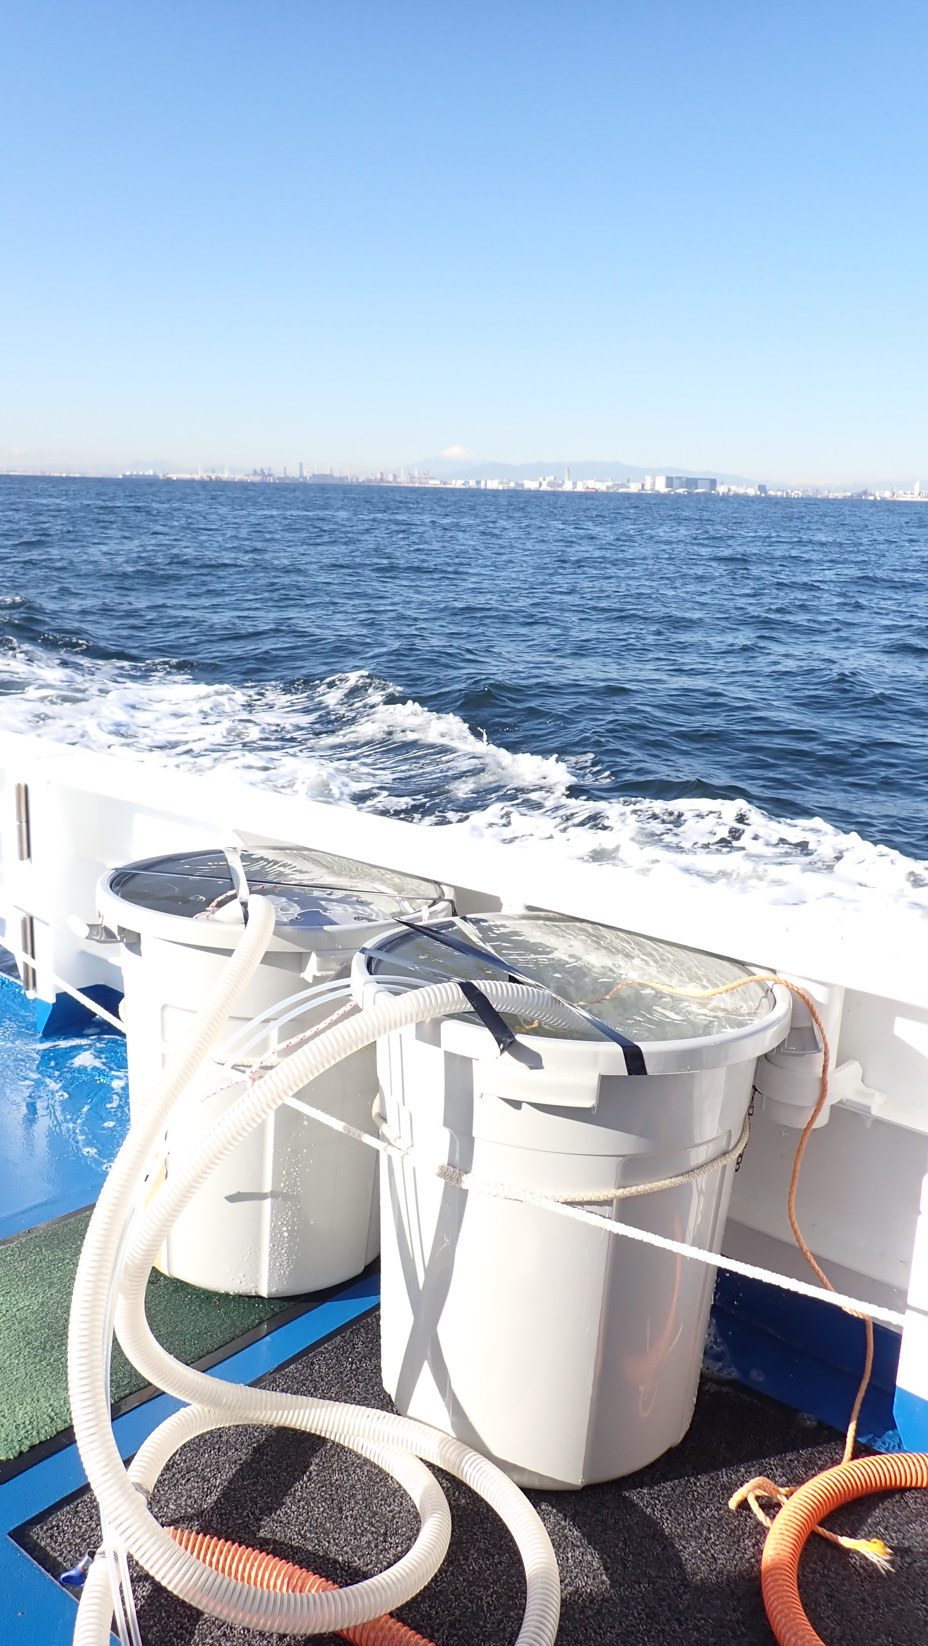
(a)
(b)
Figure S1
Setup for accuracy evaluation of the developed pCO₂ measurement system during an underway observation in Tokyo Bay. (a) Side-by-side comparison of the developed device (left) and a commercially available pCO₂ analyzer (right) installed in separate buckets. Seawater pumped from ~50 cm depth was directed into each bucket to supply the equilibrators. (b) View of the experimental setup on the ship’s deck during continuous pCO₂ monitoring.

Slide 2
xCO₂ (ppm)
xCO₂ (ppm)
xCO₂ (ppm)
Time since start (min)
Figure S2
Raw xCO₂ data (ppm) obtained during the laboratory response time experiments, corresponding to the normalized results shown in Figure 3.

Slide 3
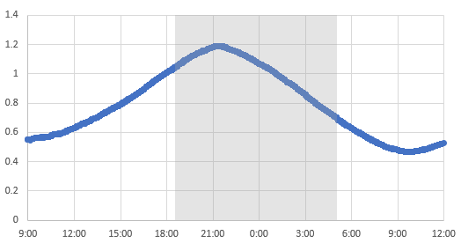
Tide level (m)
Time (JST)
Figure S3
Temporal variation of tidal level in Lake Komuke measured using an Infinity-WH (JFE Advantech Co., Ltd., Hyogo, Japan). All times are in Japan Standard Time (JST, UTC+9). The shaded gray area represents the period after sunset.

