Slide 1
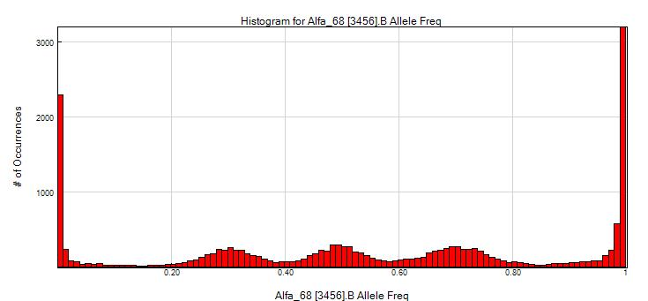
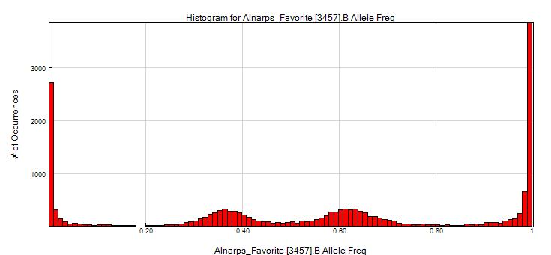
Figure S1. B-allele frequency distribution plots for the tetraploid ‘Alfa 68’ (left) and its SNP validated offspring, the triploid ‘Alnarps Favorit’ (right).

Slide 2
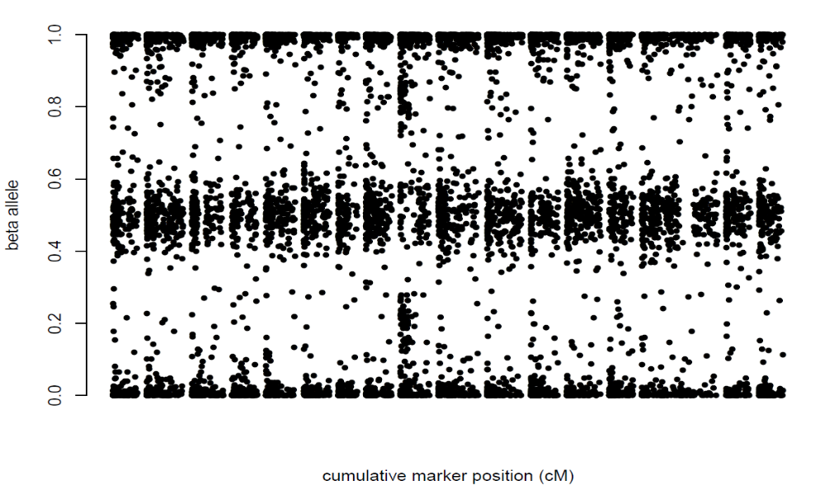
Figure S2. B-allele frequency distribution plot organized by chromosome and cM position for ‘Lord Rosebery’ (MUNQ 2805), where a possible case of partial or complete tetrasomy was observed for the proximal part of chromosome 9.
B allele frequency
1 2 3 4 5 6 7 8 9 10 11 12 13 14 15 16 17
Cumulative marker position (cM)

