Slide 1
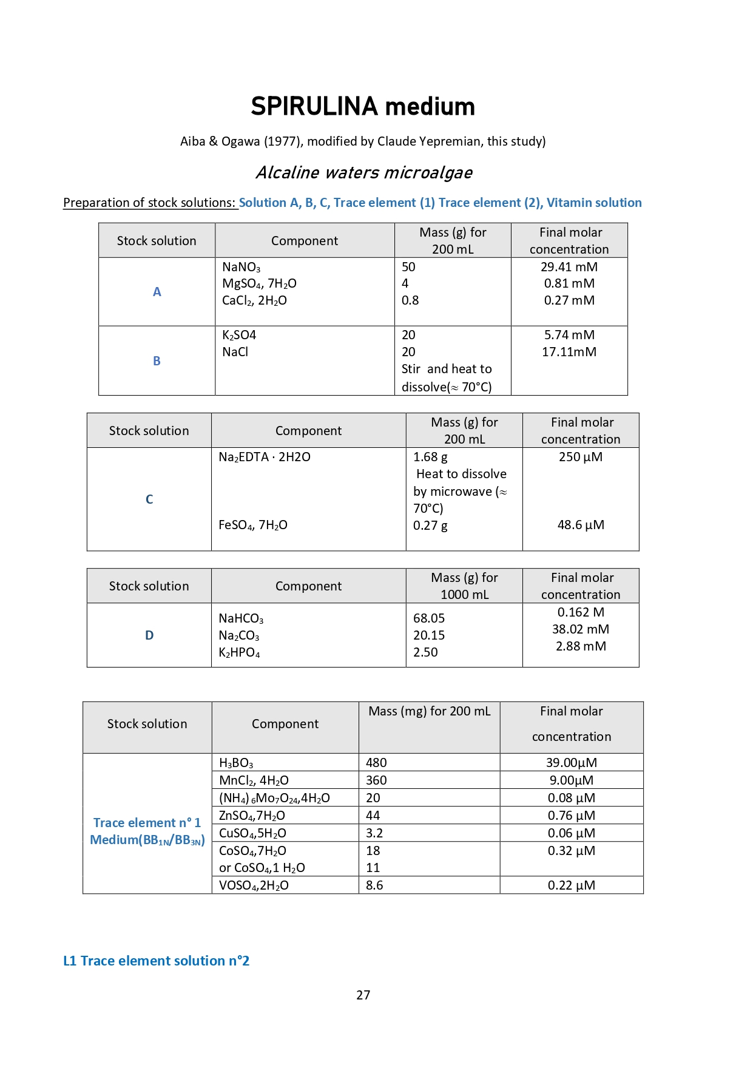
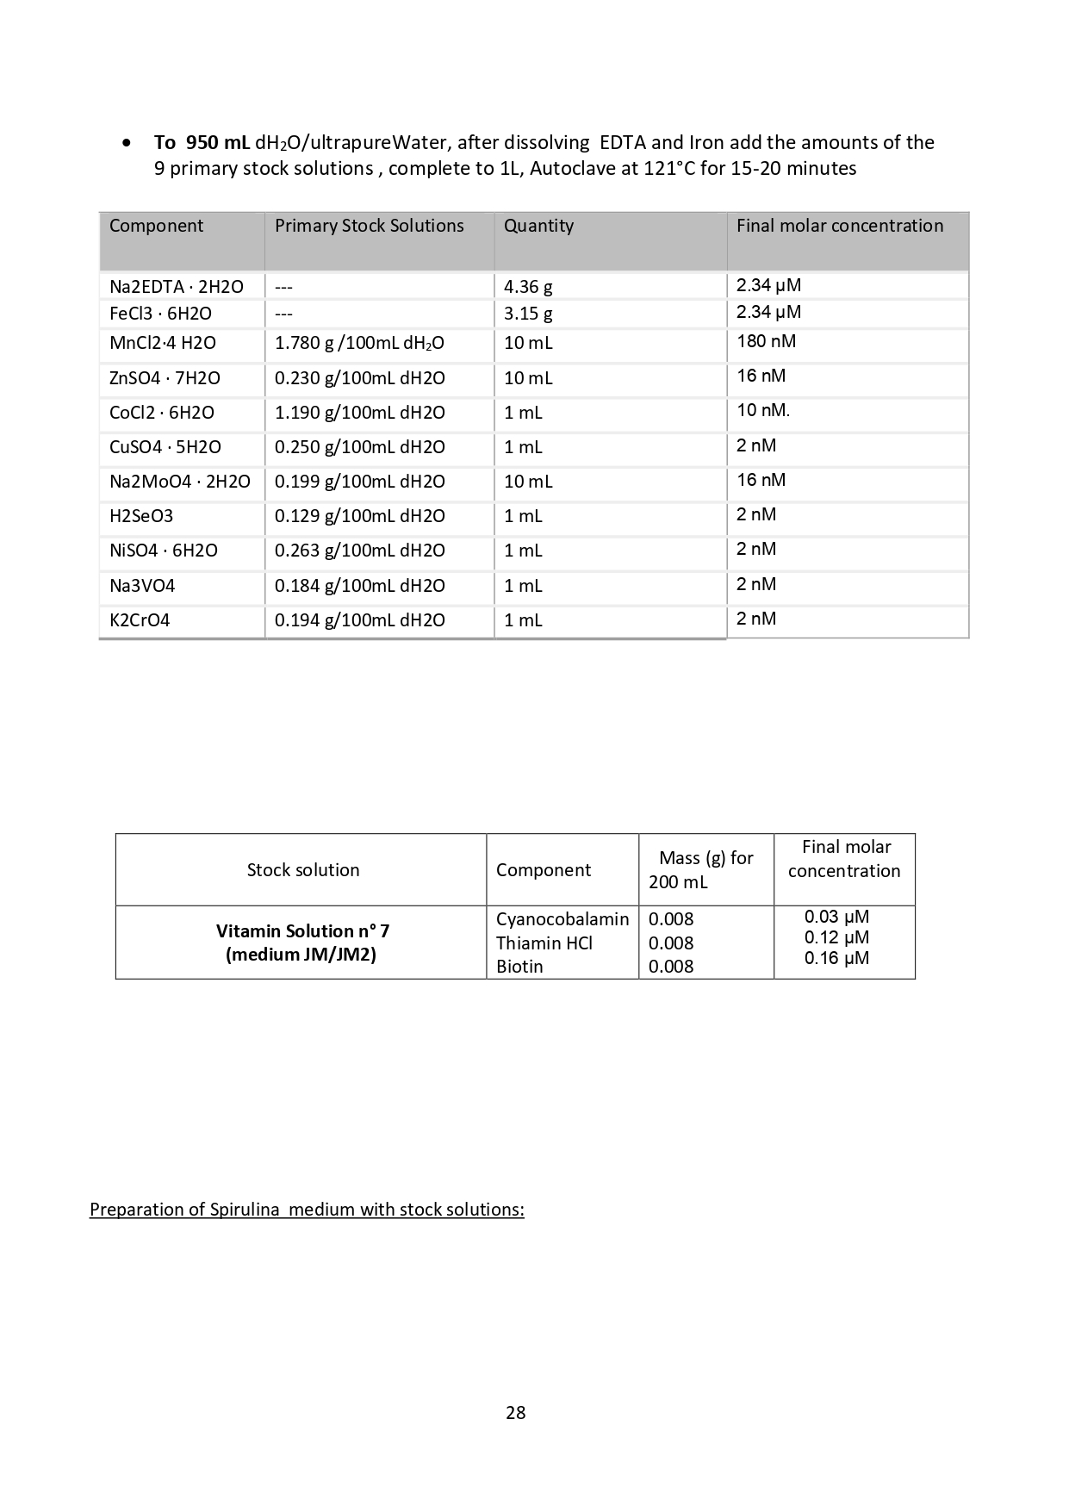
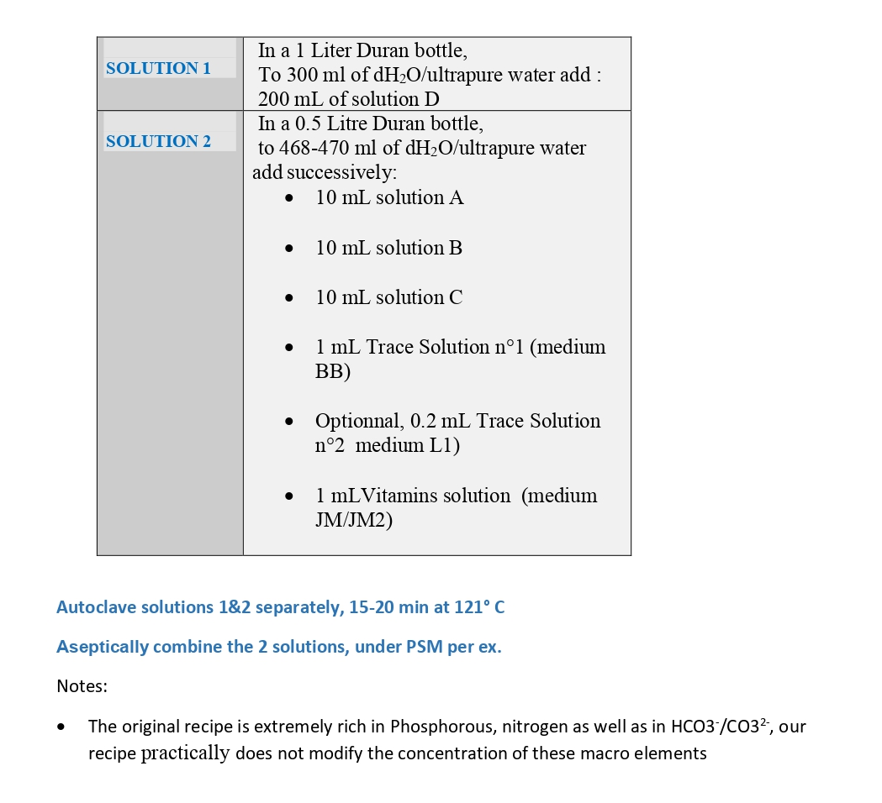
Supp. Figure S1. « Spirulina » medium

Slide 2
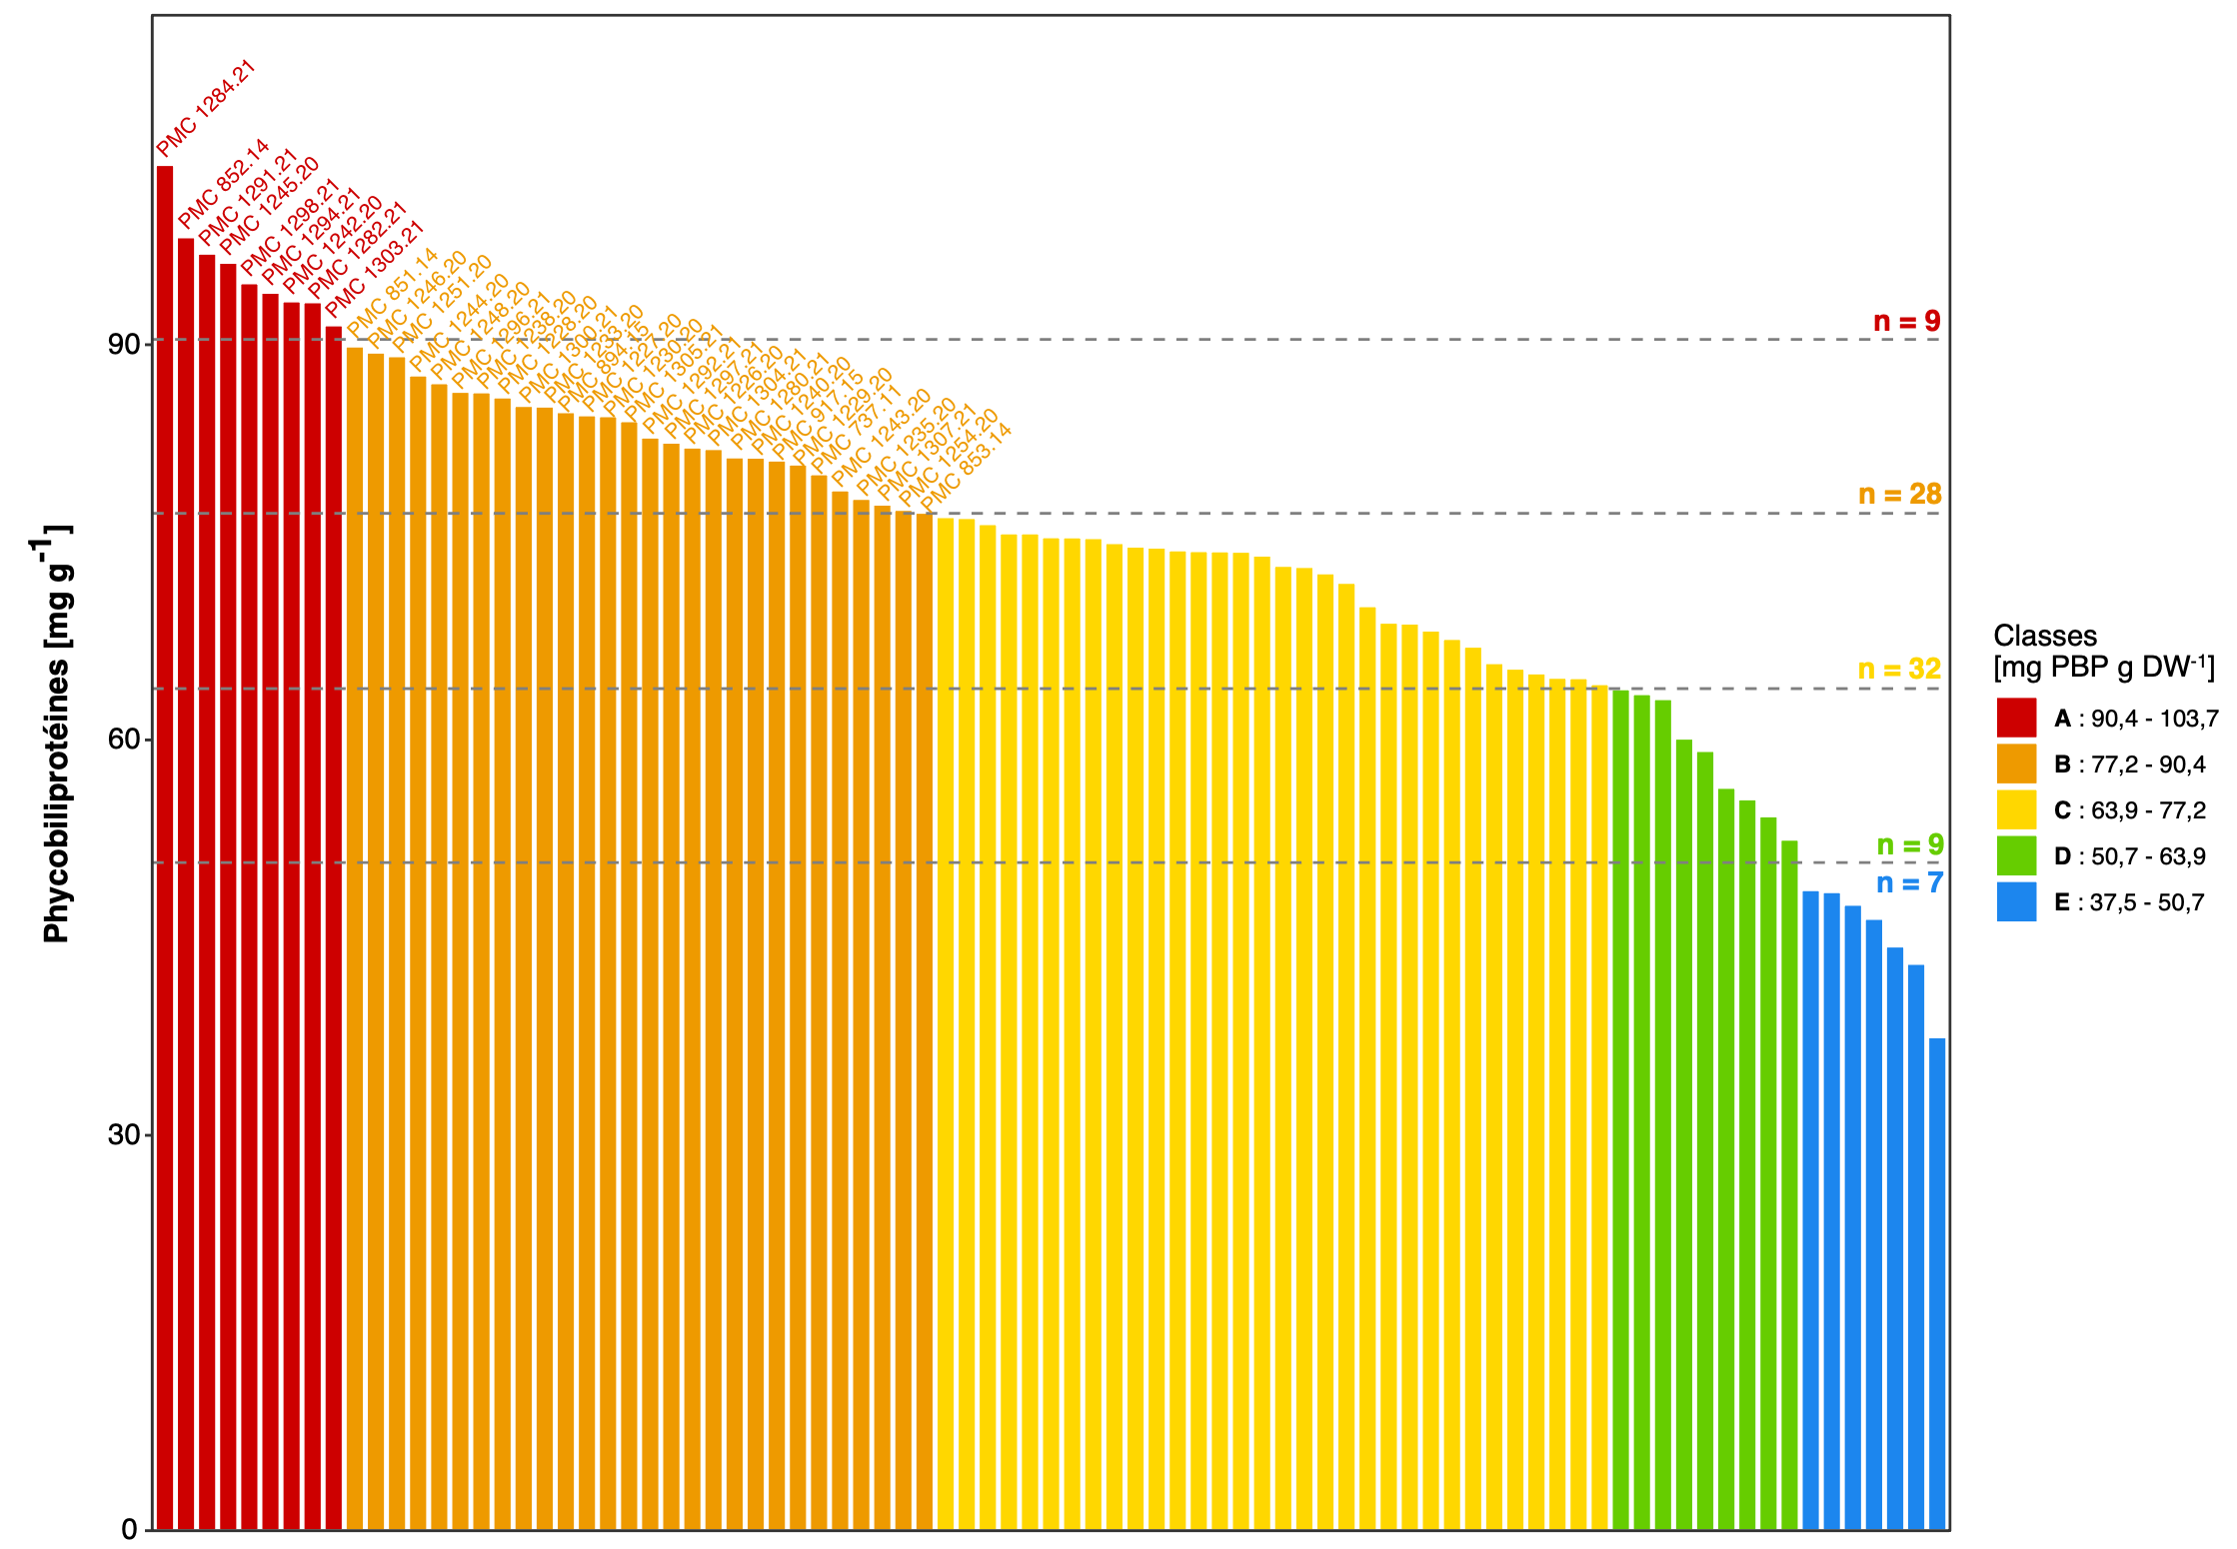
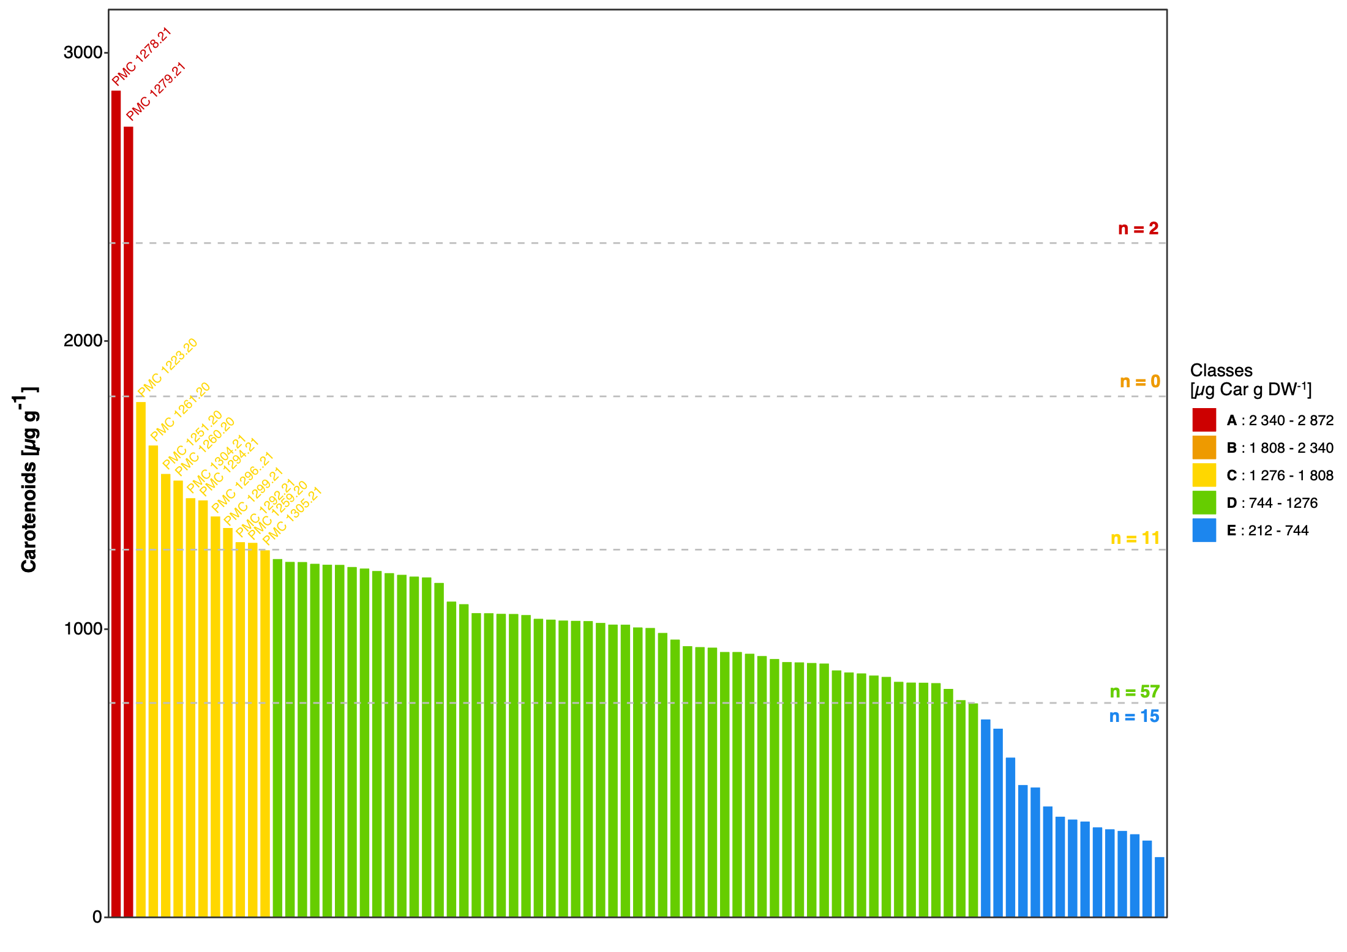
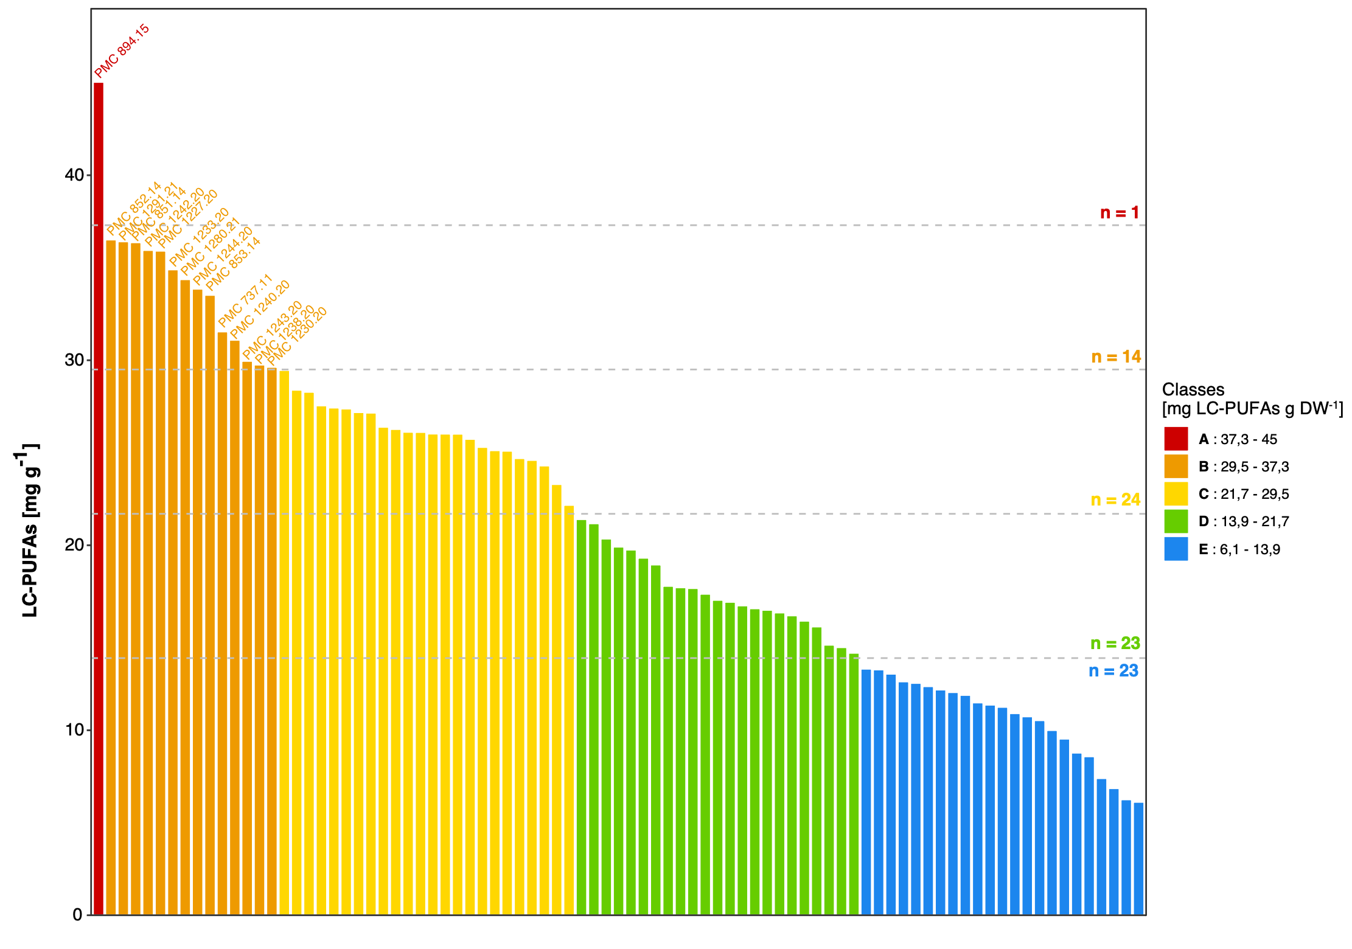
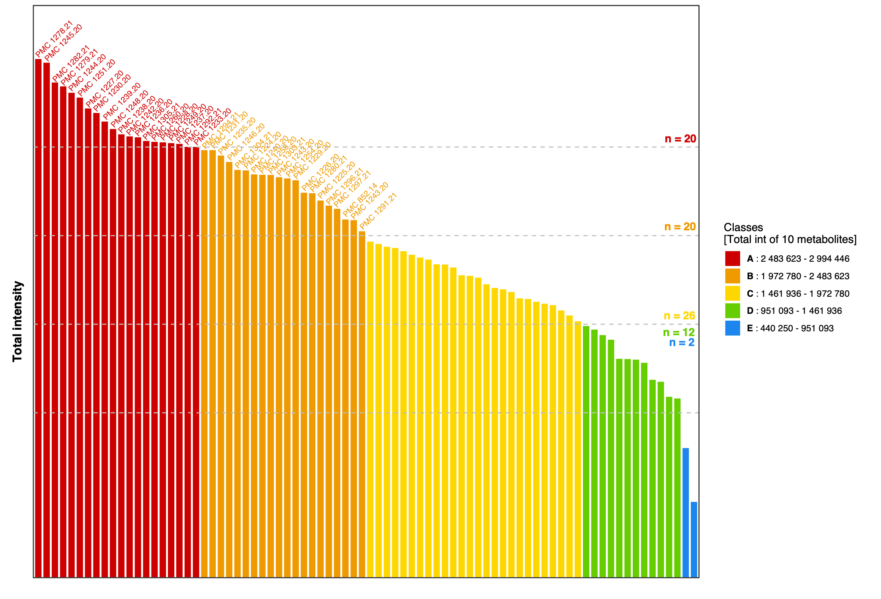
Supp. Figure S2. Ranking classification of the 85 Limnospira strains investigated for their production of PBP (A) , carotenoids (B), PUFA (C) and other metabolites of interest (D).
A B
C D

Slide 3
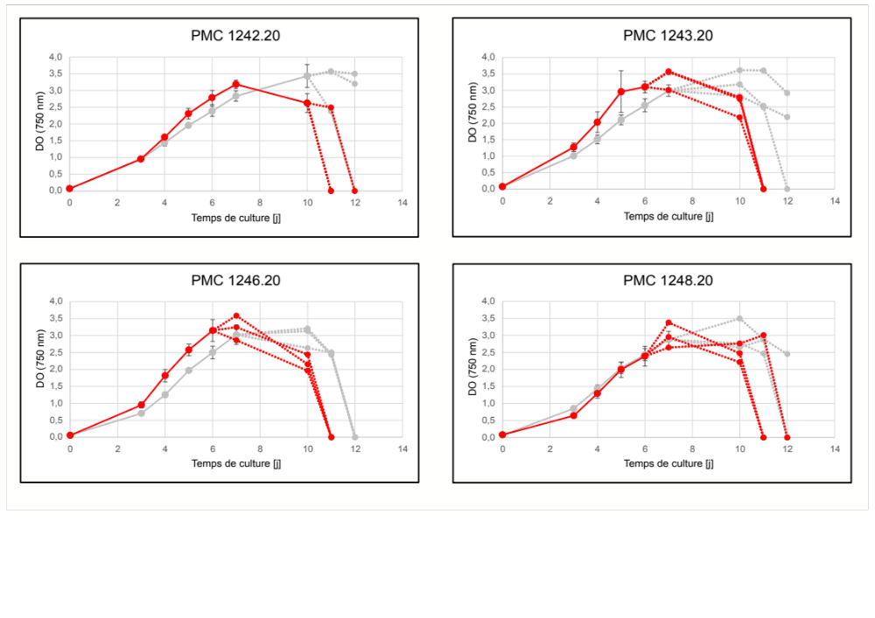
Supp. Figure S3. Absorbance (DO_{750nm}) curves of the L. platensis PMC 1242.20, PMC 1243.20, PMC 1246.20, et PMC 1248.20 strains under white (gray color) or red-light (red) conditions. Asynchronous replicates are illustrated by dot-lines. *: significative difference between the two light conditions (p<0.05; MWW test).
PMC 1242.20
PMC 1243.20
Day of culture
Day of culture
PMC 1246.20
PMC 1248.20
Day of culture
Day of culture

Slide 4
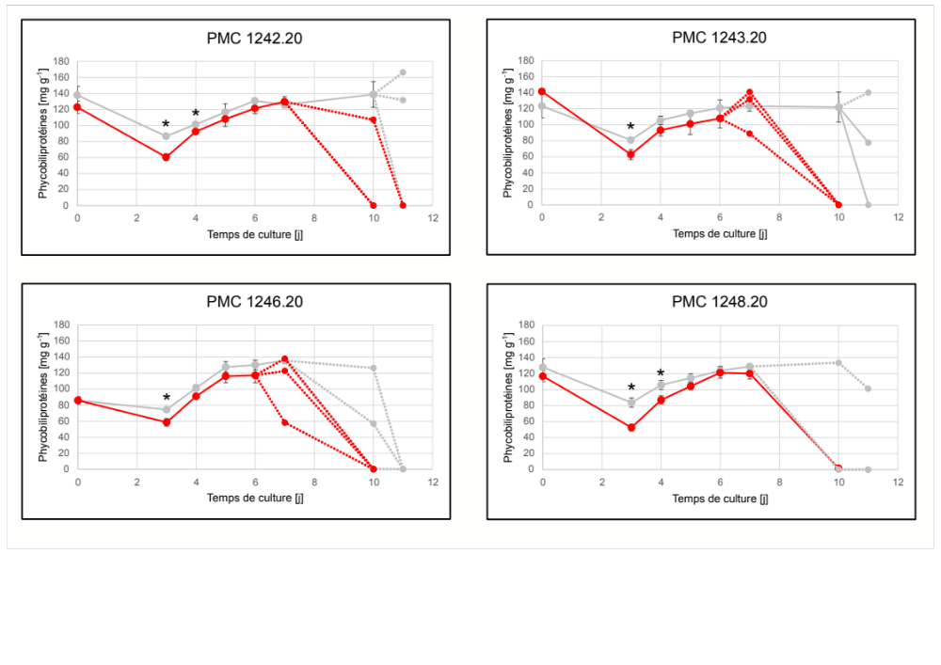
Supp. Figure S4. Phycobiliproteins production curves (mg g⁻¹ DW) of the L. platensis PMC 1242.20, PMC 1243.20, PMC 1246.20, et PMC 1248.20 strains under white (gray color) or red-light (red) conditions. Asynchronous replicats are illustrated by dot-lines. *: significative difference between the two light conditions (p<0.05; MWW test).
PMC 1242.20
PMC 1243.20
Phycobiliproteins
Phycobiliproteins
Day of culture
Day of culture
PMC 1246.20
PMC 1248.20
Phycobiliproteins
Phycobiliproteins
Day of culture
Day of culture

Slide 5
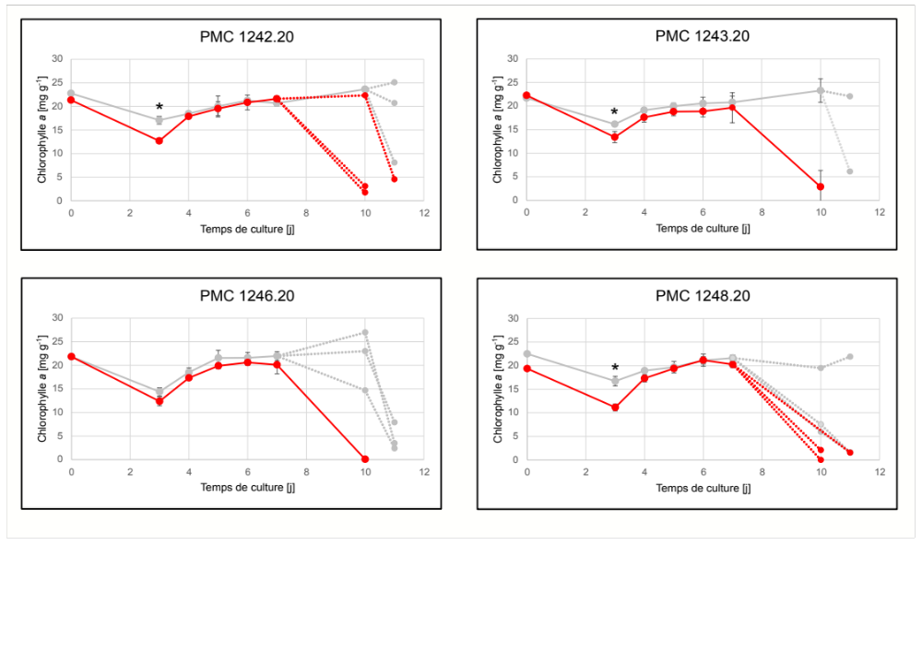
Supp. Figure S5. Chlorophyll a production curves (mg g⁻¹ DW) of the L. platensis PMC 1242.20, PMC 1243.20, PMC 1246.20, et PMC 1248.20 strains under white (gray color) or red-light (red) conditions. Asynchronous replicates are illustrated by dot-lines. *: significative difference between the two light conditions (p<0.05; MWW test).
PMC 1242.20
PMC 1243.20
Chlorophyll a
Chlorophyll a
Day of culture
Day of culture
PMC 1246.20
PMC 1248.20
Chlorophyll a
Chlorophyll a
Day of culture
Day of culture

Slide 6
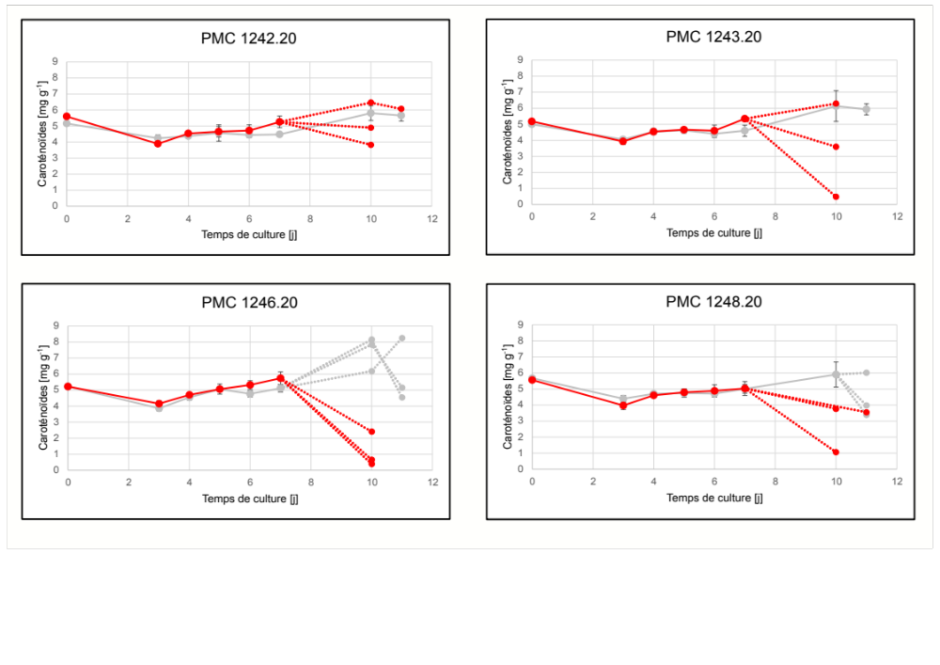
Supp. Figure S6. Carotenoids production curves (mg g⁻¹ DW) of the L. platensis PMC 1242.20, PMC 1243.20, PMC 1246.20, et PMC 1248.20 strains under white (gray color) or red-light (red) conditions. Asynchronous replicates are illustrated by dot-lines. *: significative difference between the two light conditions (p<0.05; MWW test).
PMC 1242.20
PMC 1243.20
Carotenoids
Carotenoids
Day of culture
Day of culture
PMC 1246.20
PMC 1248.20
Carotenoids
Carotenoids
Day of culture
Day of culture

Slide 7
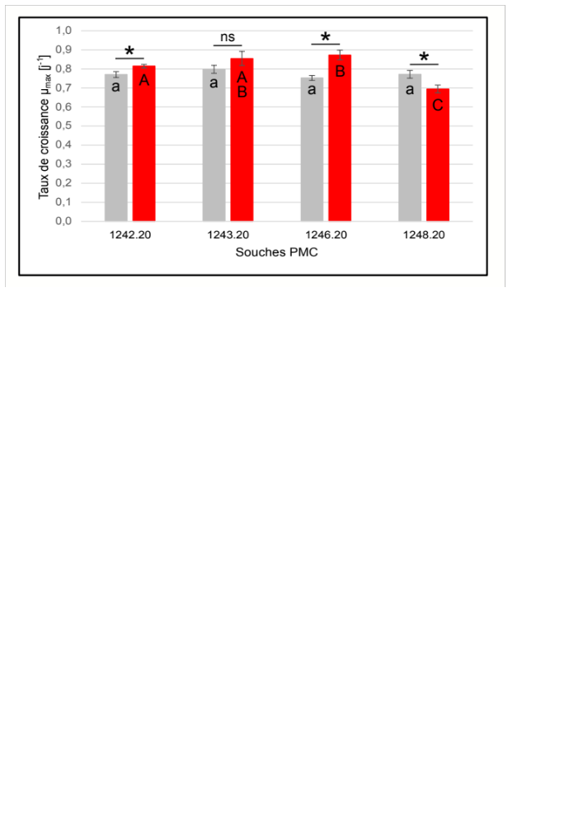
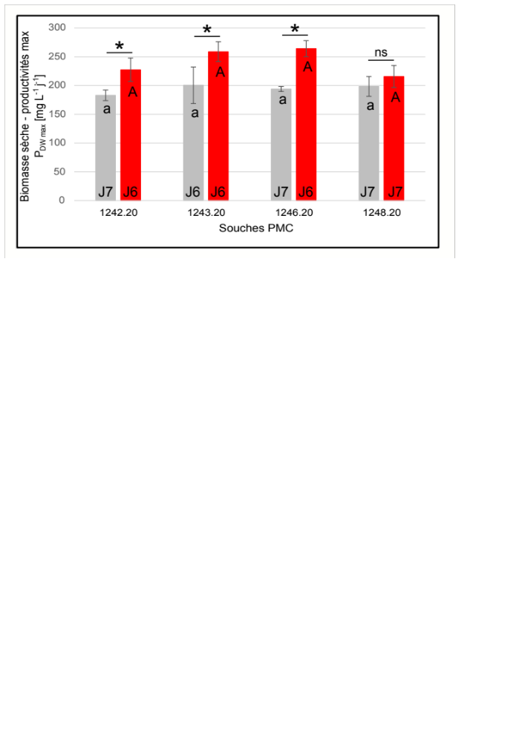

Supp. Figure S7. Productivity performances of the L. platensis strains PMC 1242.20, PMC 1243.20, PMC 1246.20, and PMC 1248.20 strains, regarding maximum growth reached per day (µ_{max} D⁻¹) (A), and maximum biomass production rates (PDW_{max}) (B). Gray: White light, Red: Red light. Significant differences between the two light quality conditions for a given strain are marked with an asterisk (*) (p < 0.05, MWW test), ns = non-significant. Significant differences between all strains under white or red light are indicated by different lowercase and uppercase letters, respectively (p < 0.05, KW test and post-hoc MWW tests).
A B
Growth rate [µ_{max} D⁻¹]
Maximal dry biomass productivity
PDW $[$mg L⁻¹ D⁻¹]
PMC strains
PMC strains

Slide 8
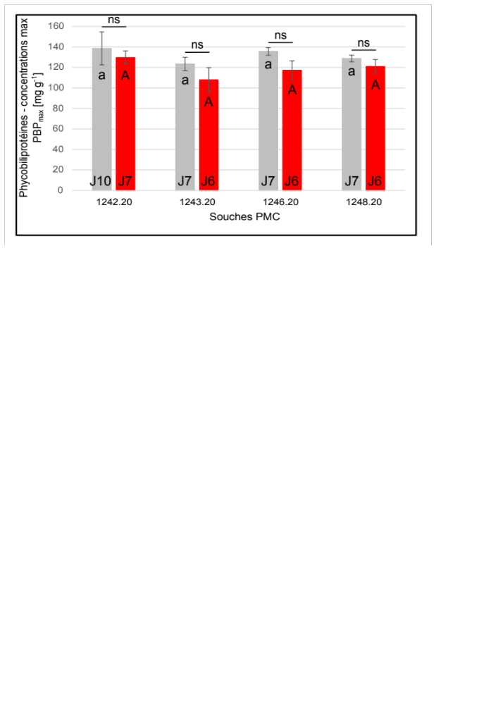
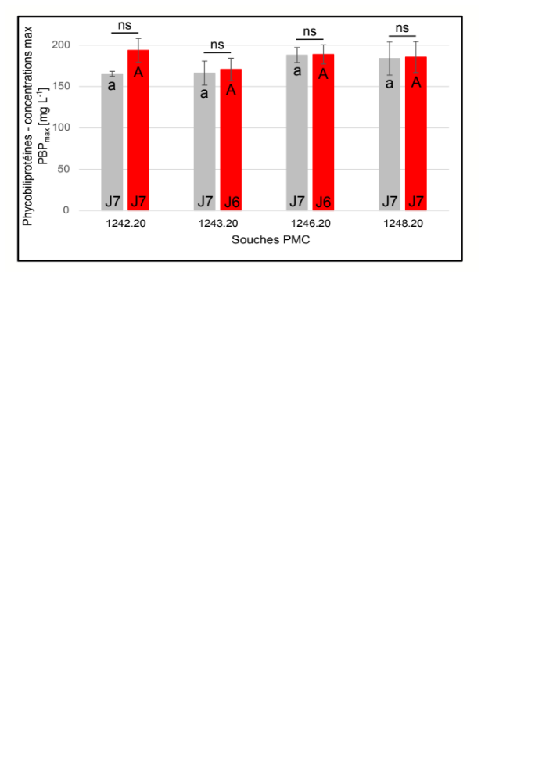
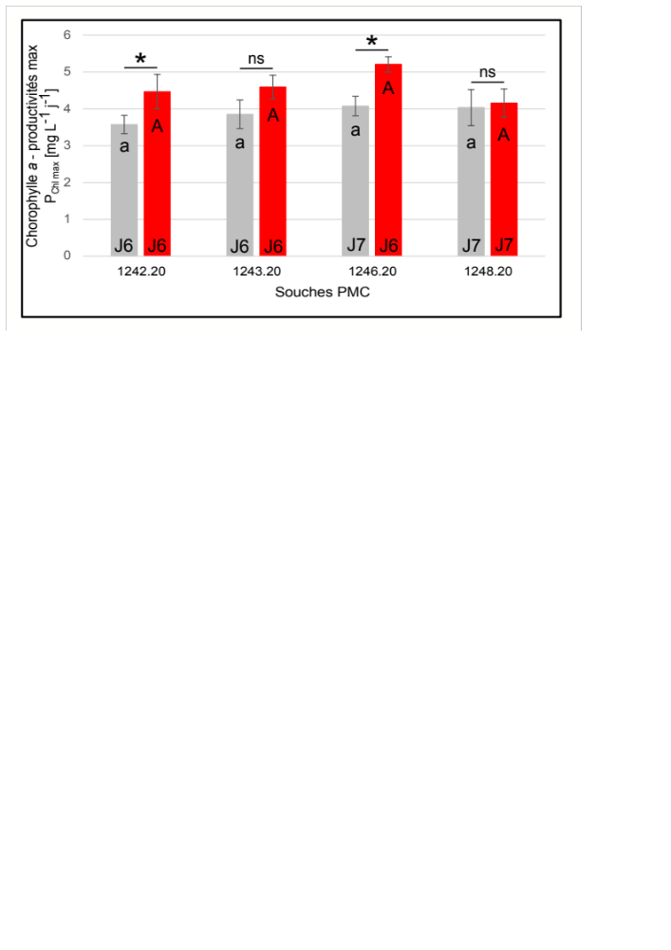
Supp. Figure S8. Production performances of the L. platensis strains PMC 1242.20, PMC 1243.20, PMC 1246.20, and PMC 1248.20 strains, regarding maximum concentrations of phycobiliproteins per unit of biomass (PBP_{max}) expressed in mg g⁻¹ DW (A), or in mg L⁻¹ of culture (B), and maximum chlorophyll-a production rate per unit volume and day (PChl_{max}) (C). Gray: White light, Red: Red light. Significant differences between the two light quality conditions for a given strain are marked with an asterisk (*) (p < 0.05, MWW test), ns = non-significant. Significant differences between all strains under white or red light are indicated by different lowercase and uppercase letters, respectively (p < 0.05, KW test and post-hoc MWW tests).
A B
C
Maximal PBP concentration
Maximal PBP concentration
PMC strains
PMC strains
Maximal chlorophyll a productivity [mg L⁻¹ d⁻¹]
PMC strains

Slide 9
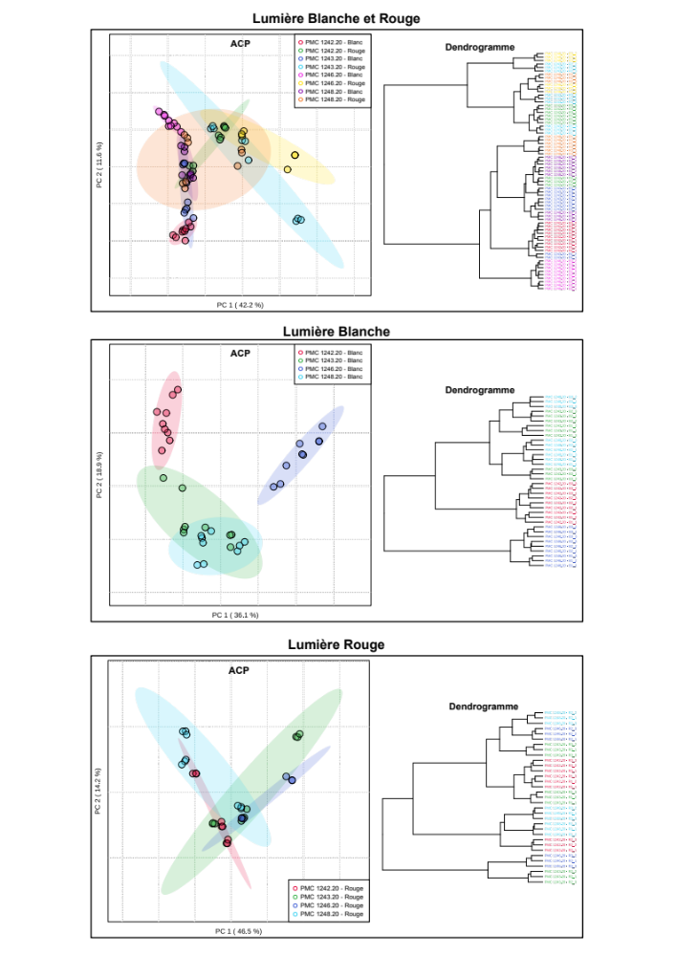
Supp. Figure S9. Principal component analysis of the whole untargeted metabolomic dataset generated for the L. platensis strains PMC 1242.20, PMC 1243.20, PMC 1246.20, and PMC 1248.20 strains grown under white and red light by LC-MSMS (positive mode).
White and red light
White light
Red light
PCA
White
Red
White
Red
White
Red
White
Red
PCA
White
White
White
White
PCA
Red
Red
Red
Red

