Slide 1
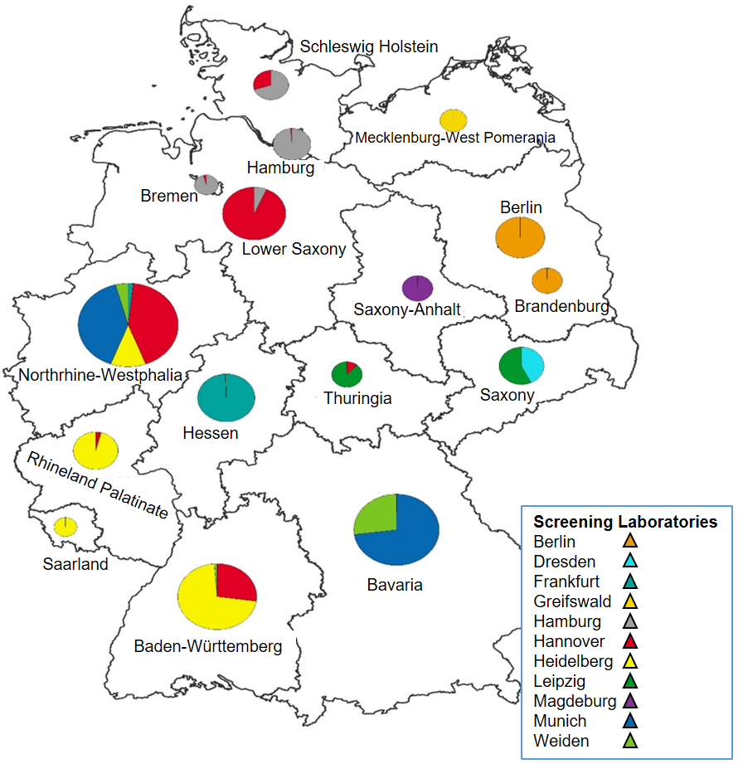
Screening distribution and catchment areas of the 11 screening laboratories across the 16 German federal states.
Circle diameter reflects the number of samples. Coloring indicates which laboratories were processing samples in which states (e.g. screeenig samples from newborns in Northrhine-Westphalia are covered by five different screening laboratories)

