Slide 1
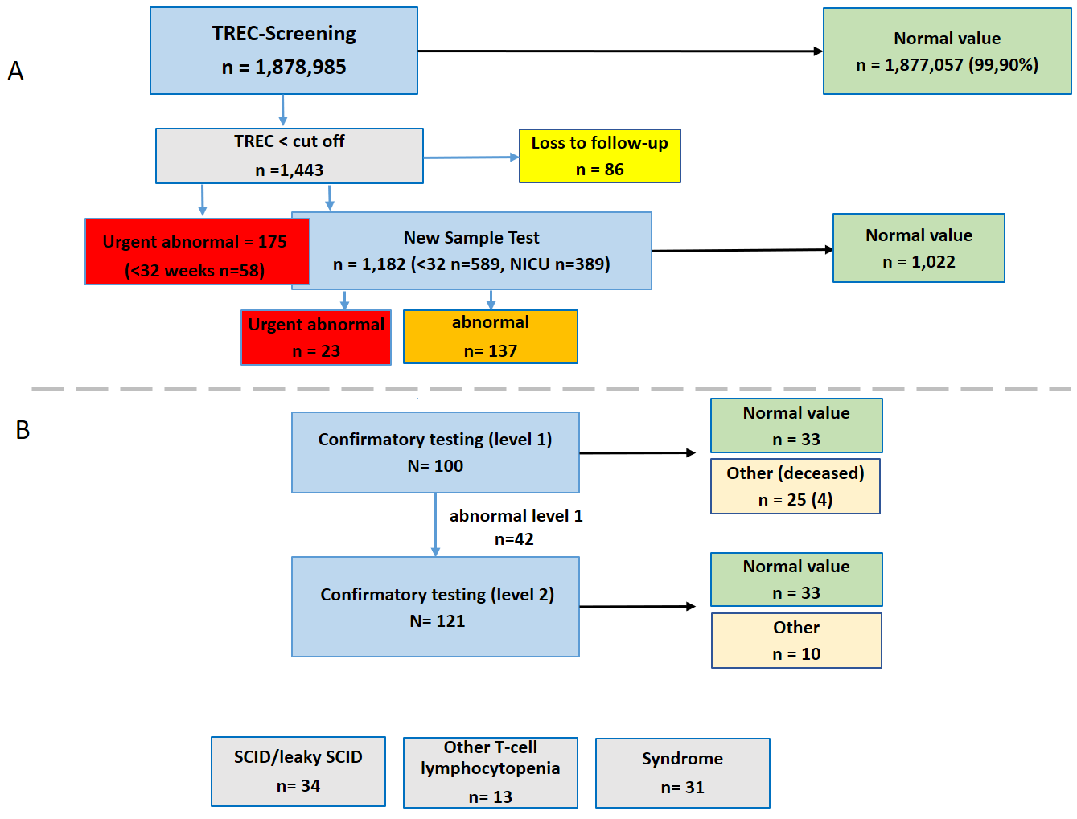
Primary NBS laboratory data (DNGS report evaluation from August 2019 until December 2021)
A) 1,878,985 newborns underwent TREC-NBS (top blue box). Numbers of newborns with normal value (green), urgent abnormal (red) and confirmed abnormal (orange) TREC-NBS are indicated.
A New Sample Test (bottom blue box) was requested as indicated. 86 newborns with a (unconfirmed) initial abnormal TREC NBS were lost to follow up (yellow box). Numbers of NICU/preterm
patients are indicated. 175 newborns had an urgent abnormal TREC-NBS in the first card (top red box). Overlapping of the red and blue box illustrates, that an unknown number of
urgent abnormal tested children received a New Sample Test (and was not directly referred for level 2 CT).
B) The DGNS report registered core information on 100 newborns who underwent level 1 CT and 121 patients undergoing level 2 CT (42 following level 1 CT). Normal value results (false positive
initial TREC screen) are indicated (green boxes). The yellow boxes indicate numbers of patients with secondary causes of T-cell lymphopenia and newborns who
deceased (n=4) during CT the work-up progress (detailed in the results section). 78 patients with an identified primary causes of congenital T-cell lymphocytopenia, following level 2 CT
evaluation are depicted at the bottom (grey boxes).

