Slide 1
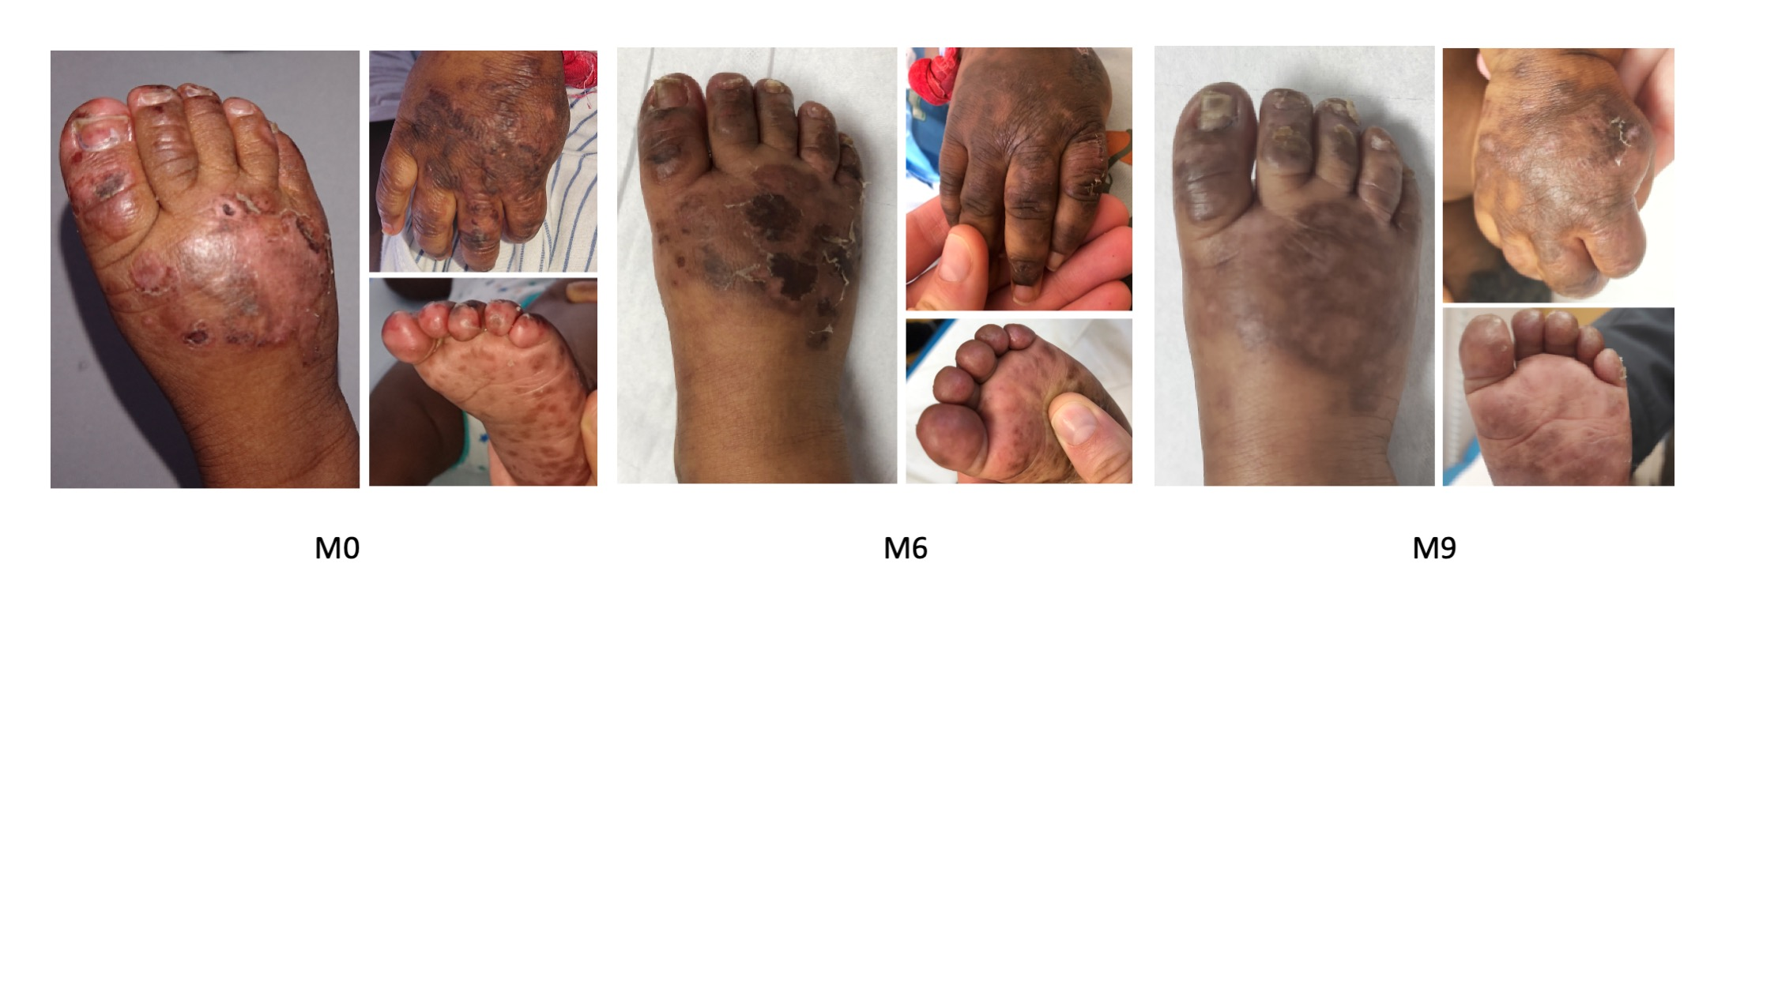
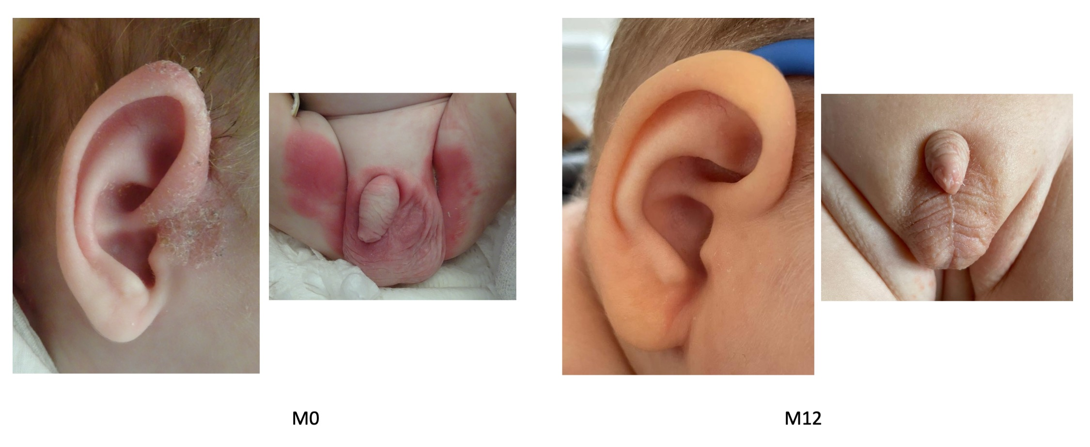
Supplementary Figure 1. Skin involvement in the cohort
A
B

Slide 2
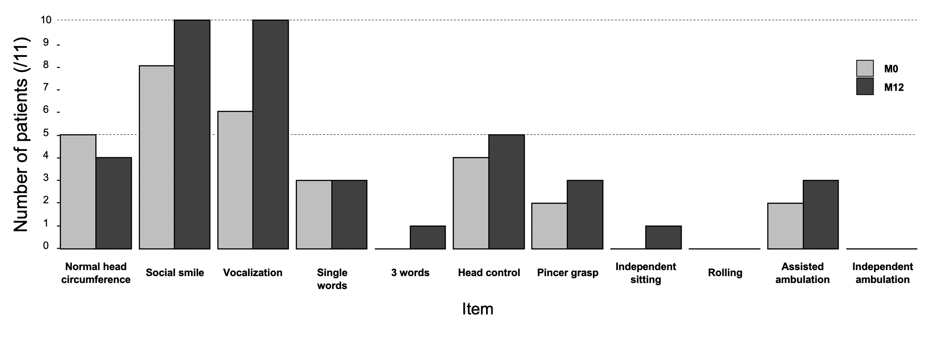
Supplementary Figure 2. Evolution of AGS developmental items, polyhandicap severity scale and caregiver assessment scale under JAK inhibition
A
B
TREX1
ADAR1
IFIH1
RNASEH2B
RNU7
C
TREX1
ADAR1
IFIH1
RNASEH2B
RNU7

Slide 3
Supplementary Figure 3. Interferon score before and under treatment in P6
qPCR
Nanostring

Slide 4
Supplementary Figure 4. Interferon scores under treatment according to time point
**
***
***
**

Slide 5
Supplementary Figure 5. Interferon alpha levels in the cerebrospinal fluid and the blood of patients under JAK inhibitors
A
Blood
CSF
B
*
ns
P1
C
P2
D
P3
E
P4
F
P5

Slide 6
Supplementary Figure 6. Neopterin levels in the cerebrospinal fluid before and under treatment
ns
P1
P2
P3
P6
P7
#
P8
P9
P10

Slide 7
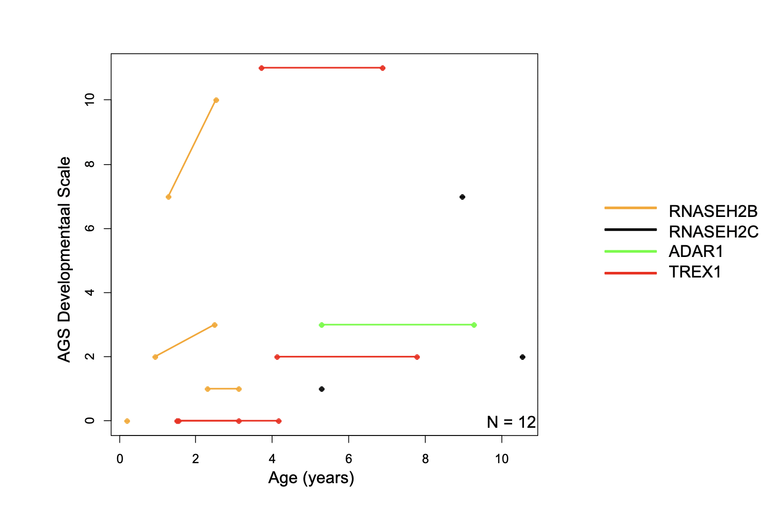
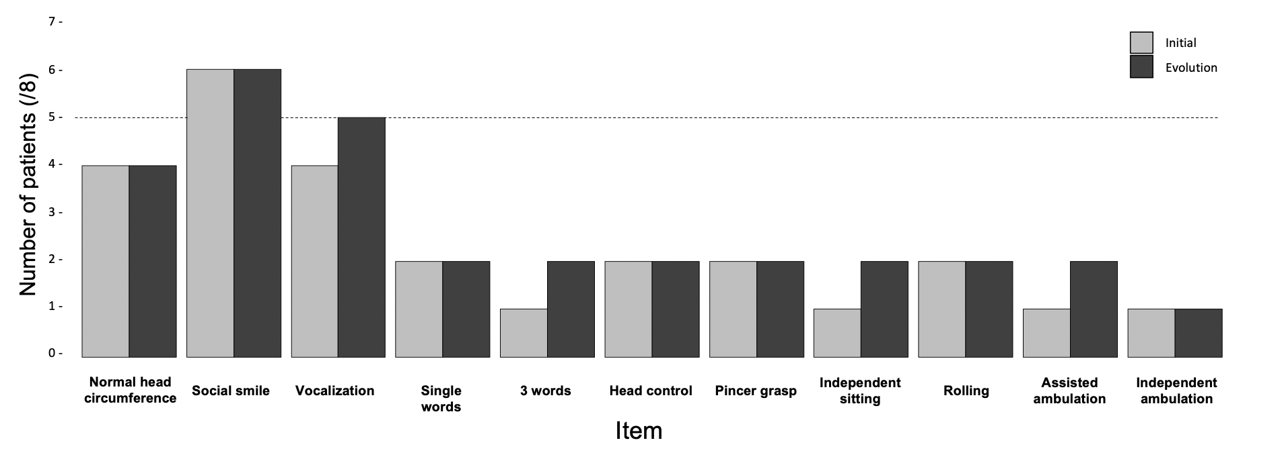
Supplementary Figure 7. AGS developmental scale in untreated patients
A
B

