Slide 1
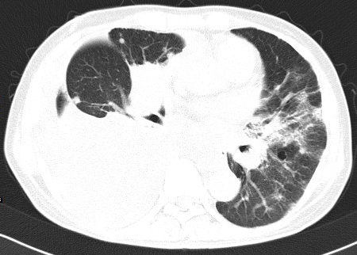
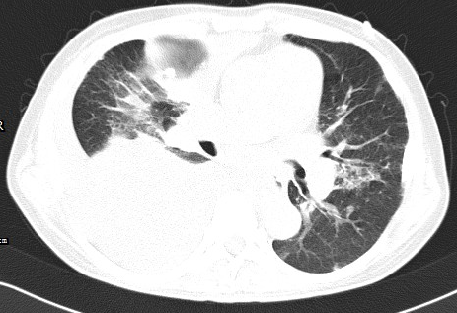
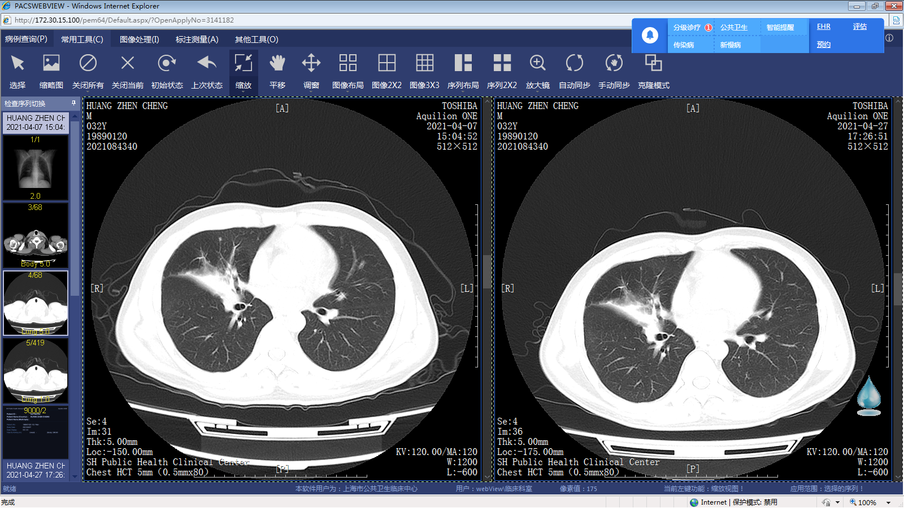
Supplementary Figure 1
On admission
Antituberculosis therapy for 4 month
  Kindred A
  c.125C>A:p.T42K
  P1
On admission
IFN-γ combined Antituberculosis therapy for 2 weeks
  Kindred B
  c.43A>G:p.I15V
  P2

Slide 2
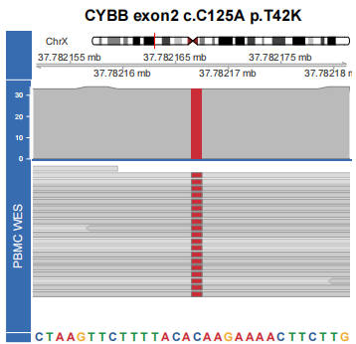
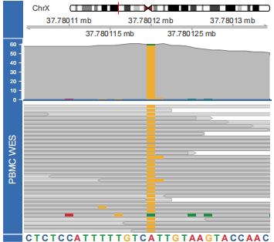
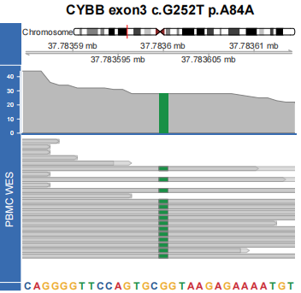
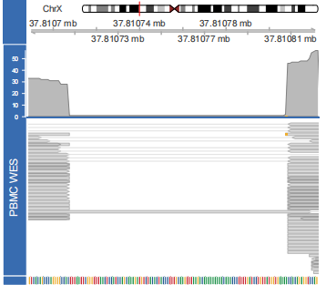
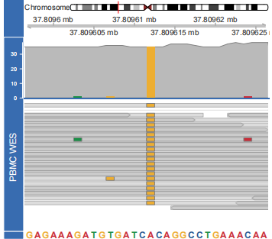
Supplementary Figure 2
A
Kindred A P1
CYBB exon2 c.C125A p.T42K
B
Kindred B P2
CYBB exon1 c.A43G p.I15V
C
Kindred C P3
CYBB exon3 c.G252T p.A84A
D
Kindred D P5
CYBB exon13 c.1587_1604del p.T530_F535del
Kindred E P6
CYBB exon12 c.A1507G p.T503A

Slide 3
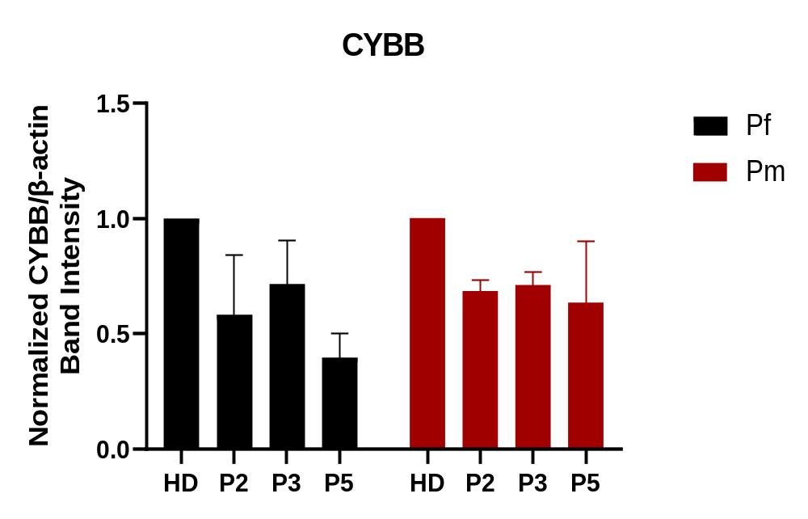
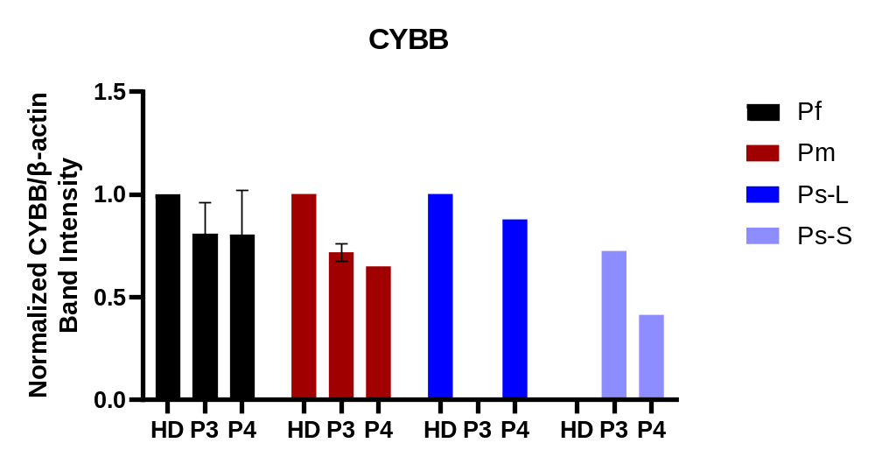
Supplementary Figure 3

Slide 4
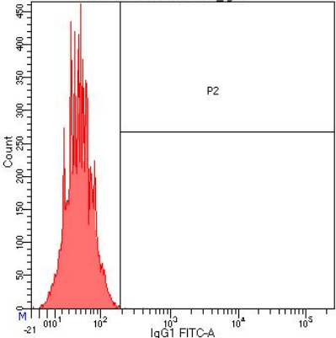
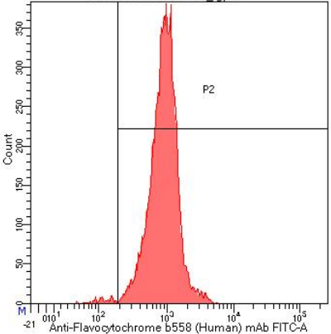
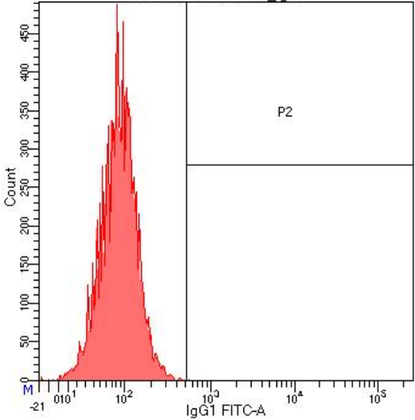
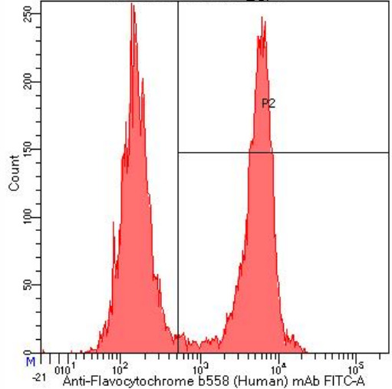
Supplementary Figure 4
gp91 isogenic control
gp91 protein expression
Health control
  Kindred C
  c. 252 G>T:p.A84A
Ⅲ.1 (P4)

Slide 5
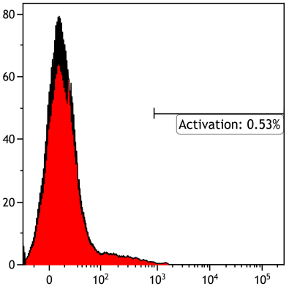
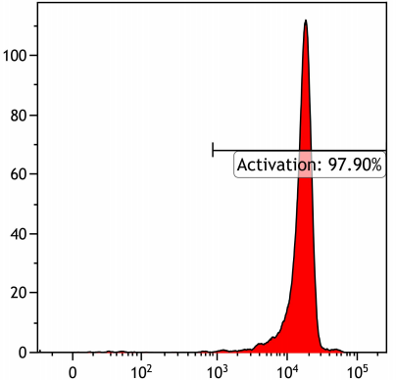
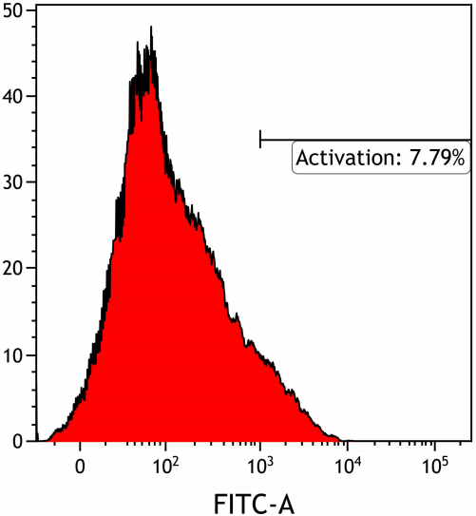
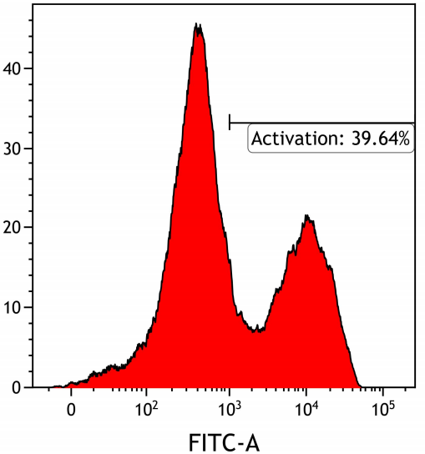
Supplementary Figure 5
PBS stimulates neutrophils
PMA stimulates neutrophils
Health control
  Kindred C
  c. 252 G>T:p.A84A
Ⅲ.1 (P4)

