Slide 1
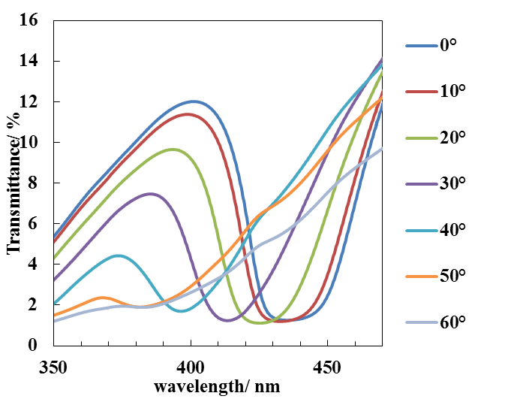
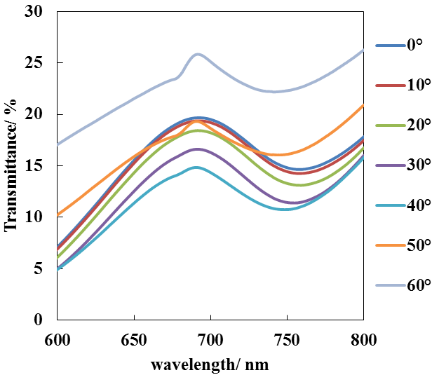
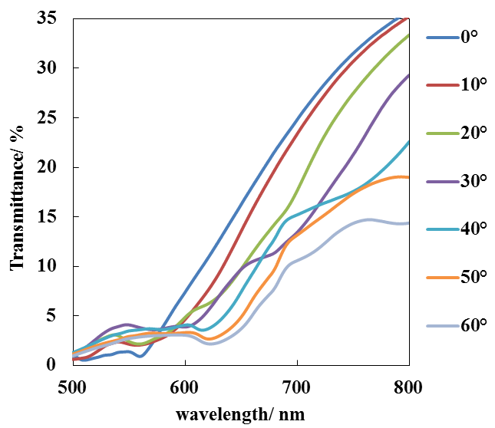
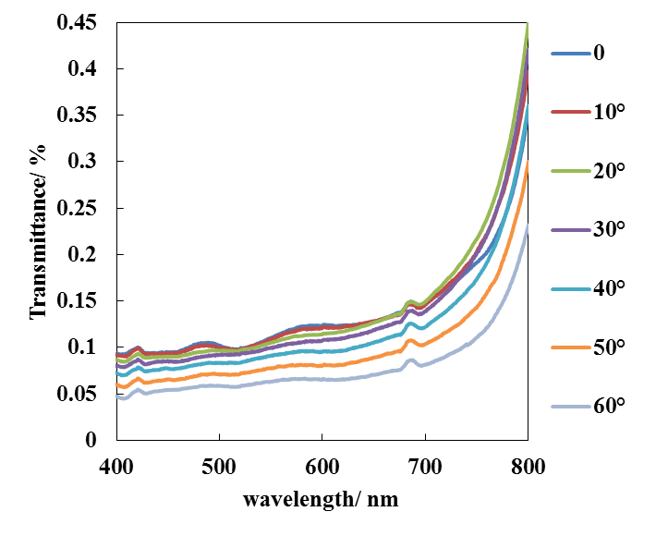
(a)
(b)
(c)
(d)
Supporting Information 1. Optical transmittance spectra of opals fabricated from 202 nm-(a), 356 nm-(b), 457 nm-(c), and 731 nm-(d) PS spheres.
Notes:
オリジナルから線種を変更する必要あり。現時点で細かく治す必要なし。0416

Slide 2
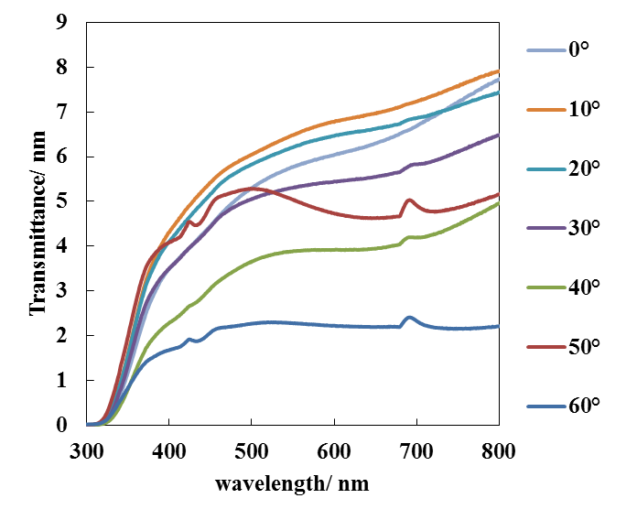
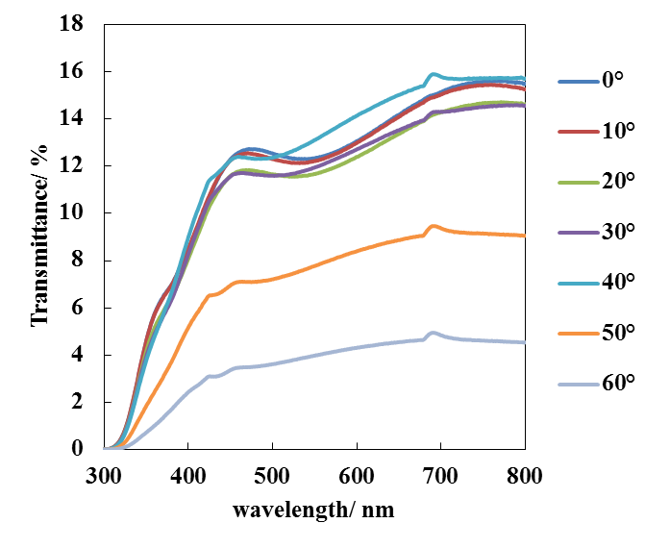
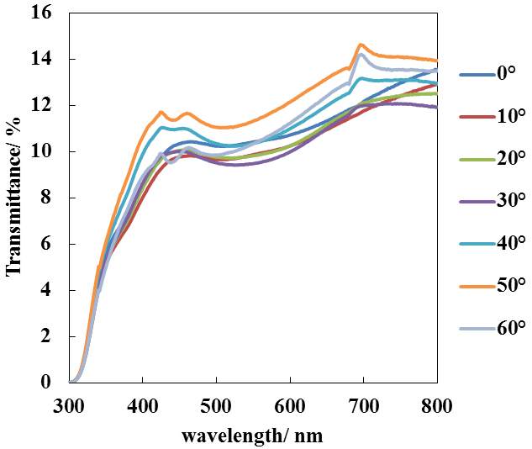
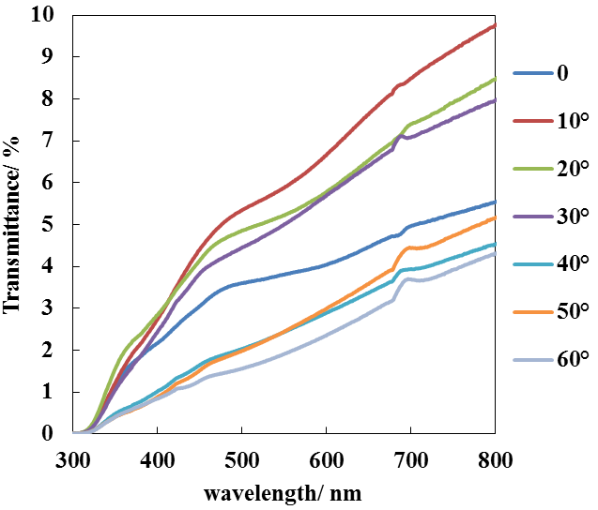
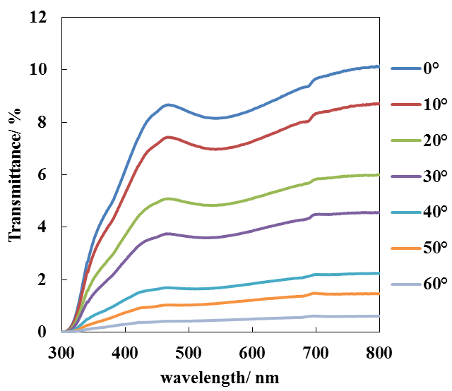
(a)
(b)
(c)
(d)
(e)
Supporting Information 2. Optical transmittance spectra of TiO₂-coated ITO (a), IO202(b), IO356(c), IO457 (d) and IO731 (e).

Slide 3
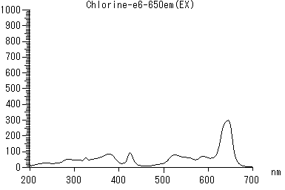
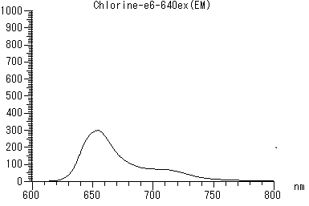
Supporting Information 3. Emission spectra of our Chlorine e6.

