Slide 1



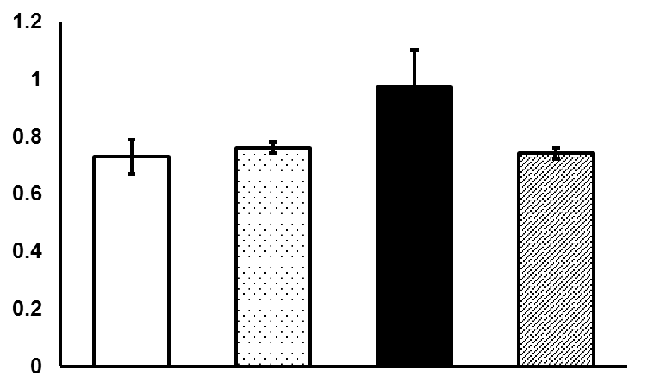
Supplementary Figure 1. MB treatment reduces atrial natriuretic peptide (ANP) in the DB heart (upper panel). Densitometric analysis is shown as reported to GAPDH as the loading control (lower panel). * p<0.05. CTL = Control (N=3), CTL+MB = Control + Methylene Blue (N=3), DB = Diabetic (N=3), DB+MB = Diabetic + Methylene Blue (N=3). Mean ± SEM.
kDa
15
38
ANP
GAPDH
CTL CTL+MB DB DB+MB
p=0.06
ANP/GAPDH
CTL CTL+MB DB DB+MB

