Slide 1
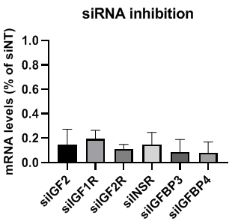
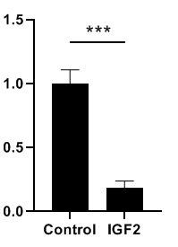
Supplemental Figure 1
a
b
siRNA inhibition
Fold change
compared to siNT
Fold change
compared to siNT
c
Cell viability
d
Cell viability

