Slide 1
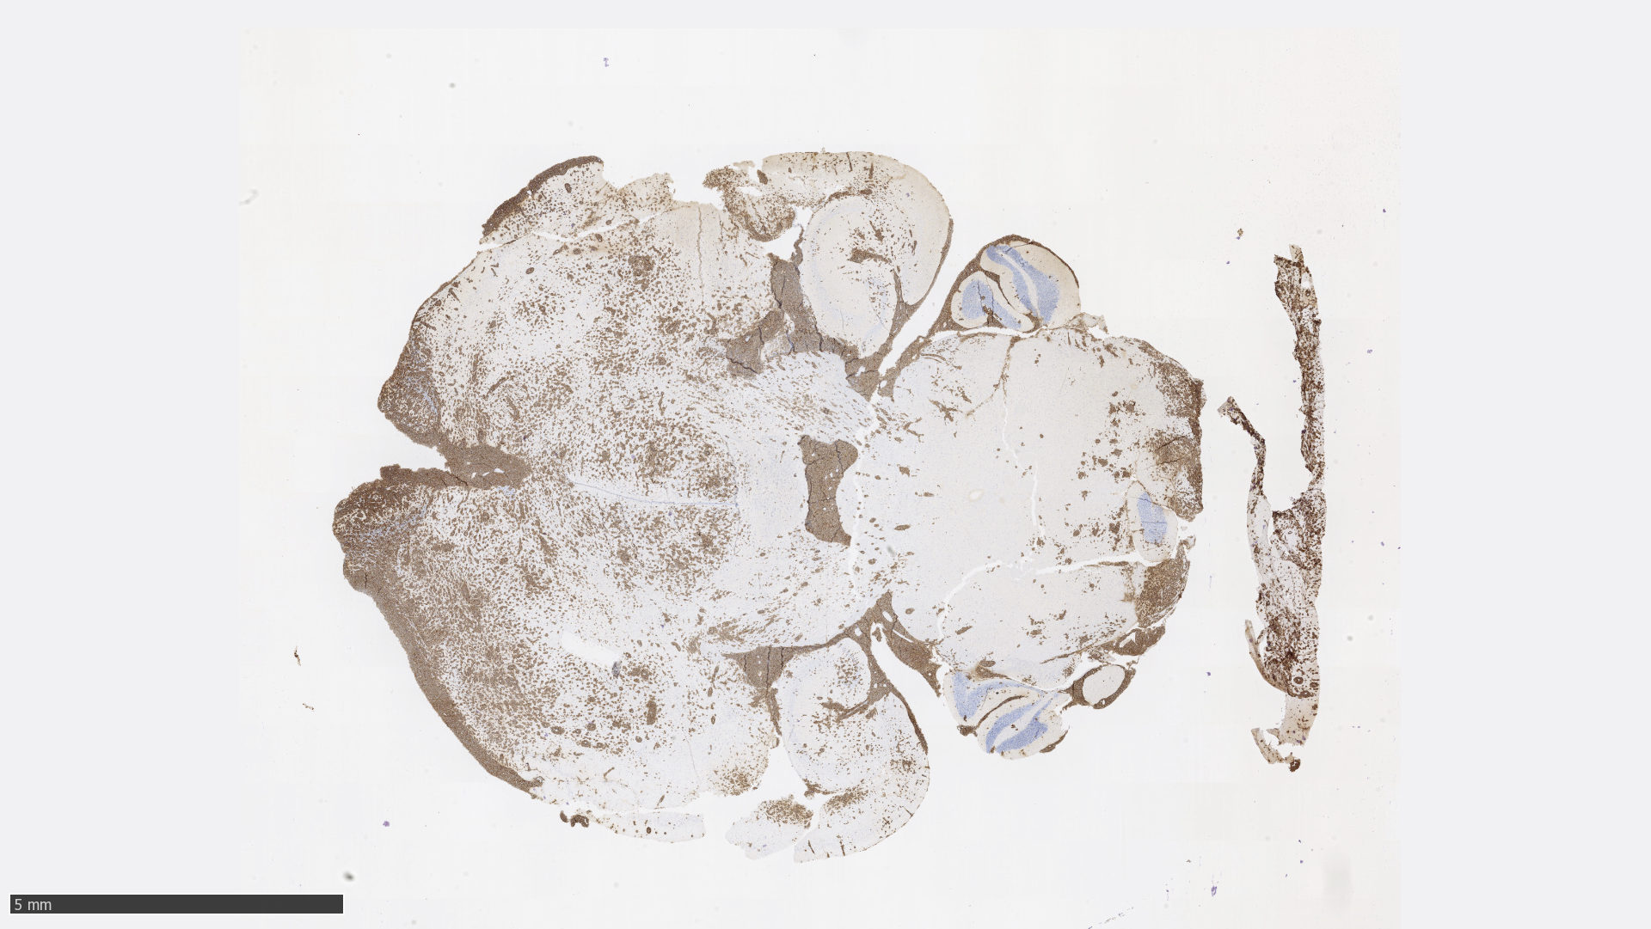
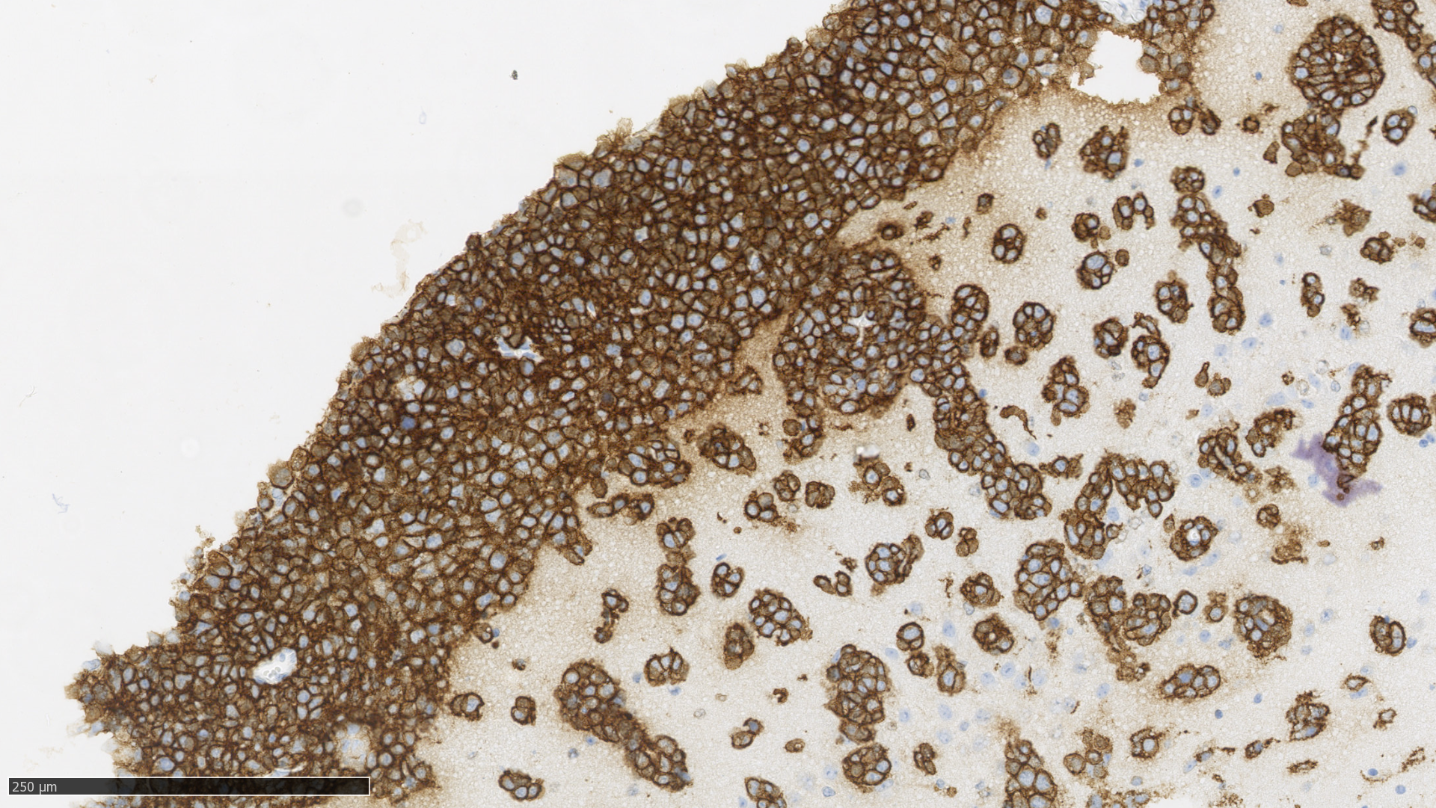
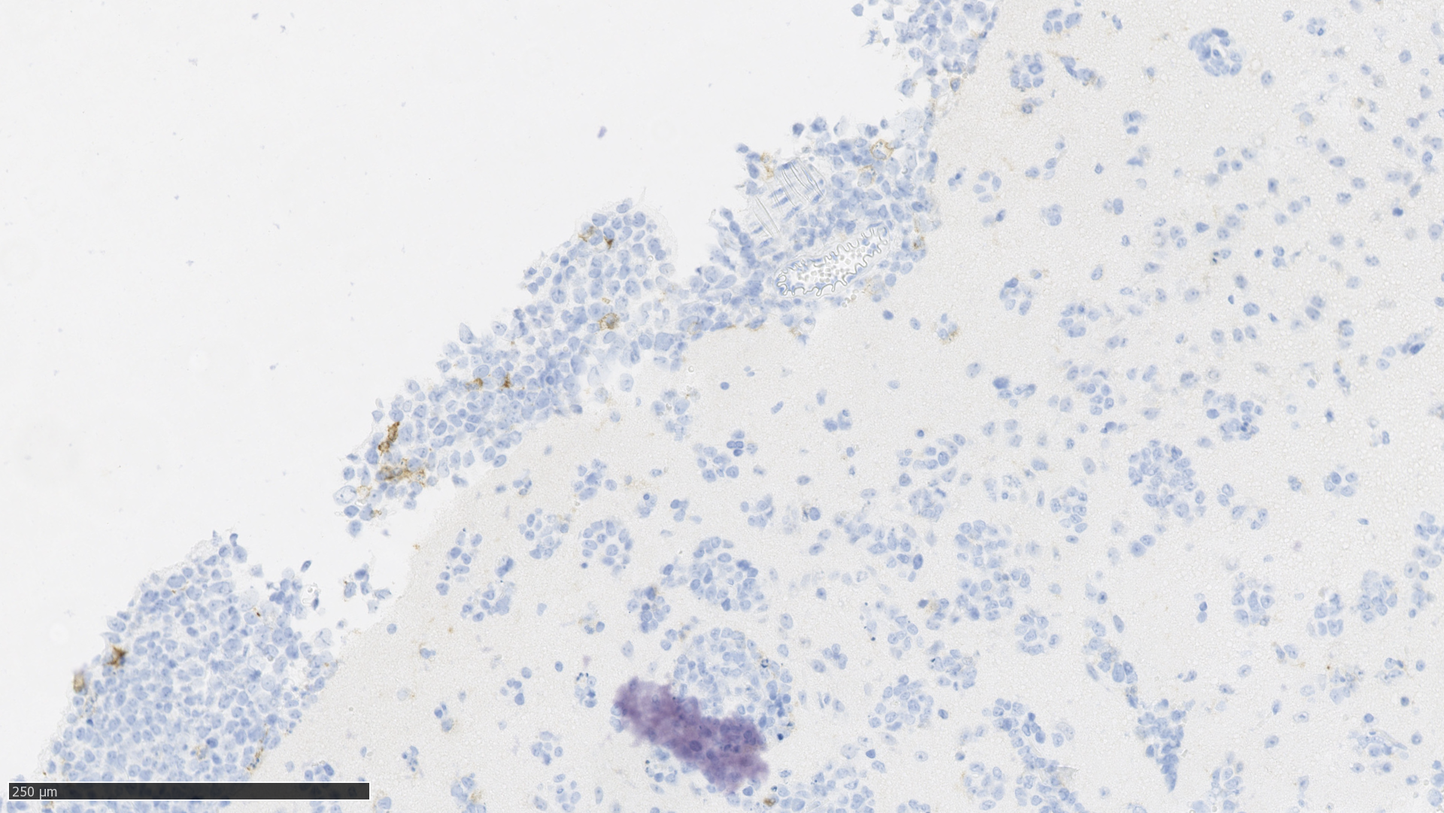
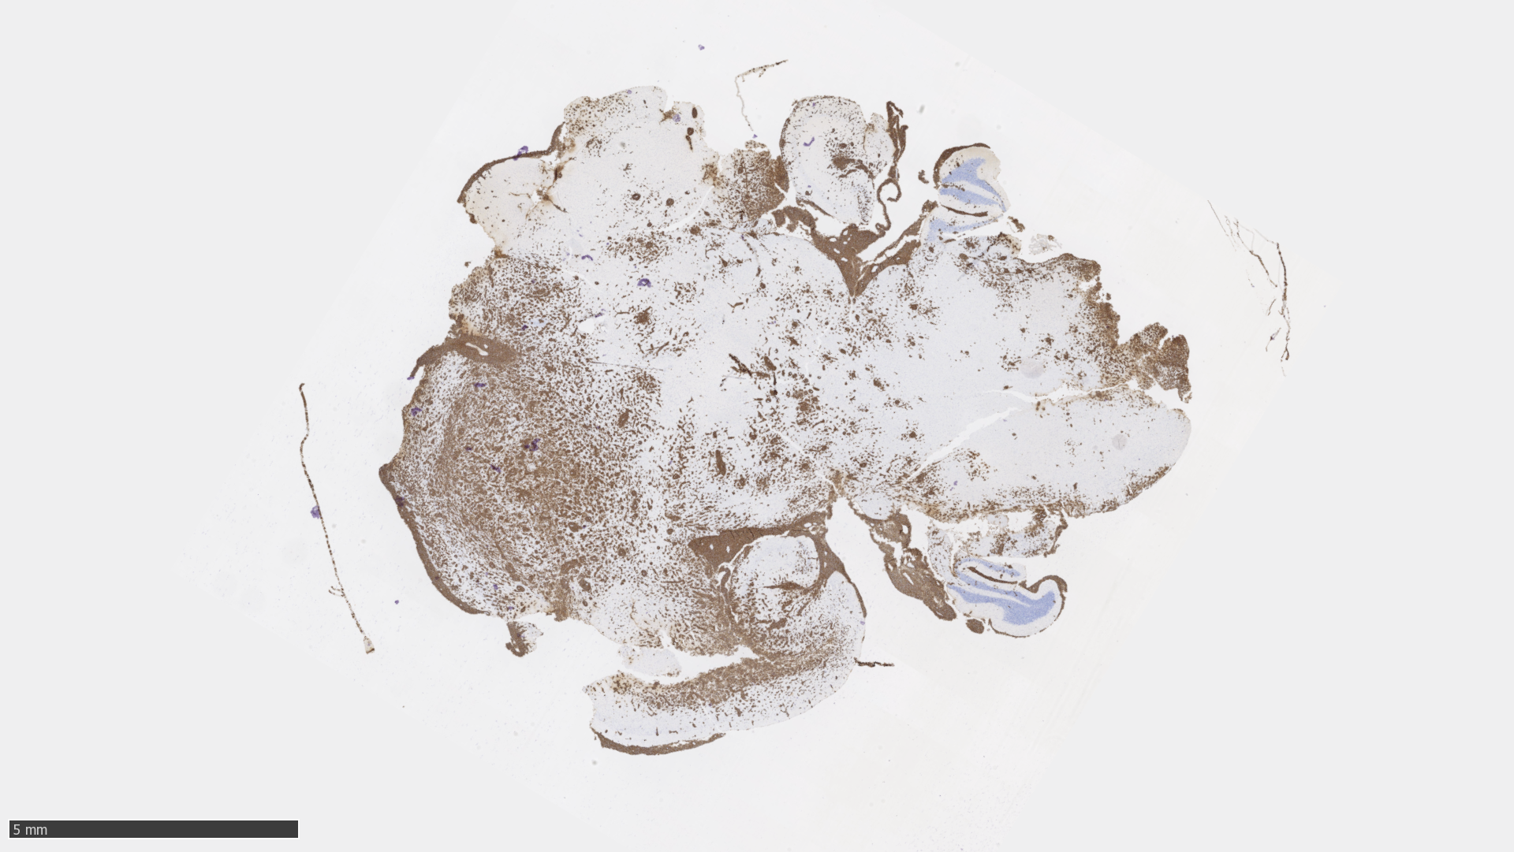
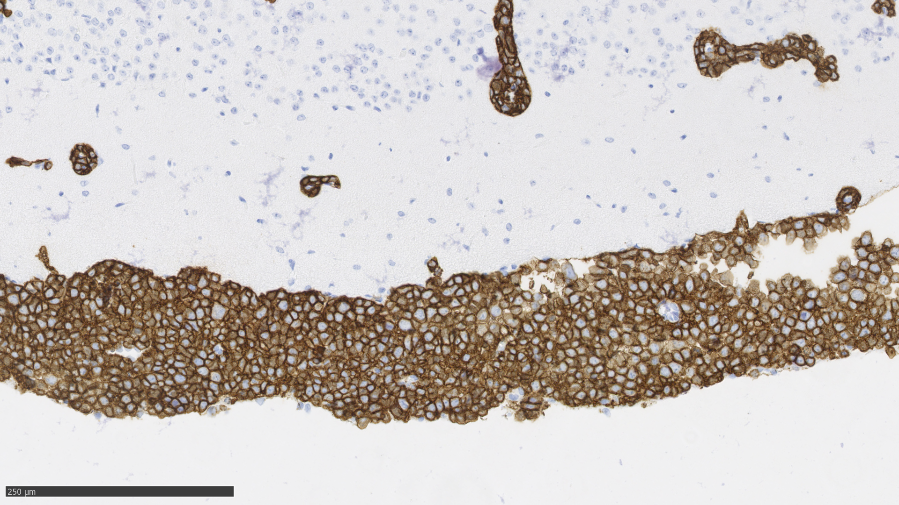
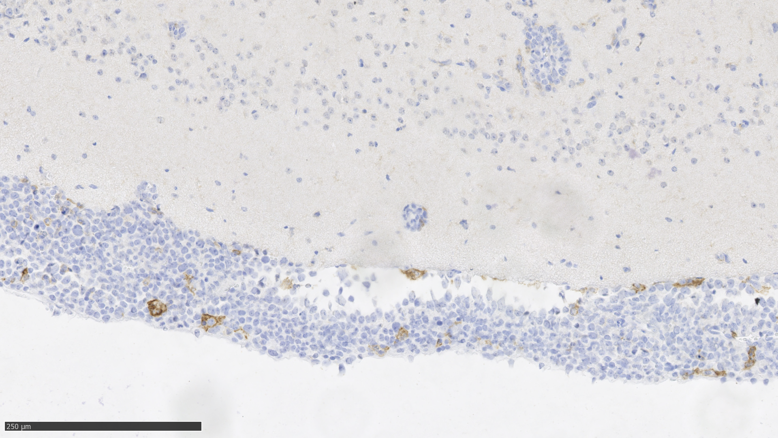
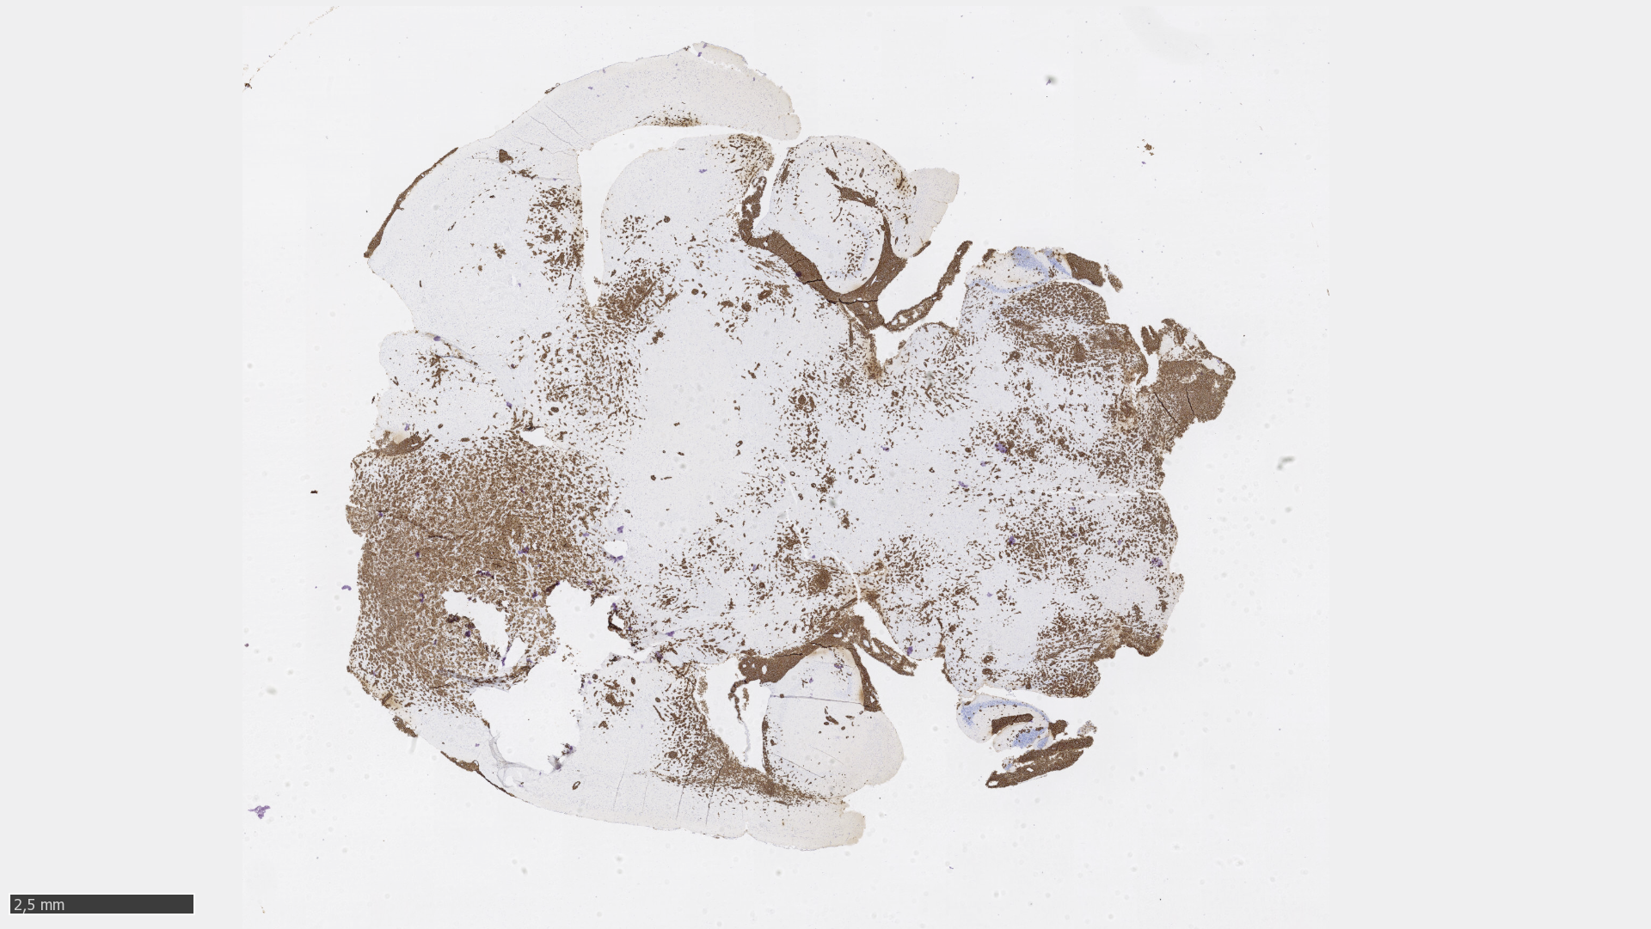
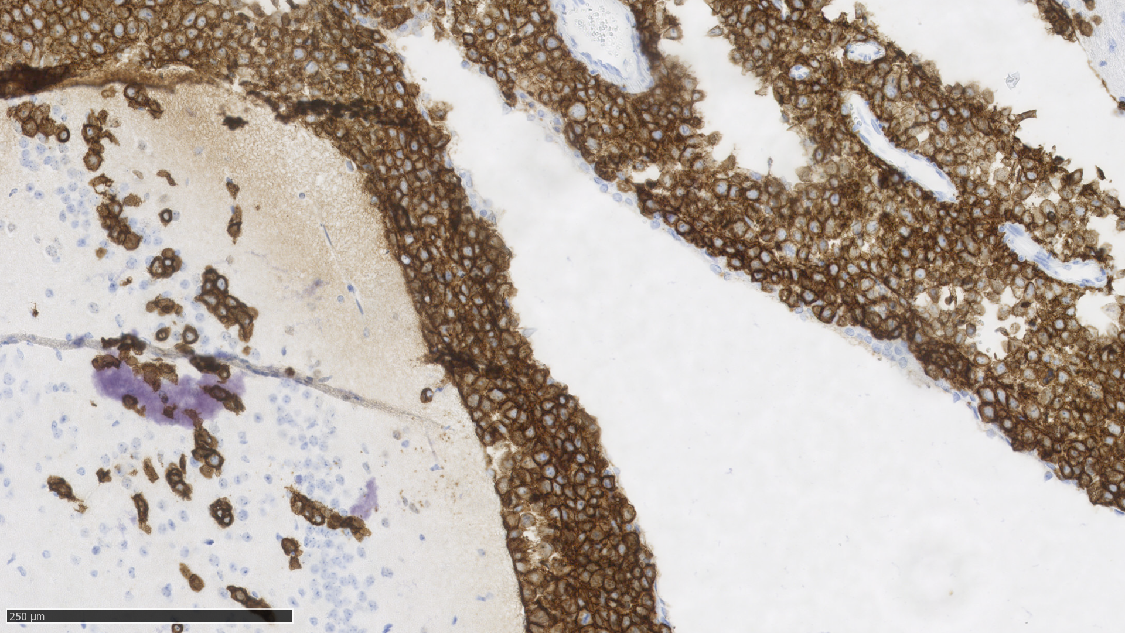
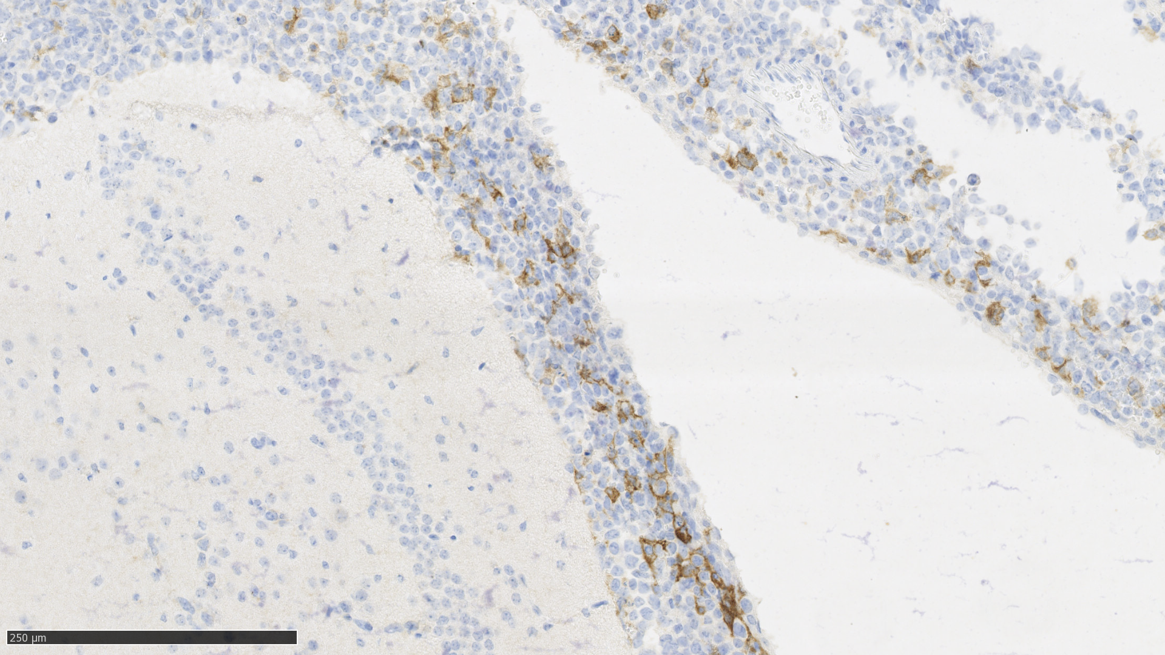
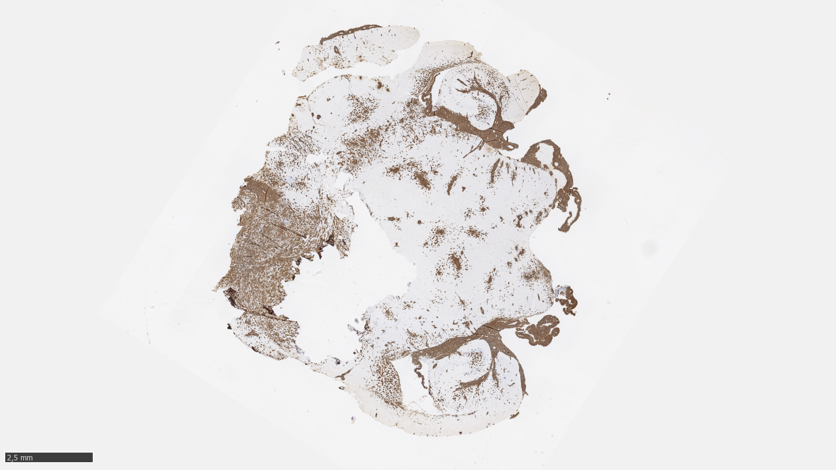
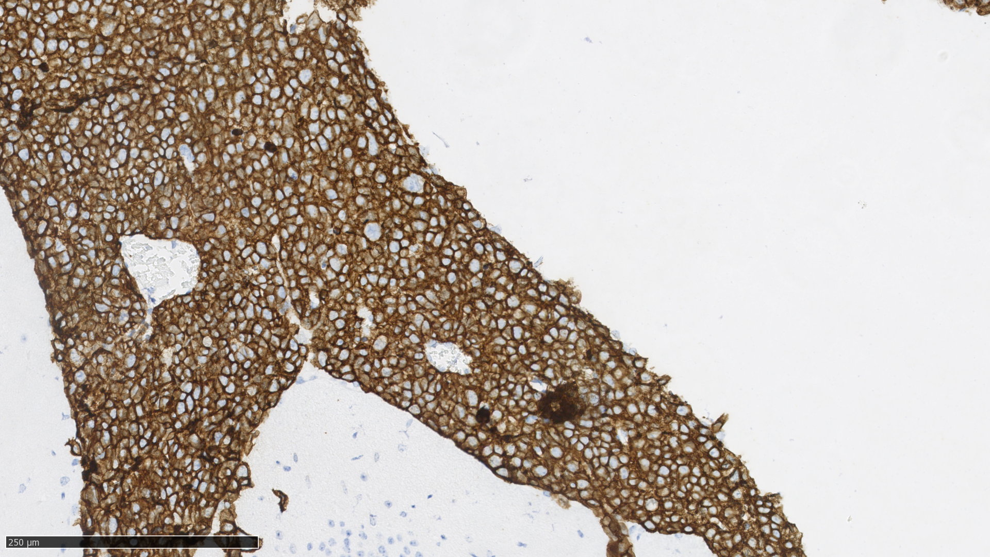
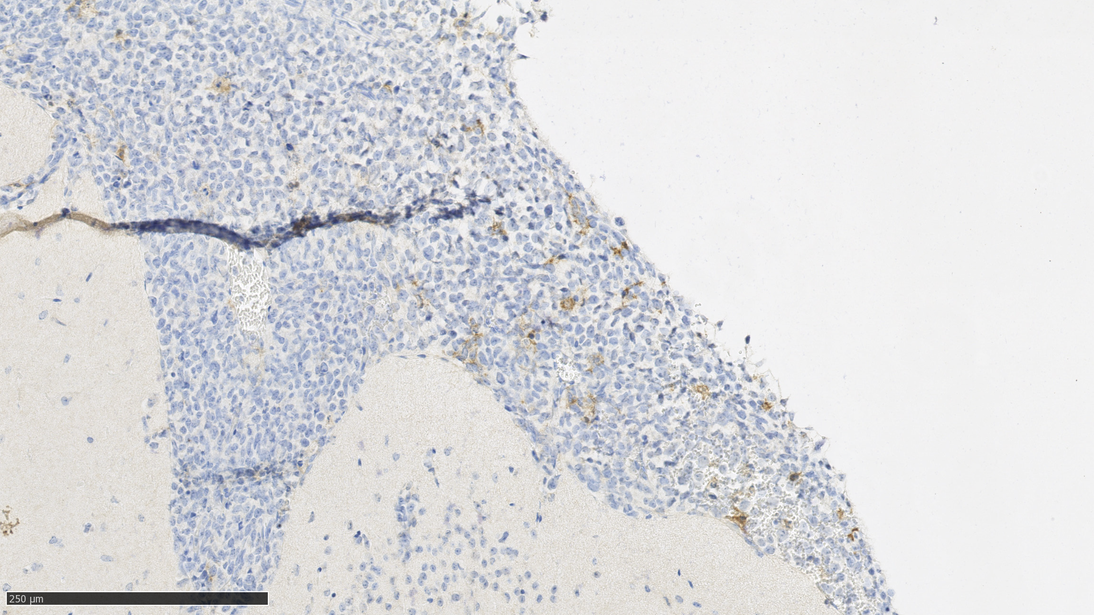
OCI_Ly10
CD20
Brain
F4/80
Vehicle #30
(1,46·10⁹ ph/s)
Vehicle #40
(9,76·10⁸ ph/s)
Vehicle #45
(2,61·10⁸ ph/s)
Vehicle #47
(1,63·10⁹ ph/s)
Supplementary Figure S1
Notes:
Mice treated after 11 days of OCI_ly10 injection. Treatment for two weeks. Vehicle.

Slide 2
A
B
C
Supplementary Figure S2
Notes:
MEDIAN SURVIVAL (days)
Vehicle: 35
Selinexor: 40
Ibrutinib: 43
Combination 55

Slide 3
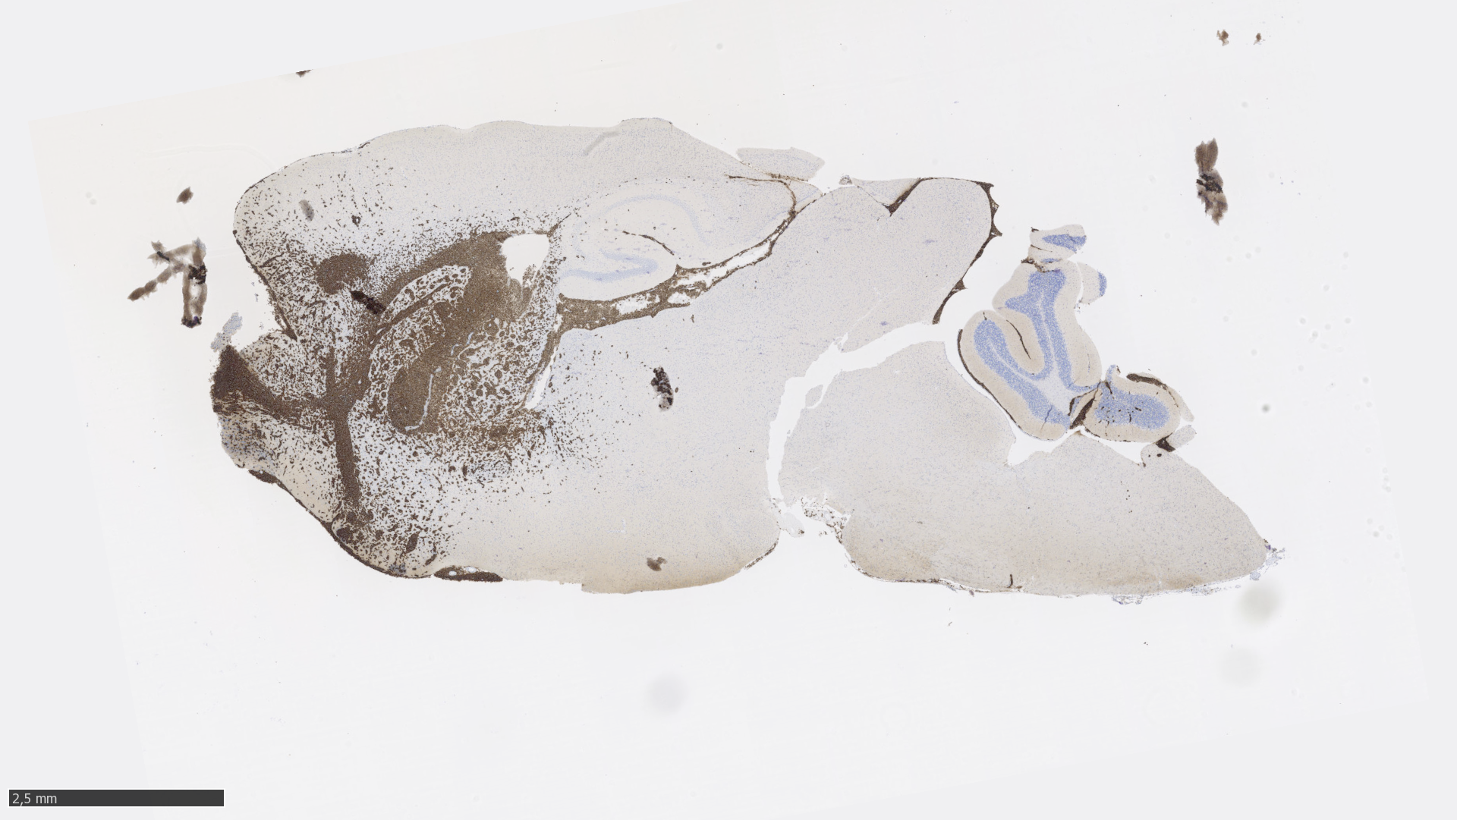
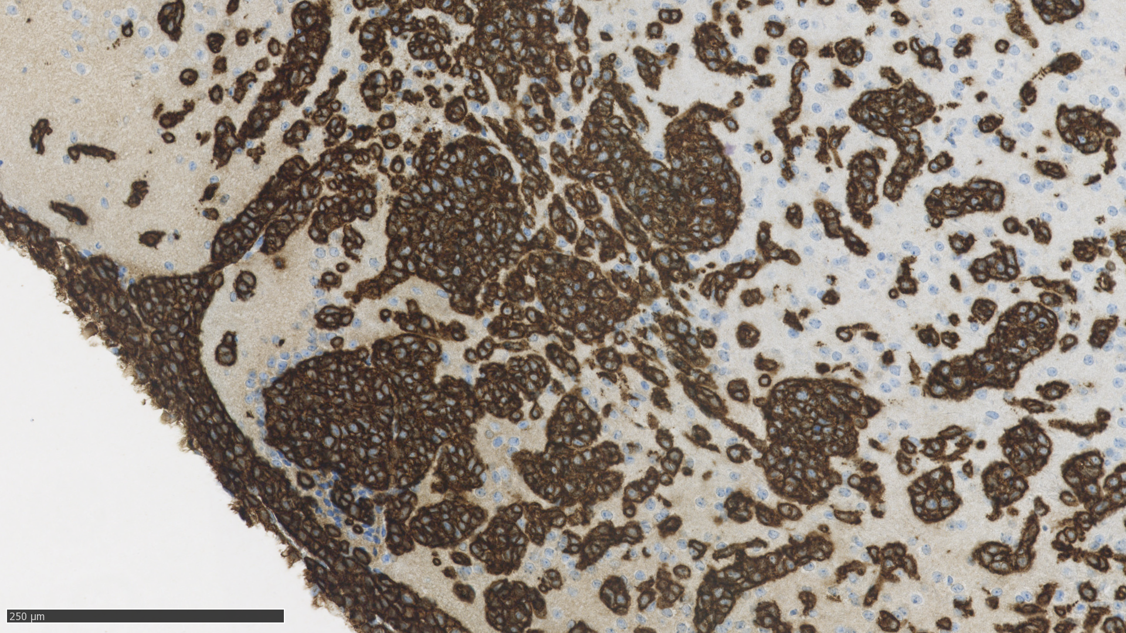
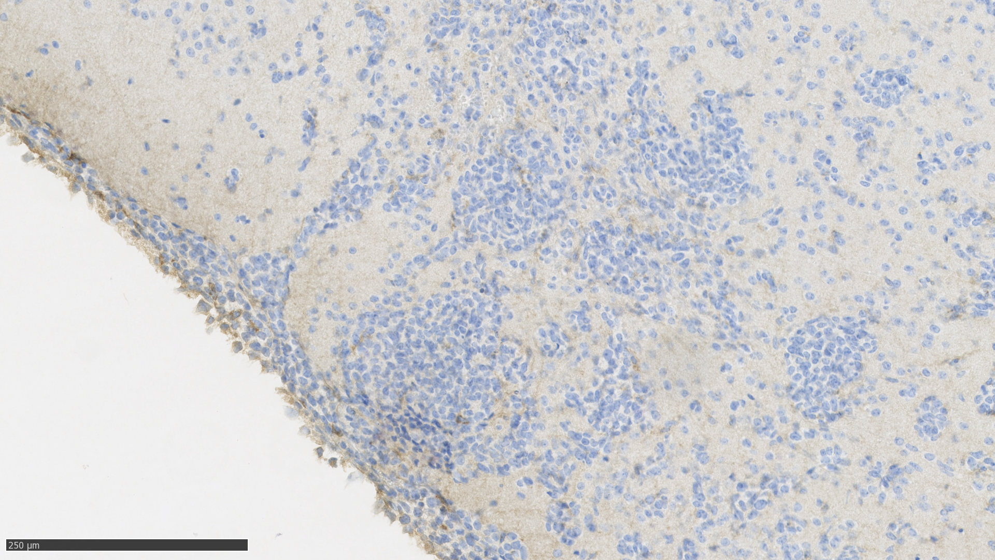
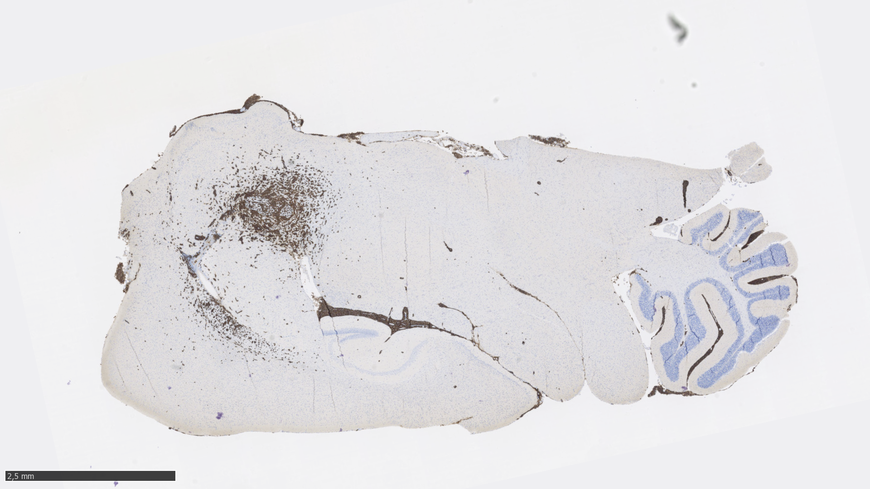
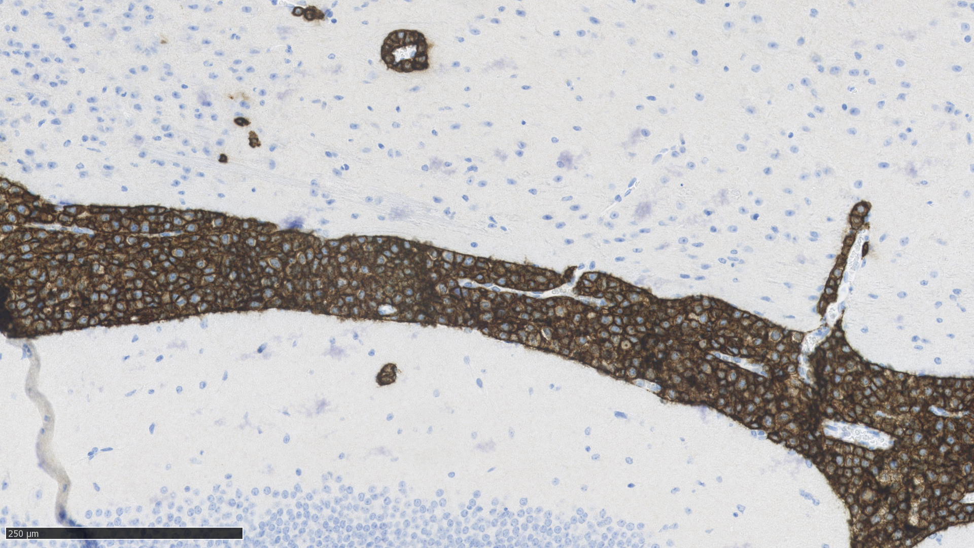
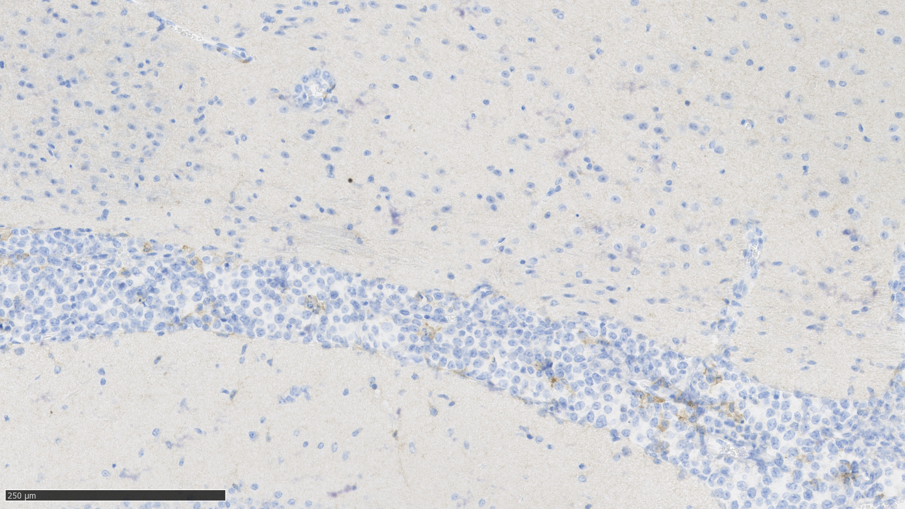
PDX nude mice
CD20
Brain
F4/80
Vehicle #91
Vehicle #85
Supplementary Figure S3

Slide 4
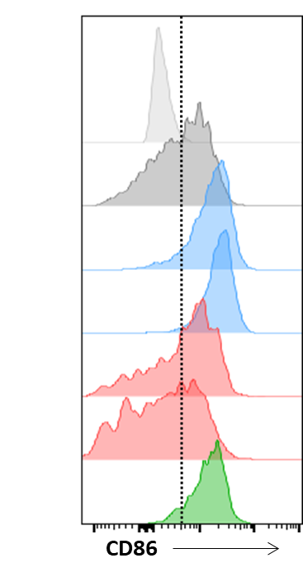
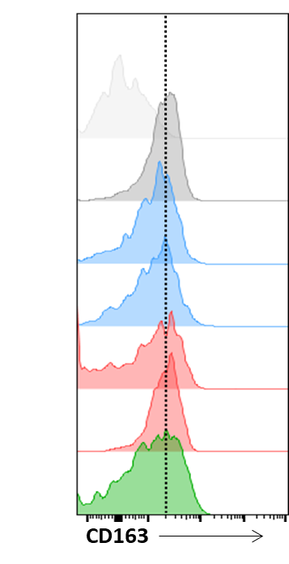
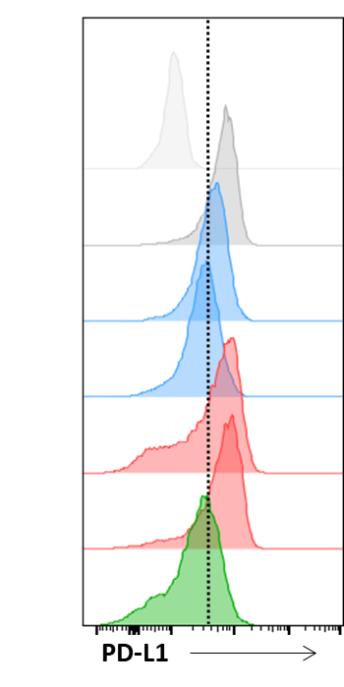
A
PD1⁺M2
B
SIRPα⁺M2
C
PD1⁺SIRPα⁺M2
D
Phagocytosis
E
CD86
F
CD163
G
PD-L1
FMO
Control
Sel 0.5μM
Sel 5μM
Ibr 0.5μM
Ibr 5μM
Comb.
H
IL-10
I
HLA-DR
J
CD206
Supplementary figure S4

