Slide 1
Supplementary figures

Slide 2
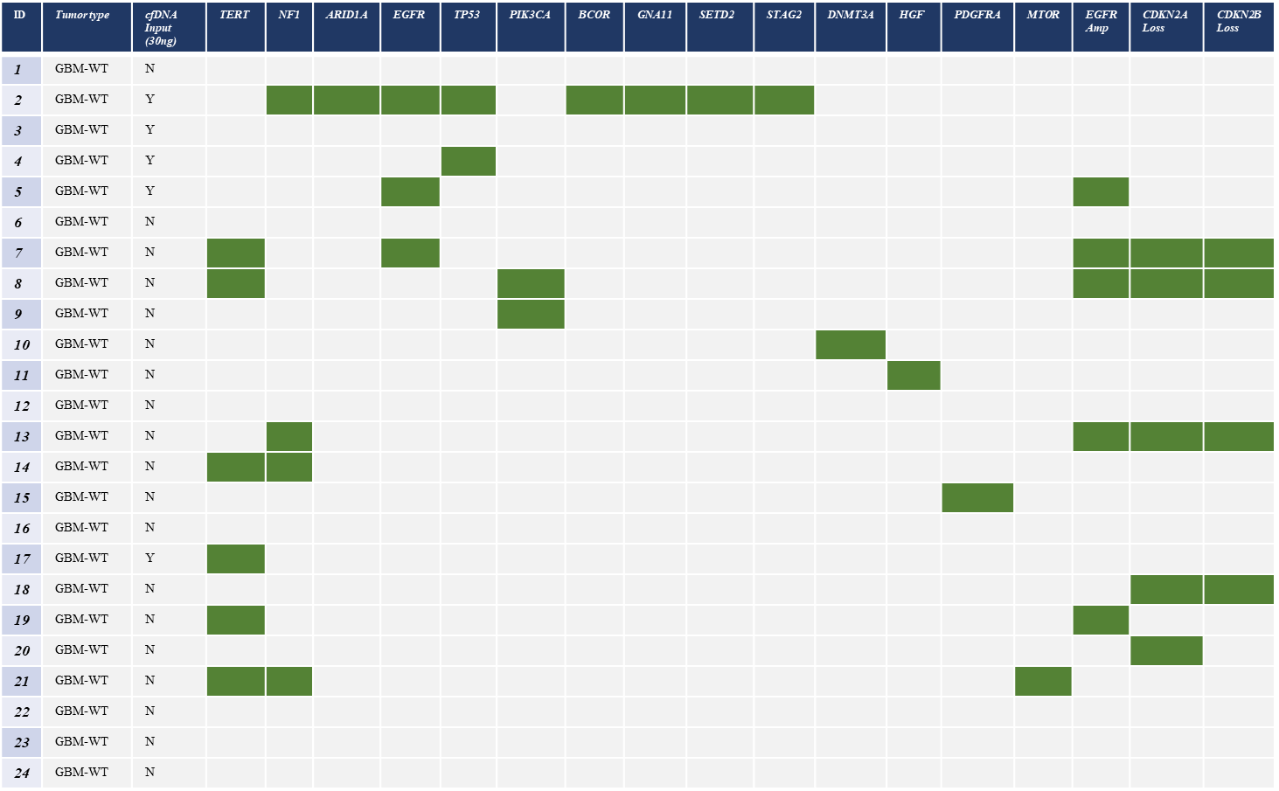
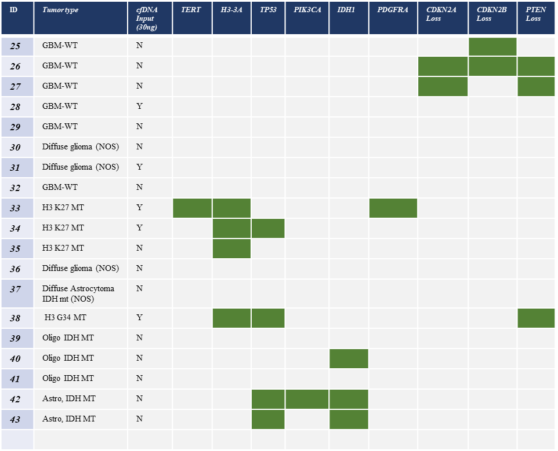
Sup. Figure 1.

Slide 3
R² = 0.03
P-value: 0.75
R² = 0.27
P-value: 0.29
Sup. Figure 2

