Slide 1
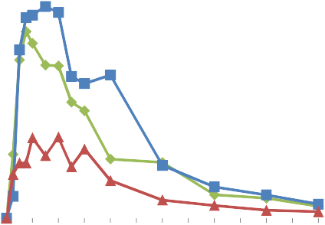
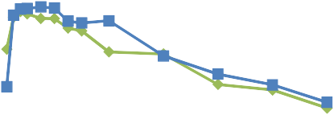
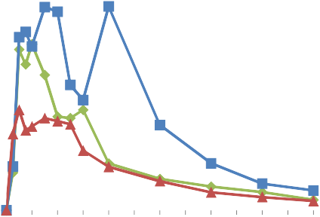
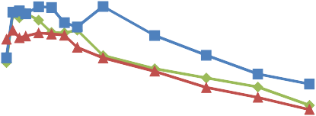
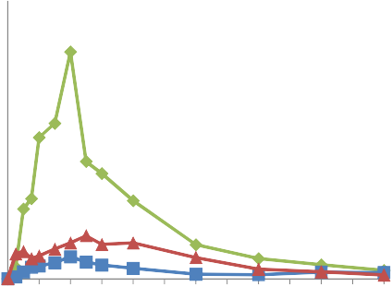
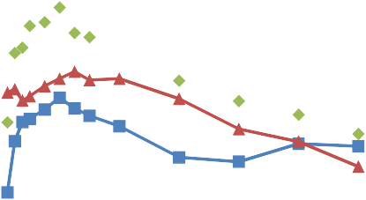
Supplementary information 1_ Individual plasma profiles per volunteer (linear and log/linear)
(P indicates the volunteer number)
Conc (ng/ml)
350
P2 linear Seq RT1T2
Conc (ng/ml)
1000
P2 log/lin Seq RT1T2
300
250
Reference: Zovirax
100
Reference: Zovirax
200
T1: Z+ 400 mg
Chit HCl
T1: Z+ 400 mg
Chit HCl
150
10
100
T2: Z+ 1000
mg Chit HCl
T2: Z+ 1000
mg Chit HCl
50
0
0 1 2 3 4 5 6 7 8 9 10 11 12time (h)
1
0 1 2 3 4 5 6 7 8 9 10 11 12time (h)
Conc (ng/ml)
300
P3 linear Seq RT1T2
Conc (ng/ml)
1000
P3 log/lin Seq RT1T2
250
200
Reference: Zovirax
100
Reference: Zovirax
150
T1: Z+ 400 mg
Chit HCl
T1: Z+ 400 mg
Chit HCl
100
T2: Z+ 1000
mg Chit HCl
10
T2: Z+ 1000
mg Chit HCl
50
0
0 1 2 3 4 5 6 7 8 9 10 11 12time (h)
1
0 1 2 3 4 5 6 7 8 9 10 11 12time (h)
Conc (ng/ml)
1200
P4 linear Seq RT1T2
Conc (ng/ml)
1000
P4 log/lin Seq RT1T2
1000
800
Reference: Zovirax
100
Reference: Zovirax
600
T1: Z+ 400 mg
Chit HCl
T1: Z+ 400 mg
Chit HCl
400
T2: Z+ 1000
mg Chit HCl
10
T2: Z+ 1000
mg Chit HCl
200
0
0 1 2 3 4 5 6 7 8 9 10 11 12time (h)
1
0 1 2 3 4 5 6 7 8 9 10 11 12time (h)

Slide 2
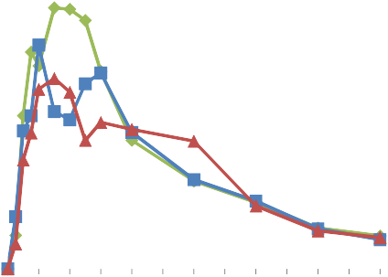
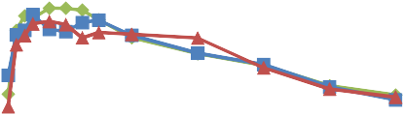
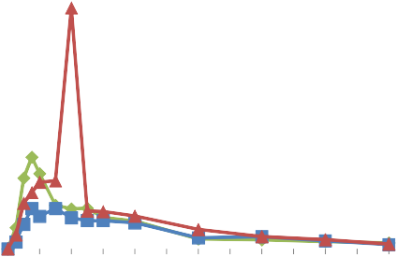
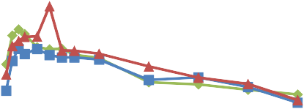
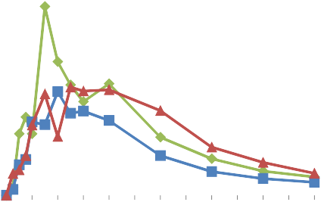
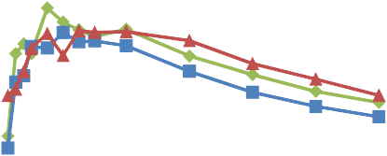
Conc (ng/ml)
200
180
160
140
120
100
80
60
40
20
0
P6 linear Seq RT1T2
Conc (ng/ml)
1000
P6 log/lin Seq RT1T2
Reference: Zovirax
100
Reference: Zovirax
T1: Z+ 400 mg
Chit HCl
T1: Z+ 400 mg
Chit HCl
T2: Z+ 1000
mg Chit HCl
10
T2: Z+ 1000
mg Chit HCl
0 1 2 3 4 5 6 7 8 9 10 11 12time (h)
1
0 1 2 3 4 5 6 7 8 9 10 11 12time (h)
Conc (ng/ml)
1200
P10 linear Seq RT1T2
Conc (ng/ml)
10000
P10 log/lin Seq RT1T2
1000
1000
800
Reference: Zovirax
Reference: Zovirax
600
T1: Z+ 400 mg
Chit HCl
100
T1: Z+ 400 mg
Chit HCl
400
T2: Z+ 1000
mg Chit HCl
10
T2: Z+ 1000
mg Chit HCl
200
0
0 1 2 3 4 5 6 7 8 9 10 11 12time (h)
1
0 1 2 3 4 5 6 7 8 9 10 11 12time (h)
Conc (ng/ml)
600
P14 linear Seq RT1T2
Conc (ng/ml)
1000
P14 log/lin Seq RT1T2
500
400
Reference: Zovirax
100
Reference: Zovirax
300
T1: Z+ 400 mg
Chit HCl
T1: Z+ 400 mg
Chit HCl
200
T2: Z+ 1000
mg Chit HCl
10
T2: Z+ 1000
mg Chit HCl
100
0
1
0 1 2 3 4 5
6 7 8 9 10 11 12time (h)

Slide 3
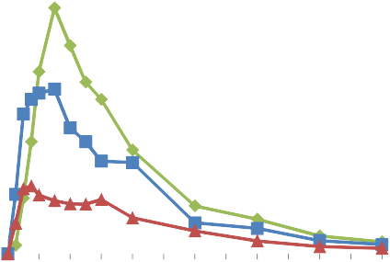
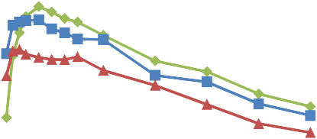
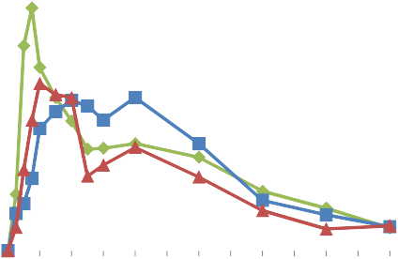
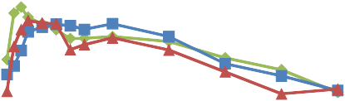
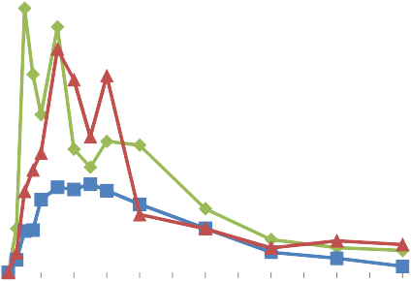
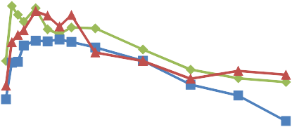
Conc (ng/ml)
400
350
300
P5 linear Seq R21T1
Conc (ng/ml)
1000
P5 log/lin Seq R21T1
250
Reference: Zovirax
100
Reference: Zovirax
200
T1: Z+ 400 mg
Chit HCl
T1: Z+ 400 mg
Chit HCl
150
10
100
50
0
T2: Z+ 1000
mg Chit HCl
T2: Z+ 1000
mg Chit HCl
0 1 2 3 4 5 6 7 8 9 10 11 12time (h)
1
0 1 2 3 4 5 6 7 8 9 10 11 12time (h)
Conc (ng/ml)
300
P7 linear Seq R21T1
Conc (ng/ml)
1000
P7 log/lin Seq R21T1
250
200
100
150
c[ng/ml]
c[ng/ml]
100
c[ng/ml]
10
c[ng/ml]
50
0
0 1 2 3 4 5 6 7 8 9 10 11 12time (h)
1
0 1 2 3 4 5 6 7 8 9 10 11 12time (h)
Conc (ng/ml)
450
400
350
300
250
200
150
100
50
P8 linear Seq R21T1
Conc (ng/ml)
1000
P8 log/lin Seq R21T1
Reference: Zovirax
100
Reference: Zovirax
T1: Z+ 400 mg
Chit HCl
T1: Z+ 400 mg
Chit HCl
T2: Z+ 1000
mg Chit HCl
10
T2: Z+ 1000
mg Chit HCl
0
1
0 1 2 3 4 5
6 7 8 9 10 11 12time (h)

Slide 4
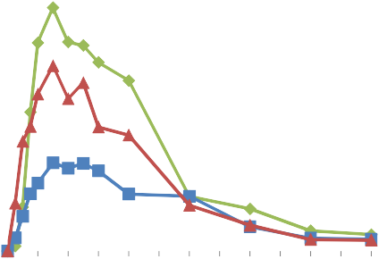
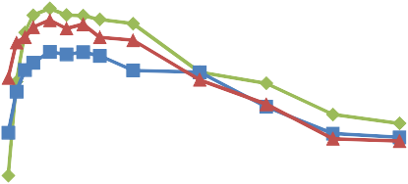
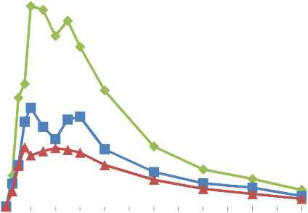
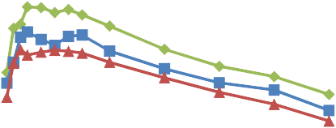
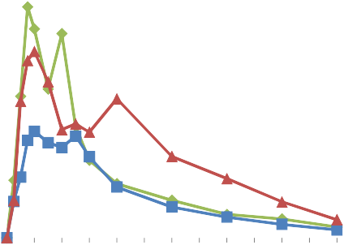
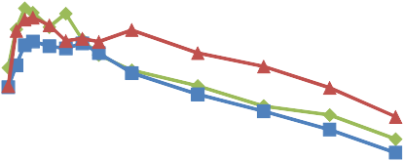
Conc (ng/ml)
400
350
300
P11 linear Seq R21T1
Conc (ng/ml)
1000
P11 log/lin Seq R21T1
250
Reference: Zovirax
100
Reference: Zovirax
200
T1: Z+ 400 mg
Chit HCl
T1: Z+ 400 mg
Chit HCl
150
10
100
50
0
T2: Z+ 1000
mg Chit HCl
T2: Z+ 1000
mg Chit HCl
0 1 2 3 4 5 6 7 8 9 10 11 12time (h)
1
0 1 2 3 4 5 6 7 8 9 10 11 12time (h)
Conc (ng/ml)
300
P12 linear Seq R21T1
Conc (ng/ml)
1000
P12 log/lin Seq R21T1
250
200
Reference: Zovirax
100
Reference: Zovirax
150
T1: Z+ 400 mg
Chit HCl
T1: Z+ 400 mg
Chit HCl
100
T2: Z+ 1000
mg Chit HCl
10
T2: Z+ 1000
mg Chit HCl
50
0
0 1 2 3 4 5 6 7 8 9 10 11 12time (h)
1
0 1 2 3 4 5 6 7 8 9 10 11 12time (h)
Conc (ng/ml)
300
P13 linear Seq R21T1
Conc (ng/ml)
1000
P13 log/lin Seq R21T1
250
200
Reference: Zovirax
100
Reference: Zovirax
150
T1: Z+ 400 mg
Chit HCl
T1: Z+ 400 mg
Chit HCl
100
T2: Z+ 1000
mg Chit HCl
10
T2: Z+ 1000
mg Chit HCl
50
0
1
0 1 2 3 4 5
6 7 8 9 10 11 12time (h)

