Slide 1
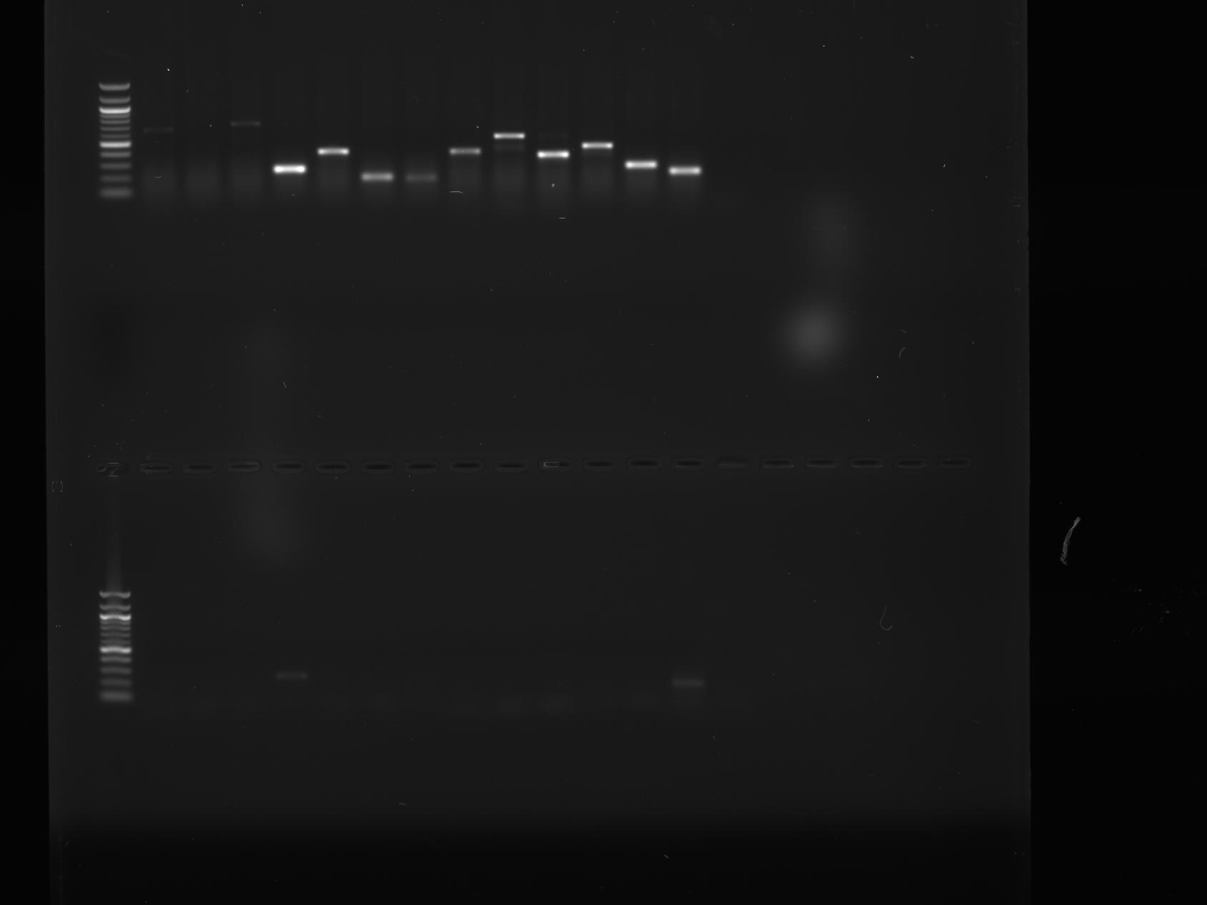
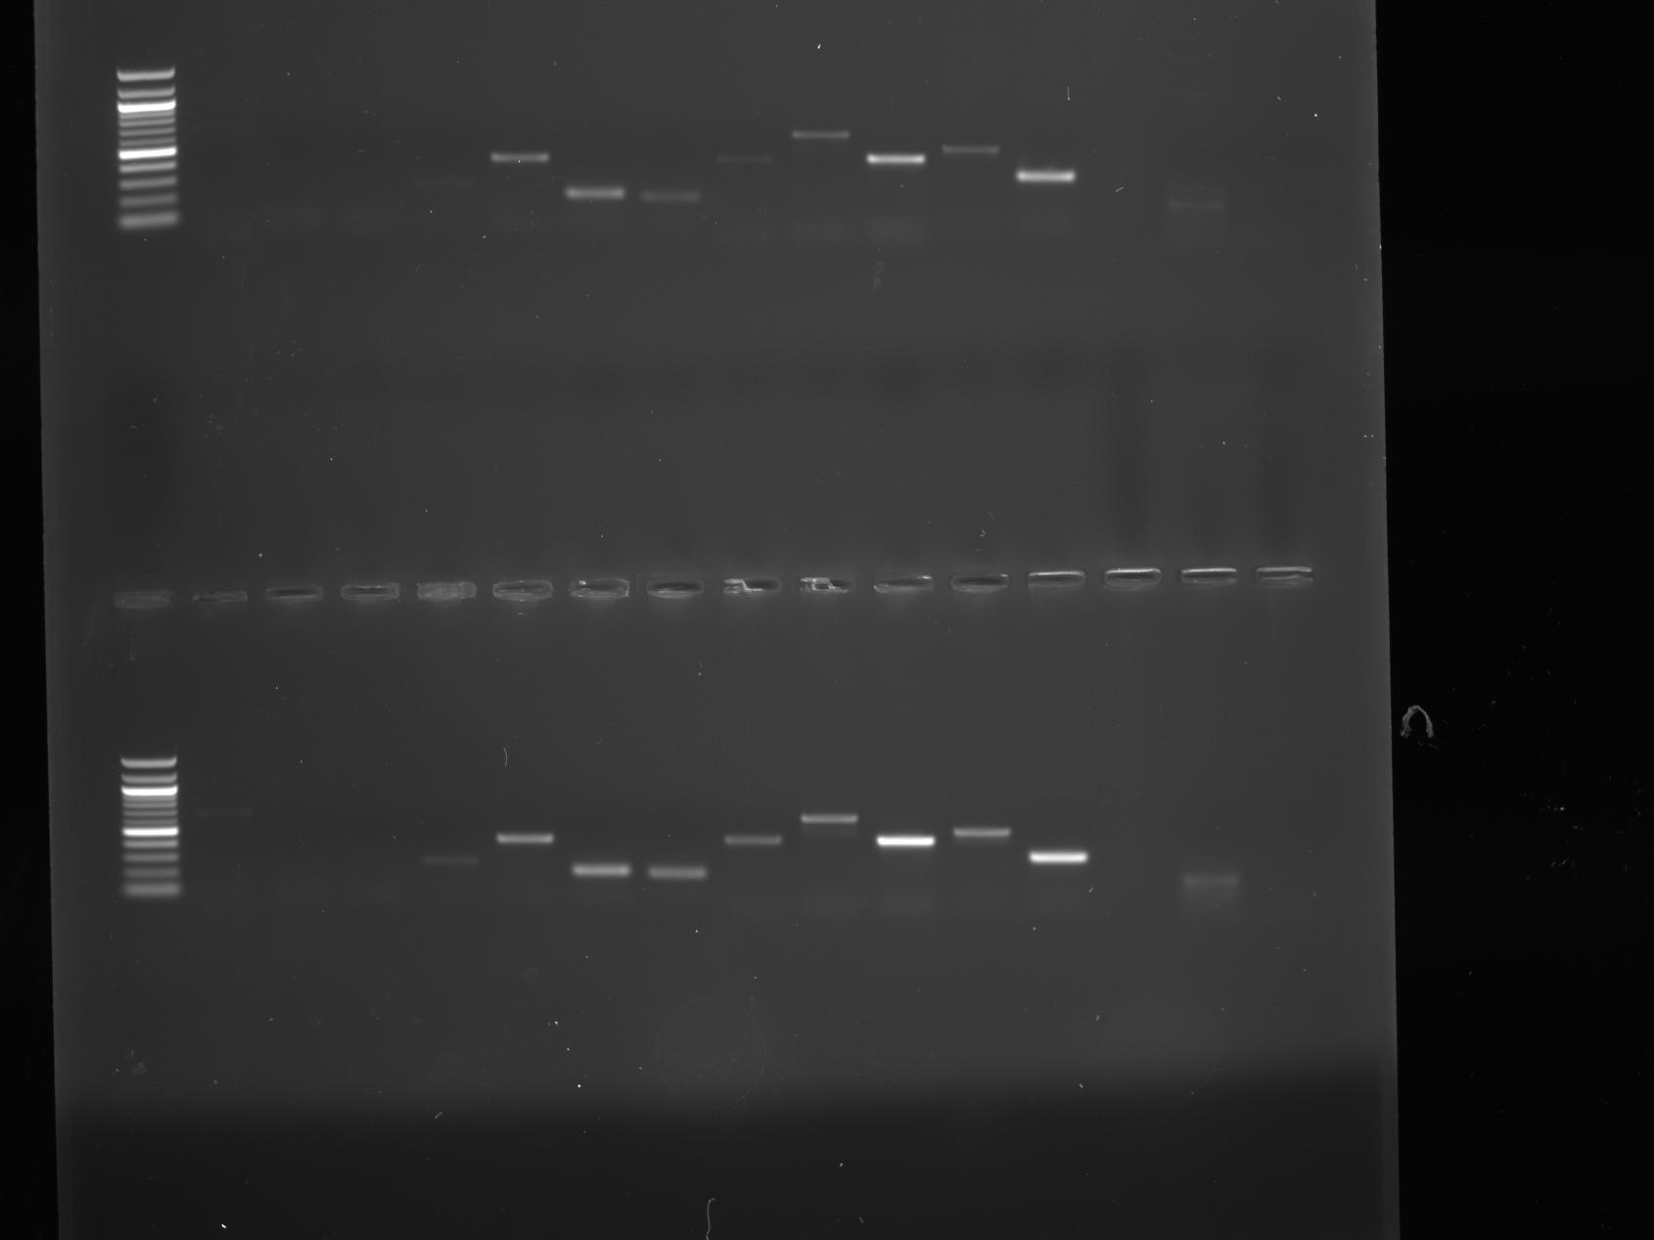
A: 58
H7
H4
H6
H3
H2
H1
H5
+ve
-ve
Genomic
0 DAH
1 DAH
3 DAH
Notes:
58-63

Slide 2
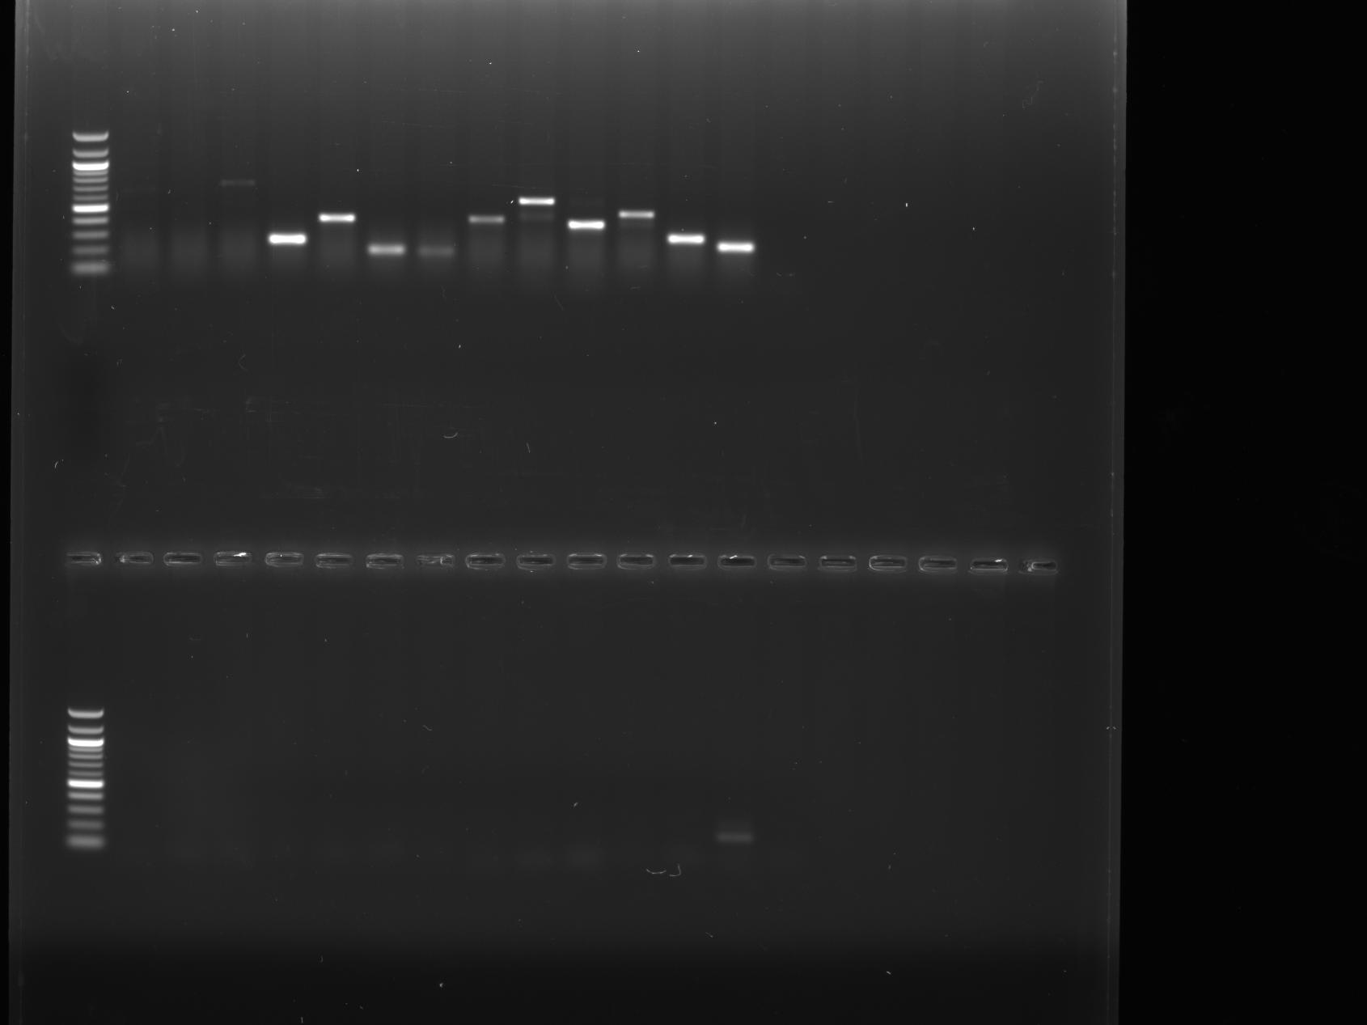
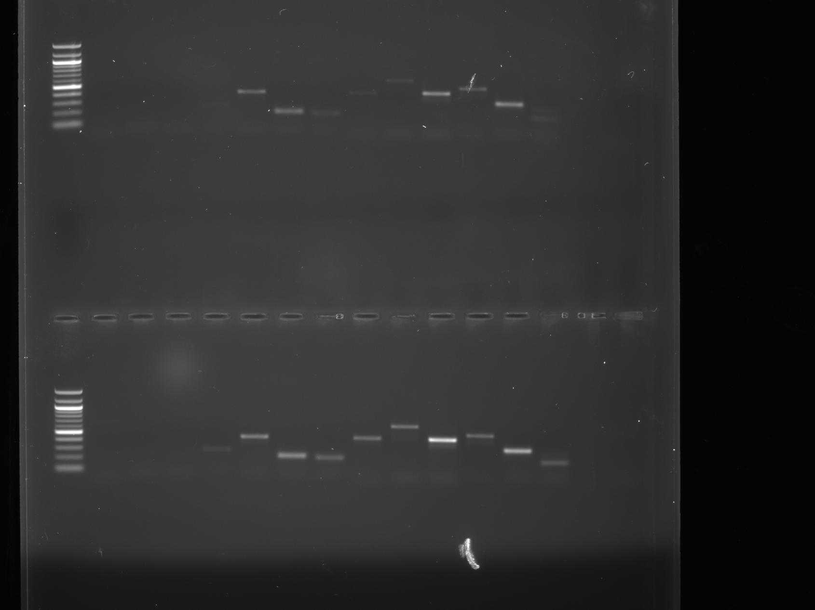
B: 59
H7
H4
H6
H3
H2
H1
H5
+ve
-ve
Genomic
0 DAH
1 DAH
3 DAH

Slide 3
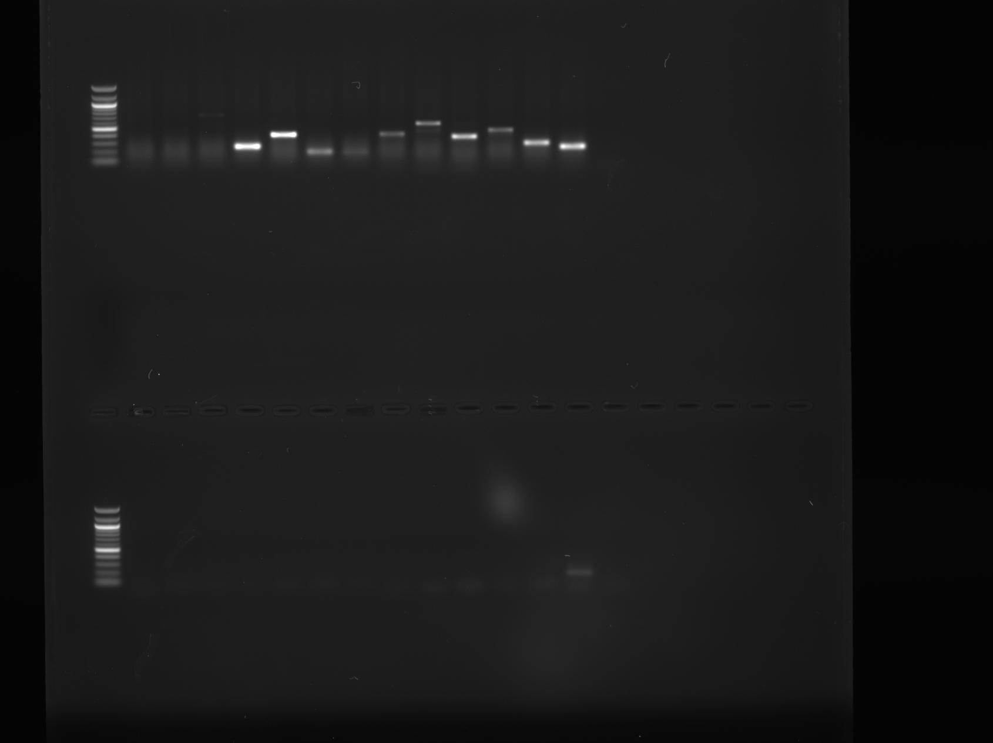
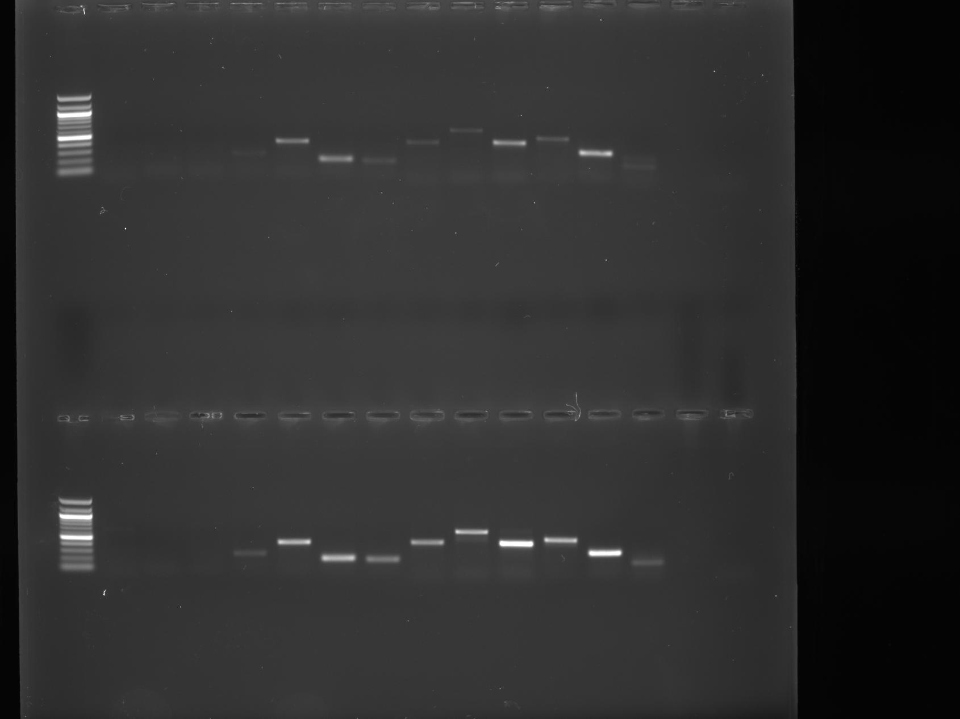
C: 60
H7
H4
H6
H3
H2
H1
H5
+ve
-ve
Genomic
0 DAH
1 DAH
3 DAH

Slide 4
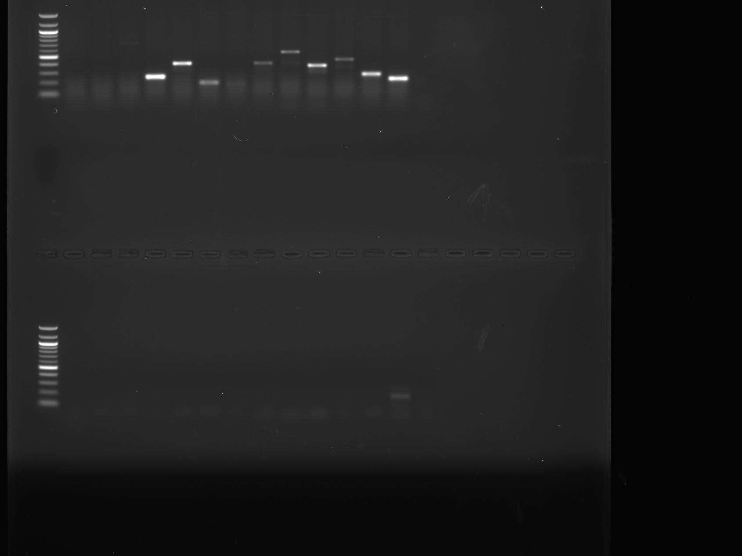
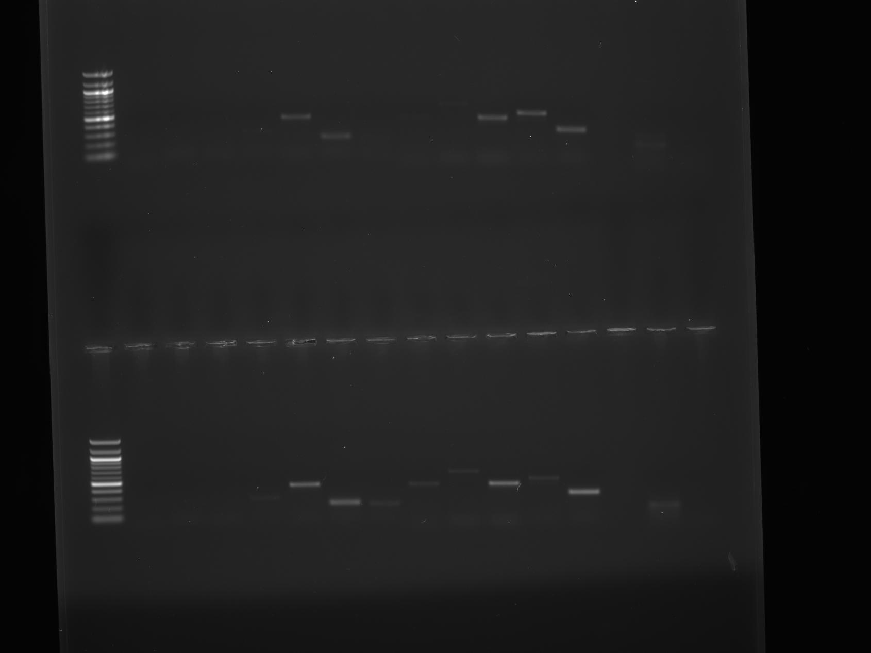
D: 61
H7
H4
H6
H3
H2
H1
H5
+ve
-ve
Genomic
0 DAH
1 DAH
3 DAH

Slide 5
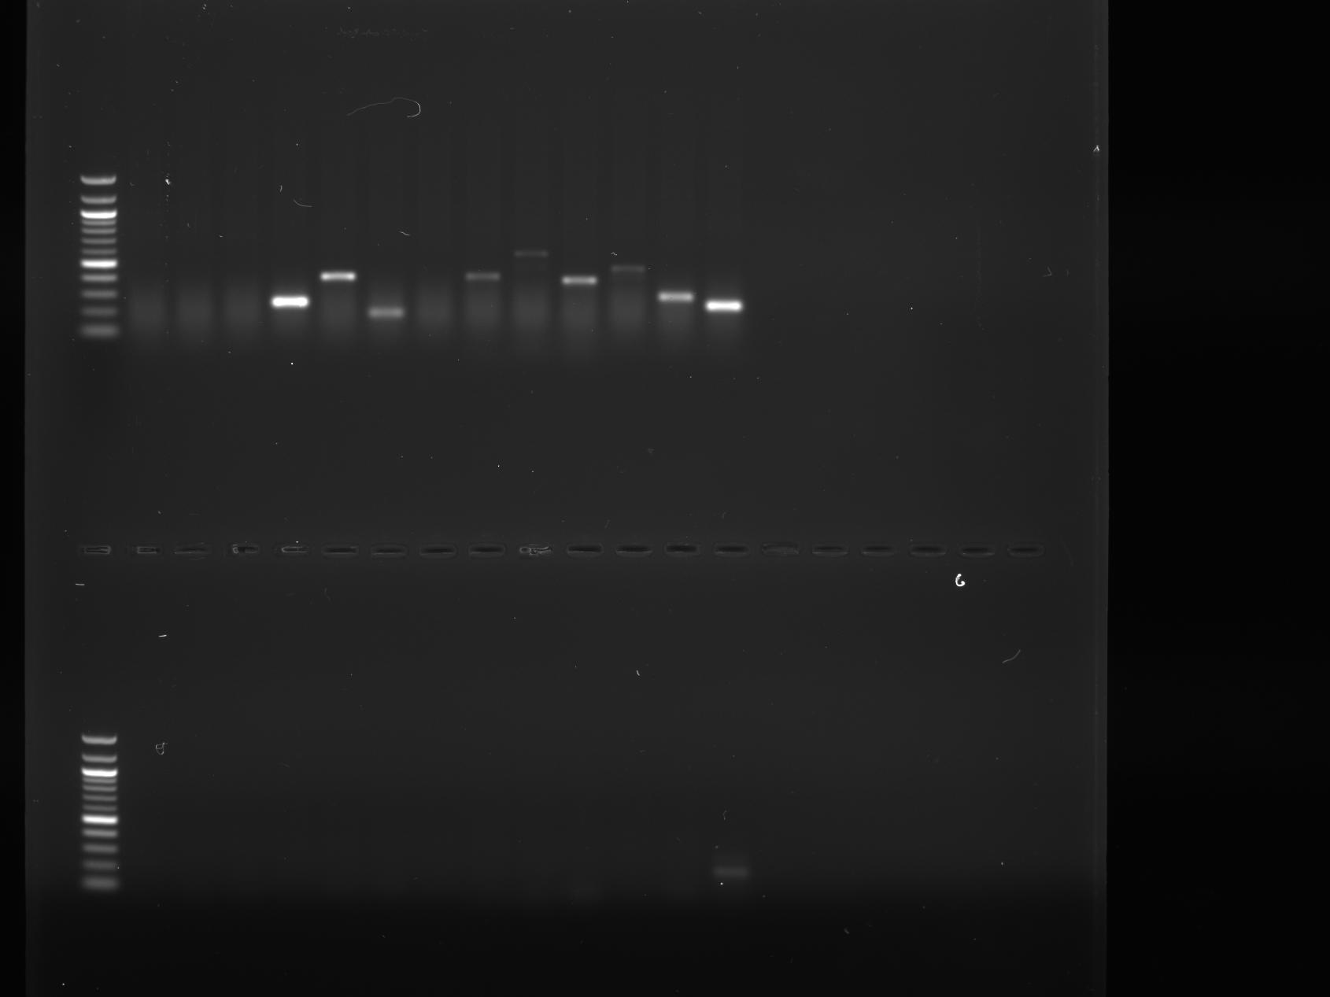
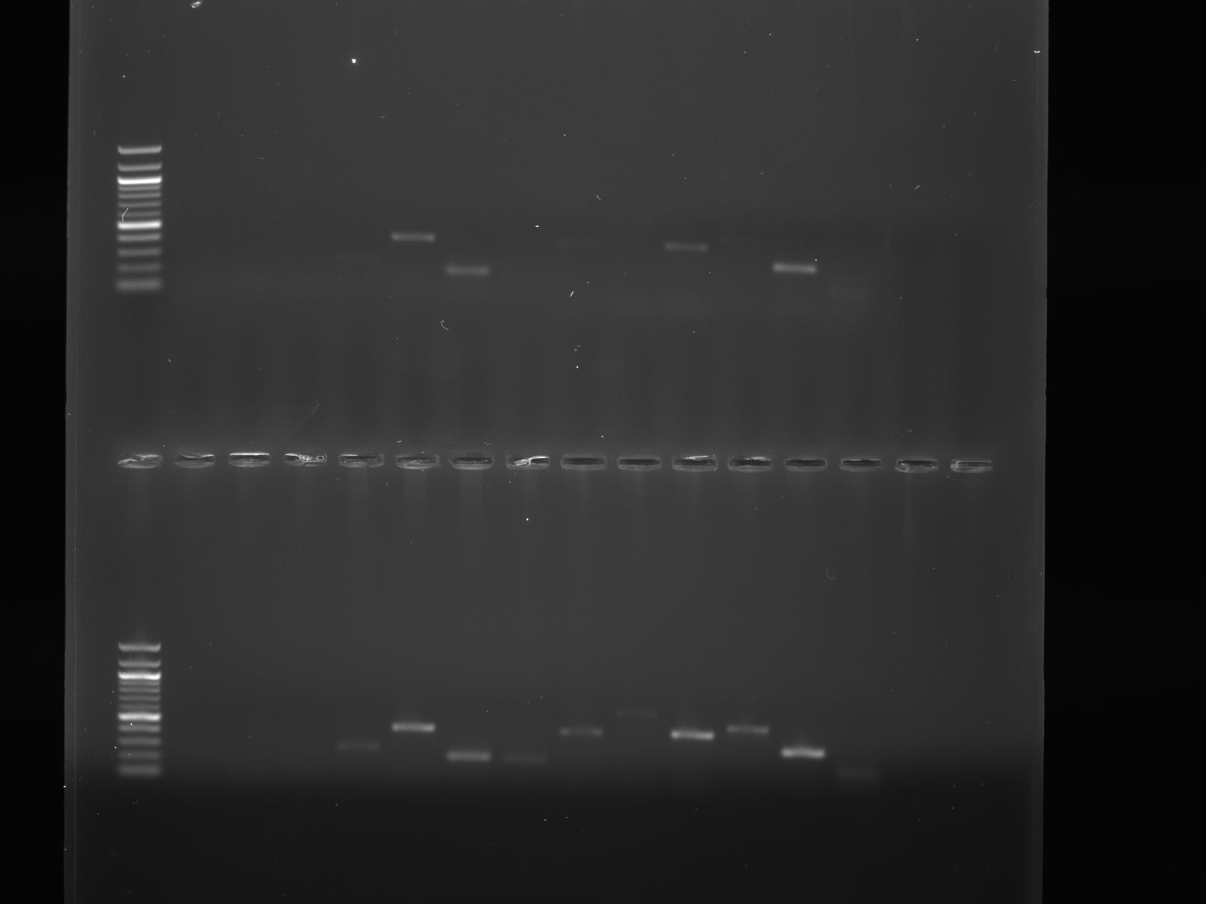
E: 62
H7
H4
H6
H3
H2
H1
H5
+ve
-ve
Genomic
0 DAH
1 DAH
3 DAH

Slide 6
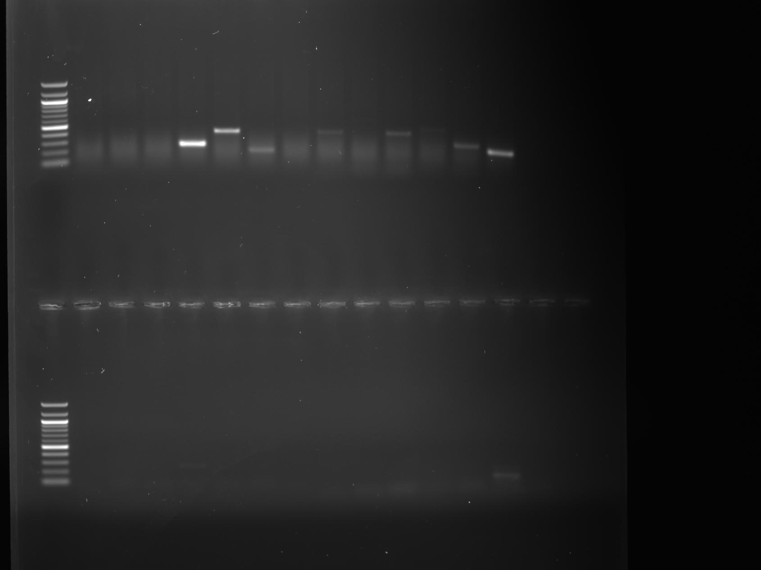

F: 63
H7
H4
H6
H3
H2
H1
H5
+ve
-ve
Genomic
0 DAH
1 DAH
3 DAH

Slide 7
Fig. S1 Expression of MeF6’H genes were verified by RT-PCR at various annealing temperatures. Genes whose bands appear and disappear at the same temperature in PCR with genomic or cDNA as templates are considered as actively expressed. H1: MeF6’H1; H2: MeF6’H2; H3: MeF6’H3; H4: MeF6’H4; H5: MeF6’H5; H6: MeF6’H6; H7: MeF6’H7; +ve: positive control (PP2A, for.: TGCAAGGCTCACACTTTCATC, rev.: CTGAGCGTAAAGCAGGGAAG); -ve: negative control. Genomic: cassava genomic DNA as template; 0 DAH: cDNA from fresh cassava root as template; 1 DAH: cDNA from cassava roots (1 day after harvest) as template; 3 DAH: cDNA from cassava roots (3 days after harvest) as template. (A): annealing temperature 58℃; (B): annealing temperature 59℃; (C): annealing temperature 60℃; (D): annealing temperature 61℃; (E): annealing temperature 62℃; (F): annealing temperature 63℃.

