Slide 1
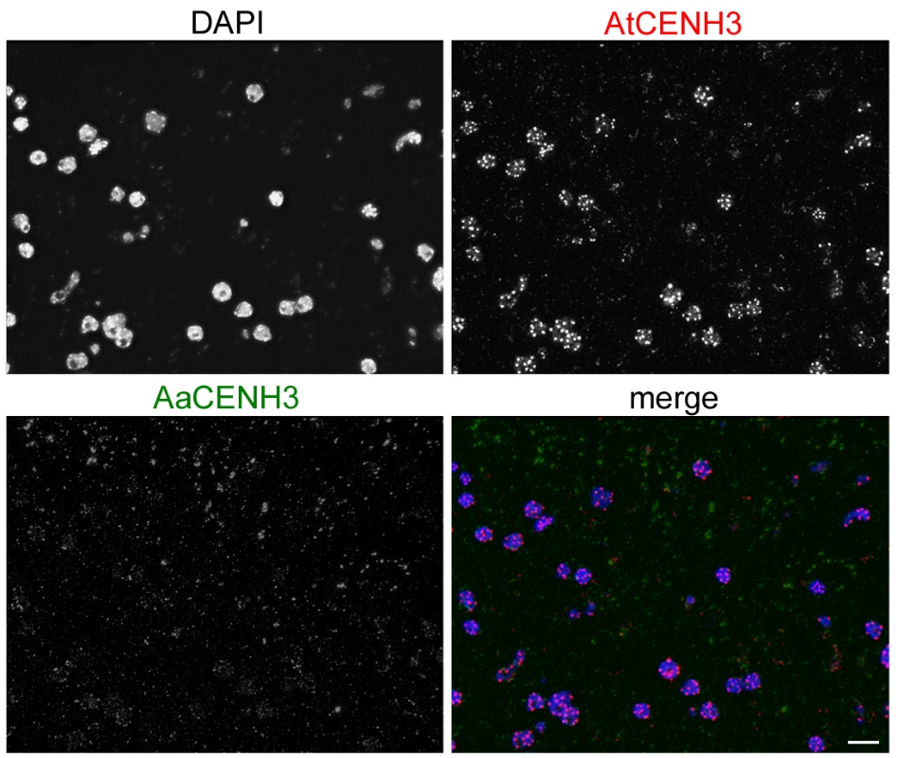
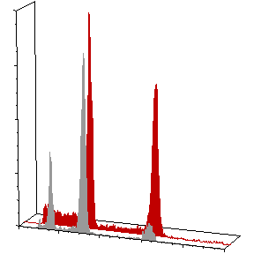
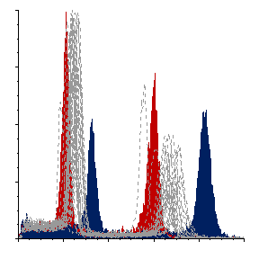
a
b
400
A. thaliana (4x)
progeny plant 6 (2x)
300
2x
200
Count
100
0
0
25
50
75
100
Fluorescence intensity
c
A. thaliana (4x)
400
A. arenosa (4x)
progeny plants
300
200
Count
100
0
40
60
80
100
120
Fluorescence intensity

